Slide 1
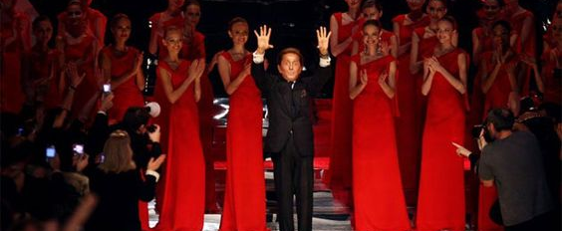
Valentino Garavani
By Ashley Triblet

Slide 2
Valentino’s major contributions
Valentino was born on May 11, 1932 in Lombardy, northern Italy.
Valentino, has dressed more major dignitaries, first ladies, celebrities and socialites than any other designer, in his 45 years of work. In 1967 he established himself as an Haute contour designer in Italy.
He was known affectionately as "Val’s Gals," these women includes actress Elizabeth Taylor, Anne Hathaway and Marie-Chantal, Crown Princess of Greece. He is universally known for his luxury couture gowns and creation of red carpet gowns.

Slide 3
Jackie O' was also fond of couture designers, but the First Lady was particularly fond of Valentino’s style.
He designed the now iconic dress for her wedding to Aristotle Onassis – the pleated, knee-length ivory creation with a mock turtleneck solidified Valentino's status as an international fashion figurehead.
Jacqueline Kennedy-Onassis was one of Valentino most influential client.

Slide 4
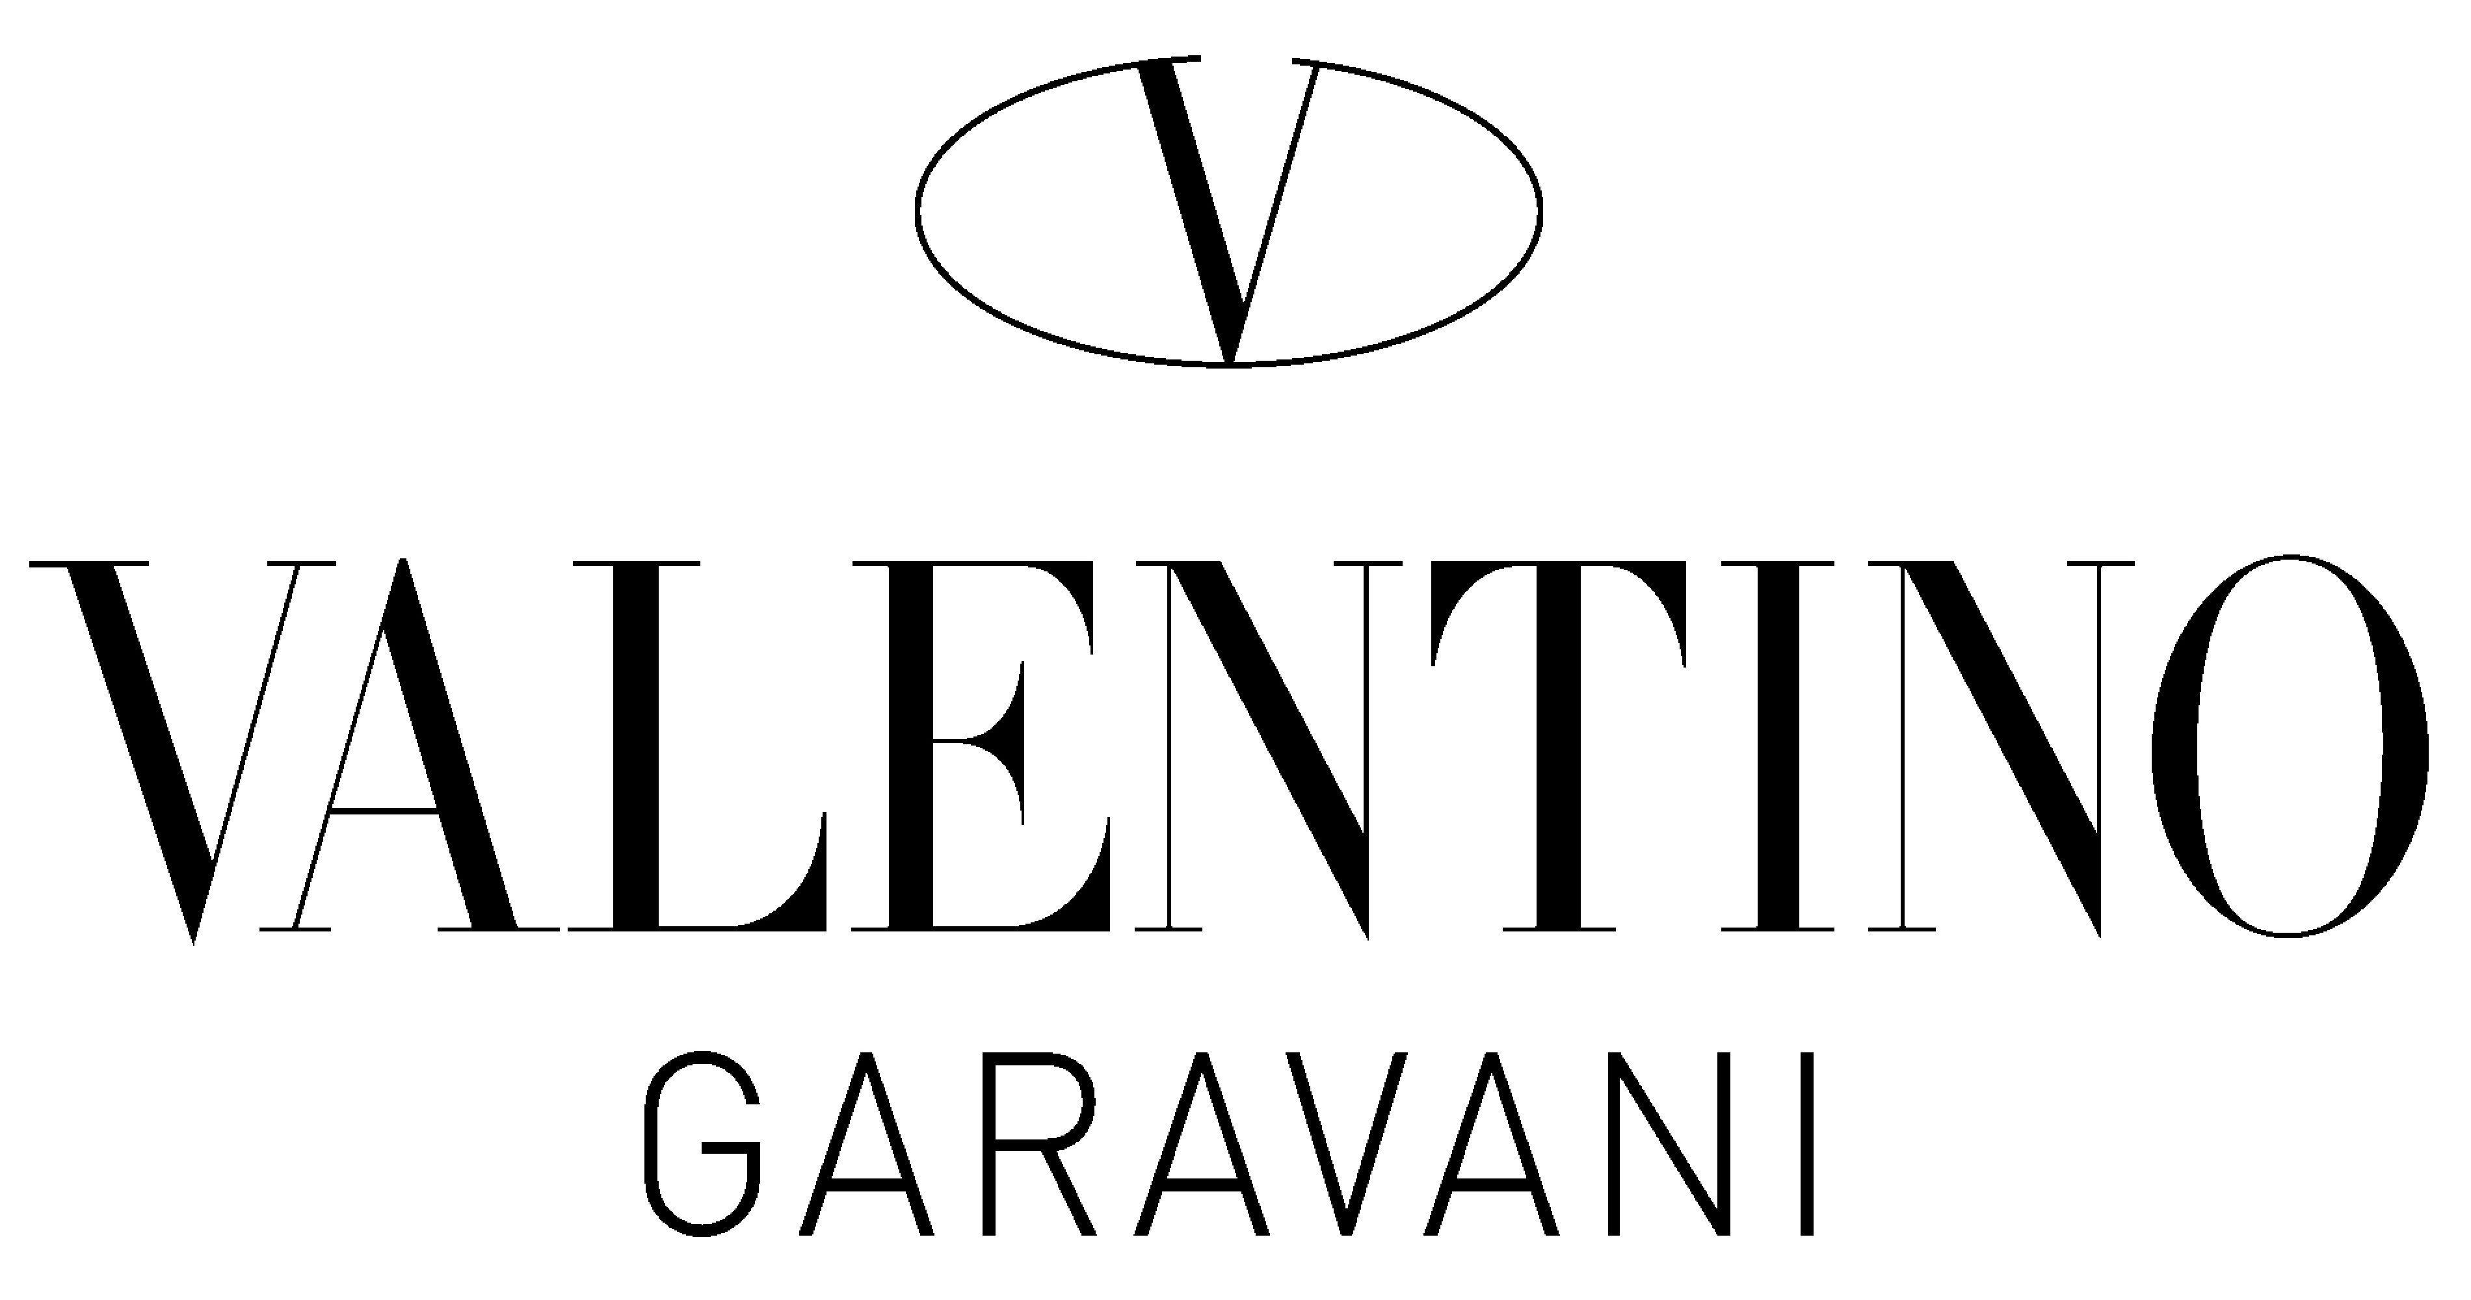
Creative Process and Ideologies
His creative process included the concept of no color by focus on beige, white, Ivory and hues. He created his ”V” trade mark label.

Slide 5
Target Consumer Market
Valentino has moved away from his target market which was only accessible to the elite. Now the brand focused on providing elegance or modernity and some coolness to the brand. His core target customers is the twenty five to forty year old women.
He appeals the modern day young chic women and upper class, who enjoys traveling in luxurious styles.
He does not directly endorse celebrities to represent his brand but he will donate to products who reflects values.

Slide 6
Outstanding work History
A Valentino customer would most likely be a high powered women which is living a luxurious city lifestyle.
He has retried from the label in 2008 but is still a very influential figure in the fashion world. His last ready to wear show in Pair include Naomi Campbell and Eva Herzig ova with his signature red color dress.

