Slide 1
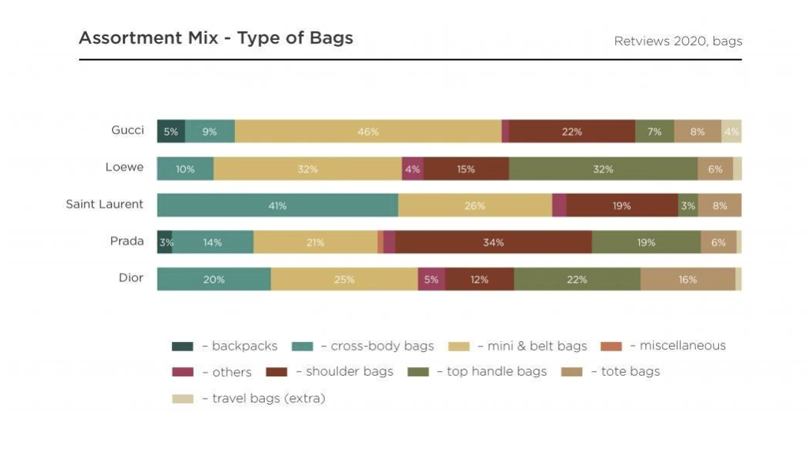
Chanel
Introduction
The SoHo brick-and-mortar Chanel store is located at the corner of Spring Street and Wooster Street, in New York City. The store is in the heart of SoHo's shopping district and is surrounded by other luxury brands stores.
Chanel recognizes that one of the greatest challenges is committing to climate change. Chanel believes their obligation to diminish the fossil fuel byproduct rate, to up to half in their clothing line by 2030. Chanel’s focuses on sustainability and needs to improve their general rating.
Competitive Analysis
If Chanel wants to level the playing field, then they need to consider their competition such as Gucci, Christian Dior, and Prada all of which are located in the Soho community.
The Marketing Mix strategy that they use isn't without risk. Organizations risk of degrading the brand's honesty, could make buyers less inclined to buy staple items.
Target Customer
The clients of Chanel are women whose ages range from 15 to 40 that tend the elegant embellishments. The clients of Chanel are from upper class and middle-income people. Millennial’s care about a brand's motivation and their way to deal with the eventual fate of our planet. However, millennials are not loyal to brands, who are not interested in the future of the plant. It seems that if Chanel wants to improve their environmental standards across the board, then the use of some eco-friendly materials.
Marketing Strategy
Chanel is entering this new digital market, which can keep up with its seriousness and extend their image successfully. Social media is a great way to connect with the target audience, and it also gives them a chance to constantly share their opinion about your brand or services. Chanel is offering an online Limited Edition; for the summer which allows the customer to purchase items at regular price. In addition, when the customer drops off their gently used items at a local point, then customer will receive 20% discount towards next purchase at regular price. Because this collection is a limited version, it can be purchased through the app and will be discounted.
Sustainable Strategy
Chanel’s focus on sustainability and its profits includes the measuring the total cost of doing business locally. The corporate concept of bottom-line strategy was effective and socially responsible during a pandemic. Chanel transformed its business associates into personal individual shoppers showing collections for customers, arranging fitting sessions and unique conveyances at home, and staying in contact through a new app.

