Slide 1
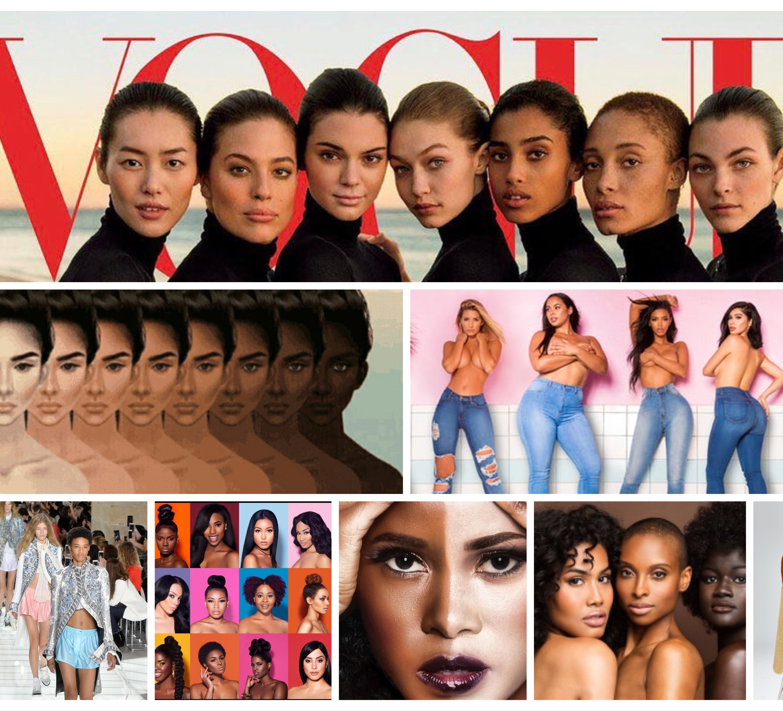
Colorism in the Fashion Industry
Is colorism affecting dark skin models and fashion companies from casting models in the fashion industry?
Today diversity is involving in the fashion Industry but are these improvements enough?
Ashley Triblet

Slide 2
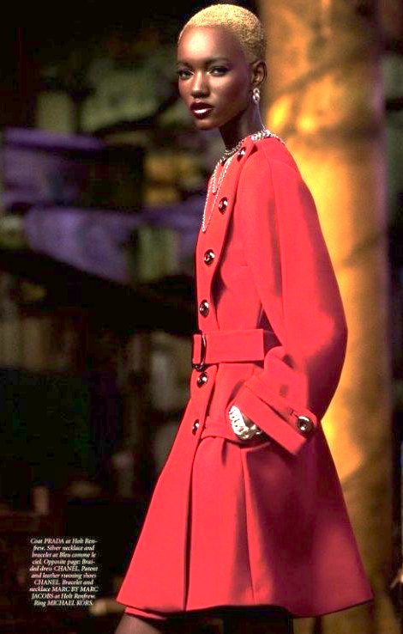
What is colorism?
Colorism is defined by the Oxford Dictonary as “prejudice or discrimination against individuals with a dark skin tone, typically among people of the same ethnic or racial group”.
Colorism plagued the fashion industry since the black models paved their way and open more opportunities in the industry for other people of color.

Slide 3
Statistics of Models on the runway
According to Mic.com a study found that after looking at a fashion magazine for three minutes it caused 70% of women to feel depressed, guilty and shameful. (Powell, 2012). That means the average woman sees 400 to 600 advertisements per day and not many of those ads that represented dark models.
According to The Guardian “in a new report, 78.2% of all the models featured in Spring 2016’s fashion adverts were white. In a breakdown of the statistics, 8.3% of models featured in ads were black, 4% were Asian and 3.8% were Hispanic.” (Elan, 2016 )Which increased from 2015.

Slide 5
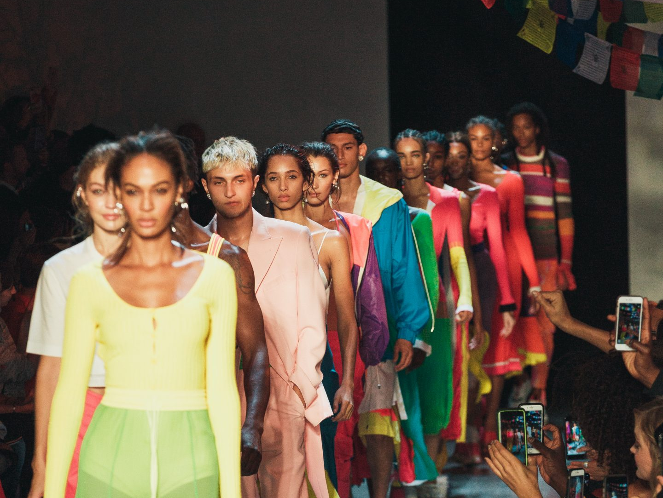
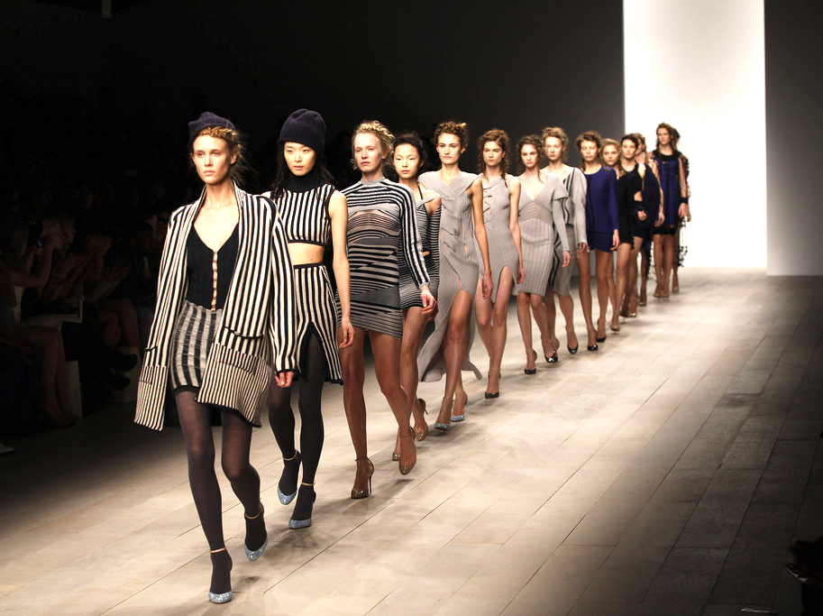
Issues in the industry
Model Naomi Sims was consistently turned down by agencies who told her she was too dark in the beginning of her career.
According to an in BBC model Leomie Anderson “says she's faced racial discrimination in the modelling industry. She says, "lighter skinned girls get more work than darker skinned girls”
Beauty YouTuber Jackie Aina addressed Fashion Nova about promoting colorism on Instagram and on their ads by using only light skin models

