Slide 1
New York City College of Technology Dental Hygiene Department Case Study Presentation # 2: Patient with Neurofibromatosis, Type 1 and Rheumathoid Arthritis
By Anna Tkachenko
Spring 2022

Slide 2
Patient Profile
27 years old Arab male.
Full time college student.
Has Neurofibromatosis, Type 1 and Rheumatoid Arthritis.
Had several spinal fusion surgeries in the past for tumor removal (has 3 cobalt rods in spinal column.)
Last dental cleaning was done in Morocco (2017).
Never had dental x-ray.
Patient stated he used medium manual toothbrush once a day in the mornings, no flossing, no tongue cleaner.

Slide 3
Chief Complaints
Patient came for check-up and cleaning
States that :
- he experiences dry mouth sometimes,
- his gingiva bleeds when he is brushing too hard,
- he has generalized sensitivity to cold.

Slide 4
Health History
Vitals: BP – 116/73, corresponds to normal, P-76. ASA II
Patient was diagnosed with Neurofibromatosis, Type 1 in the childhood, he is under the care of specialist.
Patient was diagnosed with Rheumatoid Arthritis 2 years ago.
Patient is taking following medications:
- Xeljanz 11 mg once a day for RA,
Methotrexate 90 mg once a week for RA,
Folic Acid 1 mg every day, expect day he is taking Methotrexate,
Vitamins C, D, Biotin 10 mg every 2 days.
Patient has no allergies, does not drink alcohol and smoke marijuana occasionally (2-3 times per month).

Slide 5
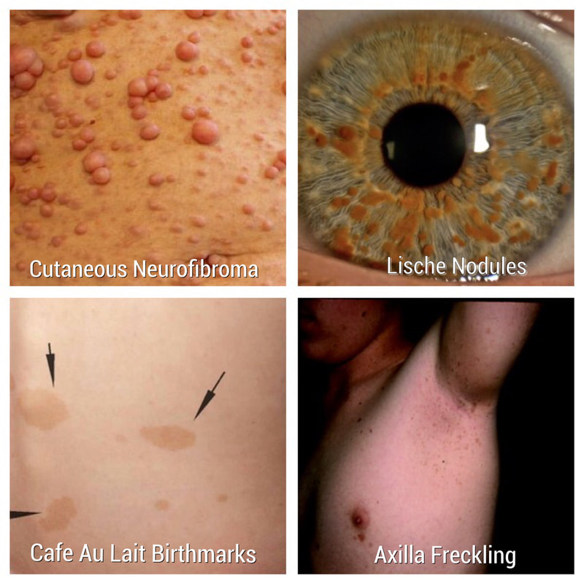
Explanation of the Condition: Neurofibromatosis, Type 1
It is a genetic disorder that can cause formation of tumors on nerve tissue including brain, spinal cord and nerves. Type 1 is usually diagnosed in childhood. Type 1 gene located in chromosome 17 and cause loss of fibromatin which allows cells to grow uncontrolled.
Tumors are usually benign but can became malignant.
Signs and symptoms are usually mild and can include:
- café au lait spots and freckling on the skin,
small soft neurofibromas on skin,
Lisch nodules in the iris of the eye,
Bone deformities,
Short stature and large head size,
Learning disabilities.

Slide 6
Neurofibromatosis, Type 1: Oral Implications
Can include:
Neurofibromas on tongue, gingiva, palate, floor of the mouth, alveolar mucosa, lips (single, multiple or plexiform).
Pigmentation of oral mucosa and tongue.
Intrabony neurofibromas.
Jaw deformity.
Impacted, displaced, missing or supernumerary teeth.
Malocclusion.
Macroglossia.
Periapical cemental dysplasia, fibrous thickening of pulp.
Gingival hyperplasia.
Caries, although the relation of NF, Type 1 and caries remains unclear.

Slide 7
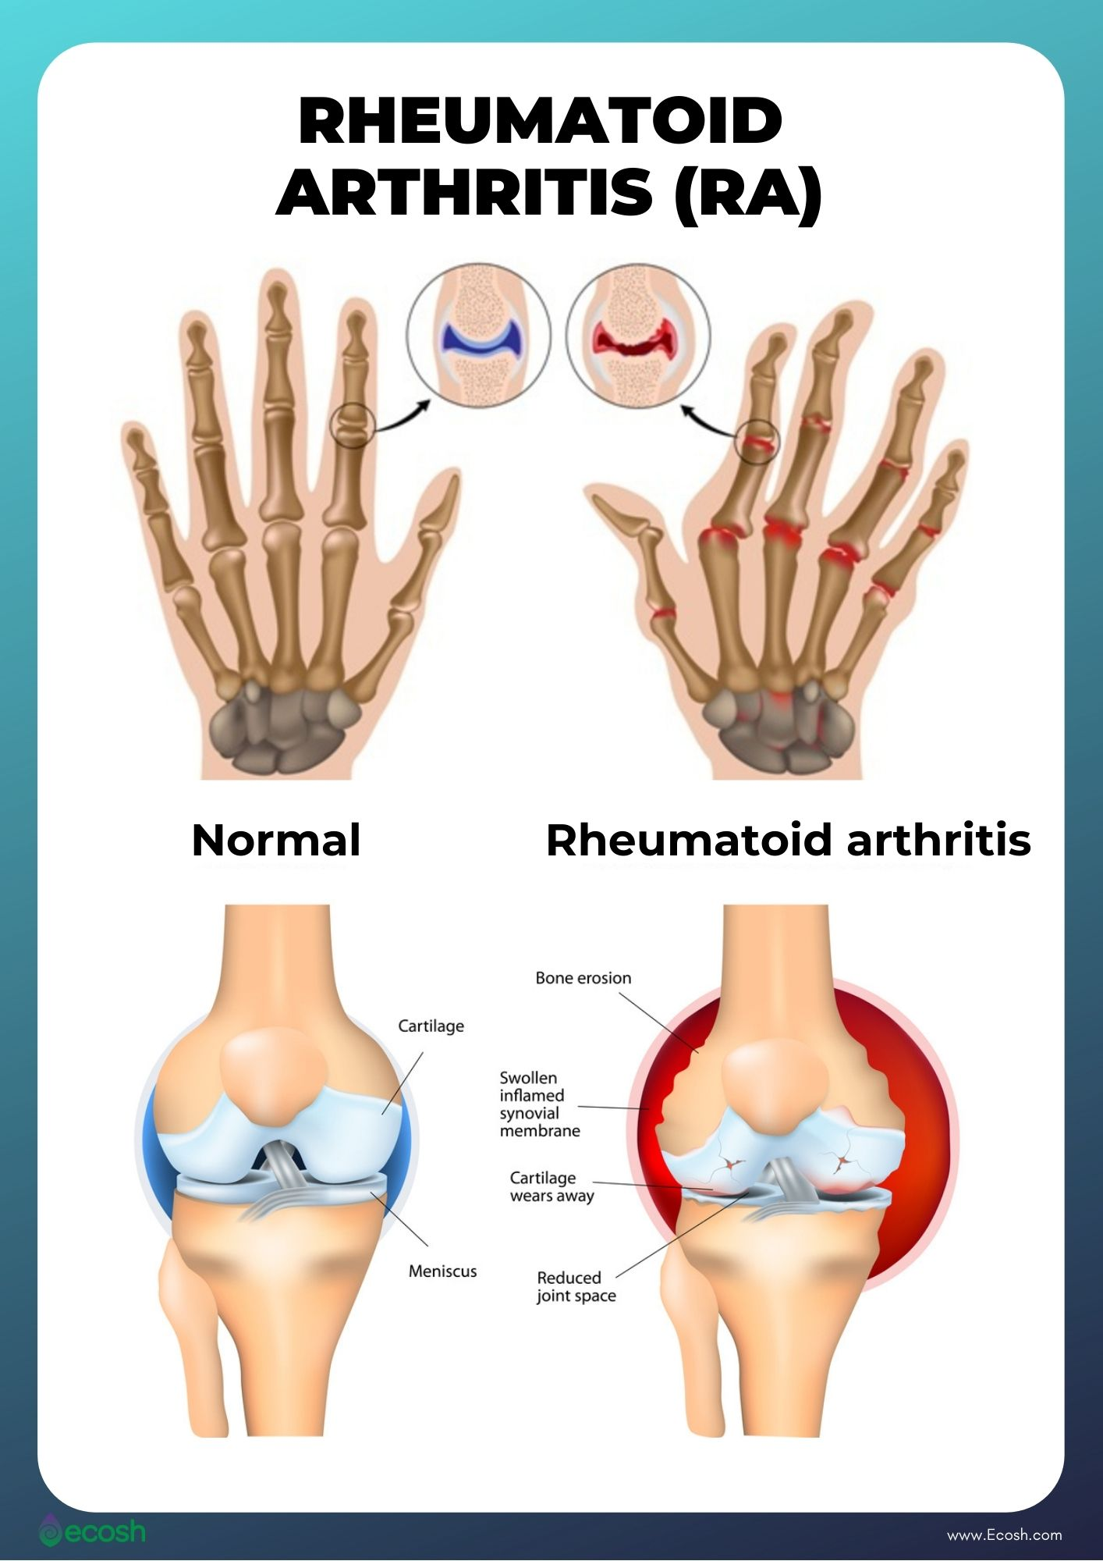
Explanation of the Condition: Rheumatoid Arthritis
It is an autoimmune chronic inflammatory
disease that commonly affects joints in hands, wrists and knees.
Signs and symptoms may include:
Pain, stiffness, tenderness of one or more joints,
Weight loss,
Fever,
Fatigue.

Slide 8
Rheumatoid Arthritis: Oral Implications
Oral implications of RA may include:
TMJ disorders,
Xerostomia,
Higher risk of periodontal disease,
Secondary Sjogren’s Syndrome.
RA may affect dexterity and ability to have proper oral hygiene.

Slide 9
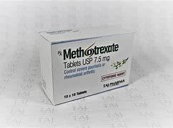
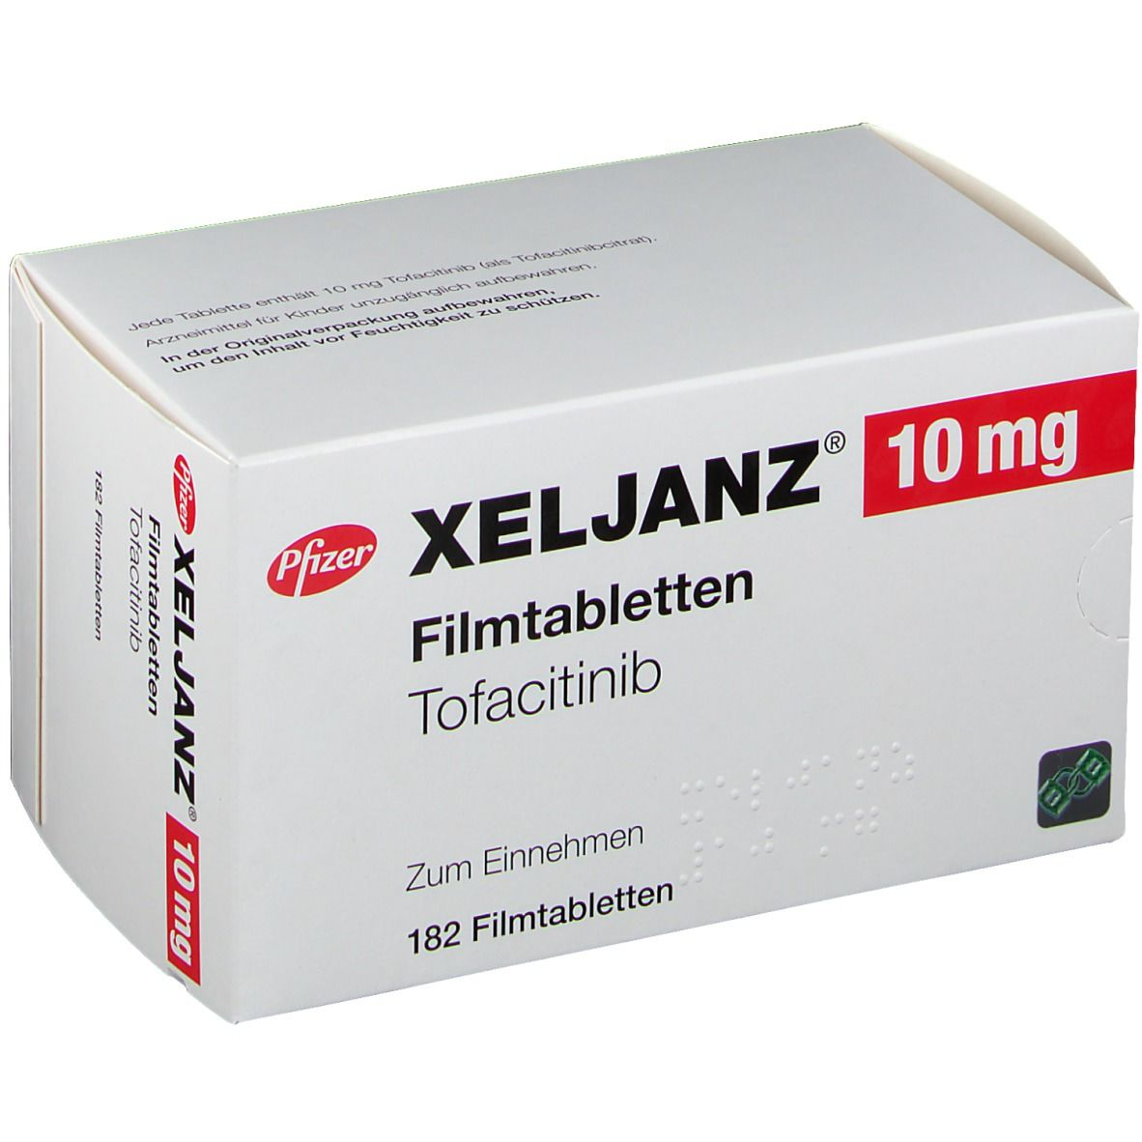
Medication and Oral Implications
Methotrexate (immunosuppressive) for RA can cause xerostomia mucositis, oral ulcers and interfere with bone healing. Folic Acid helps prevent those side effects.
Xeljanz (JAK inhibitor) for RA may cause loss of appetite, vomiting and oral ulcers.
Folic Acid (vitamin) may cause loss of appetite, bitter or unpleasant taste in the mouth.

Slide 10
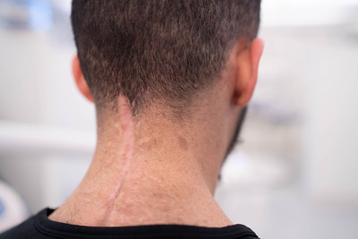
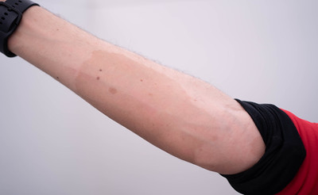
Assessments
Extraoral findings: freckling of the face and neck, café-au-lait spot on the hand, asymptomatic bilateral clicking TMJ, scar on the midline of the neck.
Intraoral findings: bilateral mandibular tori, bilateral Linea Alba, large tongue, white coated tongue, scalloping of lateral borders of the tongue, palpable small nodules on labial mucosa.

Slide 11
Dental Charting
Class I bilaterally, overjet – 6 mm, overbite 50%.
Small and narrow arch.
Fractured teeth # 8 and # 9.
Teeth # 17 and # 32 are partially erupted and impacted.
Canine to canine attrition.
Diastemas between teeth # 7 and 8 – 2mm, # 8 and 9 – 3mm, # 10 and 11 – 3mm, #24 and 25 – 2mm.
Tooth # C is deciduous.

Slide 12
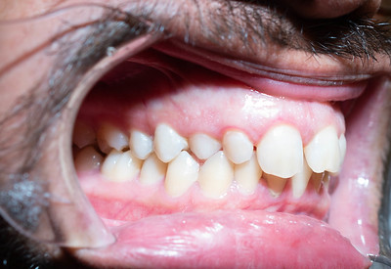
Gingival Description and Periodontal Status
Generalized pink, fibrotic gingiva with rolled margins and interproximal edema, coronal to CEJ.
Generalized moderate inflammation.
Localized severe inflammation with gingival marginal erythema near teeth #7,8 and 9.

Slide 13
Periodontal charting
Generalized pocket depth 4-6 mm on posterior teeth, and 2-4 mm on anterior teeth.
Severe generalized BOP.

Slide 14
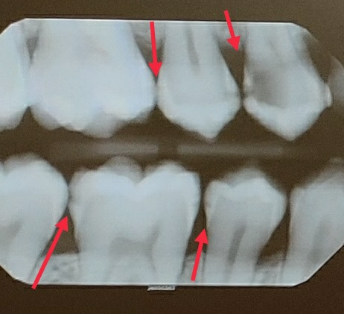
Radiographic findings: Generalized bone loss 20%, tooth # 16 is unerupted and impacted. Dilaceration on tooth # 31. Fused roots on teeth # 3 and # 14. Caries on teeth # 3-MD, 4 - MD, 5-MD, 12-D, 13-MD, 14-MD, 18-M, 19-MD, 20-D, 29-M, 30-MD, 31-M. PAP apex of tooth # 5. RL area near tooth # 12 -M . Caries may be induced by xerostomia caused by Rheumatoid Arthritis and medication.

Slide 15
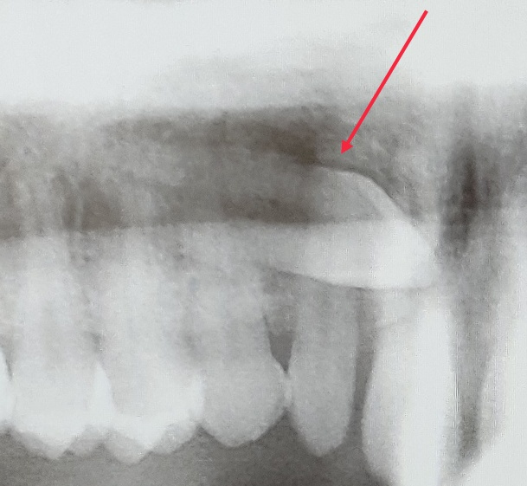
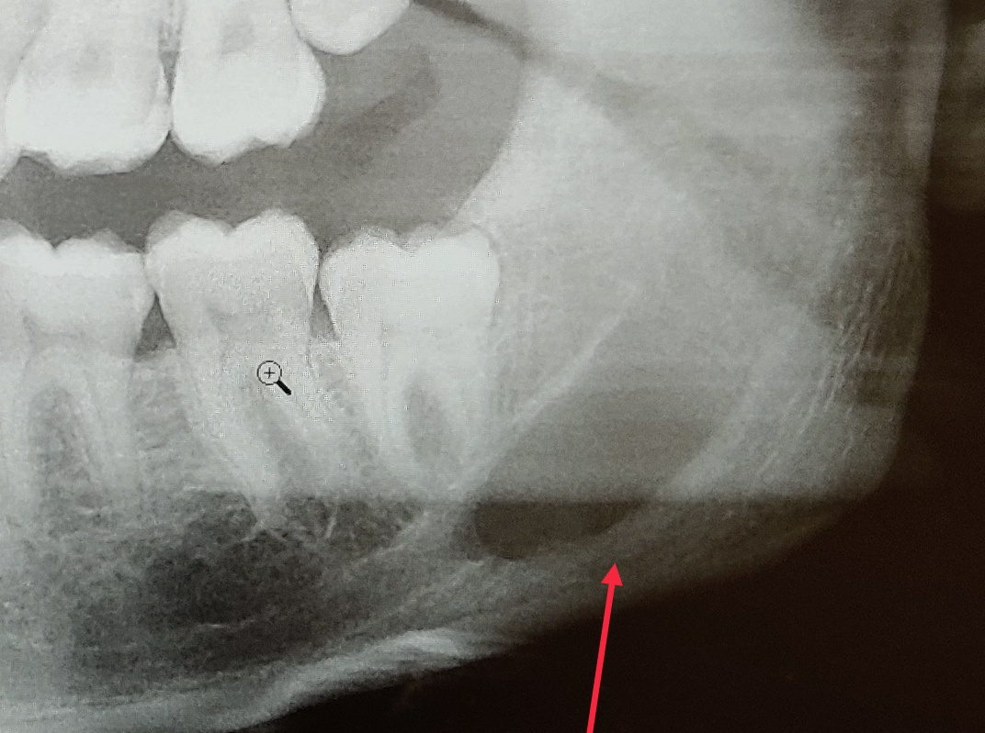
Radiographic findings: Large RL area on the left ramus of the mandible distal and inferior to tooth #17, impacted teeth # 16,17 and 32. Unerupted tooth # 6. Metal artifacts on spinal column.

Slide 16
Dental Hygiene Diagnosis
Generalized Periodontitis, Stage II, Grade B confirmed with radiographs.
Case value: Heavy due to generalized distribution of subgingival calculus on more that 16 surfaces and localized supragingival calculus on mandibular anterior teeth and premolars.
High caries risk due to the interproximal caries visible radiographically on molars and premolars.

Slide 17
Dental Hygiene Care Plan
Treatment plan was created and included 3 visits. The information about procedures was explained to patient and he signed. Patient gave verbal consent to take pictures of his mouth.
Treatment plan included oral hygiene instructions (toothbrushing and flossing), debridement, engine polishing, 5 % neutral sodium fluoride (NaF) varnish application.

Slide 18
Implementation of The Treatment Plan Visit # 1
During 1st visit :
Assessments were performed until Plaque Index.
FMS was exposed, mA - 7, kVP – 70. Upon radiographic findings ( unerupted tooth # 6, interproximal caries ) PAN was added to treatment plan for next visit.
Patient gave his verbal consent of taking photographs.

Slide 19
Implementation of The Treatment Plan Visit # 2
During 2nd visit:
PAN was exposed.
Plaque Index – 2.3 (poor) generalized distribution of biofilm on cervical and middle thirds of teeth on both arches.
Oral Hygiene Instructions – educated modified Bass method. Powered toothbrush was recommended, brushing 2 times per day was encouraged.
Biotene was recommended for xerostomia.
Quadrant 1 was scaled with ultrasonic and hand instruments. Oraqix (2.5% lidocaine, 2.5 % prilocaine ) were used for pain management. Patient tolerated well.

Slide 20
Implementation of The Treatment Plan Visit # 3
During 3rd visit:
Plaque Index – 1.16 (fair) localized distribution of biofilm on cervical third of mandibular anterior teeth and on lingual side of Q 2 and Q3.
Oral Hygiene Instructions - educated flossing, floss holder was recommended.
Quadrants 2, 3, 4 was scaled with ultrasonic and hand instruments. Oraqix (2.5% lidocaine, 2.5 % prilocaine ) were used for pain management. Patient tolerated well.
Engine polished with medium grip prophy paste, 5% NaF applied.
Fluoride containing toothpaste was recommended.

Slide 21
Referrals were given for:
Interproximal caries lesions on teeth # 3-MD, 4 - MD, 5-MD, 12-D, 13-MD, 14-MD, 18-M, 19-MD, 20-D, 29-M, 30-MD, 31-M.
Teeth # 1, 16, 17, 32 for extraction evaluation.
Unerupted tooth # 6.
RL area near tooth # 12 mesial.
Periapical pathology on apex of tooth # 5.
Large RL area on the left ramus of mandible distal to tooth # 17. Patient was reached out after treatment with follow up from his specialist about the lesion. He was told that it was there for a long, probably since he was born and out of concern.
Evaluation for prescription of fluoride rinse or/and toothpaste.

Slide 22
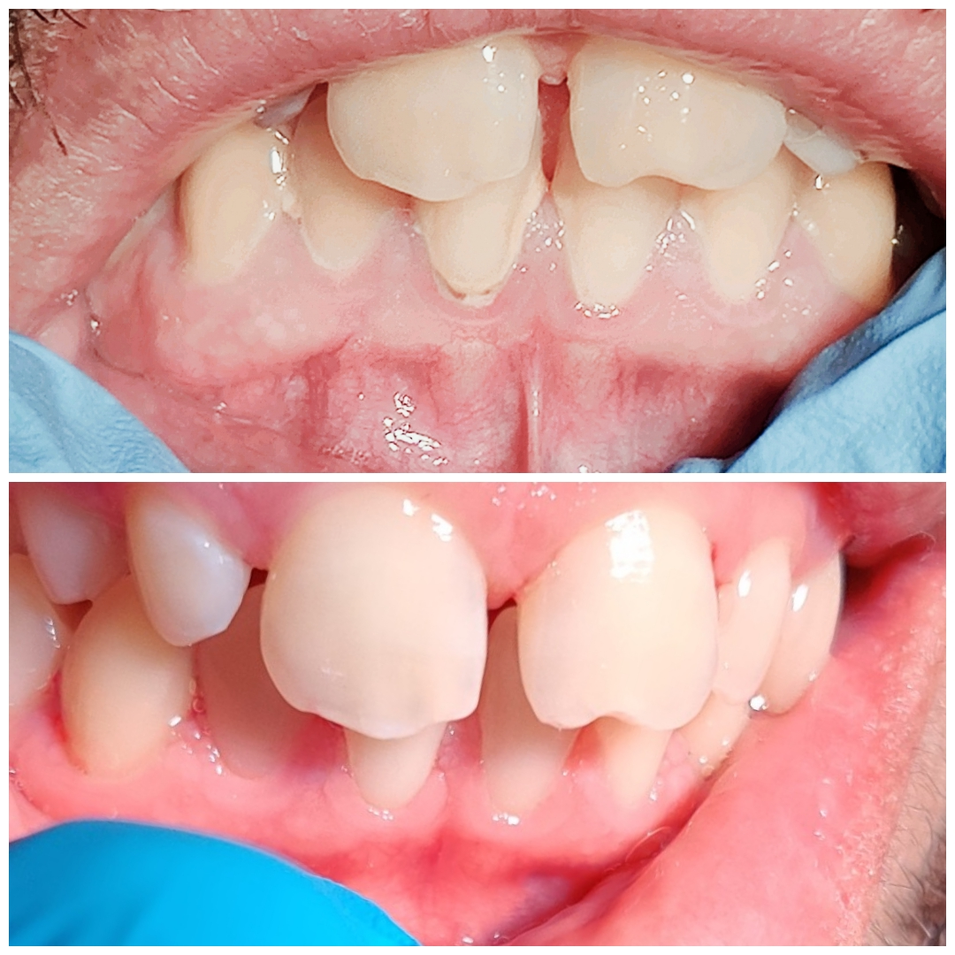
Evaluation of Care
After treatment completion the following changes were noted:
- Improvement in oral hygiene home care, patient seems to be motivated, plaque score decreased from 2.3 to 1.16.
Changes of gingiva. Gingiva on scaled quadrant showed less interproximal edema, the gingival marginal erythema near teeth #7,8 and 9 were still present but inflammation decreased.

Slide 23
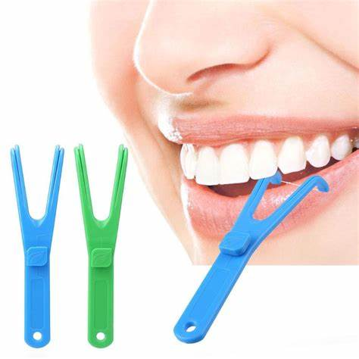
Recommendations
Patient was encouraged to brush his teeth 2 times per day with soft brush using modified Bass Method.
Electric toothbrush and floss holder were recommended because of Rheumatoid Arthritis.
Biotene mouth rinse was recommended for xerostomia.
Toothpaste with stannous fluoride was recommended as patient has high caries risk and teeth sensitivity.
Recare interval for dental cleaning – 3 months.

