Slide 1
New York City College of Technology Dental Hygiene Department Case Study Presentation # 1: Patient with Periodontitis and Severe Localized Inflammation and Suppuration
By Anna Tkachenko
Spring 2022

Slide 2
Patient Profile
36 years old Hispanic male.
Allergic to penicillin (symptoms is unknown, patient was told about that in childhood).
Drinks alcohol 2-3 times per week.
Has history of sinus problems, takes Advil Sinus once a day during one month.
Has orthodontic treatment (braces) in the age of 11-12, does not wear retainers.
Has not had medical check-up for 10 years.
Patient stated he used battery operated toothbrush, Colgate toothpaste 2 times per day, flossing every other day, no tongue cleaner, mouthwash Listerine Total Care every other day.

Slide 3
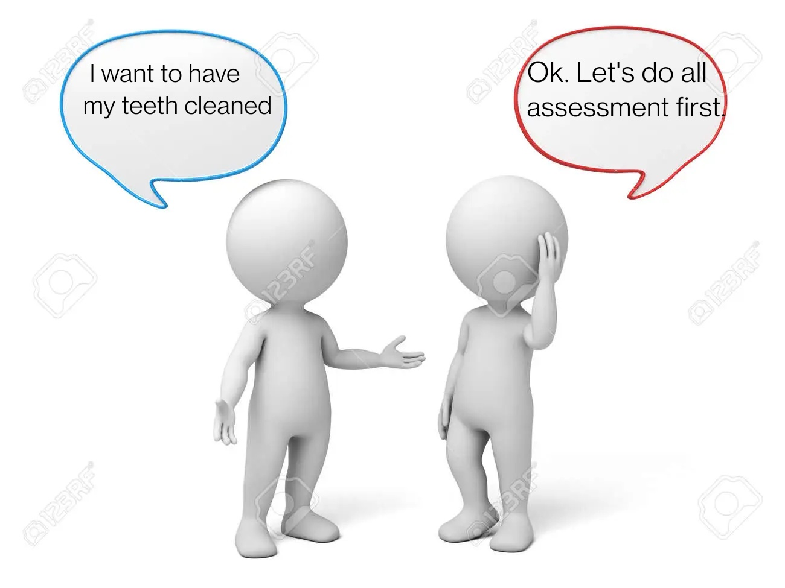
Chief Complaints
Patient came for check-up and cleaning

Slide 4
Health History
BP – 121/87, corresponds to elevated, P-125 (patient was in rush). ASA II
Allergic to Penicillin (symptoms are unknown, patient was told about that in childhood).
Has history of sinus problems, takes Advil Sinus once a day for one month.
Last dental check-up and x-ray was in 2018.

Slide 5
Assessments
Extraoral findings: asymptomatic bilateral clicking TMJ, scar near lower lip on the left side (patient fall in childhood).
Intraoral findings: Fordy's granules on buccal mucosa, asymptomatic red oropharynx, white coated tongue.
Dental examination: Occlusion class 1 bilaterally, overjet – 5mm,overbite – 90 % (severe). Canines open bite. Generalized attrition. Mild maxillary crowding and moderate mandibular crowding.

Slide 6
Dental Charting
Composites on teeth # 4- OM, 5-OD, 8- D, 13 –MOD, 14 – OM, 18 – OM.
Crown on tooth # 12.
Teeth # 1, 16, 17, 32 were extracted.
Caries on teeth # 13 –D, 20 – M, 21-D, 28-M, 29-D visible clinically.

Slide 7
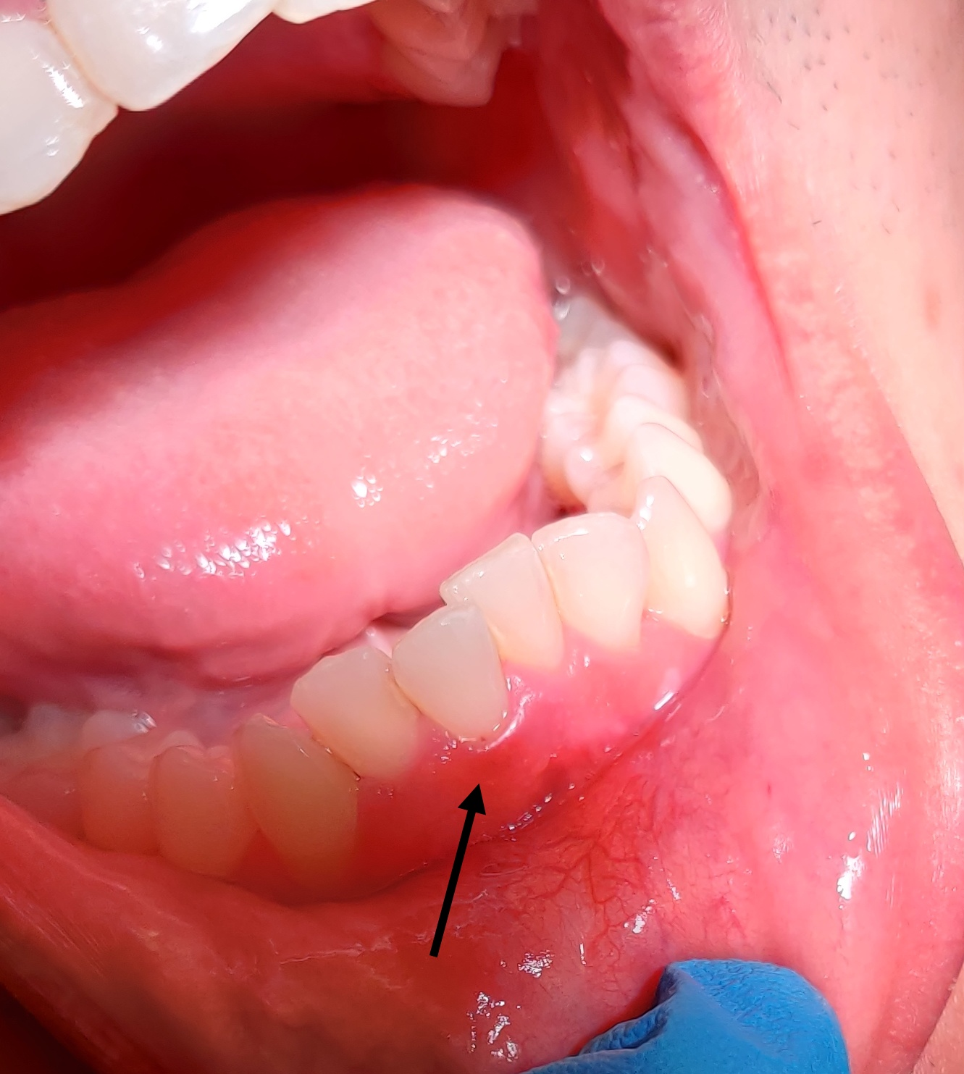
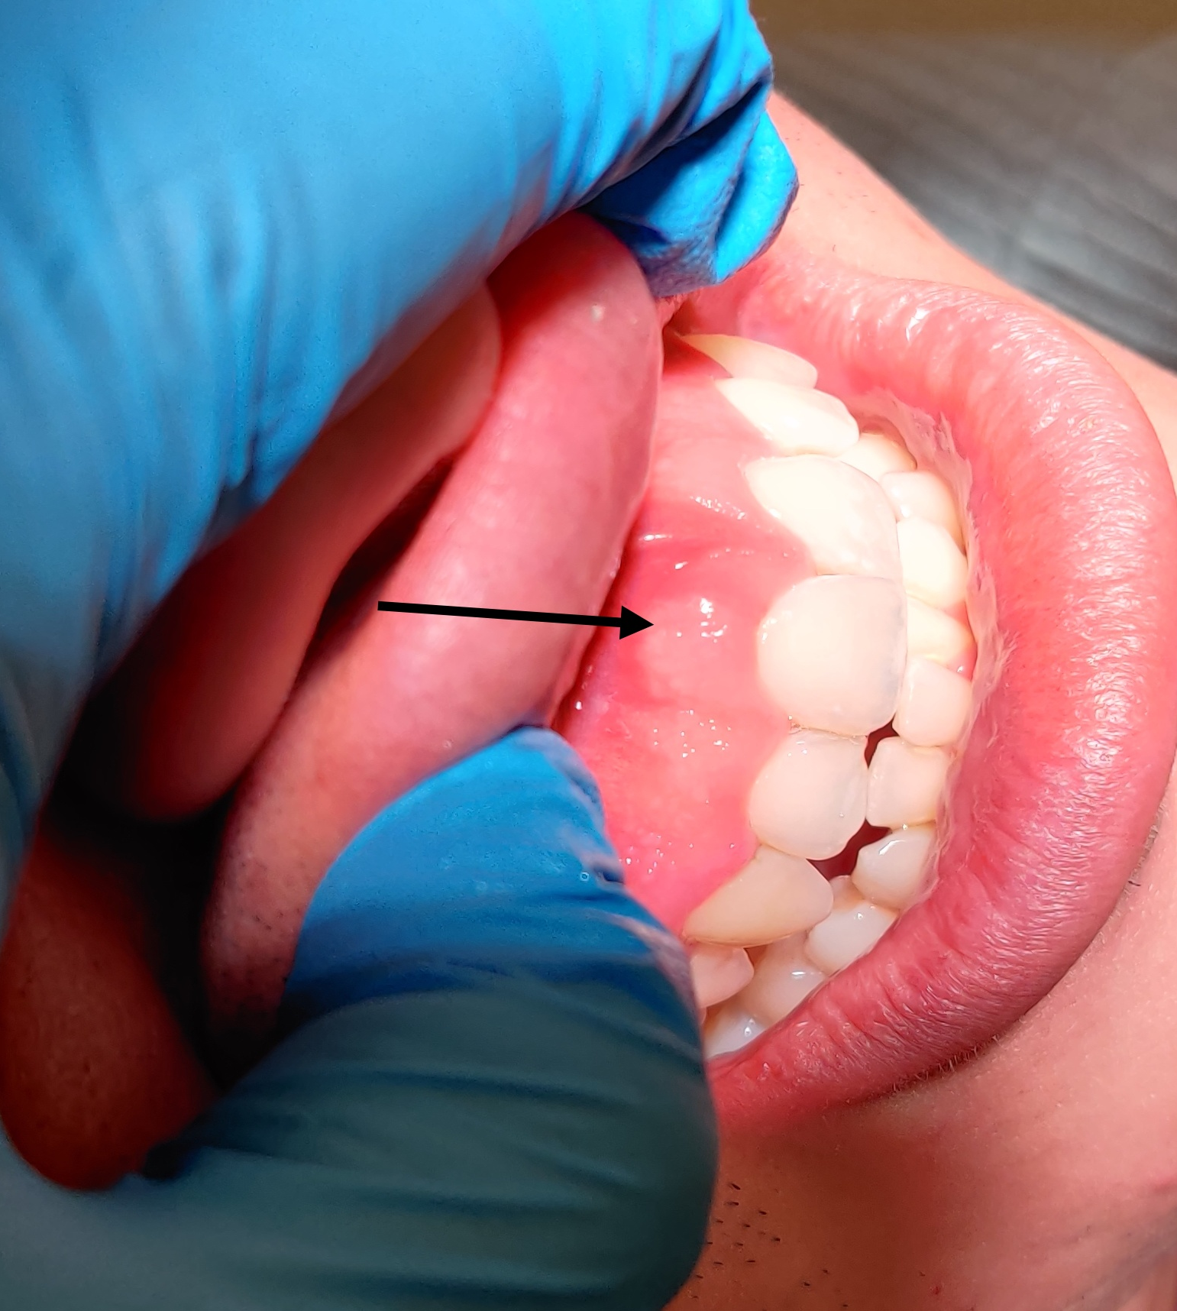
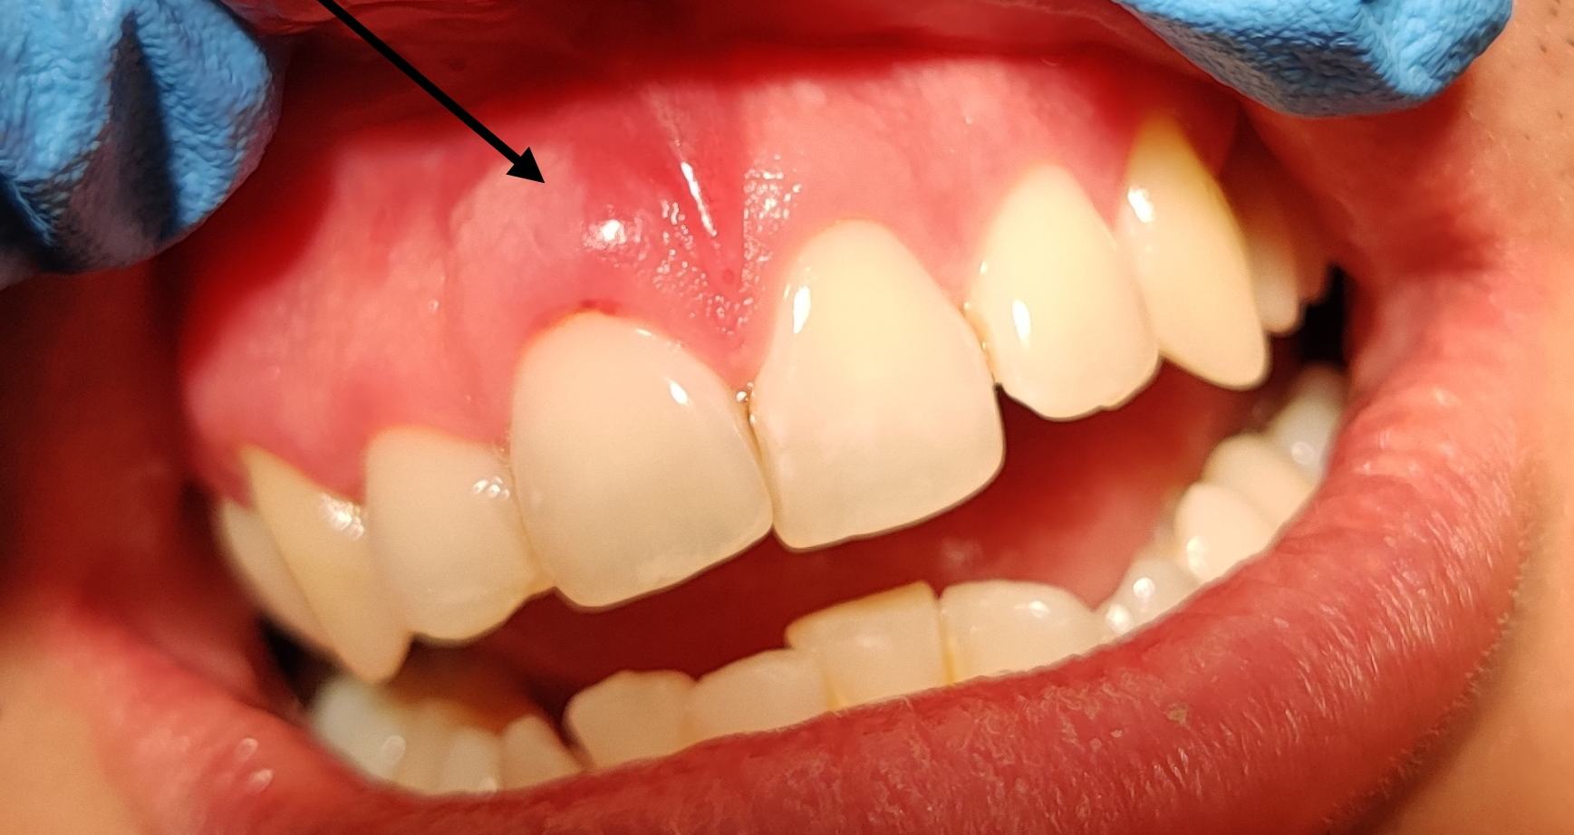
Gingival description and periodontal status
Generalized red soft gingiva with rolled margins and interproximal edema coronal to CEJ. Generalized recession on premolars, molars and anterior teeth on lingual side. Localized stippling near maxillary anterior teeth.
Localized severe inflammation with cyanotic and edematous gingiva near teeth # 8, 14,15, 25. Suppuration near teeth # 8 and 25, easily expressed by palpation (patient reports no pain).

Slide 8
Periodontal charting
Generalized sulcus depth 1-3 mm on anterior teeth and 5-7 mm on posterior teeth.
Furcation 2 on teeth # 18 BL, 31 and furcation 1 on tooth # 14.
Tooth # 8 has 5 mm pocket on facial, severe inflammation, edema, and spontaneous bleeding are present.
Teeth # 22-25 was not probed on lingual side due to the heavy calculus deposits.

Slide 9
Radiographic findings: generalized horizontal bone loss 15% with localized vertical bone loss 30% near teeth #14, 31 – D, localized calculus on maxillary left posteriors, no caries is visible radiographically, no PAP on teeth # 8 and 25.

Slide 10
Dental Hygiene Diagnosis
Generalized Periodontitis, Stage II, Grade B (based on radiographs and recession).
Heavy case value due to generalized subgingival calculus on both arches on more that 16 surfaces and localized submandibular calculus on the mandibular anterior teeth from lingual side.
High caries risk due to the caries lesions visible radiographically.

Slide 11
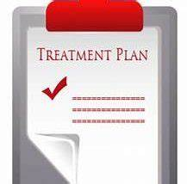
Dental hygiene care plan
Treatment plan was created and included 3 visits. The information about procedures was explained to patient and he signed. Patient gave verbal consent to take pictures of his mouth.
Treatment plan included oral hygiene instructions (toothbrushing and flossing), debridement, engine polishing, 5 % neutral sodium fluoride (NaF) varnish application.

Slide 12
Implementation of The Treatment Plan Visit # 1
During 1st visit:
All assessments were completed.
Performed CAMBRA assessment.
FMS was exposed, mA-17, kVP -70.
Plaque Index – 1 (fair), generalized distribution of biofilm on the cervical third and interproximal contacts.
Oral Hygiene Instructions – educated Modified Bass toothbrushing method.
Scaled teeth # 2-4 using ultrasonic and hand instruments.

Slide 13
Implementation of The Treatment Plan Visit # 2
During 2nd visit:
Plaque Index – 1 (fair), generalized distribution of biofilm on the cervical third and interproximal contacts. No changes since last visit.
Oral Hygiene Instructions – educated flossing.
Took alginate maxillary and mandibular impressions.
Suppuration and edema was still present on tooth # 8.
Scaled Quadrants 1 and 4 using ultrasonic and hand instruments.

Slide 14
Implementation of The Treatment Plan Visit # 3
During 3rd visit:
Plaque Index – 0.8. Generalized distribution of biofilm on cervical third on lingual side of both arches.
Oral Hygiene Instructions – reviewed and corrected modified Bass method and flossing.
No suppuration on tooth # 25.
Suppuration on tooth # 8, gingiva is still edematous and cyanotic. Upon exploring residual calculus was present, the area was rescaled till completion.
Quadrants 2 and 3 was scaled with ultrasonic and hand instruments.
Recession on mandibular anterior teeth on lingual side become visible.
Engine polished with medium grip prophy paste, 5% NaF applied.

Slide 15
Referrals were given for:
Caries on # 13-D, 20 –M, 21-D, 28-D, 29-M.
Periodontal condition and treatment.
Medical check-up.

Slide 16
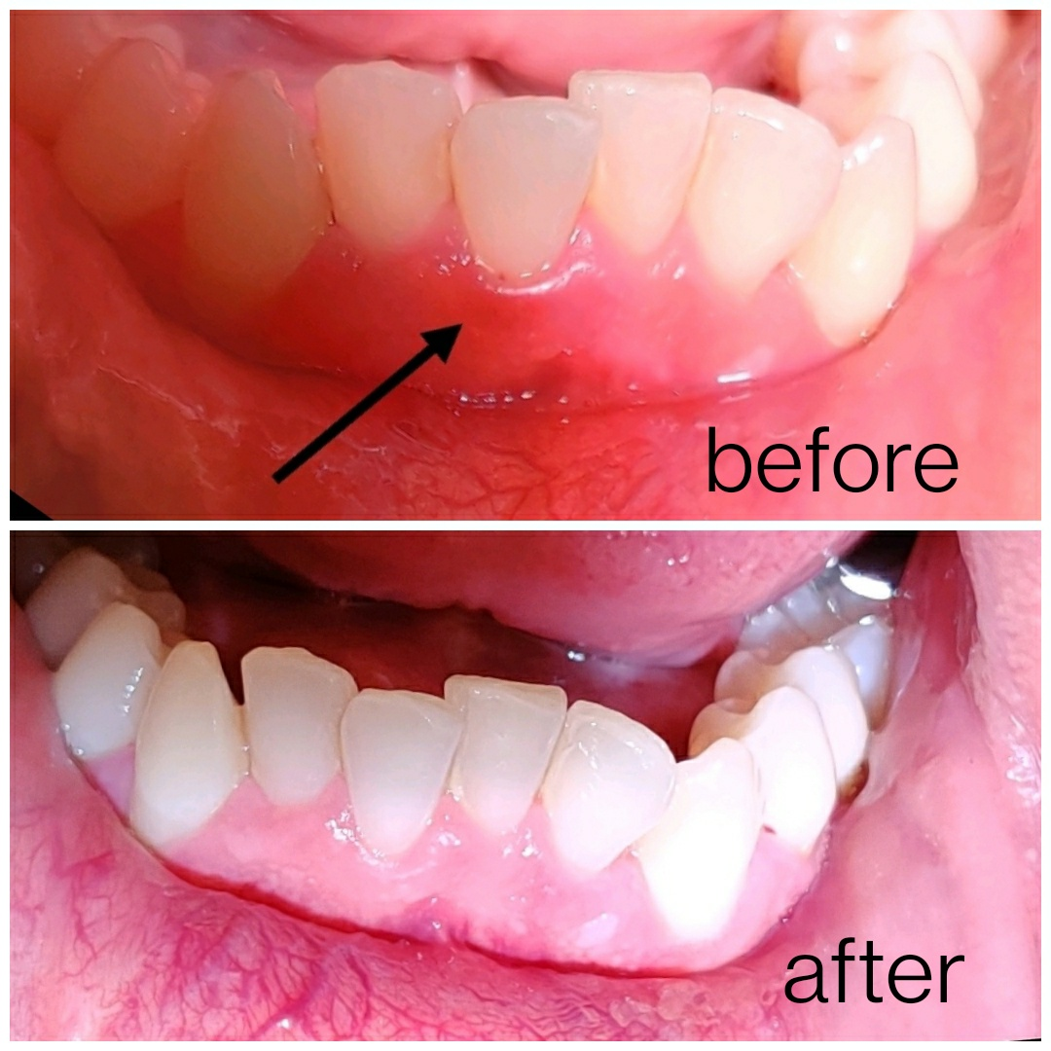
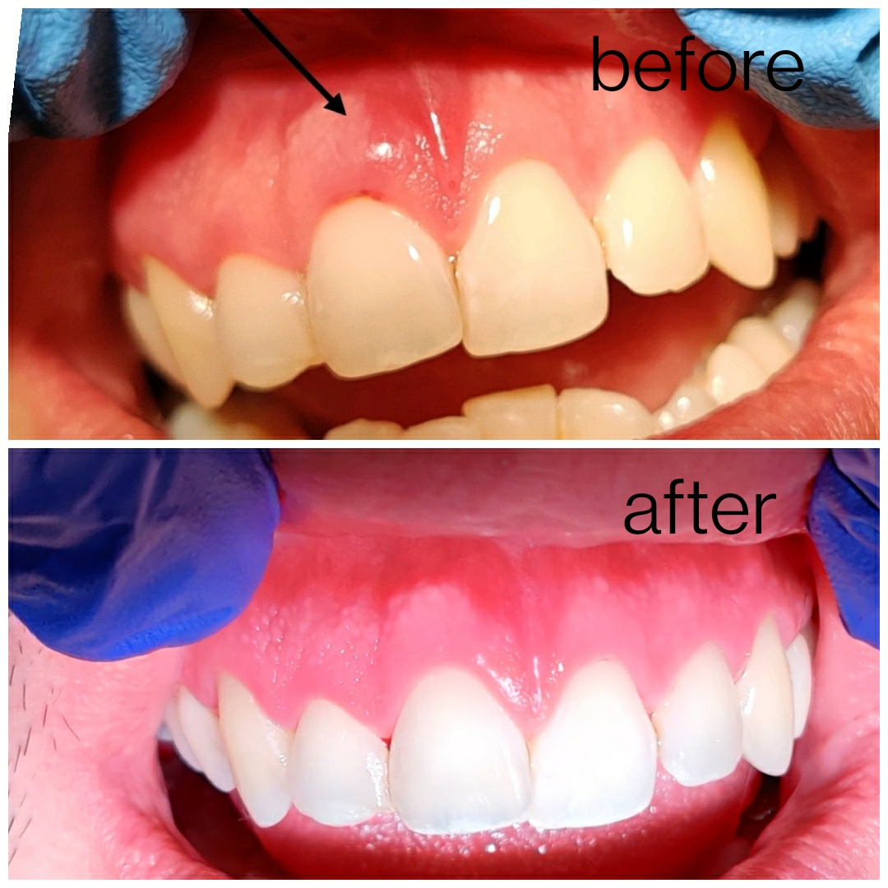
Evaluation of care
Improvement were noted in oral hygiene home care. Plaque score decreased from 1 to 0.8. Patient stated he complied with modified Bass toothbrushing technique and flossing.
Localized severe inflammation and suppuration near tooth # 8 were caused by calculus deposits. On the 3rd visit inflammation were less severe but still present. Residual calculus were detected. Tooth were rescaled till completion. Patient came back for recare in 5 months. Gingiva near tooth # 8 showed no suppuration and no severe inflammation.
During recare visit gingiva was less inflamed and showed visual improvement since last visit.

