Slide 1
Fluorosis
Ashley Sugrim

Slide 2
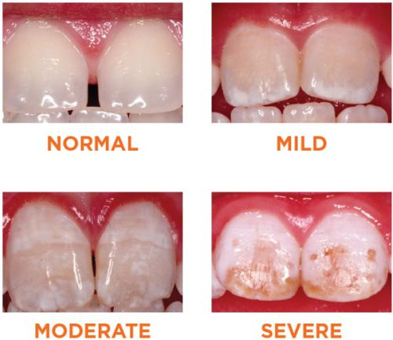
What is Fluorosis?
A developmental disturbance in the enamel caused by extremely high concentrated levels of fluoride while the teeth are developing.
Occurs during the first eight years of life since this is the time when most permanent teeth are being formed.
Fluorosis is a cosmetic condition that affects the teeth, not a disease.
Also termed mottled enamel or teeth.

Slide 3
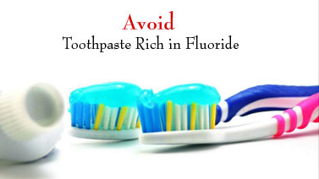
Causes of Fluorosis
Common causes of fluorosis include:
Inappropriate use of fluoride containing dental products such as toothpastes and mouth rinses.
Fluoridated drinking water (particularly during infancy)
Use of fluoride supplements
taking a higher-than-prescribed amount of a fluoride supplement during early childhood
taking a fluoride supplement when fluoridated drinking water or fluoride fortified fruit juices and soft drink already provide the right amount.
It is important to know how much fluoride your child consumes.

Slide 4
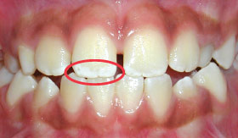
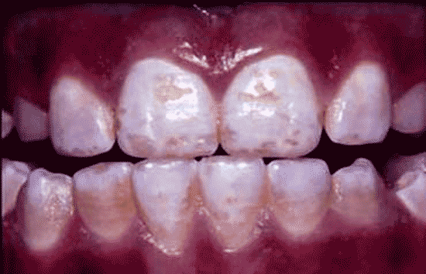
Effect on Dentition
In mild cases, tiny white specks or streaks are present but may be unnoticeable .
In moderate to severe cases, the teeth may have:
Stains ranging from yellow to dark brown
Surface irregularities
Pitted enamel that are highly noticeable
Teeth that are unaffected by fluorosis are smooth and glossy.

Slide 5
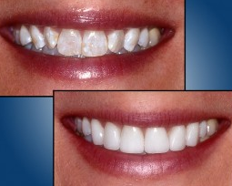
Treatment
Most of the treatment for fluorosis consists of masking the stain.
Many cases of fluorosis are minor enough not to need treatment. Sometimes fluorosis occurs only on the posterior teeth, where it can't be seen.
More serious cases and cases involving the front teeth can be treated by removing the surface-stained areas through tooth whitening or other procedures.
Severe cases of fluorosis can be covered with
Bonding
Crowns
Veneers
Bleaching teeth may temporarily worsen the appearance of fluorosis.

Slide 6
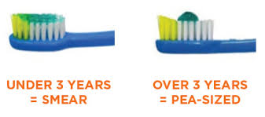
Prevention
Parental vigilance is the key to preventing fluorosis.
At home, keep all fluoride-containing products such as toothpaste, mouth rinses, and supplements out of the reach of young children.
Apply small pea-sized amount of toothpaste on the child’s toothbrush.
Encourage them to spit rather than swallow after brushing.
Avoid toothpastes with flavors that may encourage swallowing.
Since the major source of fluoride is drinking water, de-fluoridation is the best preventive measure which can be carried out at domestic as well as community level.
Nutritional interventions like high intake of vitamin C and Calcium also helps reduce the problem.

Slide 7
Role of Dental Hygienist
Inform parents of young children on the topic of fluorosis and preventive actions they can take to avoid this condition.
Educate older patients who suffer from this condition and are unhappy with the appearance of their teeth how it occurred and that it is irreversible but there are different treatment options to help cover up the stains if they are interested.

