Slide 1
Assessment at City Tech
April 17, 2015
Living Lab Associate Seminar
Susan Nilsen-Kupsch RDH MPA

Slide 2
Why Assess?
To determine whether we are meeting stated learning objectives
To improve learning
To increase retention

Slide 3
Who should be involved?
ALL faculty; full and adjunct should be included in the process
The goal
Have assessment an integral part of how faculty think about teaching

Slide 4
From the beginning
Assessment committee formed 2009
Critical Course Assessment
(ongoing)
Program Level Assessment
General Education Assessment

Slide 5
Program Level Assessment
Curriculum Mapping
Process for collecting and recording data that identifies
core skills
content taught
assessment method

Slide 6
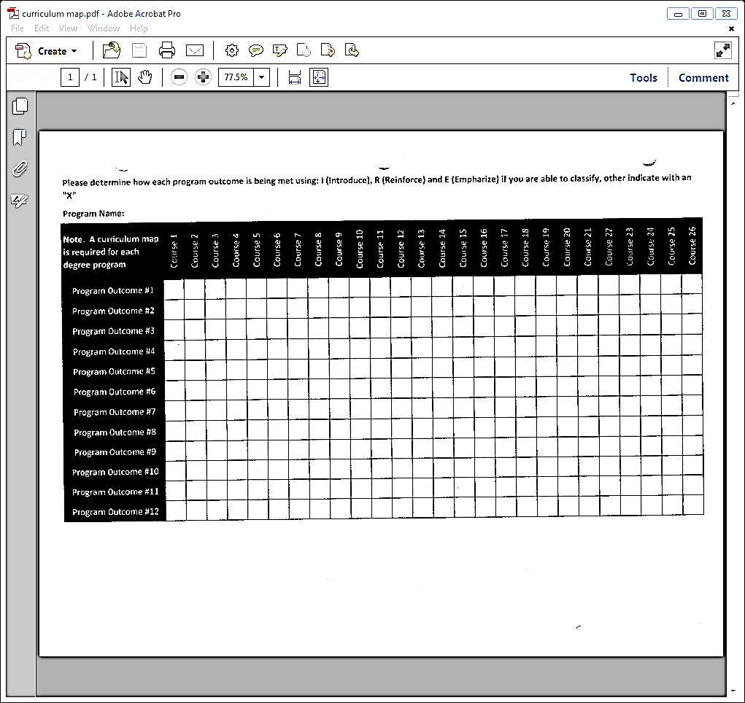
Program Level Assessment

Slide 7
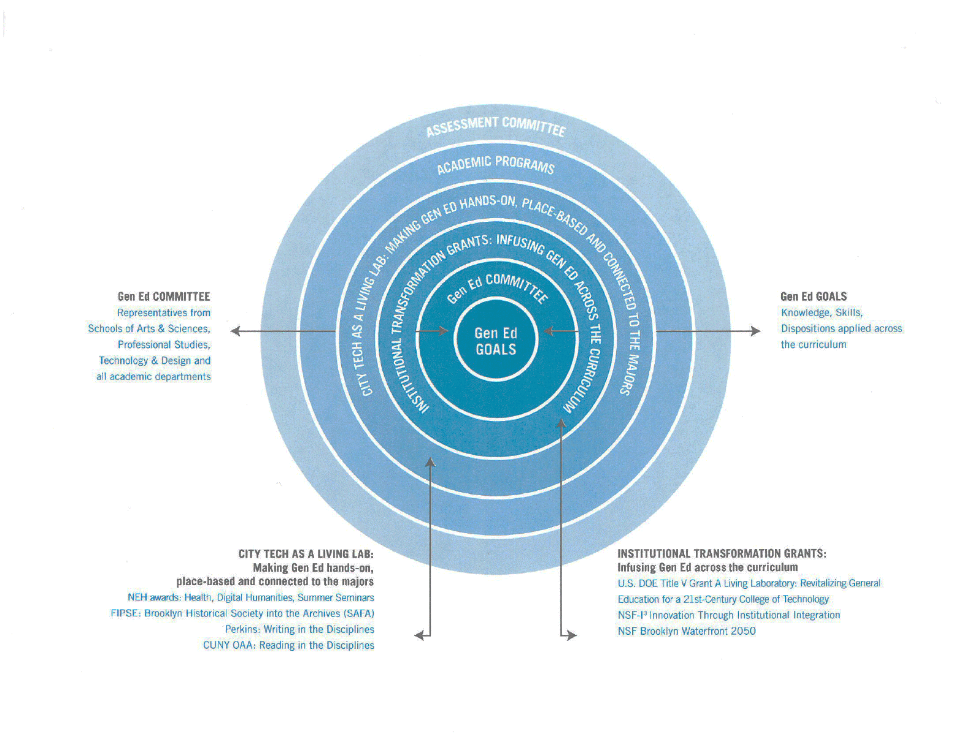
Where is Gen Ed?

Slide 8
General Education Assessment
Learning outcomes identified and adopted by College Council in 2013
http://facultycommons.citytech.cuny.edu/index.php/gen-ed/

Slide 9
Civic Engagement
Creative Thinking
Quantitative Literacy
Reading
Scientific Reasoning
Teamwork
Critical Thinking
Ethical Reasoning
Lifelong Learning
Information Literacy
Inquiry and Analysis
Integrative Learning
Intercultural Knowledge and Competence
Oral Communication
Writing
15 General Education competencies aligned with the Gen. Ed Learning outcomes

Slide 10
Currently in process…
Developing a strategic plan for Gen Ed assessment
On a 3-year cycle
5 each year
5 each year
5 each year

Slide 11
Issues
How to incorporate the results of
assessment ?
http://assessment.siu.edu/_common/images/closing_loop2.jpeg

Slide 12
AIR website
air.citytech.cuny.edu/air/default.aspx

