Slide 1
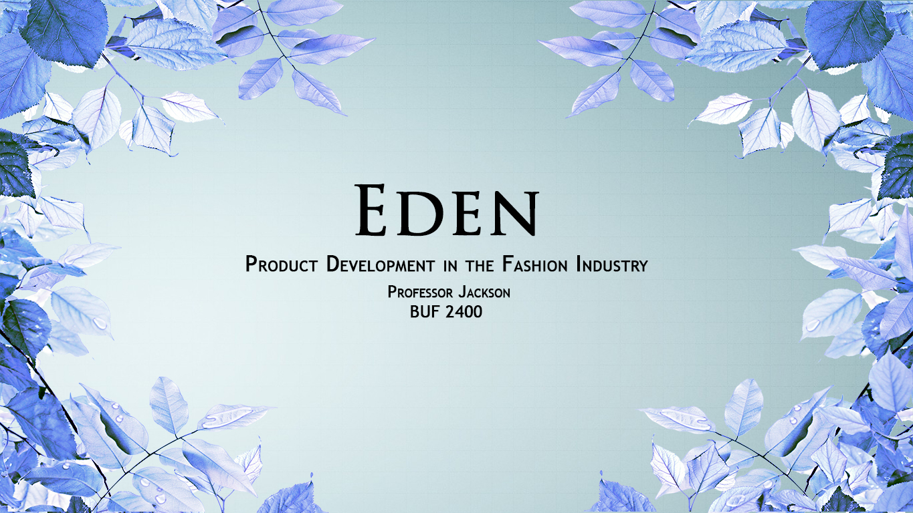
E D E N
Pascia Sangoubadi, Elliel Morales, Sidney Lora, Ariele Leon
FALL/WINTER 2020

Slide 2
M I S S I O N, V I S I O N, A N D V A L U E S
For our fall/winter 2018 debut, we will be showing sustainable leather bags and shoe accessories.
MISSION
VISION
VALUES
Eden is a brand of integrity and seeks to encourage the equality of race, gender, and body representation.
We serve to provide leather shoes and handbags that are clean, sophisticated, trendy, and that can be worn by either gender regardless of size.
Eden hopes to be a leading company for innovation of functional designs and sustainability
We are champions of 360 sustainability. This means we encourage economic, environmental, and social sustainability.
Eden is a relentless supporter of ethically sourced quality goods
We support new advances in technology that allow for greater sustainable options

Slide 3
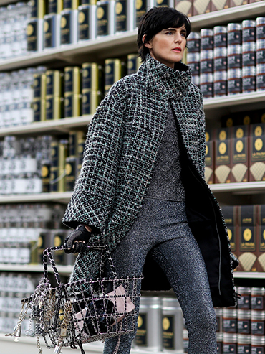
DEMOGRAPHICS
- An older millennial consumer aged 29-35, (born in the years 1988-1983)
- Major metropolitan domestic and international cities
- Single, looking for a partner but are enjoying their space of freedom and maybe living a sexually fluid lifestyle
- Bachelor’s or master’s degree, they are occupy associate to mid-level positions earning between $55,000 to $75,000 annually
- Employed on the business or tech side of creative industries. For instance, as a public relations manager, graphics/digital designer, an account executive, or tech engineer.
C O N S U M E R M A R K E T S
PSYCHOGRAPHICS
- Our ideal customer are categorized as the “thinkers” consumer group according to Strategic Business Insights Val’s Survey.
“Have high resources and are financially established” (2018). This allows them the purchasing power for Eden’s high contemporary price point.
“Use technology in functional ways and buy proven products” (2018)
- Thinkers are aware of their carbon footprint and are educated on the devastating effects of non-sustainable fashion.
Constantly on-the-go
Figure 1. Typical Eden consumer.

Slide 4
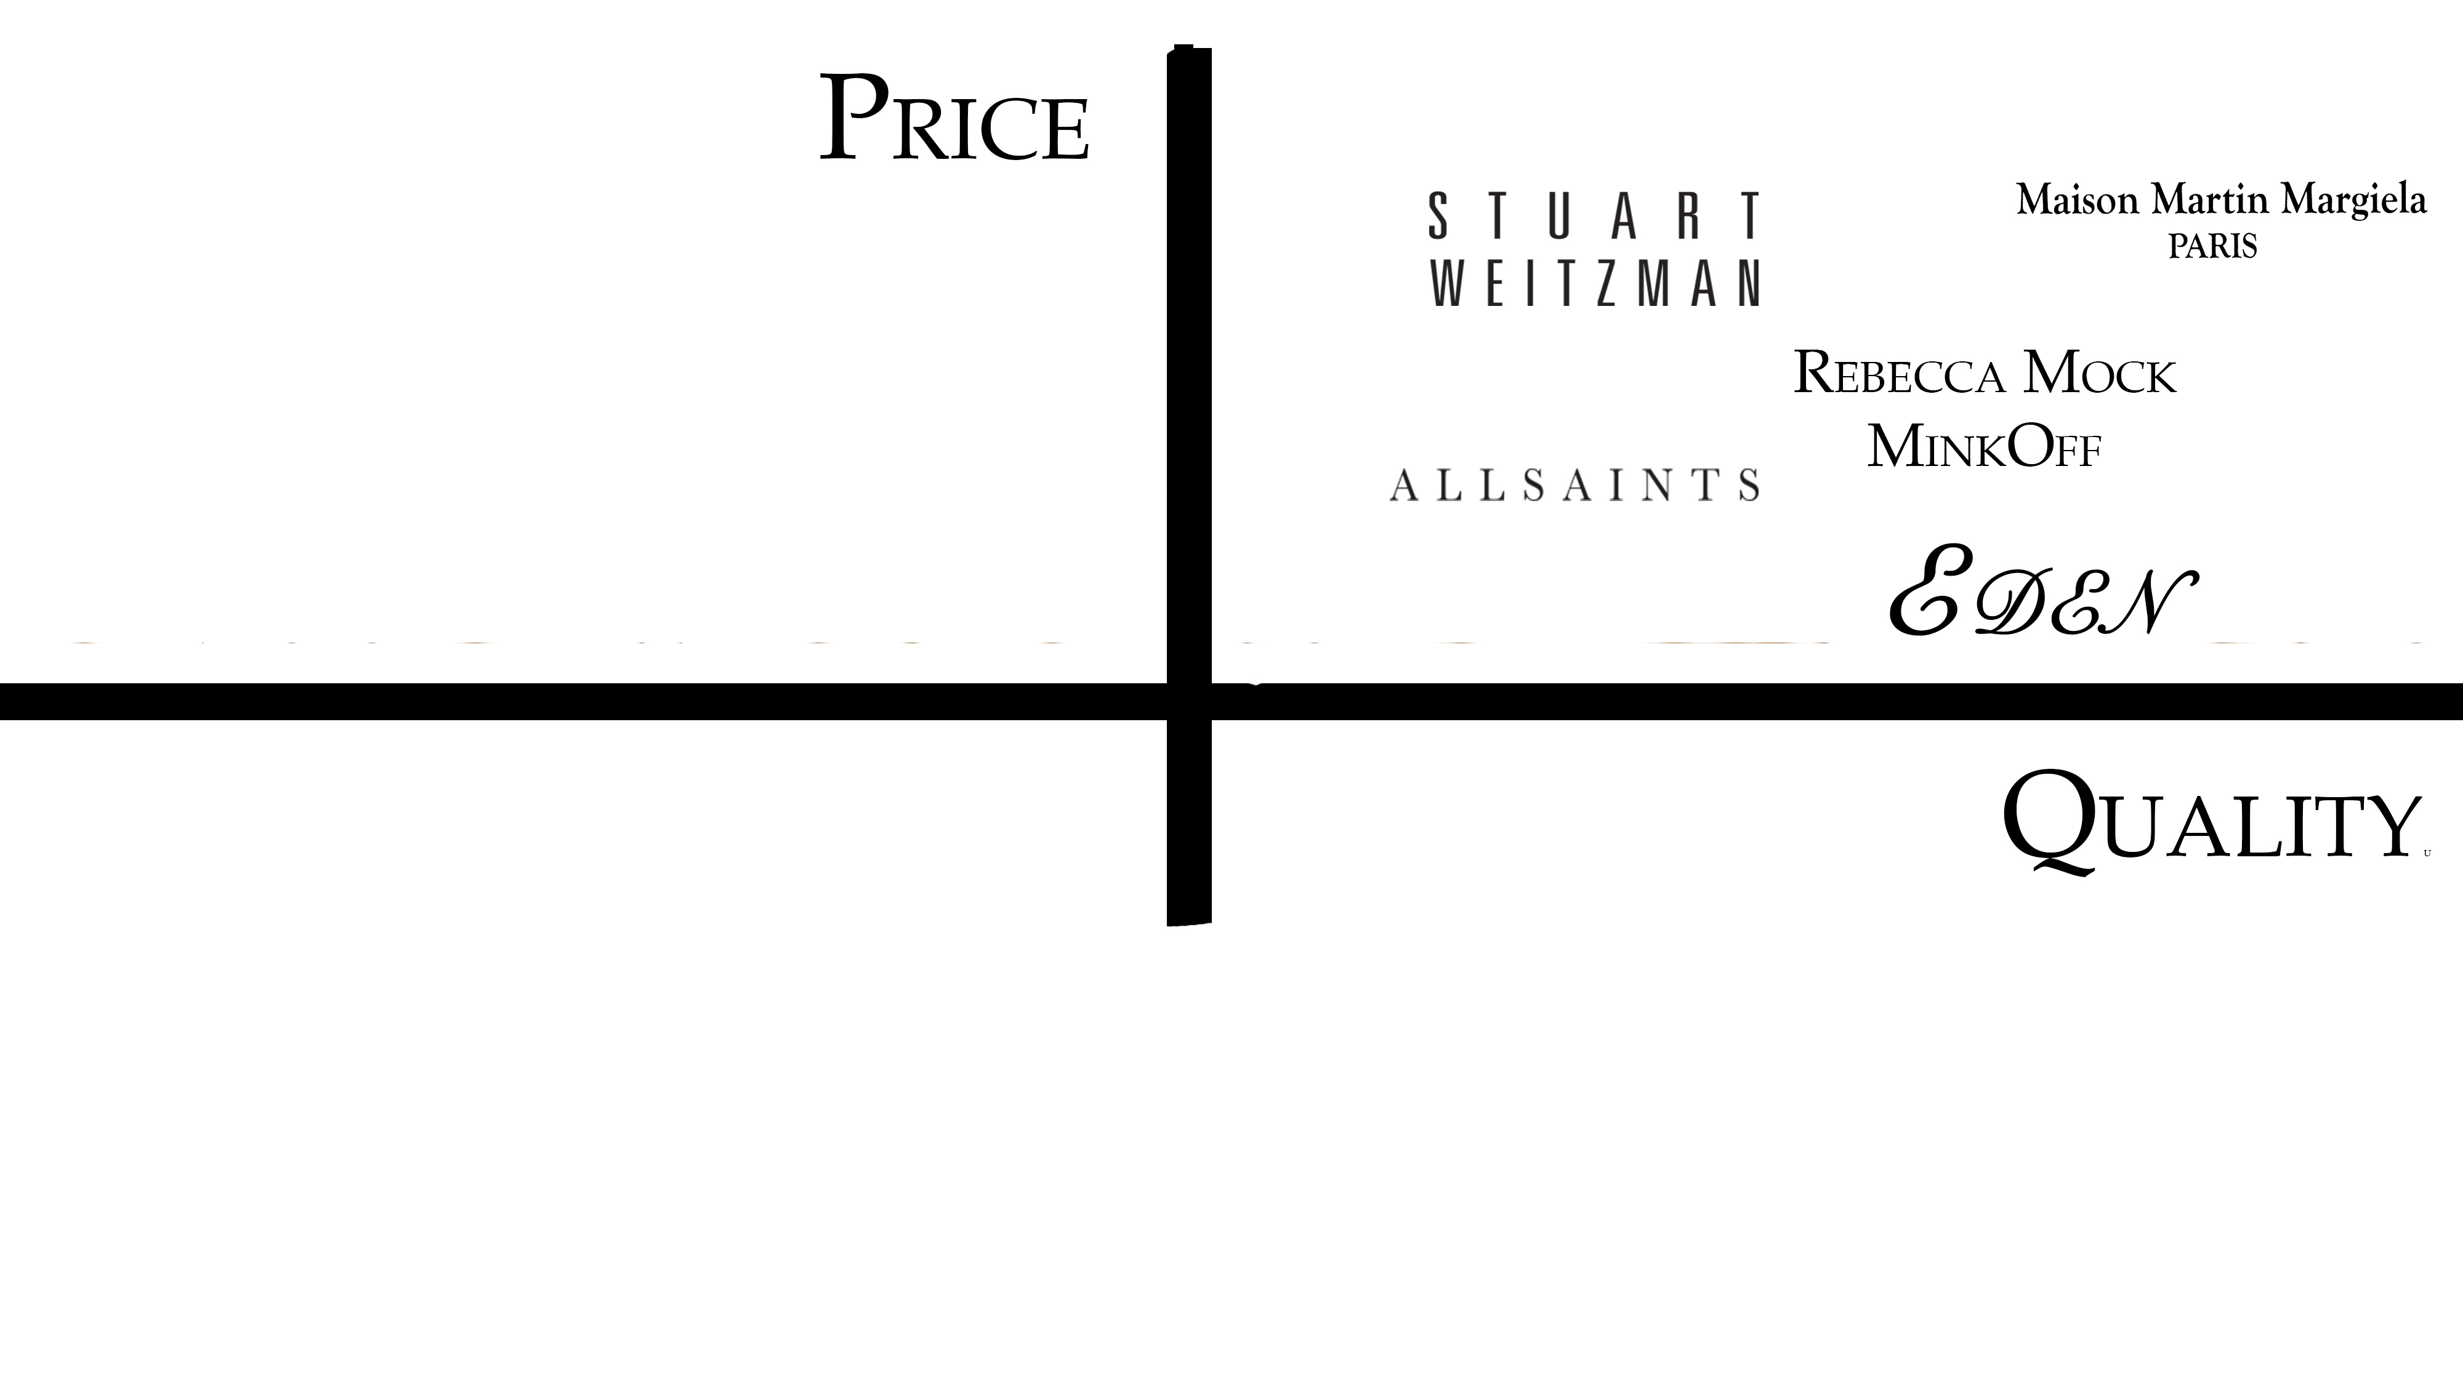
Strategic Planning
Unique attributes:
- unparalleled passion of sustainability
great quality of footwear and
- each shoe range seeks to accommodate the
typical smallest men’s shoe size to the largest.
- We include wide sole or calf footwear
and a shoe stretching service. Since Eden practices vertical integration, we are in full control of
our supply chain therefore, can control how we produce.

Slide 5
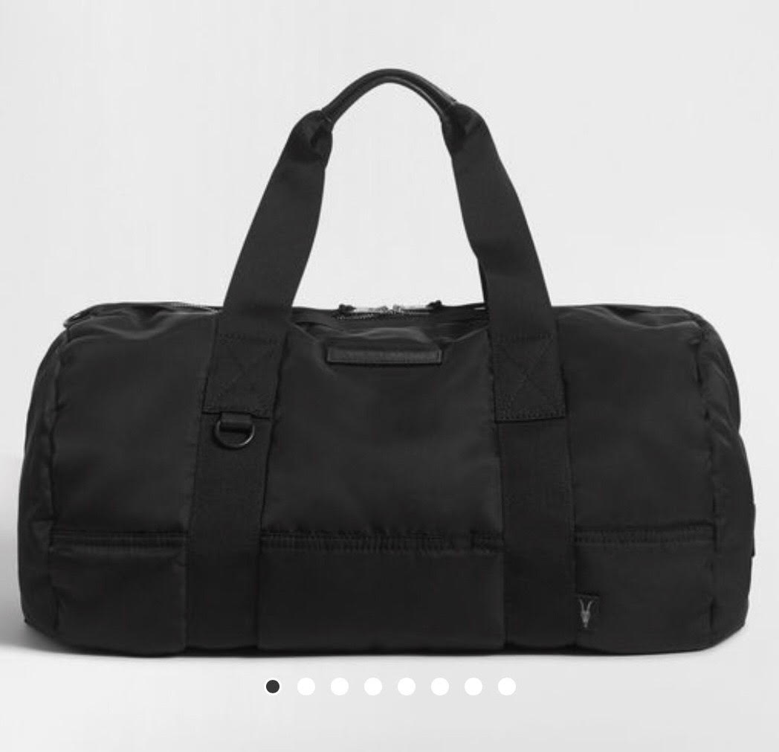
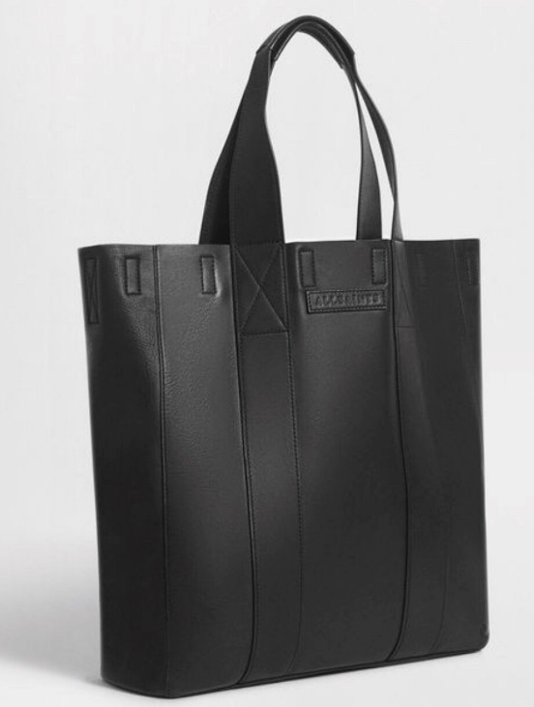
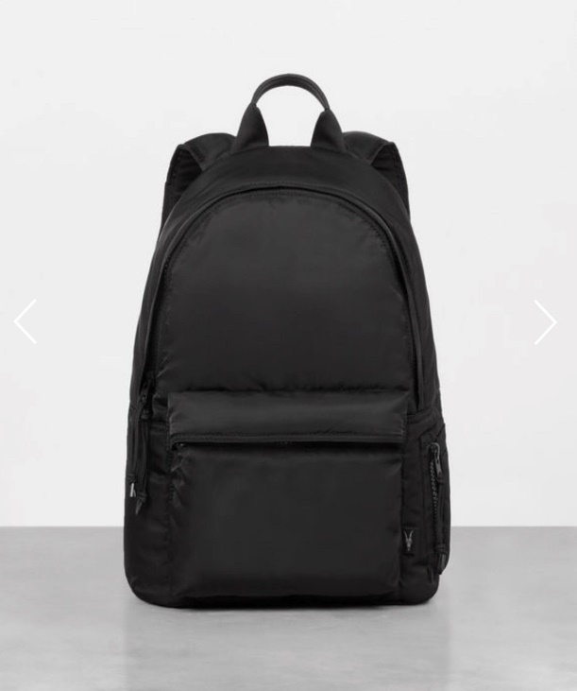
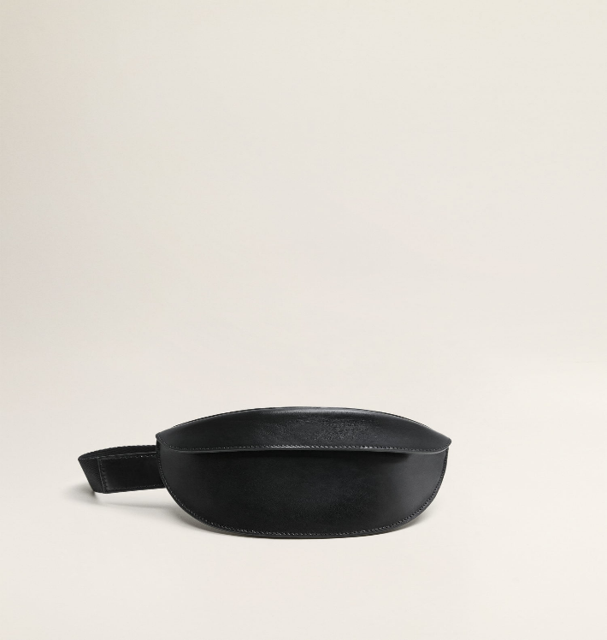
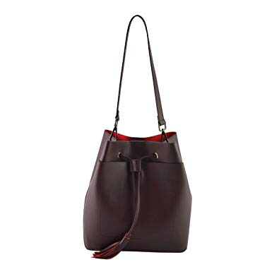
M E R C H A N D I S I N G & A S S O R T M E N T P L A N N I N G
The Duffle
The Travel Tote
The Multifunctional
Backpack
The minimal fanny pack
The reversible bucket bag

Slide 6
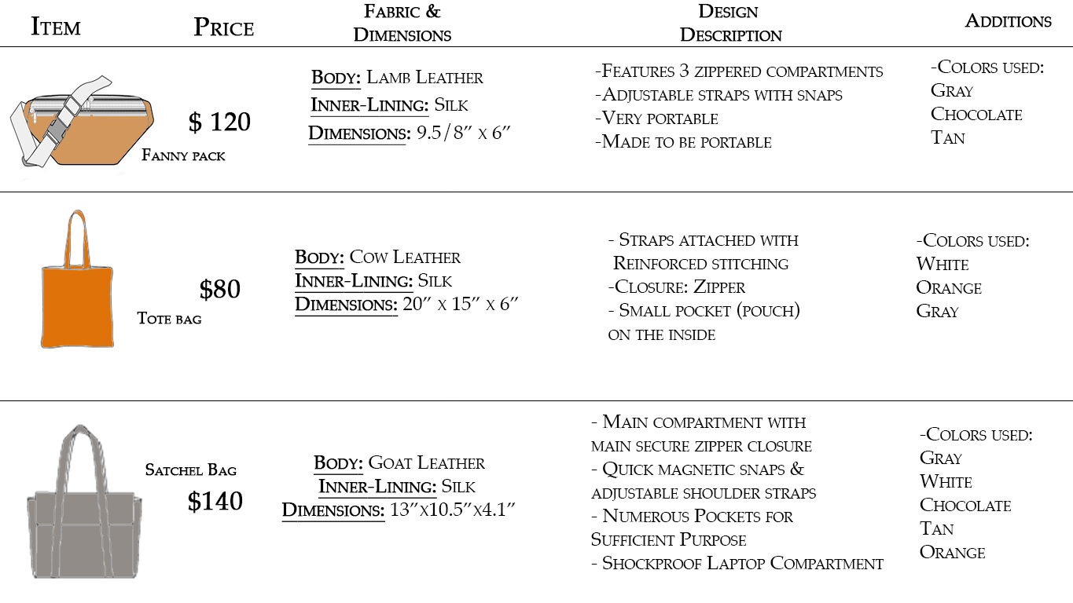

Slide 7
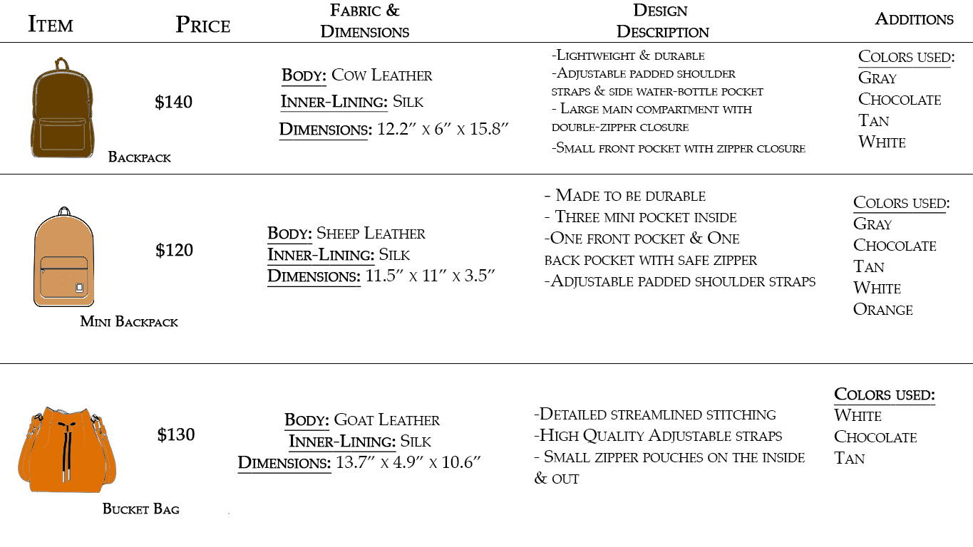

Slide 8
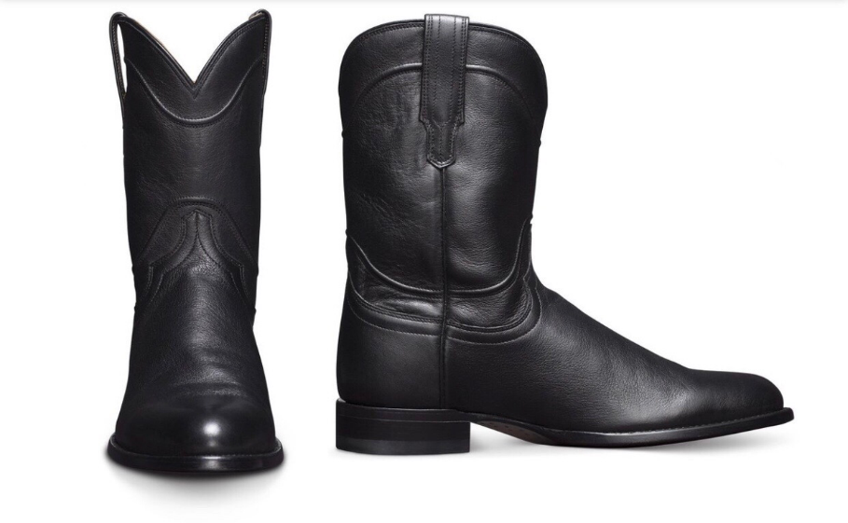
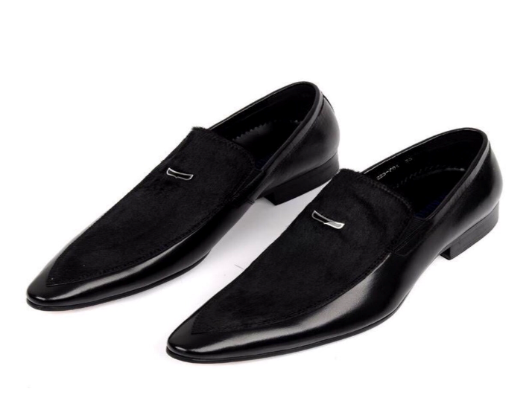
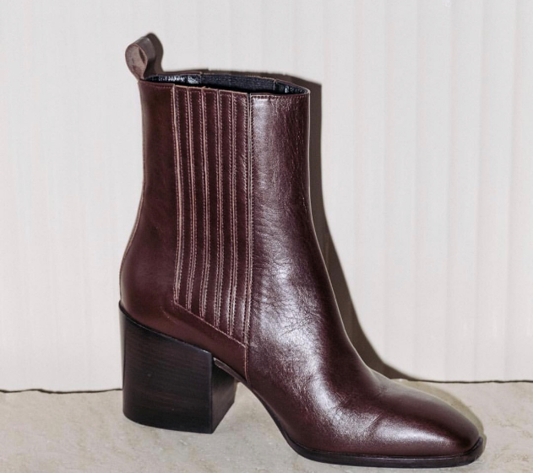
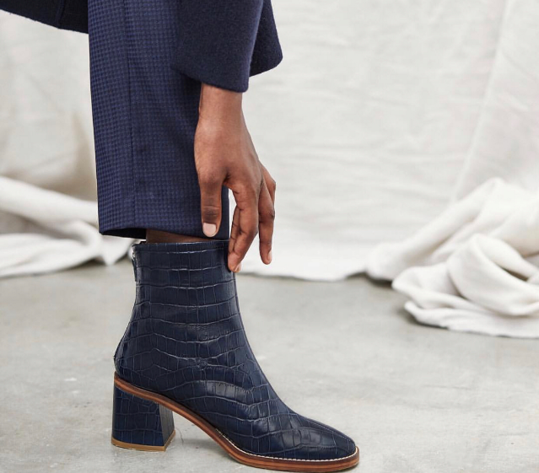
M E R C H A N D I S I N G A N D A S S O R T M E N T

Slide 9
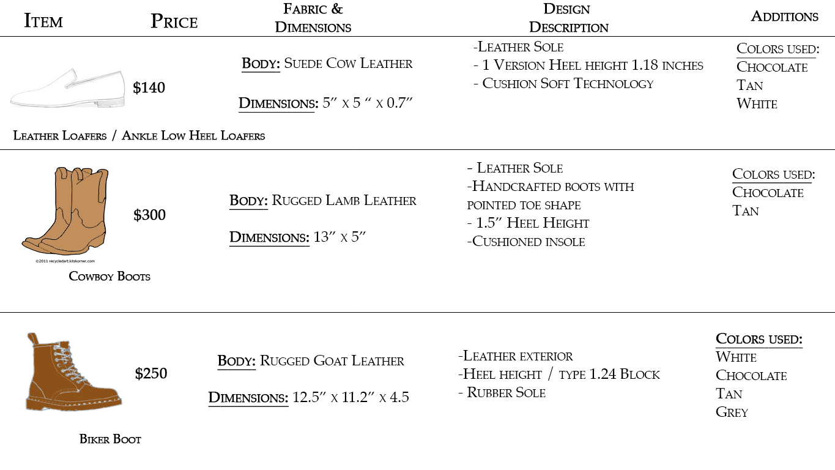

Slide 10
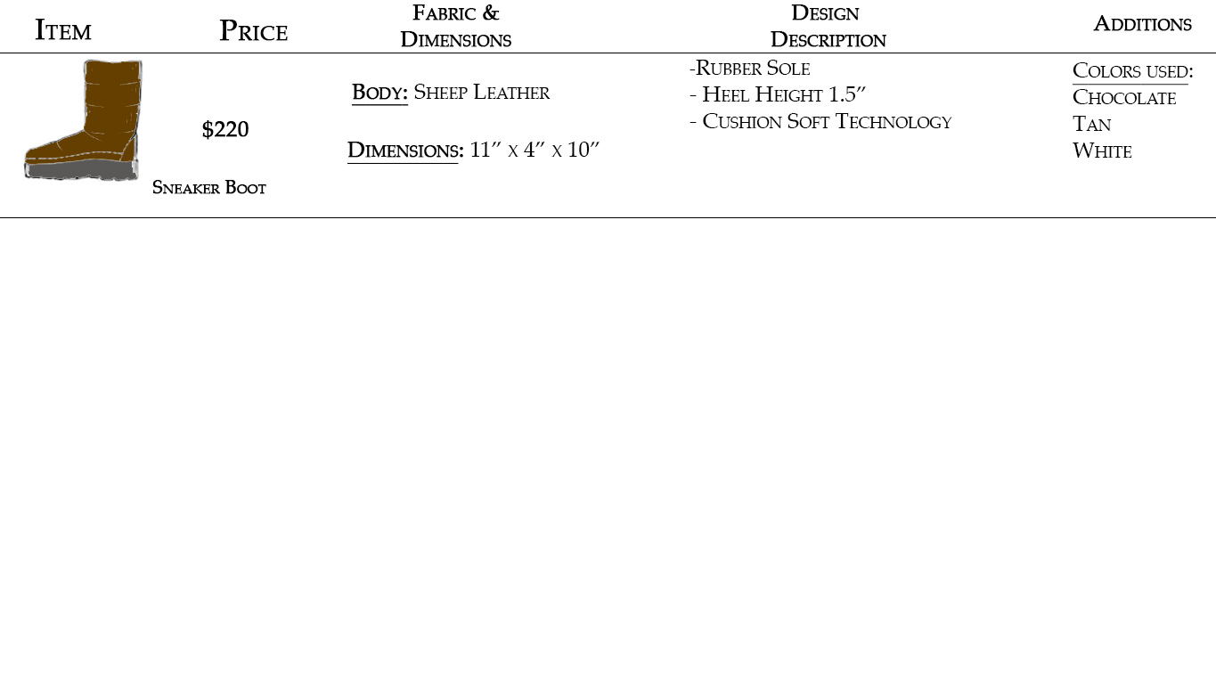

Slide 11
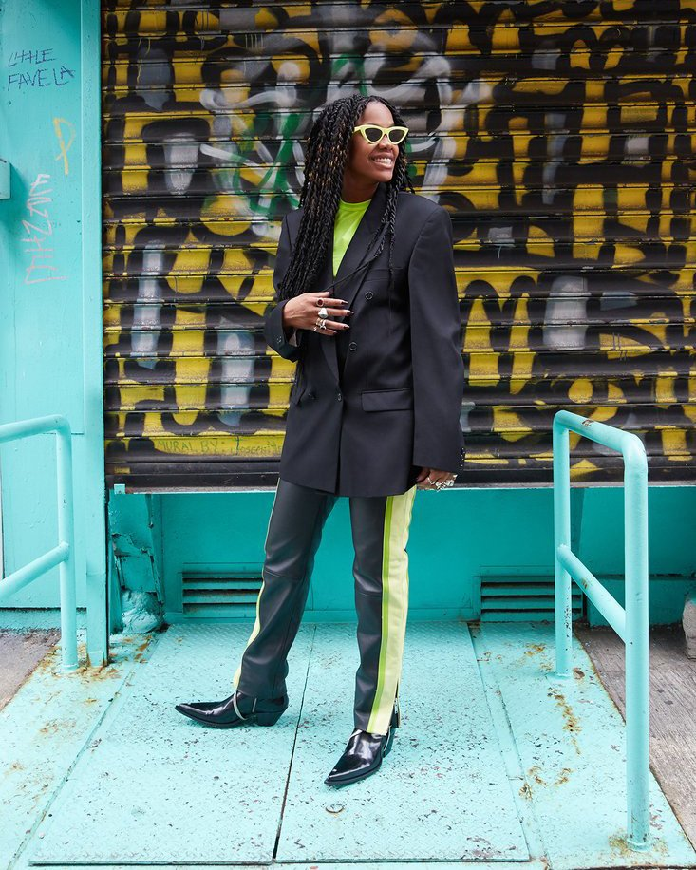
N E W E R A M A R K E T I N G
Eden plans on using micro-influencers to captivate its target market. With micro-influencers, they have enough influence and followers within small peer groups, but not as many followers macro influencers, therefore they are seen as more approachable.
Our customer wants to feel understood and related to. “92 percent of consumers trust an influencer more than an advertisement or traditional celebrity endorsement” (Moss, 2017).
Figure 2. Jan-Michael Quammie is fashion director of High Snobriety

Slide 12
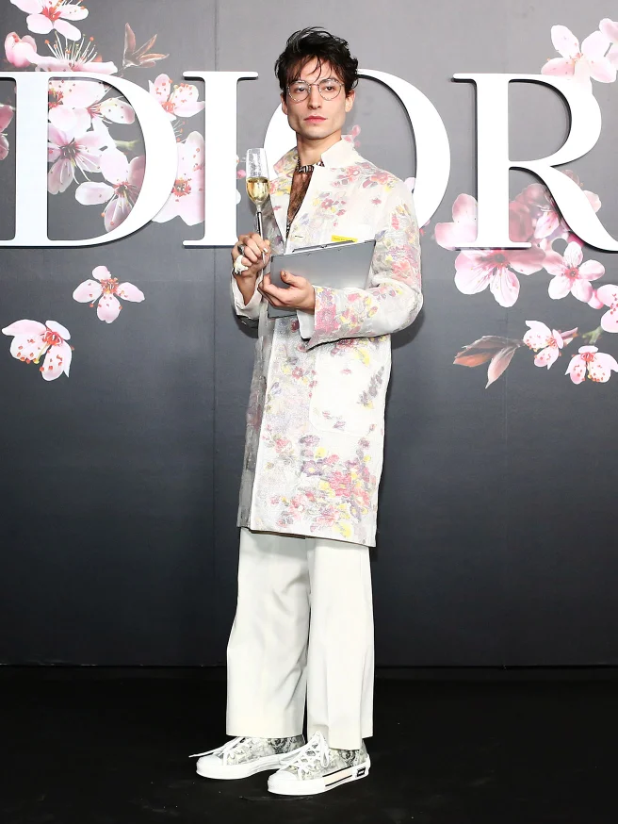
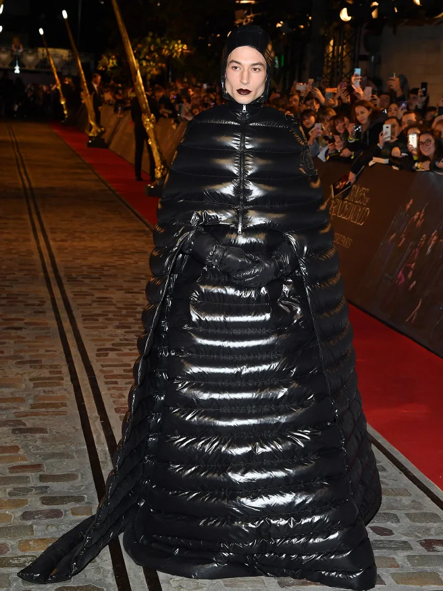
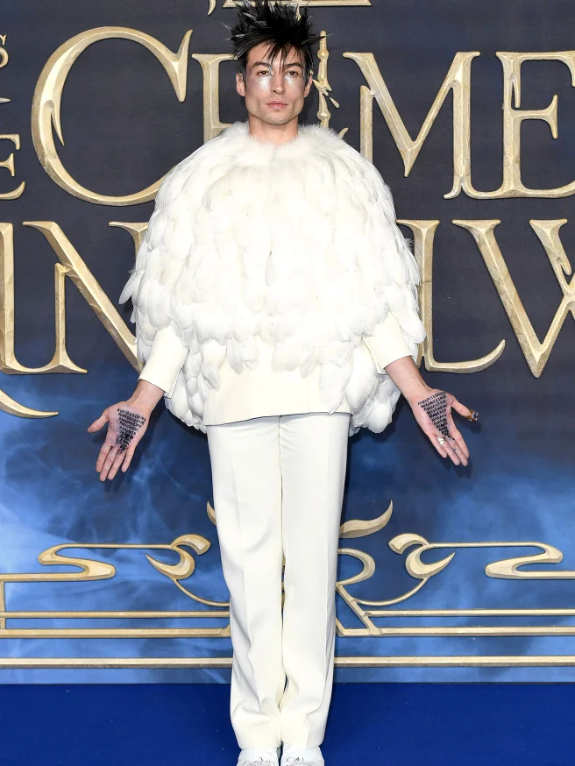
N E W E R A M A R K E T I N G
Ezra Miller is one of Hollywood’s biggest upcoming actors and has in “Perks of Being a Wallflower” and “Fantastic Beasts and Where to Find Them”. However it’s his bold and gender fluid red carpets looks and infectious personality that has captivated the fashion world.
Figure 3,4, and 5. Actor Ezra Miller’s most dazzling red carpet looks.

Slide 13
R E F E R E N C E S
Moss, S. (5 May 2017). How your business can benefit from micro-influencer marketing. Entrpreneur.com. Retrieved from https://www.entrepreneur.
com./article/293824

