Slide 1
ARCH 3691 Advanced Design & Building Information Modeling
Design and build your truss
Revit Truss Design
ARCH 3691
Advanced Design & Building Information Modeling
Moshe Goldstein
Moegoldstein@yahoo.com

Slide 2
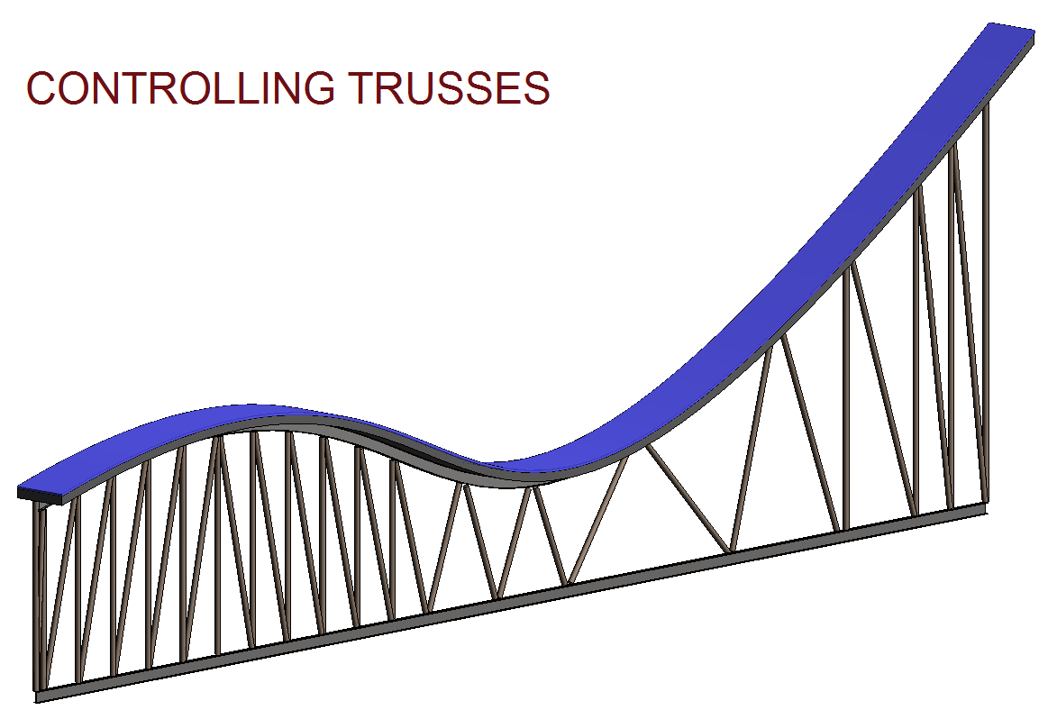
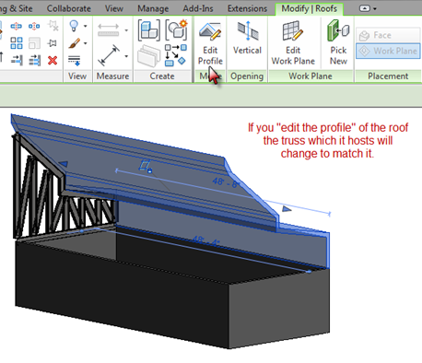
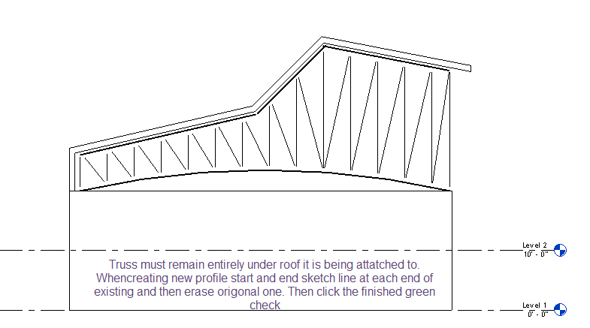
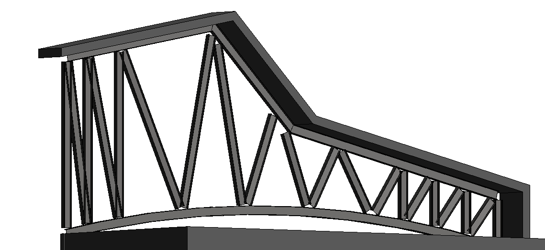
INTRO
Building the hosting wall
Placing Truss
Loading your truss
Using roof extrusion tool
Drawing profile
Attaching truss to roof
Editing existing truss
Changing truss material
Adjusting truss members
Trying it on a conceptual mass
Building your own
WRAP UP
Multiple truss customizing techniques
Abstract or to fit custom projects
Step by step
Build your own
1

Slide 3
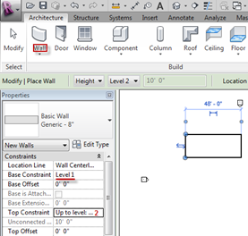
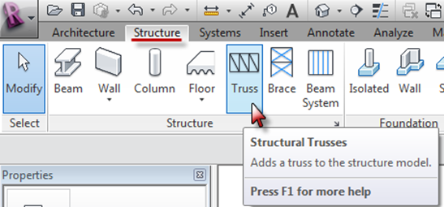
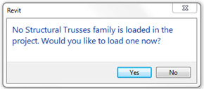
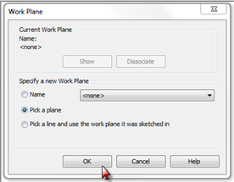
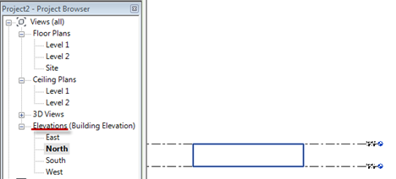
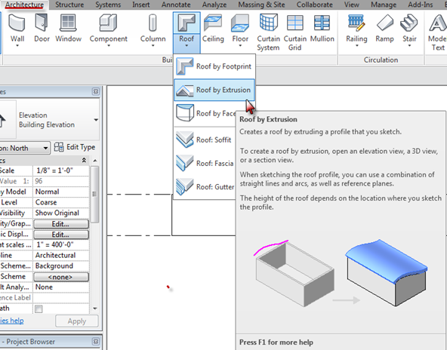
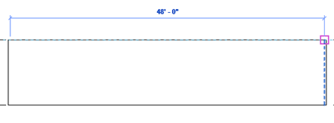
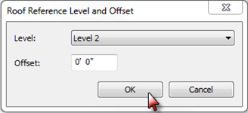
INTRO
Building the hosting wall
Placing Truss
Loading your truss
Using roof extrusion tool
Drawing profile
Attaching truss to roof
Editing existing truss
Changing truss material
Adjusting truss members
Trying it on a conceptual mass
Building your own
WRAP UP
NEXT..
2

Slide 4
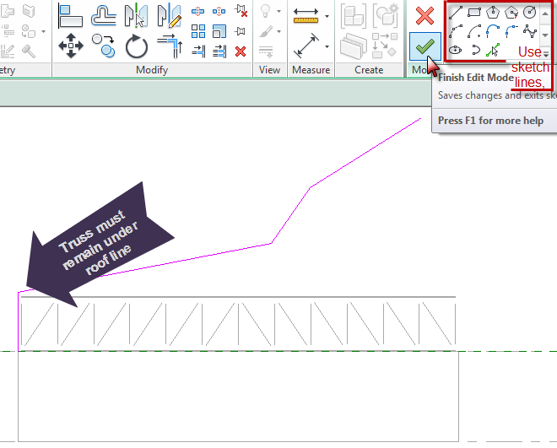
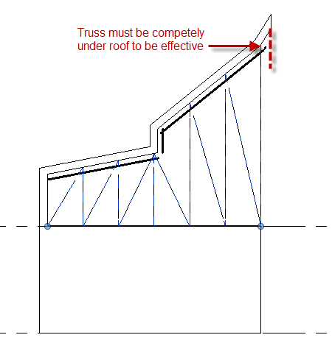
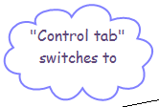
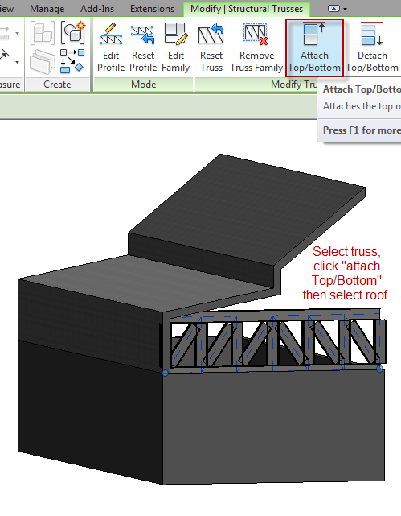
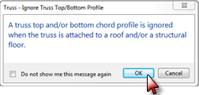
INTRO
Building the hosting wall
Placing Truss
Loading your truss
Using roof extrusion tool
Drawing profile
Attaching truss to roof
Editing existing truss
Changing truss material
Adjusting truss members
Trying it on a conceptual mass
Building your own
WRAP UP
Control +Tab switches to previous views –El. To 3D etc.
3

Slide 5
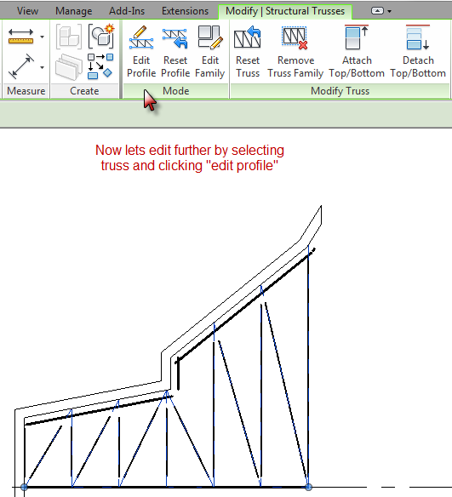
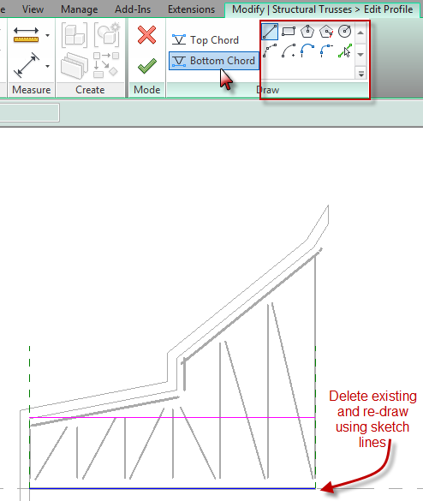
INTRO
Building the hosting wall
Placing Truss
Loading your truss
Using roof extrusion tool
Drawing profile
Attaching truss to roof
Editing existing truss
Changing truss material
Adjusting truss members
Trying it on a conceptual mass
Building your own
WRAP UP
4

Slide 6
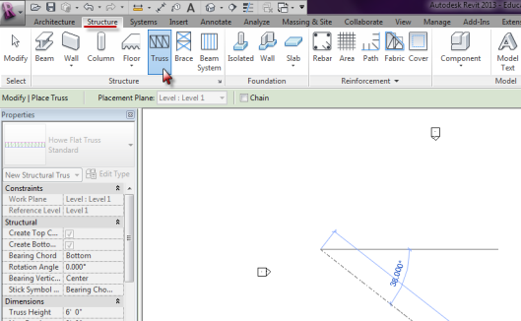
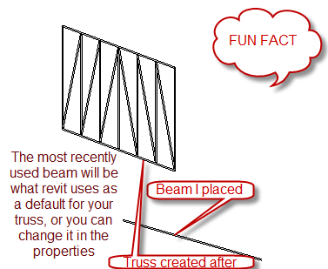
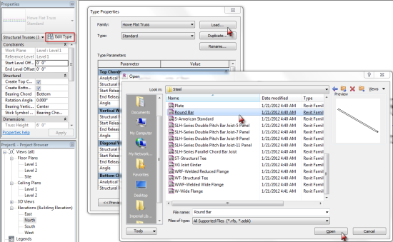
INTRO
Building the hosting wall
Placing Truss
Loading your truss
Using roof extrusion tool
Drawing profile
Attaching truss to roof
Editing existing truss
Changing truss material
Adjusting truss members
Trying it on a conceptual mass
Building your own
WRAP UP
5

Slide 7
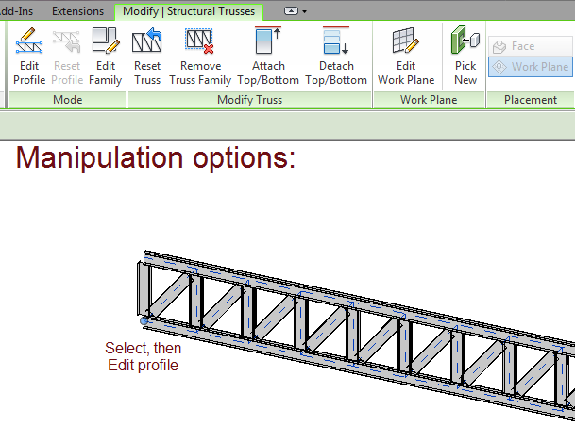
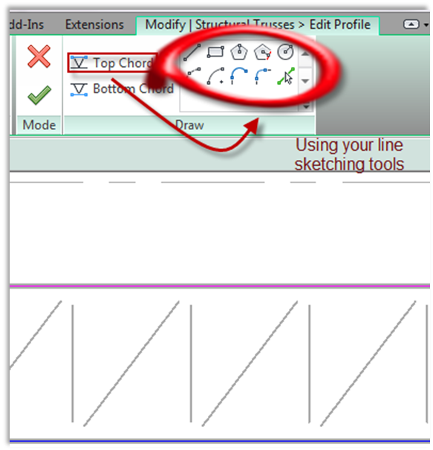
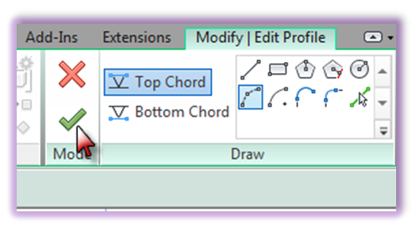
INTRO
Building the hosting wall
Placing Truss
Loading your truss
Using roof extrusion tool
Drawing profile
Attaching truss to roof
Editing existing truss
Changing truss material
Adjusting truss members
Trying it on a conceptual mass
Building your own
WRAP UP
6

Slide 8
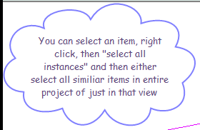
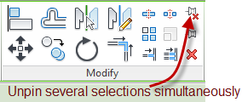
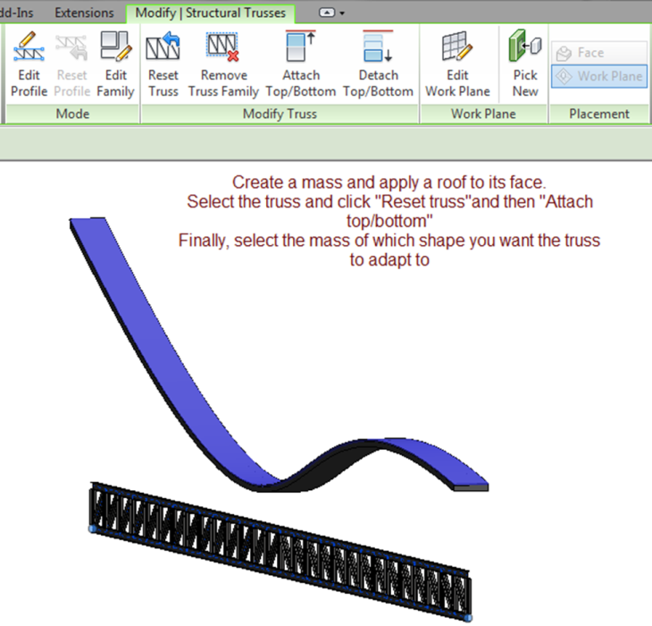
INTRO
Building the hosting wall
Placing Truss
Loading your truss
Using roof extrusion tool
Drawing profile
Attaching truss to roof
Editing existing truss
Changing truss material
Adjusting truss members
Trying it on a conceptual mass
Building your own
WRAP UP
7

Slide 9
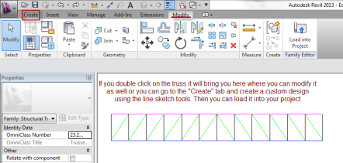
INTRO
Building the hosting wall
Placing Truss
Loading your truss
Using roof extrusion tool
Drawing profile
Attaching truss to roof
Editing existing truss
Changing truss material
Adjusting truss members
Trying it on a conceptual mass
Building your own
WRAP UP
8

Slide 10
When attaching truss to roof or mass, the truss must be entirely under (or over object.
Always make sure to be in the correct view and working plane
Pin objects to hold in place. –If you alter hosting roof or masses profile truss will change to match
When editing profile lines it may help to first create new line then erase previous one to guide origin and finishing point.
INTRO
Building the hosting wall
Placing Truss
Loading your truss
Using roof extrusion tool
Drawing profile
Attaching truss to roof
Editing existing truss
Changing truss material
Adjusting truss members
Trying it on a conceptual mass
Building your own
WRAP UP
9

