Slide 1
HOW TO CREATE A SPACE FRAME STRUCTURE
OSCAR MORALES

Slide 2
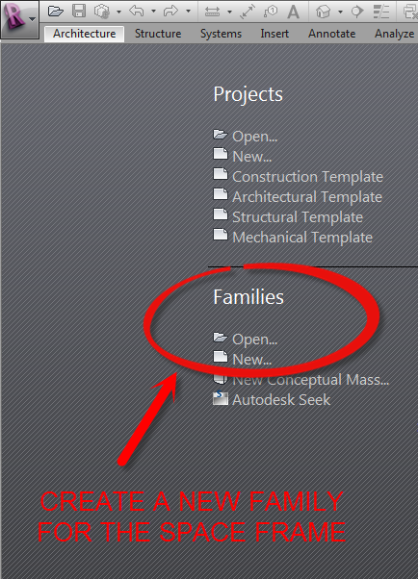
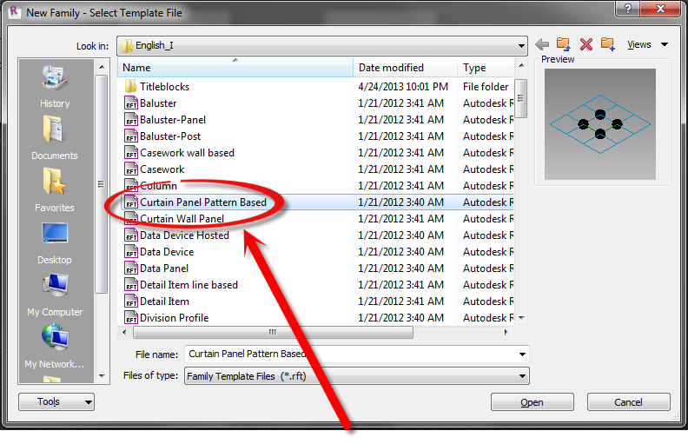
STEP 1
SELECT THE “CURTAIN PANEL PATTERN BASED” TEMPLATE

Slide 3
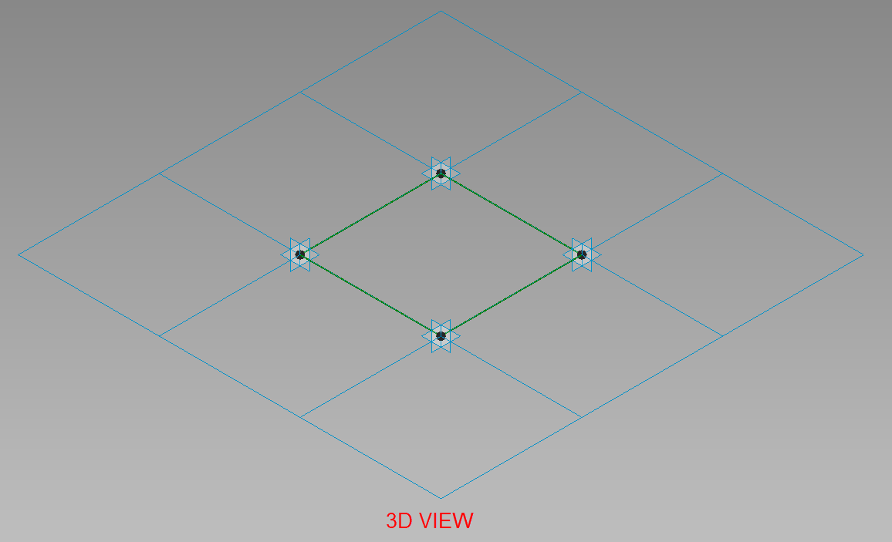
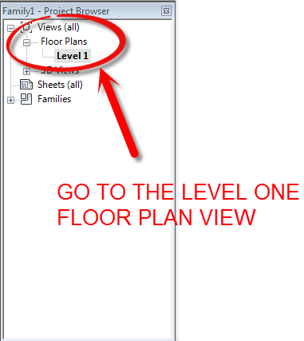
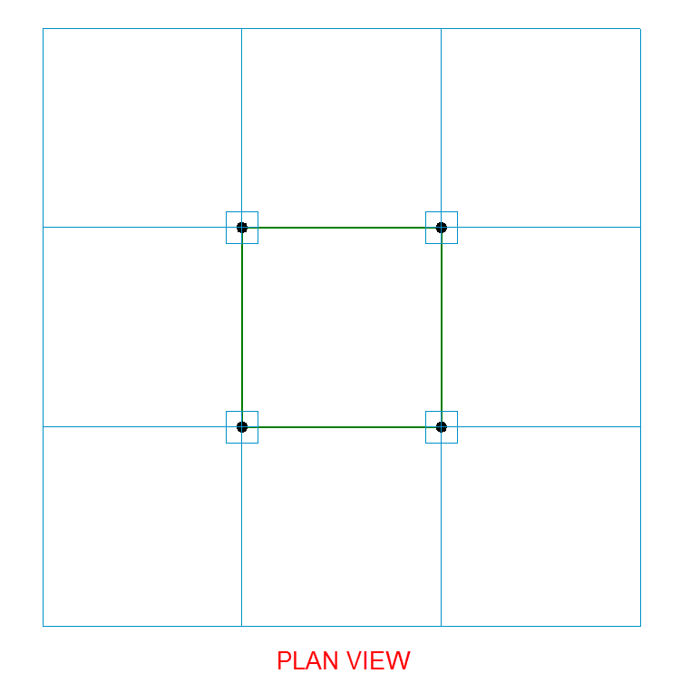
STEP 2

Slide 4
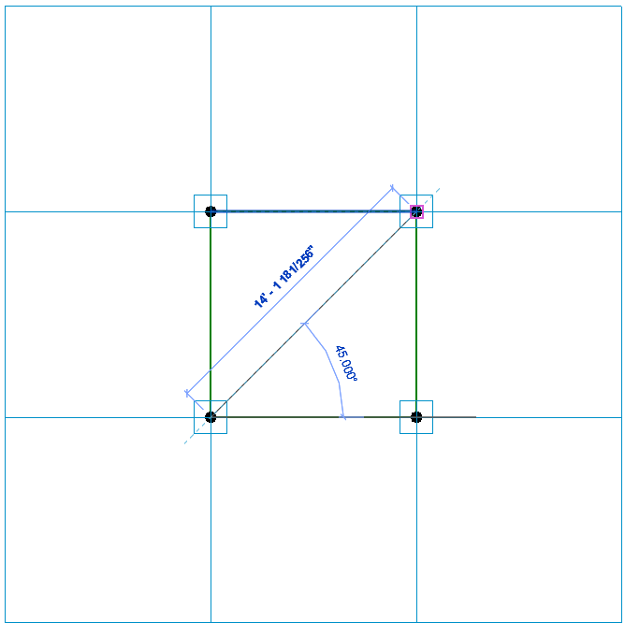
STEP 3
SELECT THE
OPPOSITE
CORNERS TO
CREATE THE REFERENCE
LINE
CREATE A REFERENCE LINE

Slide 5
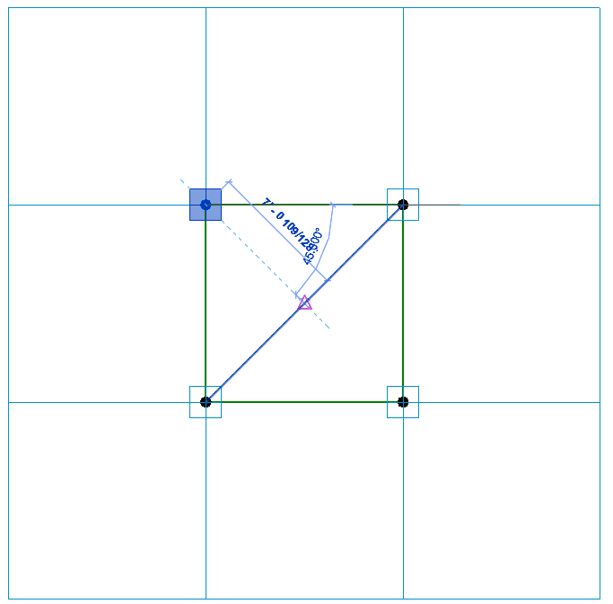
STEP 4
COPY
COPY ONE OF THE ADAPTIVE POINTS TO THE MIDDLE OF THE REFERENCE LINE

Slide 6
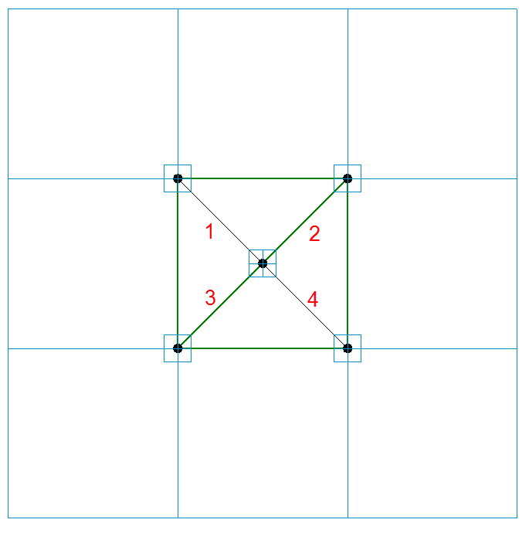
STEP 5
CREATE A REFERENCE LINE, MAKE SURE 3D SNAPPING IS CHECKED
DELETE THE PREVIOUS REFERENCE LINE AND CREATE 4 NEW REFERENCE LINE STARTING FROM THE OUTER CORNERS TO THE CENTER

Slide 7
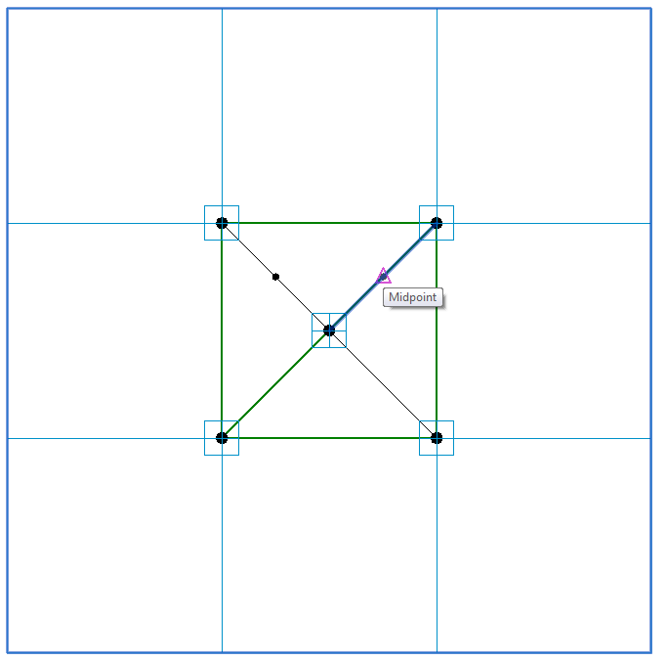
STEP 6
CREATE 2 REFERENCE POINTS ON 2 OF THE REFERENCE LINES

Slide 8
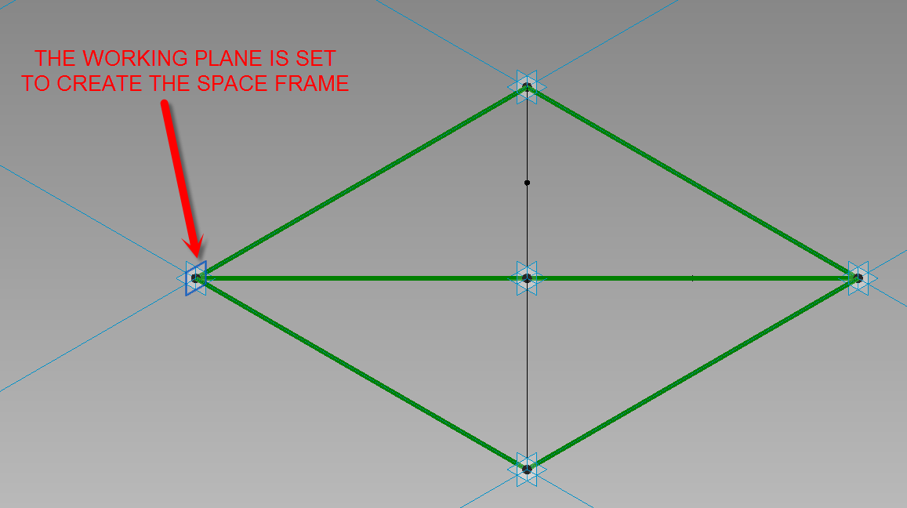
STEP 7

Slide 9
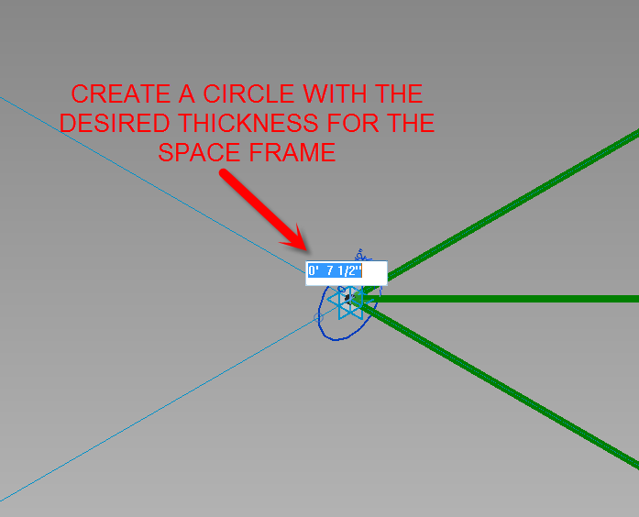
STEP 8

Slide 10
STEP 9

Slide 11
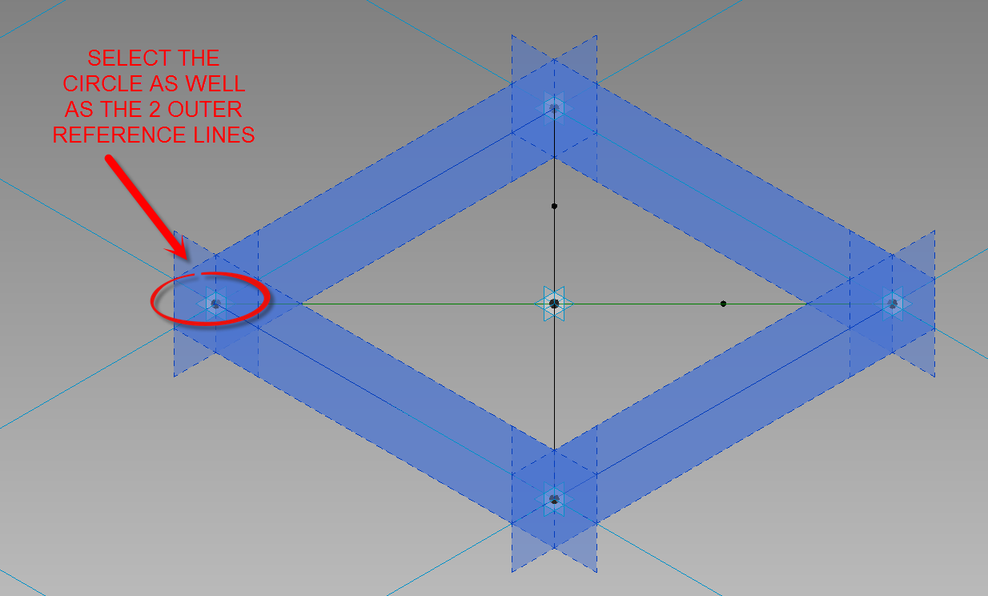
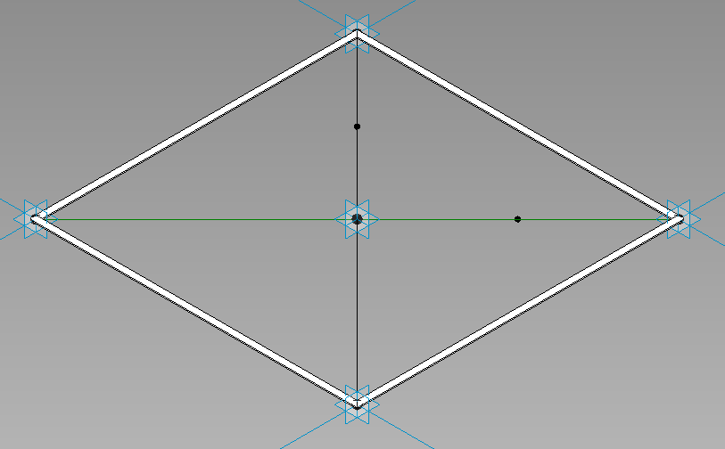
STEP 10

Slide 12
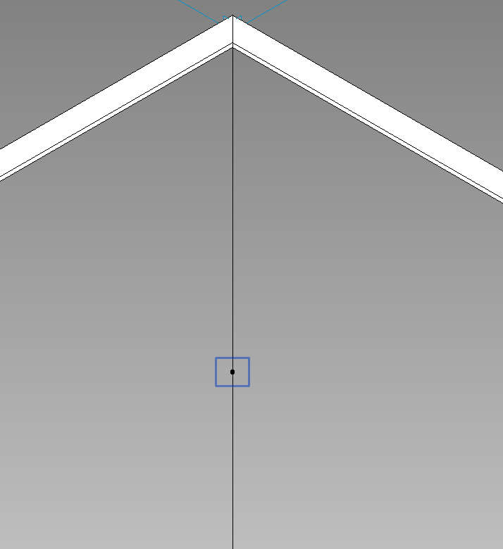
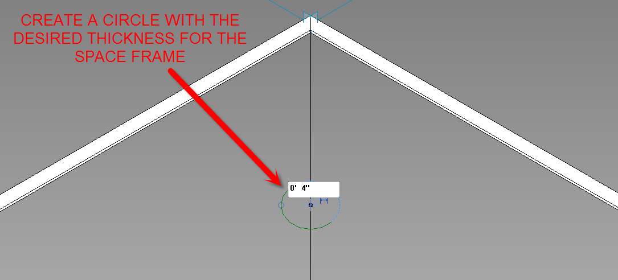
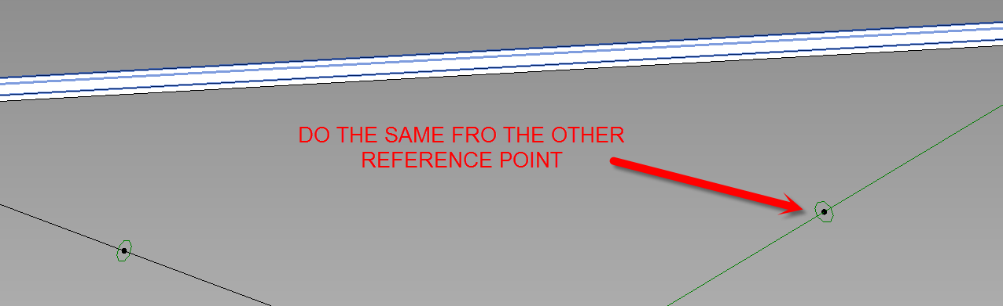
STEP 11

Slide 13
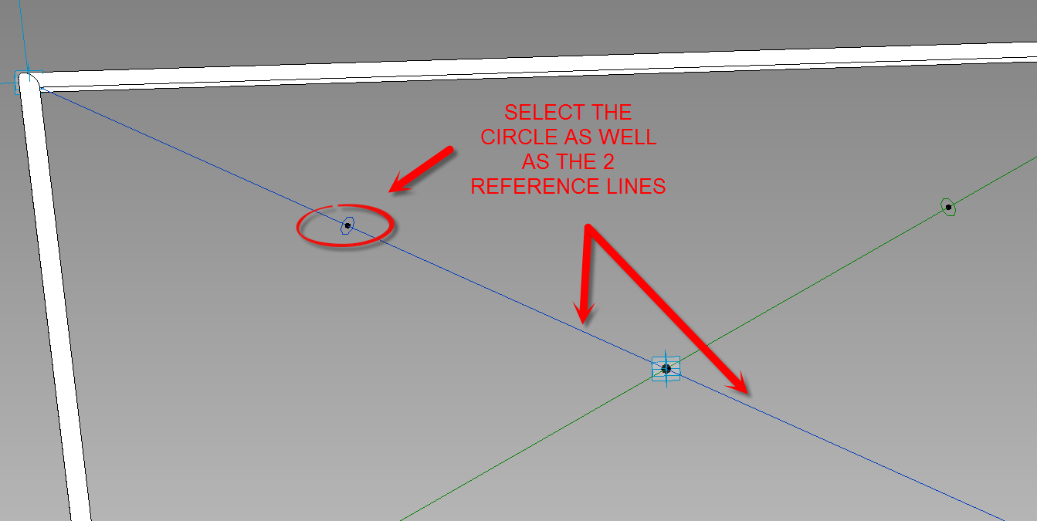
STEP 12

Slide 14
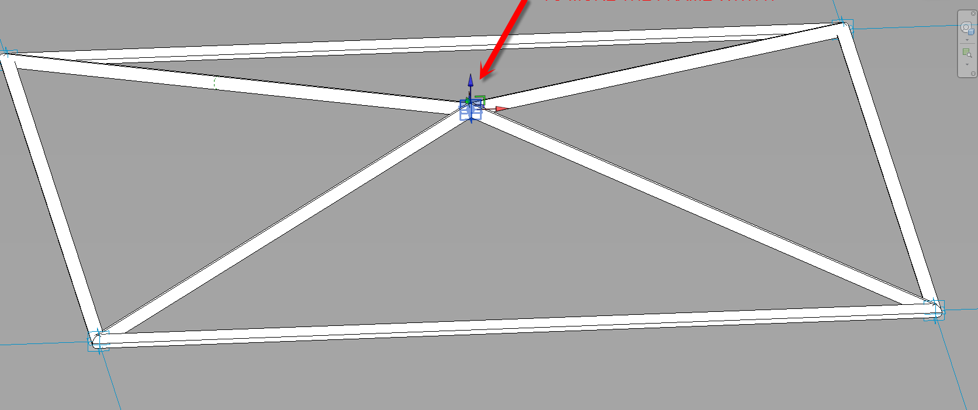
STEP 13
SELECTING THE REFERENCE POINT AND DRAGGING IT UP WILL ALLOW YOU TO MOVE THE FRAME WITH IT

Slide 15
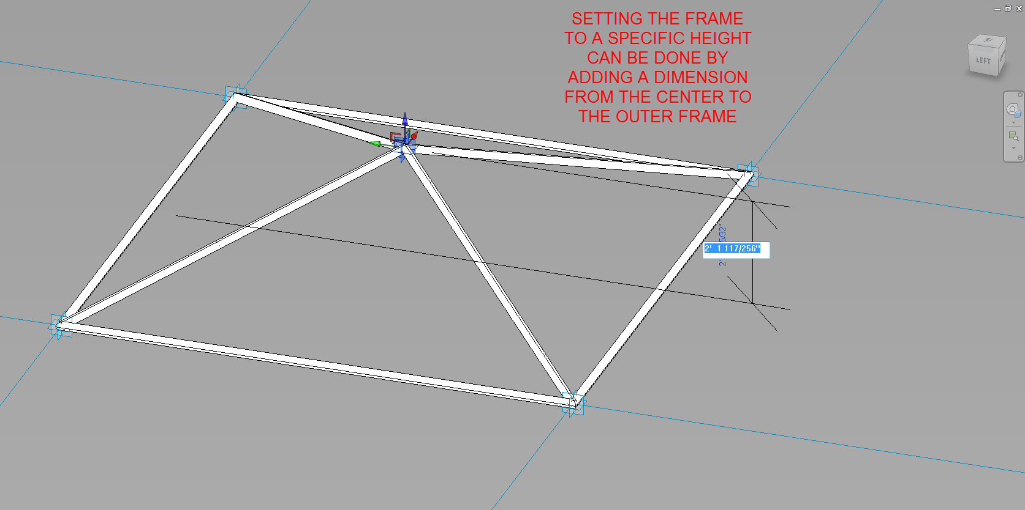
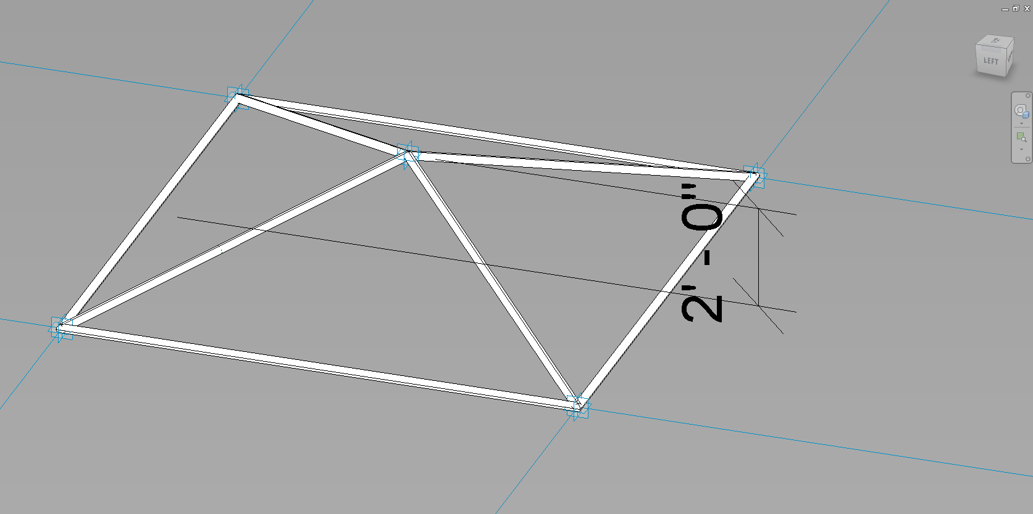
STEP 14

Slide 16
STEP 15
CREATE A SQUARE FROM MODEL LINES AS REFERENCE

Slide 17
STEP 16
USE THE OFFSET COMAND TO CRATE A GRID
CREATE A 2’ BY 2’ GRID AS A REFERENCE FOR THE SPACE FRAME

Slide 18
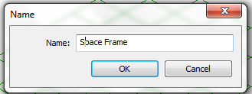
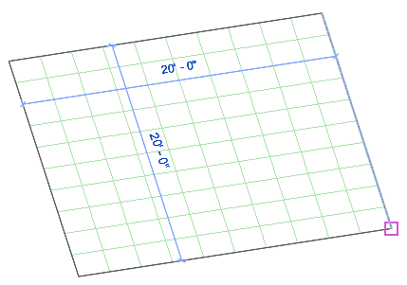
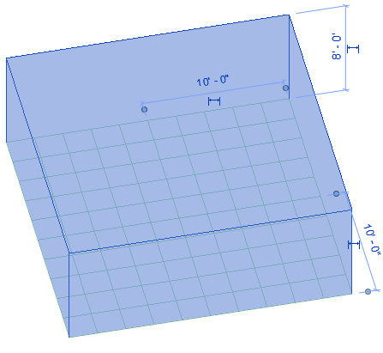
CREATE AN “IN-PLACE MASS”
STEP 16
NAME THE MASS
USE THE CREATE FORM TO CREATE THE MASSING
USE THE MODEL LINES AS A REFERENCE

