Slide 1

Pre-Lesson and First Four Hours

Slide 2
Pre-Lesson

Slide 3


Overview
Notes:
UrbanPlan is about a neighborhood called the Elmwood District in the City of Yorktown. Like many communities throughout the country, the Elmwood District, once a thriving part of town, has deteriorated. Residential and business tenants have moved away from the area, leaving vacant lots and some vacant or underused buildings.

Slide 4
The Challenge
Plan and build
You and your teammates form a real estate development company
Your company will design a plan to redevelop Elmwood in response to the City of Yorktown’s RFP
You will create a vision statement, site plan, and financial model for your plan
You will have two visits from industry experts to get feedback on your plan
Present
Your team will make a 7-minute presentation to Yorktown’s City Council
The City Council will ask you questions and you will defend your plan

Slide 5
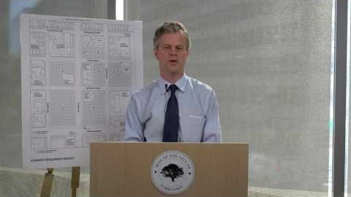
Briefing from the Mayor of Yorktown
Notes:
Now, let’s hear from the Mayor of Yorktown

Slide 6
UrbanPlan Pre-Assignments
Complete Homework Exercises 1 & 2.
No research required. No right or wrong answer.
In the next class there will be a class discussion of these questions.
Why exercise 1 & 2?
Before addressing the complex issues involved in this project, it will be helpful for you to consider some general development questions and concerns in light of your personal experience and perspectives.

Slide 7
Class 1

Slide 8
Exercise #1 Discussion
Where you live:
If you had to describe your city or town to an outsider, what would you say? What does it look like? What kinds of things can you do there? Who lives there? Who works there?
What do you think is the worst or least appealing building or place in your city or town?
What building or place do you like the best?
How much do you know about the history of your city or town? How old is it? Do you know about any major changes or developments that have taken place over time or recently?
Based on what you know of how your city or town has changed, would you say your city or town is becoming more or less of a good place to live? Why?

Slide 9
Exercise #1 Discussion
Where you want to live:
What kind of place would you like to live in? Why?
If you could make a wish list of good living conditions, what would it include? Identify at least five characteristics of a good place to live.
Do you know of any place that has more of those characteristics than your city or town?

Slide 10
Exercise #2 Discussion
What is a tradeoff?
Every decision comes with a cost.
Each decision to use a resource requires a tradeoff with another possible use for that resource (e.g., if you decide to spend $ on clothes, you will have less $ for food).
In designing your development, you will confront some difficult decisions and have to make tradeoffs.

Slide 11
Exercise #2 Discussion
There is no “correct” answer for the best mix of land uses.
Often you will need to decide whether the cost—social/political, financial, or aesthetic—of a decision will be worth the benefit it will bring to the City and its residents.
Aesthetic/ Design
Social/ Political
Financials

Slide 12
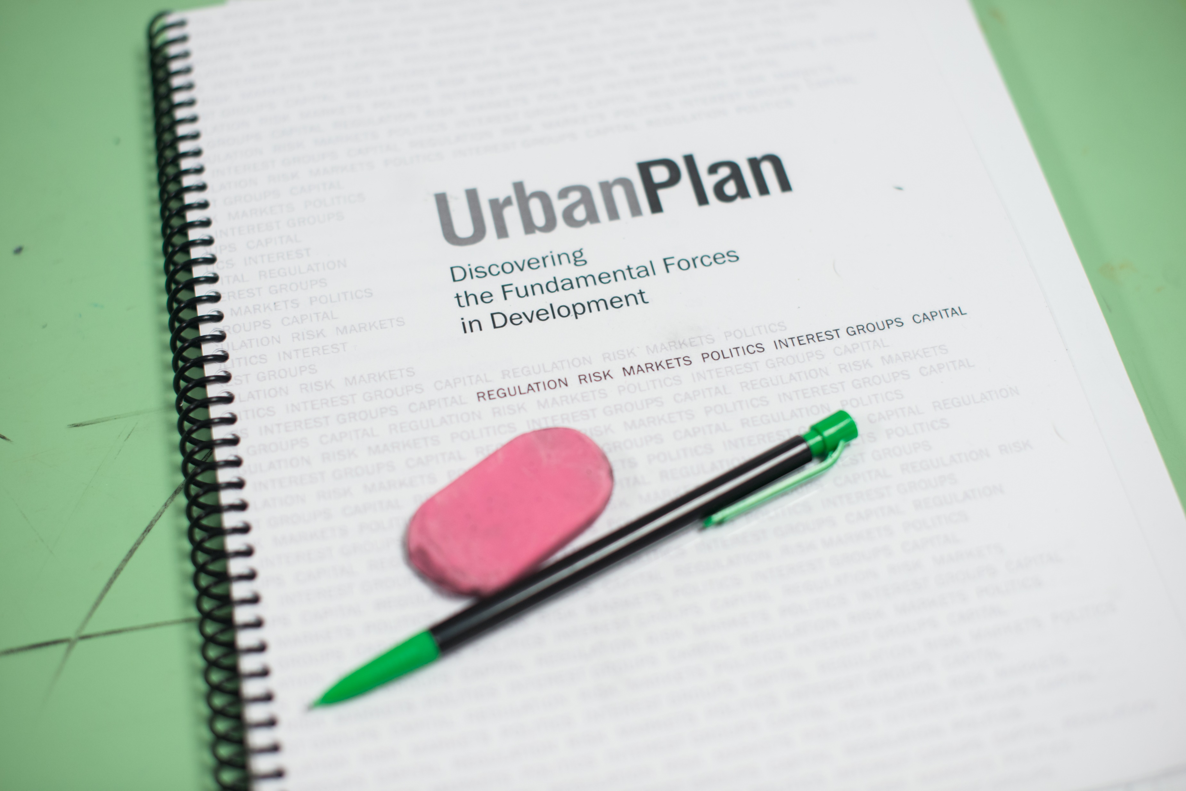
Intro to UP Handbook and Guided Reading
Open handbook to page 1 in the About UrbanPlan section. Let’s read the “Overview”.
Your homework will be Exercise #3, Questions 1-21. Where would you find the answers to the first three questions?
Why does the City need a private developer
to propose and build the Elmwood project?
What is “due diligence” and why is it
important?
What makes large, mixed-use infill projects
so risky?

Slide 13
Homework for Next Class
From the UrbanPlan Handbook:
  Read the entire section About UrbanPlan
  Look at the Site Plan tab
  Read the RFP. (Consult this section throughout the entire project. It has an immense amount of important information.)
  Read the Design Guidelines
Guided Reading Homework Exercise 3, Questions #1 to #21:
  Respond in writing based on the assigned readings.

Slide 14
Observation Paper
Due in a week. If you cannot go out and walk in different neighborhoods, use your memory and/or tools such as Google Earth to answer the questions below.
Pick a neighborhood that you are familiar with and answer:
What do the buildings look like? Are they old or new? Or both?
What is parking like? What about streets and traffic flow? Are there normally lots of people, bikes, cars?
What people occupy which areas? Which streets feel 'fun?' 'boring?' 'active?'
What behaviors are occurring? What time of day is it? What types of trees and landscaping exist?
What is the state of the infrastructure? The sidewalks?

Slide 15
Class 2

Slide 16
Class Hour 2
Watch Edutopia Video: Developing Minds – UrbanPlan (10 min.) https://www.edutopia.org/developing-minds-urban-planning-project-video
We will dedicate the rest of the class to the review of Exercise 3 and we will have a guided tour of the handbook.
Students will be assigned to their teams. Some roles may be shared if there are groups with more than 5 students.

Slide 17
RFP: Primary Goals Goals
  Remove blighting influences
  Generate tax revenues for the City
  Create employment opportunities
  Attract retail businesses
  Create housing to meet the needs of mixed-income groups
  Create affordable housing
  Create or preserve public and private amenities
  Preserve legally designated historic sites

Slide 18
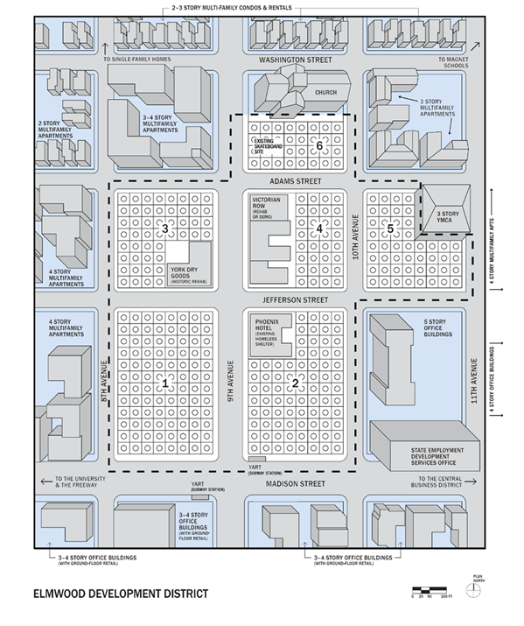
Elmwood Site Plan
  5.5 block area
  11.75 acres
  Entire area must be built
  Note context around Elmwood

Slide 19
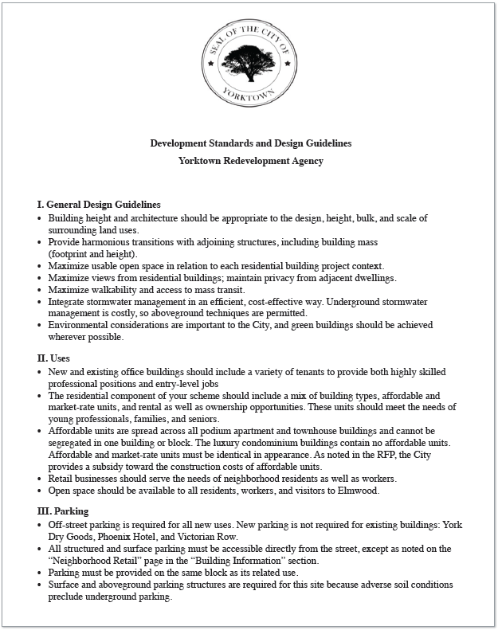
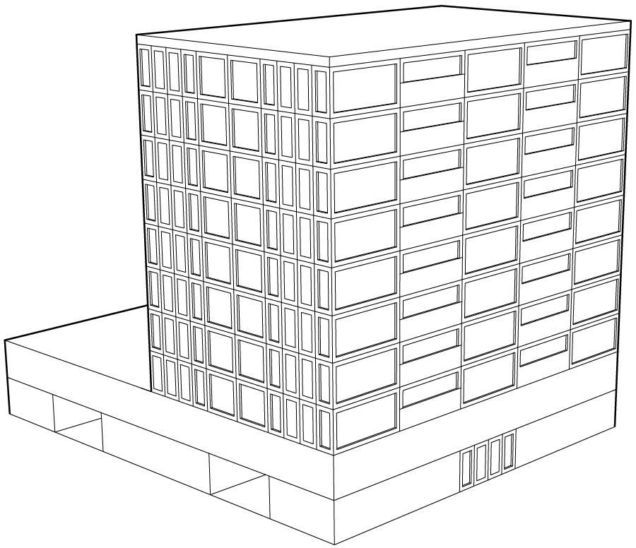
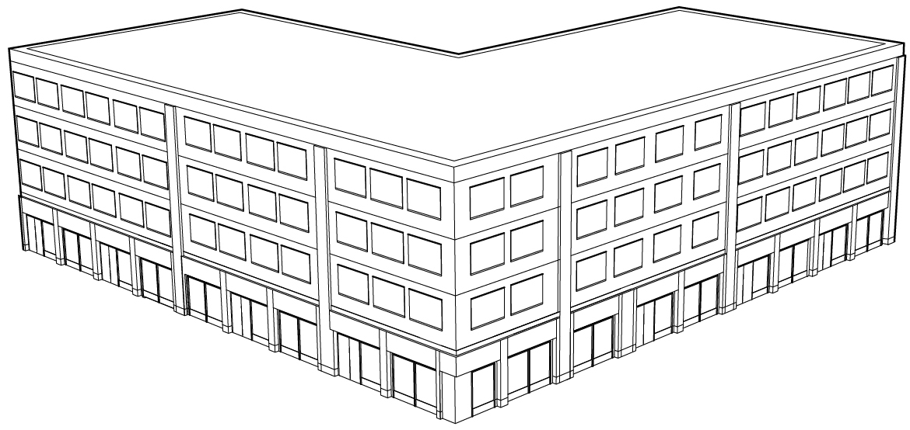
Design Guidelines

Slide 20
Neighborhood Group Letters

Slide 21
Community Interest Group Letters

Slide 22
Homework for Next Class
From the UP Handbook:
  Read the Neighborhood and Non-Neighborhood Letters
  Finish Exercise 3, Questions #22 to #26. Provide written responses.
  Read descriptions under tabs for each development team role
  Under the About UrbanPlan tab, read:
    Strategies & Tactics for Success
    Creating an Effective Development Team, and
    Understanding Your Investors

Slide 23
Class 3

Slide 24
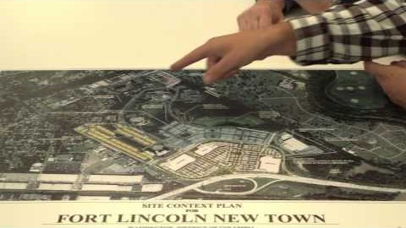
Roles Video

Slide 25
Role Briefings
Decide amongst your teammates who will assume each development team role:
  City Liaison
  Financial Analyst
  Marketing Director
  Neighborhood Liaison
  Site Planner

Slide 26
Class Hour 3
Discuss questions #22 to #26 in Exercise 3
Do Exercise 4: Pre-Building Basics
  Each team answers the questions working cooperatively with your teammates (30 minutes)
Exchange contact information with your teammates so you can text or email to work together outside of class or reach each other if one of you is absent from class

Slide 27
Homework for Next Class
Review the questions in Exercise 5 that are specific to your role.
  You will meet with classmates from other teams who have that role tomorrow in class.
  Come to class prepared to discuss and write the answers to the questions for your role.
Watch the UP Roles video: https://youtu.be/wGp2-wAV38w
Notes:
Note that link is to same roles video that is linked at the beginning of Class 3. You may choose not to show it, to show it once, or to show it at the beginning of class before students pick their roles and have them re-watch just the clip for their role once the roles are assigned.

Slide 28
Class 4

Slide 29

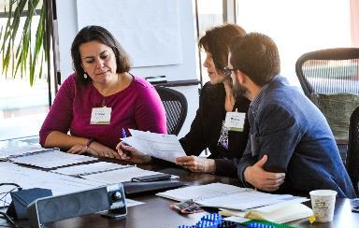
Team Roles
Reminders and Tips
  You work for your team’s development company, not for the City
  Each role needs to contribute for the team to be successful
  Different perspectives are critical to finding the best solution

Slide 30

Development Company Names
As a team, decide on a name, tagline and logo for your team’s development company

Slide 31
Class Hour 4
Students meet by roles (all Site Planners together, all City Liaisons together, etc.)
Exercise 5:
  Please discuss as a group each question and individually write the answers for your role.
  If you have not completed the assignment by the end of the class, finish it and turn it in at the beginning of our next class.
In our next class we are going to learn the financial model. All the roles – not just the Financial Analyst -- need to understand the financial model, as it provides important information to each role.

Slide 32
Homework for Next Class
From the UP Handbook:
Under the About UrbanPlan tab, review the following sections:
  Understanding Your Investors and
  Financial Analysis Model and Meeting Financial Goals
Review Glossary for definitions of words used in the Handbook and study specific words assigned by your teacher, including:
  Absorption rate, Affordable housing, Amenities, Demand, Footprint, Market forces and Non-market forces, Stakeholder and Subsidy

