Slide 1
Site Strategy Diagram: This is one sheet showing the important forces that may guide your design based on all the information gathered during site analysis. This should be a summary of what important elements that the designer believes are important to the development of the site and project. It may vary from student to student.
You may ask yourself a few questions:
How do people approach the site?
Where/What are the transportation options?
Is there parking for cars? Bicycles? Kayaks?
Where should the entrance be?
How does the sun reach the site?
Noise?
Wind?
Smells?
Neighboring activities?
Good Views? Bad View?
Eating/drinking options?
Site Strategy
ARCH 3612

Slide 2
Site Strategy Diagram: This is one sheet showing the important forces that may guide your design based on all the information gathered during site analysis. This should be a summary of what important elements that the designer believes are important to the development of the site and project. It may vary from student to student.
Site Strategy
ARCH 3612

Slide 3
Site Strategy Diagram: This is one sheet showing the important forces that may guide your design based on all the information gathered during site analysis. This should be a summary of what important elements that the designer believes are important to the development of the site and project. It may vary from student to student.
Spaces For your Project
Garbage/recycling/refuse
Mailroom
Bike storage
Storage for Tenants
Front Desk/Security
Building Offices
Storage for Maintenance/building
Laundry Room
Parking
Site Strategy
ARCH 3612

Slide 4
Site Strategy Diagram: Locate your amenities on the site plan - bubbles
Amenities: (just a list of ideas- can add different amenities as you like)
Rock Climbing
Pool
Gym
Library
Study Rooms
Music Rooms
Rec rooms
Community Rooms
Movie theater
Retail Space
Office Space
Garden Spaces
Terraces
Playground
Play Space
Site Strategy
ARCH 3612

Slide 5
Site Strategy Diagram: Housing Requirements
This is the size limits for the following apartments:
1 bedroom 600sf
2 bedroom 900sf
3 bedroom 1200sf
Your design will have a variety of all of these types. These types will be stacked 1 bedrooms over 1 bedrooms and 2 bedrooms over 2 bedrooms and 3 bedrooms over 3 bedrooms…..or staggered, or offset to create balconies….
Requirements:
Living Rooms, Dining Rooms, Bedroom must all have natural light.
Kitchens, bathrooms, closets, entry and offices do not need natural light.
Kitchens must be mechanically vented – hood over range.
Bedrooms: minimum dimension is 8′ with a minimum area of 80sf (for the first 2 bedrooms) the third bedroom may be smaller.
Lighting and air requirements: Bedrooms, Living Rooms and Dining Rooms need 10% of the area to be glazed windows. 5% must be operable.
Bathrooms: Typical bathrooms are 5’x7′ – that will accommodate a tub/shower, toilet and vanity/lavatory.
Closets are 2′ deep clear.
Site Strategy
ARCH 3612

Slide 6
Site Strategy Diagram:
Apartments need:
Entry + coat closet
kitchen,
dining area
living room
bathrooms
bedrooms
Strategies:
Try to have the short dimension of your rooms be along the window wall.
Smaller apartments will only have one side facing windows
There are only so many corners in a building for multiple sides of windows.
There is only so much perimeter of your buildings, so try to keep any space that doesn’t require natural light to be away from the window.
Try to create a module that is consistent (maybe it is a certain depth) and then the width becomes longer as you add bedrooms.
Site Strategy
ARCH 3612

Slide 7
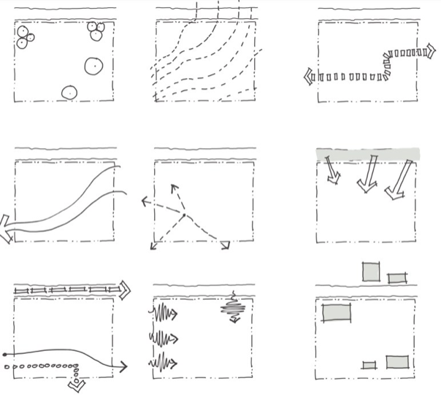
Diagram Notations- Different colors and weights can be used to denote each element. A legend or text is needed.
Site Strategy
ARCH 3612

Slide 8
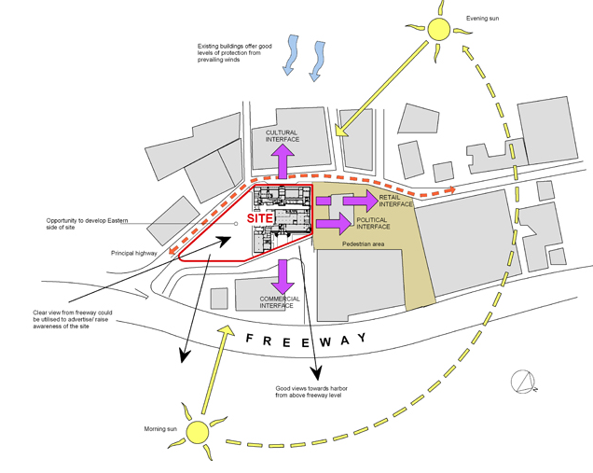
Site Strategy Diagram Example
Site Strategy
ARCH 3612

Slide 9
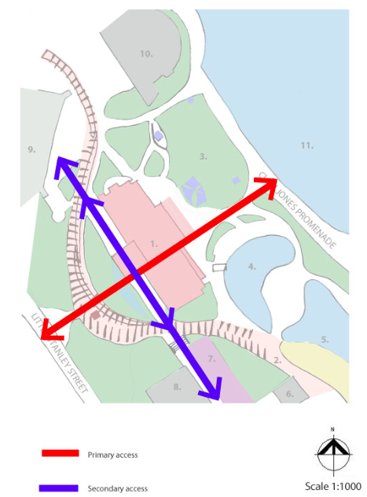
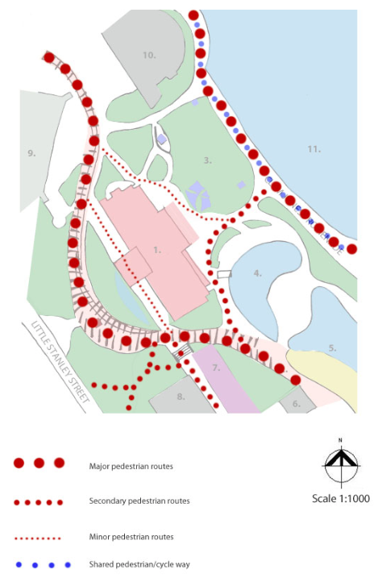
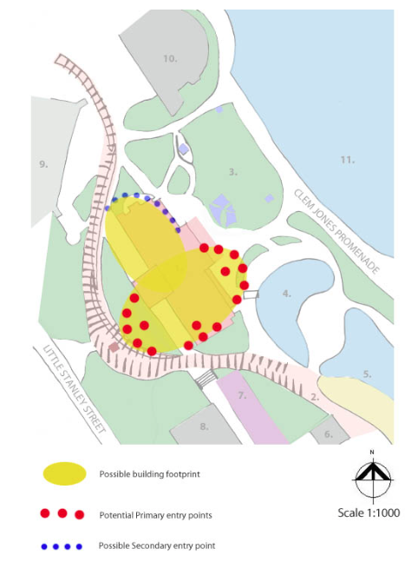
Site Strategy
ARCH 3612

Slide 10
Site Strategy Diagram: Example
Site Strategy
ARCH 3612

Slide 11
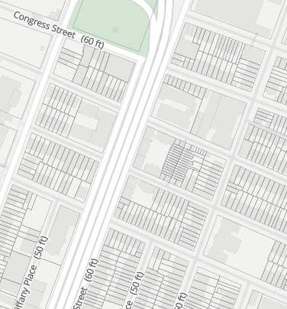
WHERE ARE:
View?
Amenities?
Crosswalks?
Parking/curbcuts –not only on your site – but blocks near by?
Walking paths?
Driving paths?
Sun/Shade?
Zoning mass?
Entrances to housing?
Entrances to amenities?
Entrances to Community Facilities?
Open spaces?
What are the open spaces?
COLOR Code your diagrams – give a legend….
BROOKLYN BRIDGE PARK
BIKE/WALKING PATH
FERRY
DOWNTOWN BROOKLYN
SCHOOL
Site Strategy Diagram: Example
SHOPPING/COURT +SMITH STREET
Site Strategy
ARCH 3612

