Slide 1
Target Tenant List

Slide 2
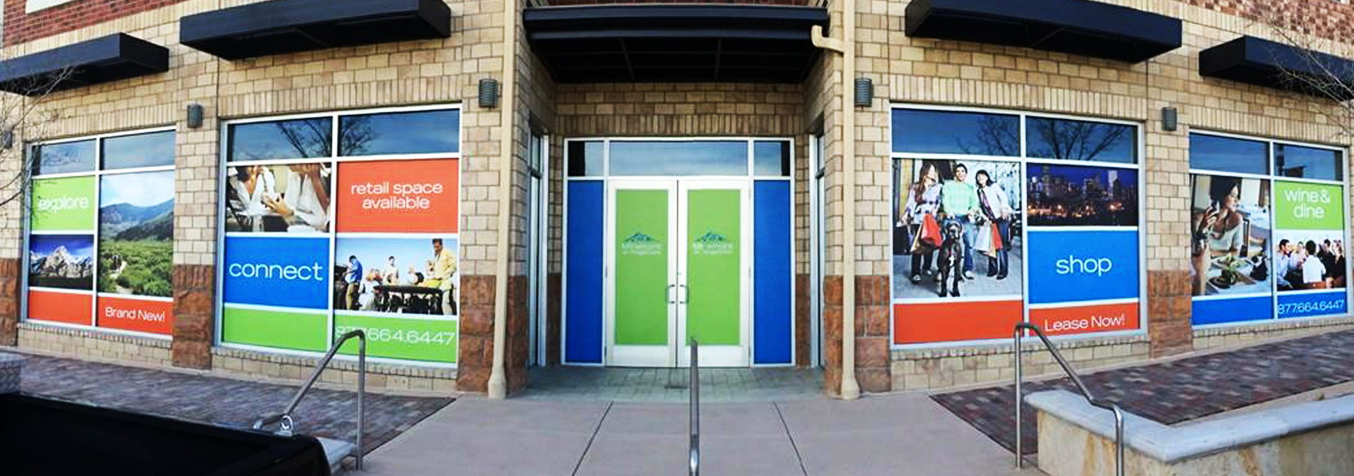
Target Tenant List

Slide 3
Target Tenant List
For each of your buildings, create a list of “target tenants,” i.e., the sorts of tenants you would like to occupy your building
If you have time, research the approximate size of those uses
Your Marketing Director should take the lead and work with the Site Planner

Slide 4
Be Mindful of Adjacencies
Be mindful of adjacencies
What sorts of tenants are good/bad adjacent (next to) each other?
If you have a building full of doctors’ offices, what use might be helpful have nearby?
What might you want near a gym?
What retail tenants would do better near a park vs near the YART station?

Slide 5
Use the Target Tenant List Template
List the desired tenants for your office, retail, residential, and community facilities
Do this for each block
Have ready for Facilitation #2 and include in City Council Packet

Slide 6
Target Tenant List

