Slide 1
PLACEMAKING
Lia Dikigoropoulou
Information taken from PPS
(Project for Public Spaces-www.pps.org)

Slide 2
Project for Public Spaces
For 30 years, the Project for Public Spaces has worked with cities and neighborhoods to help create places that attract people—places where people young and old, rich and poor encounter one another, enjoy their surroundings, and experience being part of a community. What makes these places work? Why do some parks, main streets, and other public spaces become alive with activity and fun, while others become magnets for crime or sit empty?

Slide 3
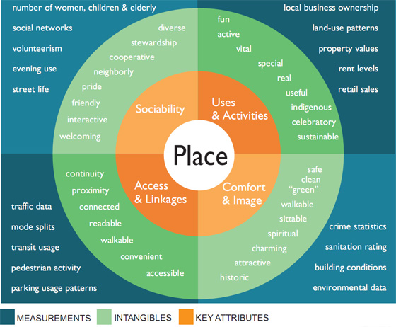
How to create a great place?
Imagine that the center circle on the diagram is a specific place that you know: a street corner, a playground, a plaza outside a building. You can evaluate that place according to four criteria in the orange ring. In the ring outside these main criteria are a number of intuitive or qualitative aspects by which to judge a place; the next outer ring shows the quantitative aspects that can be measured by statistics or research

Slide 4
Access and Linkage
You can judge the accessibility of a place by its connections to its surroundings, both visual and physical. A successful public space is easy to get to and get through; it is visible both from a distance and up close. The edges of a space are important as well: For instance, a row of shops along a street is more interesting and generally safer to walk by than a blank wall or empty lot. Accessible spaces have a high parking turnover and, ideally, are convenient to public transit.
Notes:
A great place is easy to see and easy to get to—people want to see that there is something to do, that others have been enticed to enter. On the other hand, if a place is not visible from the street or the street is too dangerous for older people and children to cross, the place won't be used. The more successful a place is, the more the success will feed upon itself. Sometimes, if a place is really good, people will walk through it even if they are headed somewhere else.

Slide 5
Questions to consider on Access & Linkages:

Slide 6
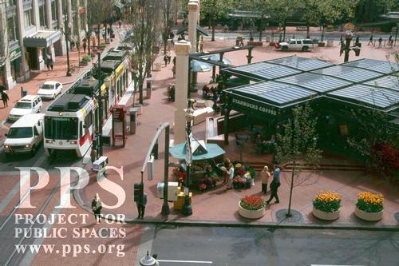
Can you see the space from a distance?
Pioneer Courthouse, Portland Oregon

Slide 7
Can people easily walk to the place?
A main street is not a highway. One should not fear crossing the street so much that the activity needs to occur in groups, as on George Street in Sydney, Australia
Crossing the street should be an easy, comfortable activity. Even if you have to wait (Paris)

Slide 8
Is there a good connection between the space and the adjacent buildings, or is it surrounded by blank walls?
The blank wall contributes nothing to the activity of the street
The area around a space is as important to its success as the design and management of the space itself. (Vancouver)

Slide 9
Are transit stops conveniently located?
Inconveniently located transit stops Bus or train stops located in places where no one wants to use them are a good recipe for failure.

Slide 10
Comfort and Image
Whether a space is comfortable and presents itself well - has a good image - is key to its success. Comfort includes perceptions about safety, cleanliness, and the availability of places to sit - the importance of giving people the choice to sit where they want is generally underestimated.

Slide 11
Does the place make a good first impression?
Are there enough places to sit?
Are spaces are clean and free of litter?
Does the area feel safe?
Do vehicles dominate pedestrian use of the space?

Slide 12
Uses and Activity.
Activities are the basic building blocks of a place. Having something to do gives people a reason to come to a place - and return. When there is nothing to do, a space will be empty and that generally means that something is wrong
Notes:
A great place starts with offering a variety of things to do in one spot. A park is good. A park with a fountain, playground, and popcorn vendor is better. A library across the street is even better, more so if it features storytelling hours for kids and exhibits on local history. If there's a sidewalk café nearby, a bus stop, a bike trail, and an ice cream parlor, then you have what most people would consider a great place.

Slide 13
Bryant Park
A great place starts with offering a variety of things to do in one spot. A park is good. A park with a fountain, playground, and popcorn vendor is better. A library across the street is even better, more so if it features storytelling hours for kids and exhibits on local history. If there's a sidewalk café nearby, a bus stop, a bike trail, and an ice cream parlor, then you have what most people would consider a great place

Slide 14
Sociability
This is a difficult quality for a place to achieve, but once attained it becomes an unmistakable feature. When people see friends, meet and greet their neighbors, and feel comfortable interacting with strangers, they tend to feel a stronger sense of place or attachment to their community - and to the place that fosters these types of social activities.
Notes:
A great place is one where people want to go to observe the passing scene, socialize, or celebrate interaction with a wide range of people who are different from themselves. It is where you arrange to meet friends, or bring visitors. When a place is working well, it encourages people to be relaxed and affectionate—the best places are full of affectionate activity, whether people are holding hands, having spontaneous friendly conversations with strangers, or sharing a kiss with a loved one. Have you ever noticed how many people are enjoying a conversation at a farmers market or on a friendly Main Street?

Slide 15
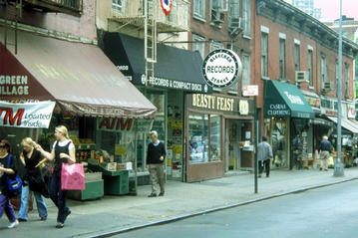
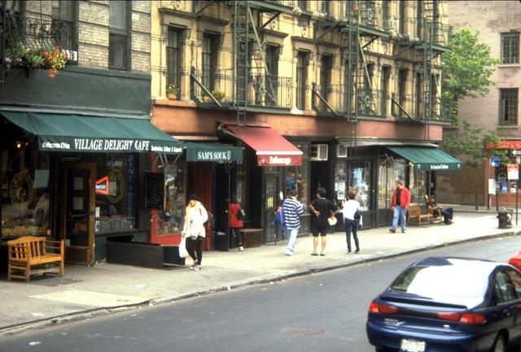
Bleecker St. NYC
Lined with restaurants, cafes and bars, the street is lively at almost all hours of the day. With a multitude of establishments, and many activities spilling out from buildings onto the sidewalks, street life is abundant. Many residents are old-timers who know one another and the shopkeepers.

Slide 16
Sometimes a great place has great beauty, or thoughtful design touches that say someone wanted you to feel welcome there. At other times, a great place works well just because it is neighborly— it draws people in and enables them to relax, talk, and watch people.
If you feel refreshed and rejuvenated after you leave it, you've been in a great place

Slide 17
Streets as Places
The overarching goal of Streets as Places is to transform the design and construction of public streets into places that improve the quality of human life and the environment rather than simply move vehicles from place to place
If a street is to become a convenient and enjoyable place, it must be looked at holistically—that is, as a distinctive environment with many different interrelated elements reflecting the character, needs and aspirations of a particular community.

Slide 18
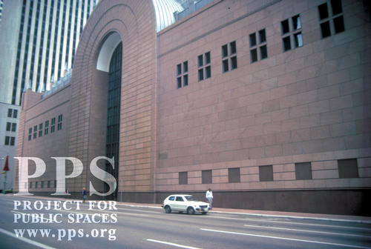
What is wrong with this street?
Louisiana Street, Houston, Texas
Notes:
The street pictured on the left is considered to be a major downtown destination of a well- known U.S. city. Yet you hardly see any people! A closer look shows why:
1. Blank walls The building facades say stay Away.� At the ground floor there are no doors, shops, services or other features that encourage public activity. 2. A wide street A vast expanse of roadway, with six wide traffic lanes, monopolizes most of the space. 3. fast moving traffic Cars pass by very quickly, which stifles any other activity on the street. 4. narrow sidewalks Although sidewalks, as their name conveys, are for walking, these sidewalk strips are simply too narrow to use. 5. overall Image The general impression here is 撤eople Beware.� Whether or not crime is really an issue, there is a sense of isolation, coupled with the very real threat posed in try- ing to walk across a street with quickly moving traffic, which makes this area feel unsafe. No wonder this street isn稚 filled with people. It is not a place.

Slide 19
What is a place?
Oslo, Norway
Notes:
1. Activity and Interest at the street level People are walking, talking, looking around, sitting, standing and going about their business in a setting where they feel like they belong. Instead of blank walls, there are shop windows displaying merchandise, people-sized doors and places to sit. 2. A comfortably scaled street This roadway is narrower than the first one pictured, with fewer lanes for traffic. 3. slow-moving traffic and on-street parking The vehicle traffic here is in balance with pedestrian activities. Drivers pull in and out of parking spaces at a leisurely pace that does not intimidate people. 4. Ample sidewalks There痴 room on the sidewalks for people to walk and for other pedestrian-friendly activities, like sidewalk cafe. 5. overall Image This street has a personality that identifies it as a special place. It is easy to cross from one side to the other, adding to the overall feeling of safety. The street above is a place that welcomes people, in contrast to the first street pictured, which is not a place at all. The first street is nothing more than a conduit for motor vehicles

Slide 20
Nostalgia
There was a time in our cities and towns when getting from here to there was a pleasant and often enriching experience.

Slide 21
The car takes over
When people describe their communities now, they refer to streets that are too wide to cross without feeling endangered by traffic, sidewalks that are too empty to feel safe, a lack of places to sit or stroll and a dearth of interesting and attractive things to look at.

Slide 22
What causes traffic?

Slide 23
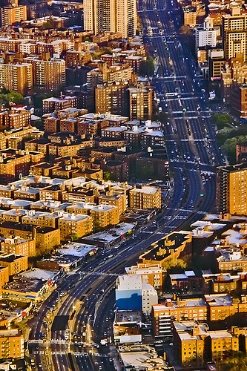
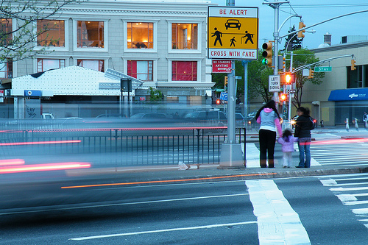
One way streets
Two-way streets are converted to one-way, or broad new one-way streets built, to allow for greater traffic flow. But people in communities now have to contend with dangerous speedways that disconnect people on one side of the street from the other
Notes:
Queens Boulevard, NY

Slide 24
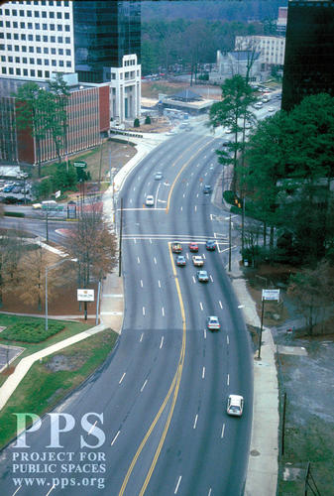
Elimination of on street parking
This adds more traffic lanes to the street and encourages more speeding traffic. It also hurts neighborhood
businesses by preventing motorists from easily stop- ping off to shop or do errands along the street.

Slide 25
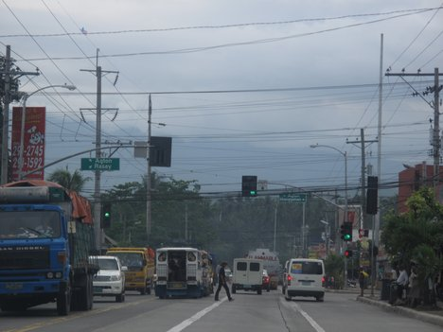
Traffic signal timing
Generally, traffic lights are synchronized, so that drivers can keep moving steadily without having to stop at red lights. This, along with a longer green time for vehicles (meaning less walk time on the signal) makes it difficult for pedestrians to get across a street

Slide 26
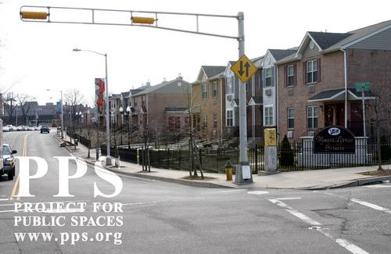
Broad corner turning curves
One can see how much easier it is for a car or truck to turn around a curve with a large radius. But anyone who has ever started to cross a street at an intersection and suddenly been con- fronted by a car whizzing around the corner knows what such a broad corner radius can mean: higher speeds for vehicles; longer crossings and less warning time to see oncoming cars (in other words, danger) for pedestrians.

Slide 27
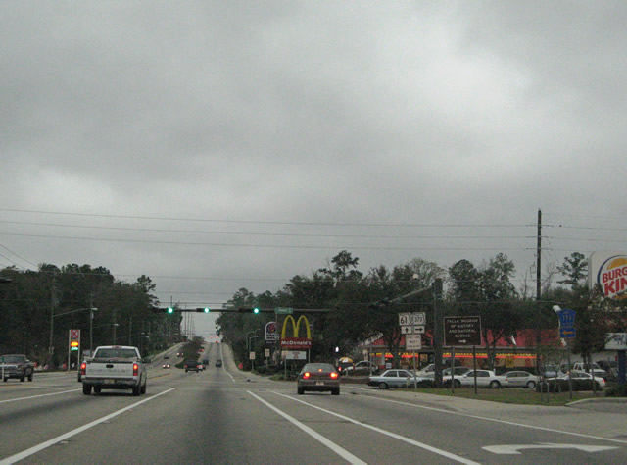
Speed limits and street design
The design of a street affects how fast motorists drive much more than the posted speed limit. The higher the speed limit,the faster motorists will drive their vehicles.

Slide 28
Traffic Calming
Traffic calming has shown a potential for helping to improve places in ways that go beyond reducing accidents, pollution and noise.
By reclaiming space from vehicles, traffic calming provides an opportunity for greening and other community enhancements.

Slide 29
Traffic Calming tools

Slide 30
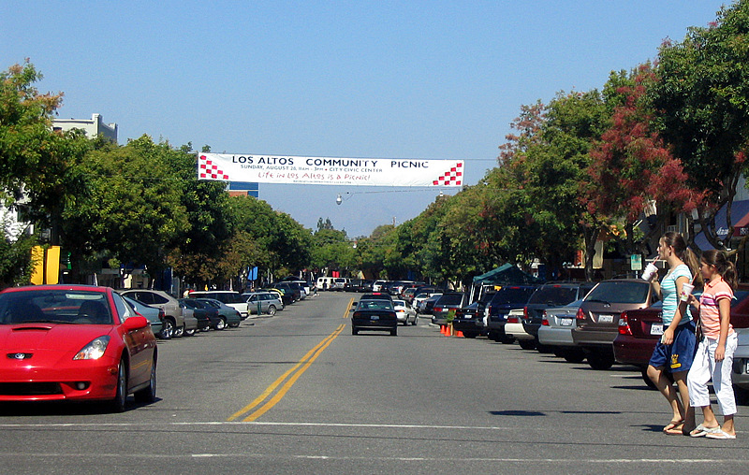
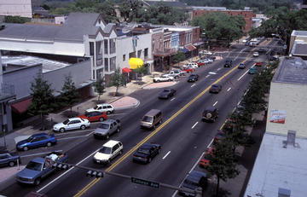
Diagonal Parking
Merchants like diagonal parking, because it can add as much as 40 percent more parking space than parallel, making it easy for people to stop and shop
Notes:
Cars park diagonally, jutting out from the curb, rather than parallel to it. The benefits:
*
Simple and inexpensive
*
Changes both the perception and the function of a street
*
Shortens the "peering distance" for people crossing the street
*
Drivers pulling out must be alert to approaching traffic
*
Oncoming drivers must be alert to the cars pulling out
*
All of this added driver awareness creates more awareness of pedestrians
*
Can add up to 40% more parking space than parallel parking

Slide 31
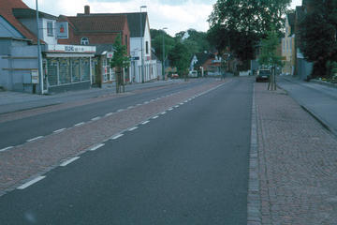
Converting One-Way to Two-Way Streets
Two-way streets calm traffic and also eliminate the need to drive blocks and blocks out of the way or make extra turns to get to nearby destinations.
Notes:
benefits:
Less driving, less confusion, and better traffic access
Eliminates the need to drive blocks and blocks out of the way
No need to make extra turns to get to nearby destinations
Drivers can get directly to their destination
Increases commercial traffic and business
Decreases the speed of traffic

Slide 32
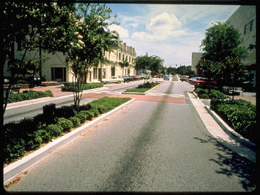
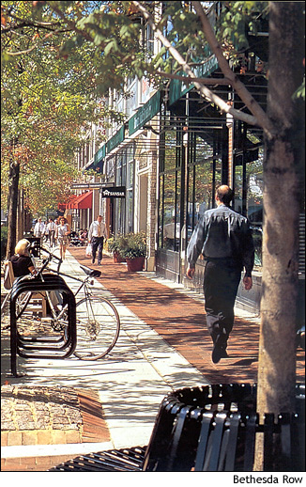
Widening Sidewalks/Narrowing Streets and Traffic Lanes
These techniques provide a flexible way to take back space from the street for non-motor-vehicle uses. Traditional traffic engineering calls for 12- to 13-foot lanes, citing "traffic safety" standards - but newer evidence shows that lanes as narrow as nine feet can still be safe for driving.
Notes:
Narrowing lanes and to widen sidewalks eases crossing for pedestrians and gives them more space to walk.
Lanes can also be removed from serving traffic and designated for busses, trolleys, or other types of transit.
Traffic lanes can be transformed into bicycle lanes.
All street lanes can be narrowed together to create more room for non-auto uses.
Vertical elements like trees or bollards further reduce the "optical width" of a narrowed street, thereby discouraging speeding.

Slide 33
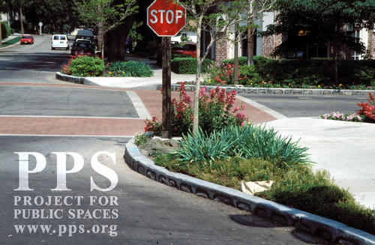
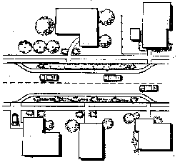
Bulbs - Chokers - Neckdowns
Interchangeable terms for sidewalk extensions in selected areas - such as at intersections or at mid-block - as opposed to a full sidewalk widening
Notes:
Provide a haven for pedestrians waiting to cross the street
Shorten the crossing distance
Define parking bays
Deflect through traffic at a corner
Function as entry points
Provide space for amenities and enhancements (e.g. kiosks, trees, lighting)

Slide 34
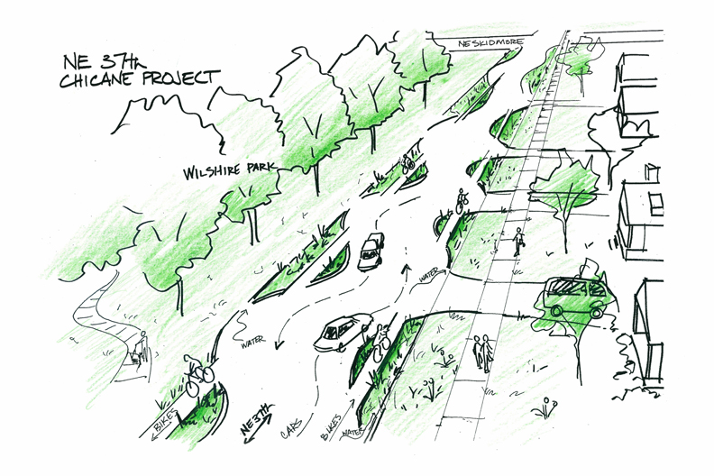
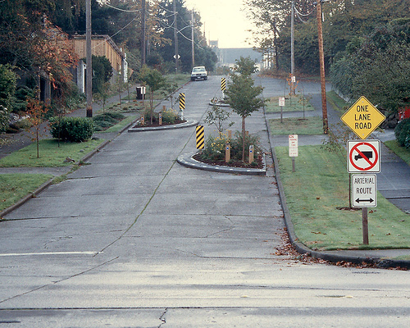
Chicanes
Sidewalk extensions that jog from one side of a street to the other to replicate such a circuitous route. Chicanes work best when the roadway is narrow.
Notes:
Narrow, curving roads encourage motorists to drive more slowly and carefully
An undulating path interrupts any clear view ahead and compels drivers to slow down
Chicanes can be formed using sculpture, plantings and parking to enhance the appearance and function of a street
Diagonal parking and parallel parking can be alternated to create a chicane effect.
Chicanes are best used on narrow roads, to prevents cars from swinging out to maintain their speed around the bends.

Slide 35
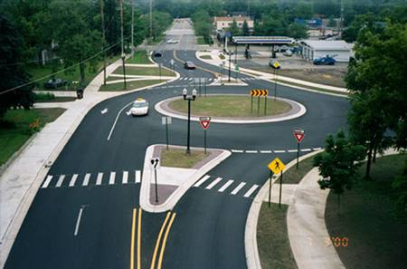
Roundabouts
Large, raised, circular islands at the middle of major intersections, around which all oncoming vehicles must travel until reaching their destination street, where they then turn off
Notes:
Create a "calmed," steady flow of traffic
Reduction in conflict points, which can lead to fewer accidents
Traffic signals are not customarily required (although traffic control signs are prominent)
Streets narrow as they approach the roundabout, and crosswalks are installed on these approaches - thereby slowing oncoming vehicles and giving pedestrians a safe, obvious opportunity to cross
Enhanced with fountains, sculpture or attractive landscaping, the island can serve as a striking gateway
A sloping ramp around the perimeter of the raised island allows buses, trucks and other large vehicles to maneuver the continuous curve while still maintaining a lowered speed.

Slide 36
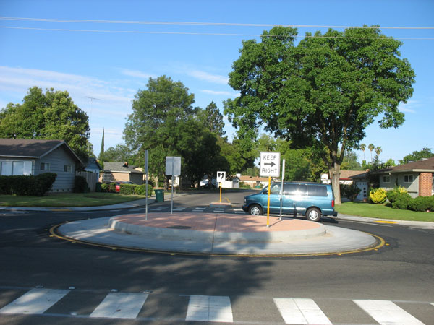
Traffic Circles
Essentially "mini-roundabouts" designed for small intersections, often used to slow traffic from a wide street into a smaller local street.
Notes:
*
Help to slow down traffic in neighborhoods and remind drivers that they must proceed carefully
Help to sustain lowered vehicle speeds when they're used in a series
Provide an opportunity for community activity in residential areas, where citizens can create plantings or add other enhancements

Slide 37
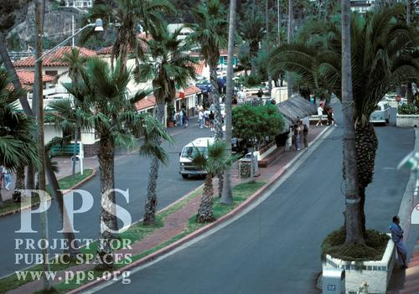
Raised Medians
Elevated islands parallel to traffic lanes down the middle of the street, as on a boulevard
Notes:
*
Curtail vehicle space
Provide a safe in-between refuge for pedestrians as they make their way across the street, split up a lengthy curb-to-curb distance (especially helpful for people who cannot move quickly)
Provide ideal locations for trees, flowers, sculpture and other amenities

Slide 38
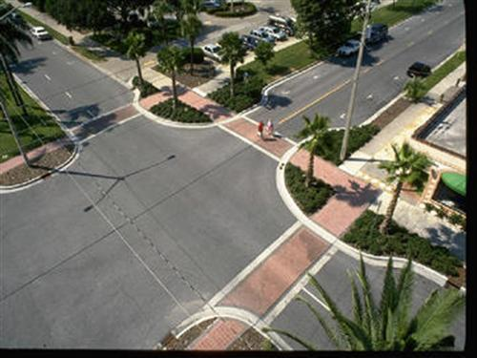
Tight Corner Curbs
Reducing a corner radius to somewhere between one and twenty feet can:
Inhibit the speed of turning vehicles
Give pedestrians a better chance to see and be seen by approaching traffic
Add sidewalk space, thereby shortening the distance to the other side of the street

Slide 39
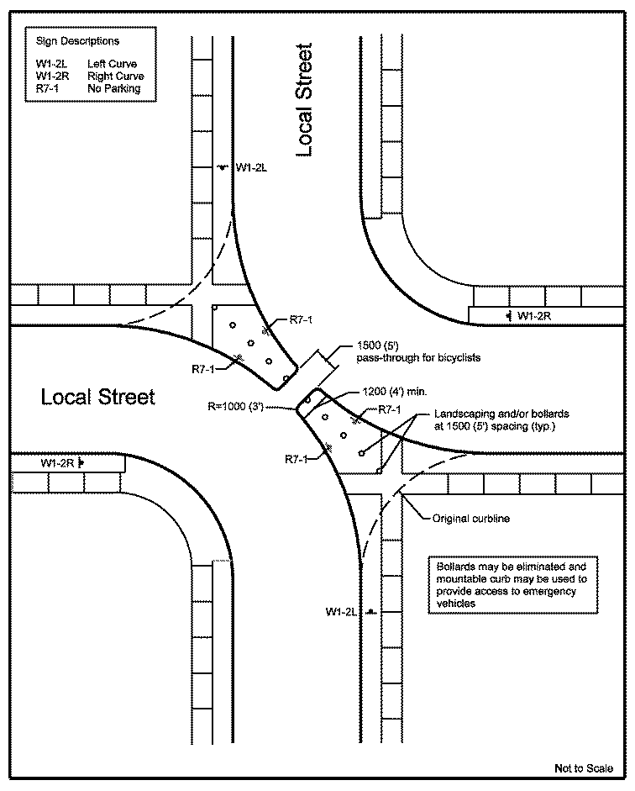
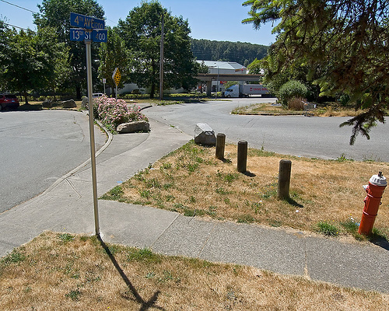
Diverters
These physical barriers redirect traffic heading for a certain street onto a different course, reducing vehicle overload on vulnerable (usually residential) streets overrun by through traffic looking for shortcuts
Notes:
Diagonal Diverters traverse an entire intersection, actually creating two unconnected streets that each turn sharply away from one another.
Semi-Diverters restrict traffic in one direction to prevent entrance to a street, while permitting traffic to pass through in the other direction.
Although they effectively reduce traffic volume, diverters must be part of a comprehensive improvement scheme or else they can end up simply displacing congestion

Slide 40
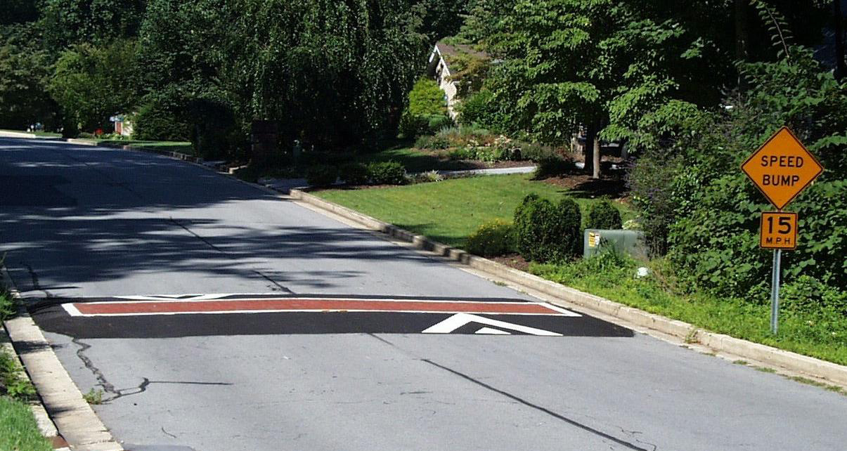
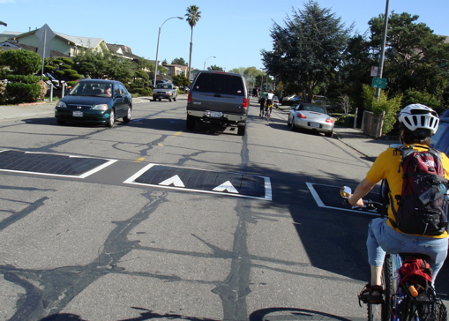
Road Humps-
Road humps (or "speed humps") are rounded mounds, approximately 3 inches high and 10 to 12 feet long. They effectively slow down traffic to 15-20 mph without making drivers uncomfortable. For optimum speed reduction, road humps need to be placed at frequent, designated intervals based on the street's dimensions, to minimize the tendency to accelerate between them. (Humps are not to be confused with the speed bumps, which are usually at least 5-6" high and less than three feet long.)
Notes:
Speed bumps to the right

Slide 41
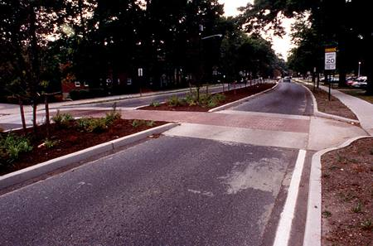
Speed Tables
Speed tables are road humps that are flat on top and sometimes slightly longer. They are the same width as the street and rise to meet the grade of the sidewalk, providing safe and comfortable crossings for walkers and wheelchairs (and greater access for snow clearance than road humps). One benefit of speed tables is that people cross at the point where drivers decrease speed.

Slide 42
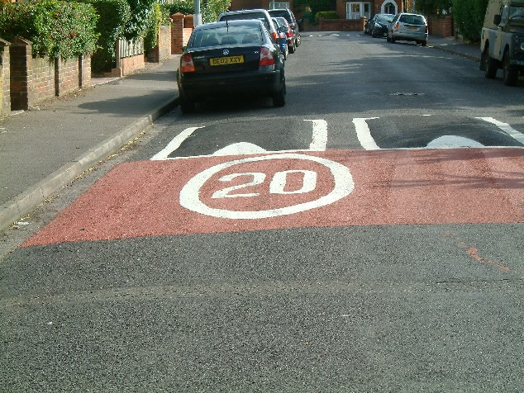
Cushions
Cushions cover only part of the width of the street to allow passage for emergency vehicles, buses or other large vehicles, and bicycles; they are usually placed at varying intervals to respond to the need to channel the wheels of larger vehicles, while still providing hurdles wide enough to slow standard-sized vehicles

Slide 43
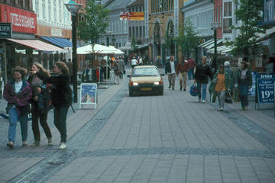
Rumble Strips and Other Surface Treatments
The rumble strip provides visual and aural cues to alert drivers to areas that require special care .

Slide 44
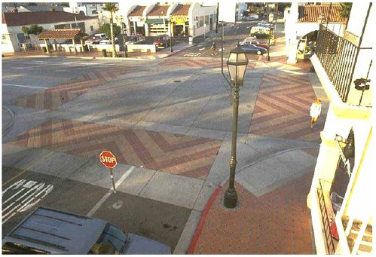
Changes in pavement color and texture
These paving treatments also: delineate and create awareness of a pedestrian crosswalk or haven; make a street appear narrower than it is to deter speeding; define a street from a sidewalk or a parking lane.

Slide 45
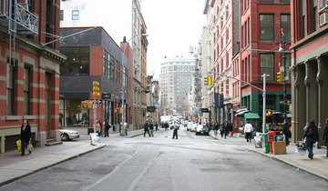
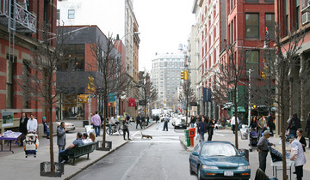
Putting it together
Traffic calming, in partnership with a variety of Placemaking elements, can improve the livability of many types of urban and town environments
Notes:
Traffic-calming tools outlined above can be effective in a variety of ways.However, each tool has its own specific applications, and not every one fits every single circumstance. Some tools are more effective if used in combination with each other, or with alternative transportation approaches like bicycles, buses or light rail. The right use hinges on existing conditions along a street and the desired outcomes. The following is a sampler of issues that need to be considered when making traffic calming choices
NYCity street before and after

Slide 46
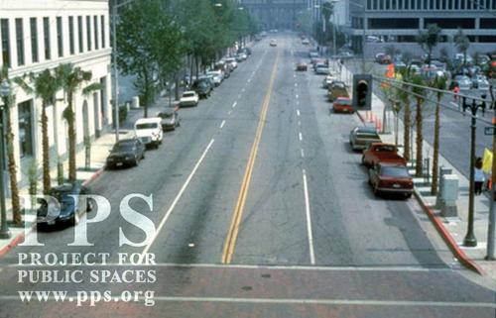
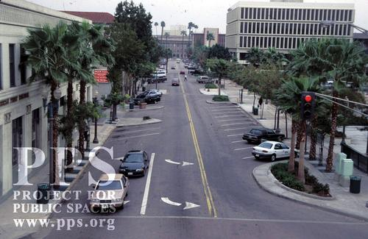
San Bernardino Street, California
Before and after

Slide 47
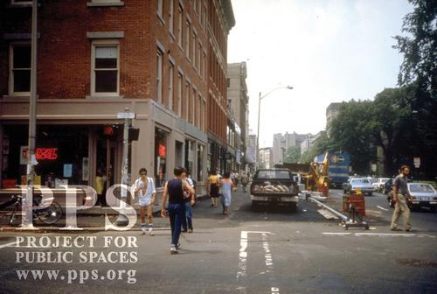
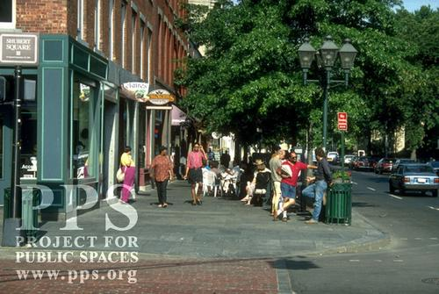
Chapel street , New Haven CT
Before and After

Slide 48
Public Space Bill of Rights
Walk and stroll in comfort
Sit down in nice, comfortable places
Meet and talk by chance and by design
Enjoy pleasant places to go to and comfortable places to stop
Look at attractive things along the way
See places that are interesting
Feel safe in a public environment
Enjoy other people around them

