Slide 1
Specifications
According to the Dictionary of Architecture & Construction a specification is, “a written document describing in detail the scope of work, materials to be used, methods of installation, and quality of workmanship for a parcel of work to be placed under contract; usually utilized in conjunction with working (contract) drawings in building construction.”

Slide 2
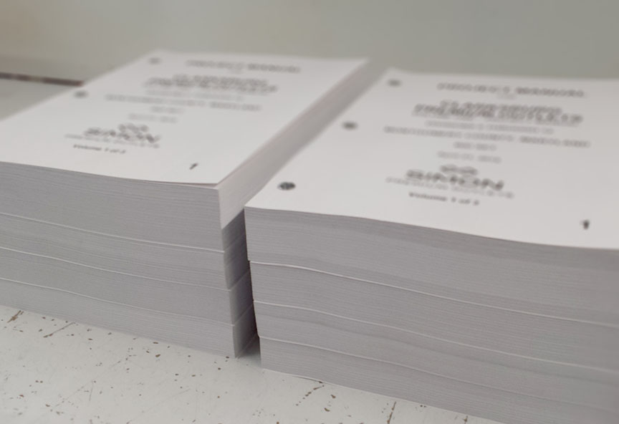
What are Specifications?
Specifications are a part of the Contract Documents that define the scope of work for the Contractors. They are written, rather than drawn, documents that define the technical information of products and their installation procedures.
Drawings =graphic representation of the work,
Specifications = the instructions of what pieces need to be purchased and any associated installation requirements.

Slide 3
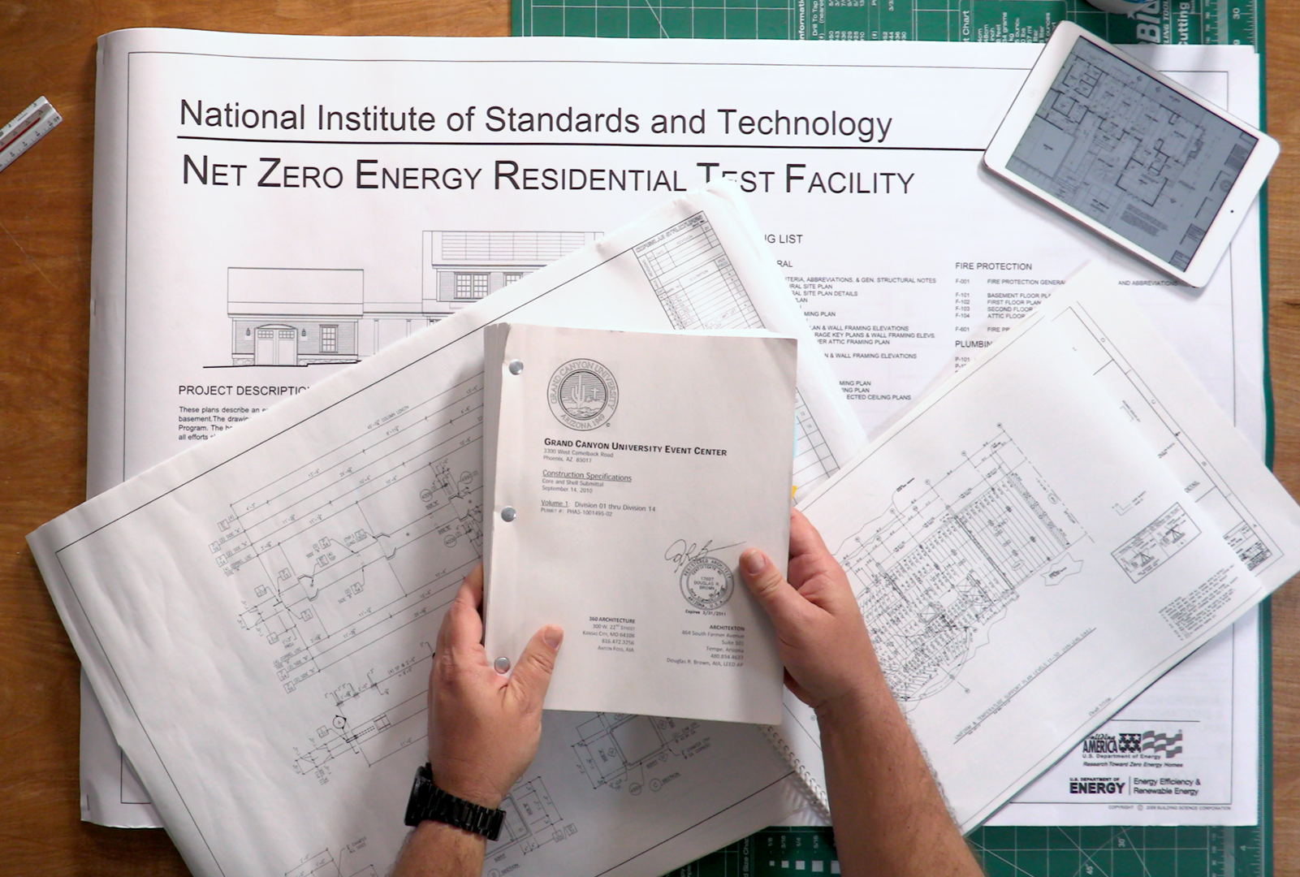
How Important are Specifications?
Specifications are just as important as Drawings to the success of a project.
They are weighted equally with drawings in terms of their importance to a set of Contract Documents.
This is both the case for their importance in a Court of Law and in terms of how the information is conveyed to the Contractor.

Slide 4
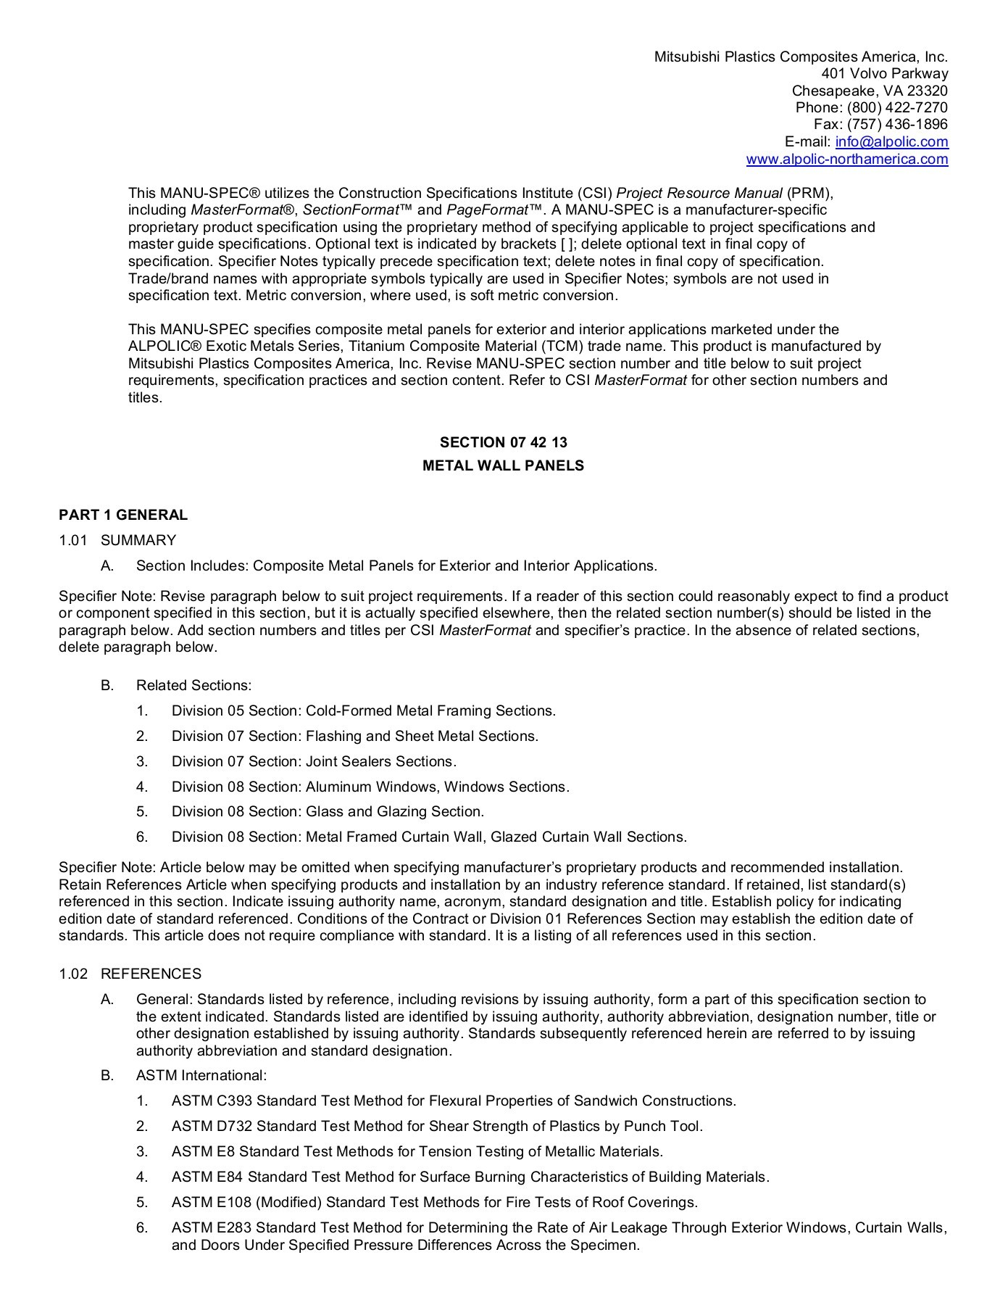
What is the structure of specifications?
Part I is called ‘General.’ This is the section where you define the administrative procedures and list any related Specifications that deal with the product you’re specifying. Think of this as the introduction.

Slide 5
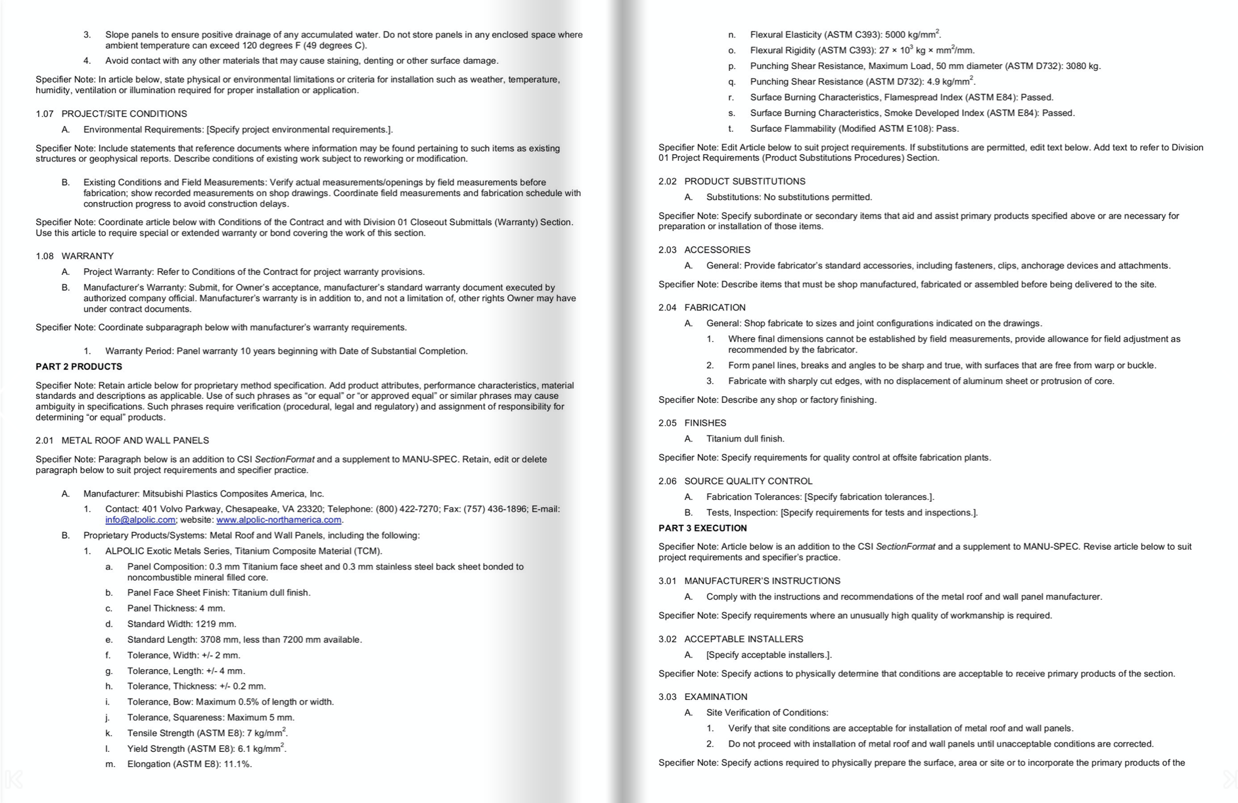
Part II is called ‘Products.’ This is the section where you define the quality and components required. Think of this as the technical information of the product itself.

Slide 6
Part III is called ‘Execution.’ This is the section where you define the preparation and installation requirements for the product. Think of this as the instruction manual of how the product must be installed.

Slide 7
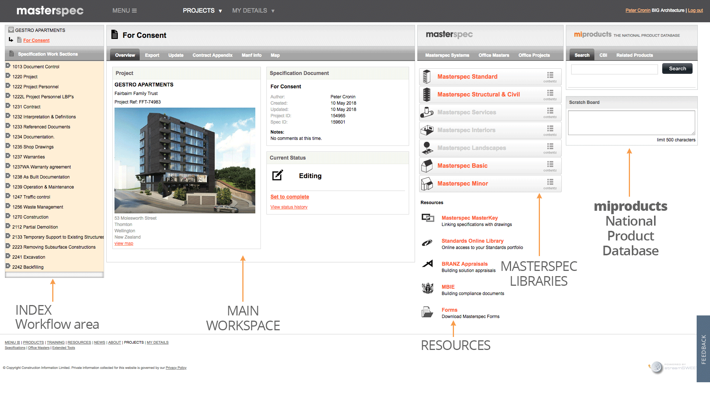
How do you know what to write?
Each manufacturer provides a specification that can be modified for individual projects.
Specification writing software:
MasterSpec
Delek
SpecBuilder
Spec Writer – Consultant or In-house

Slide 8
How are Specifications Organized?
Division 23 - Heating, Ventilating, and Air Conditioning (HVAC)
Division 25 - Integrated Automation
Division 26 - Electrical
Division 27 - Communications
Division 28 - Electronic Safety and Security
Division 31 - Earthwork
Division 32 - Exterior Improvements
Division 33 - Utilities
Division 34 - Transportation
Division 35 - Waterway and Marine Construction
Division 40 - Process Integration
Division 41 - Material Processing and Handling Equipment
Division 42 - Process Heating, Cooling, and Drying Equipment
Division 43 - Process Gas and Liquid Handling, Purification and Storage Equipment
Division 44 - Pollution and Waste Control Equipment
Division 45 - Industry-Specific Manufacturing Equipment
Division 46 - Water and Wastewater Equipment
Division 48 - Electrical Power Generation
MasterFormat Divisions
Division 00 - Procurement and Contracting Requirements
Division 01 - General Requirements
Division 02 - Existing Conditions
Division 03 - Concrete
Division 04 - Masonry
Division 05 - Metals
Division 06 - Wood, Plastics, Composites
Division 07 - Thermal and Moisture Protection
Division 08 - Openings
Division 09 - Finishes
Division 10 - Specialties
Division 11 - Equipment
Division 12 - Furnishings
Division 13 - Special Construction
Division 14 - Conveying Equipment
Division 21 - Fire Suppression
Division 22 - Plumbing

Slide 9

Material Boards /
Mood Boards

Slide 10
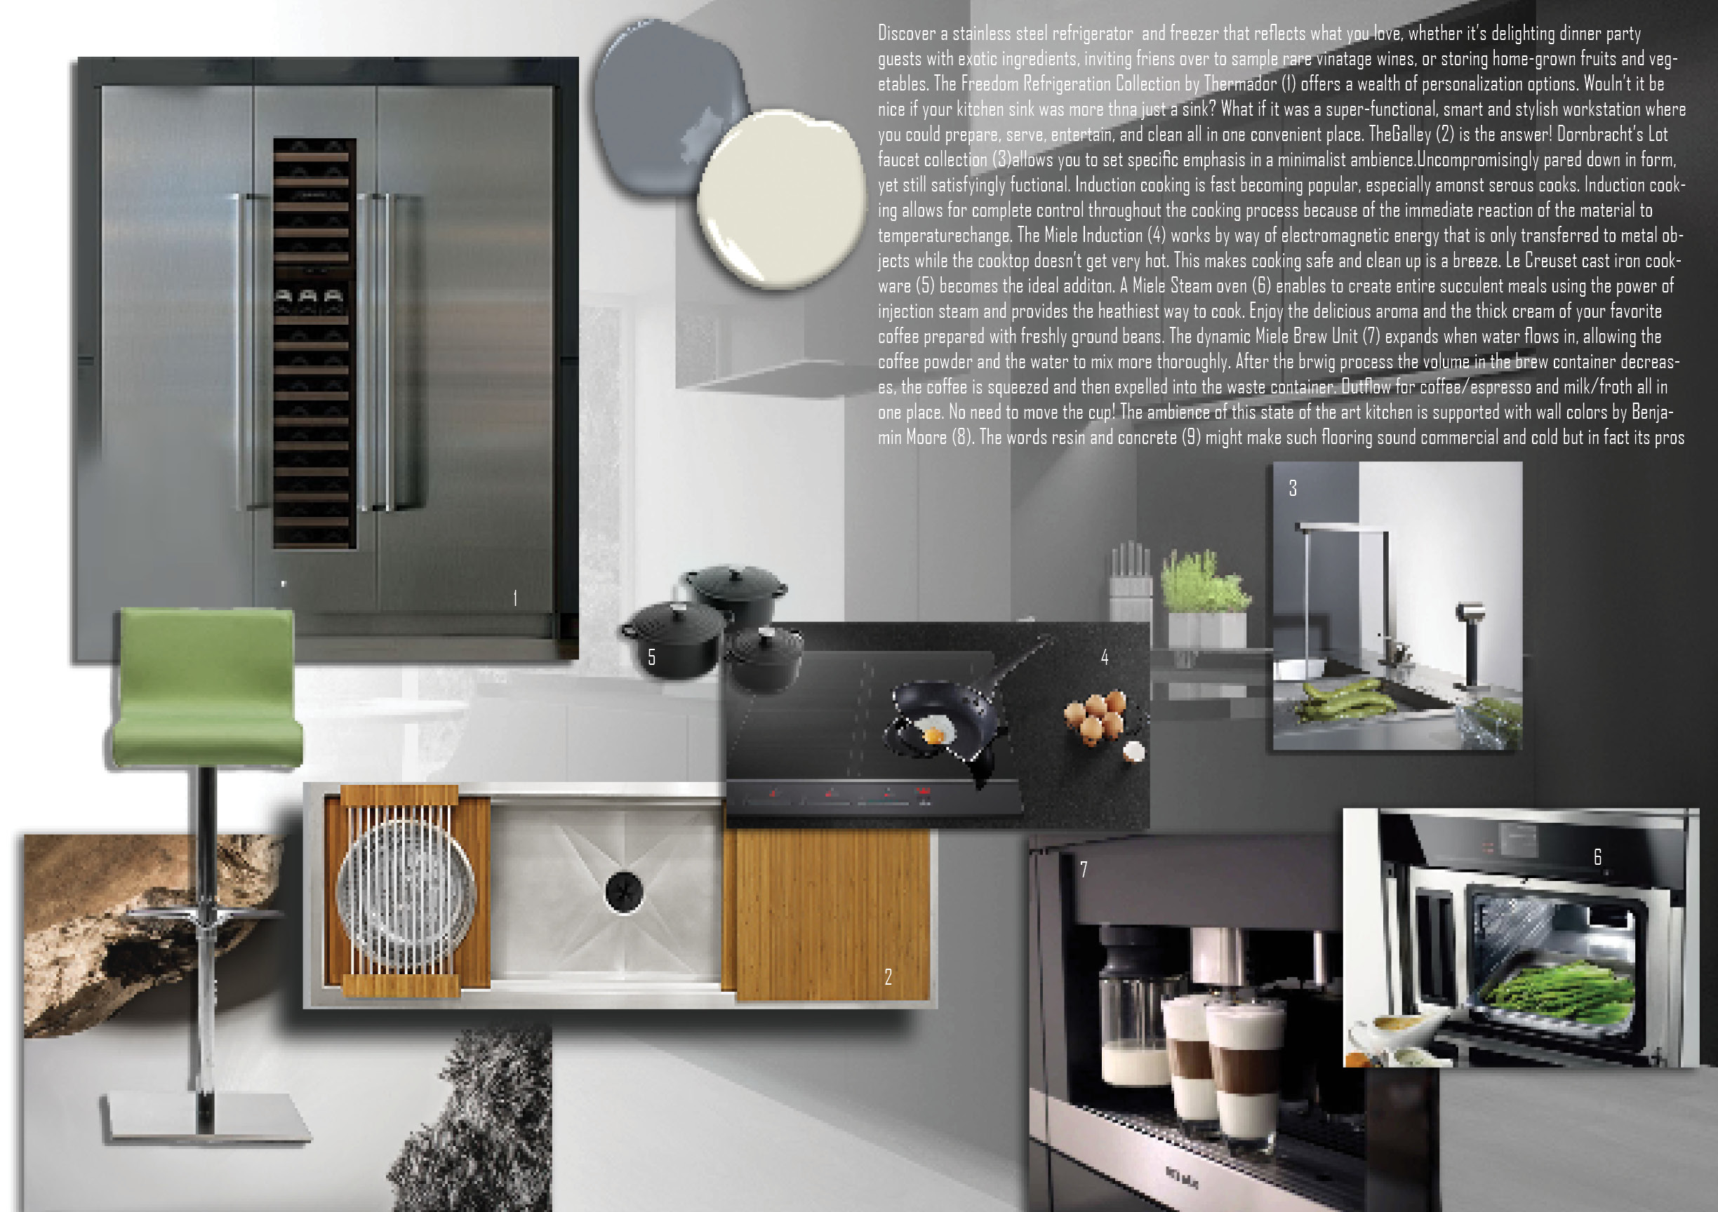
Collage of materials, colors,+ fixtures visual representation of what will be specified for the client to view

Slide 11
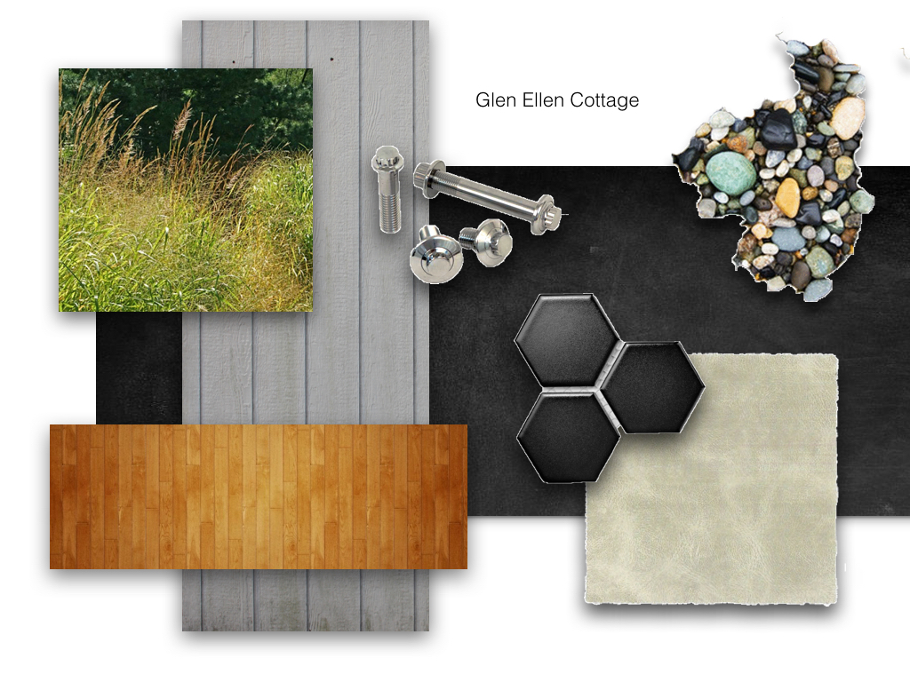

Slide 12


Pinterest
Mood boards were created using samples and actual materials, currently many architects, designers and clients share boards on Pinterest.

Slide 13
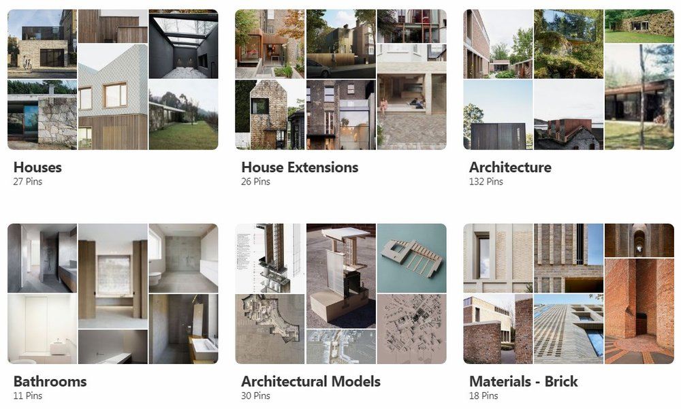
Pinterest Boards
Individual Boards can be made that cluster similar ideas –and can be named as needed.
They can be shared and can collaborate with others.

Slide 14
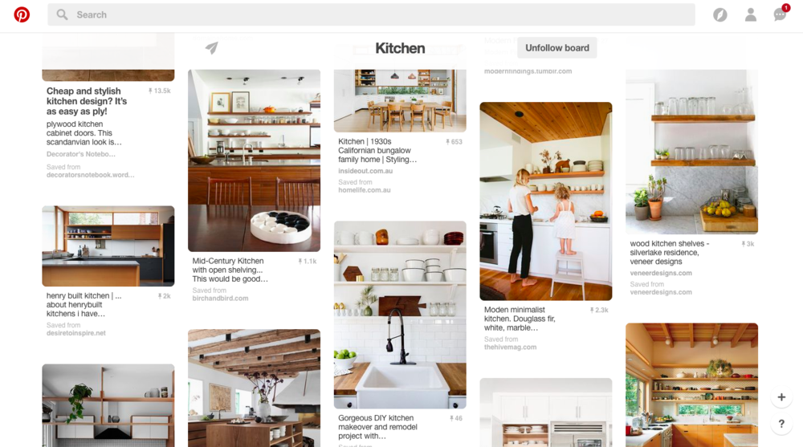
Pinterest Boards
Each board can have similar items and Pinterest will make suggestions for your search

Slide 15
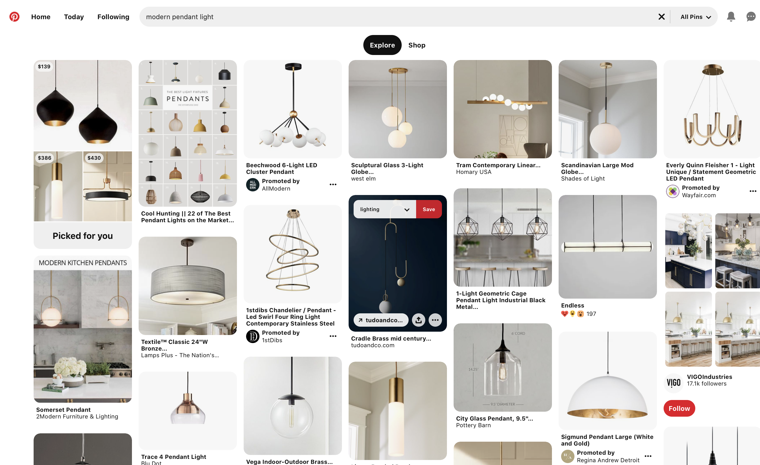
Beginning your pinterest
If you do not have an account – set one up (they are free)
Begin a search –modern pedant light
Go through the images and hover over the image
Click Save

Slide 16
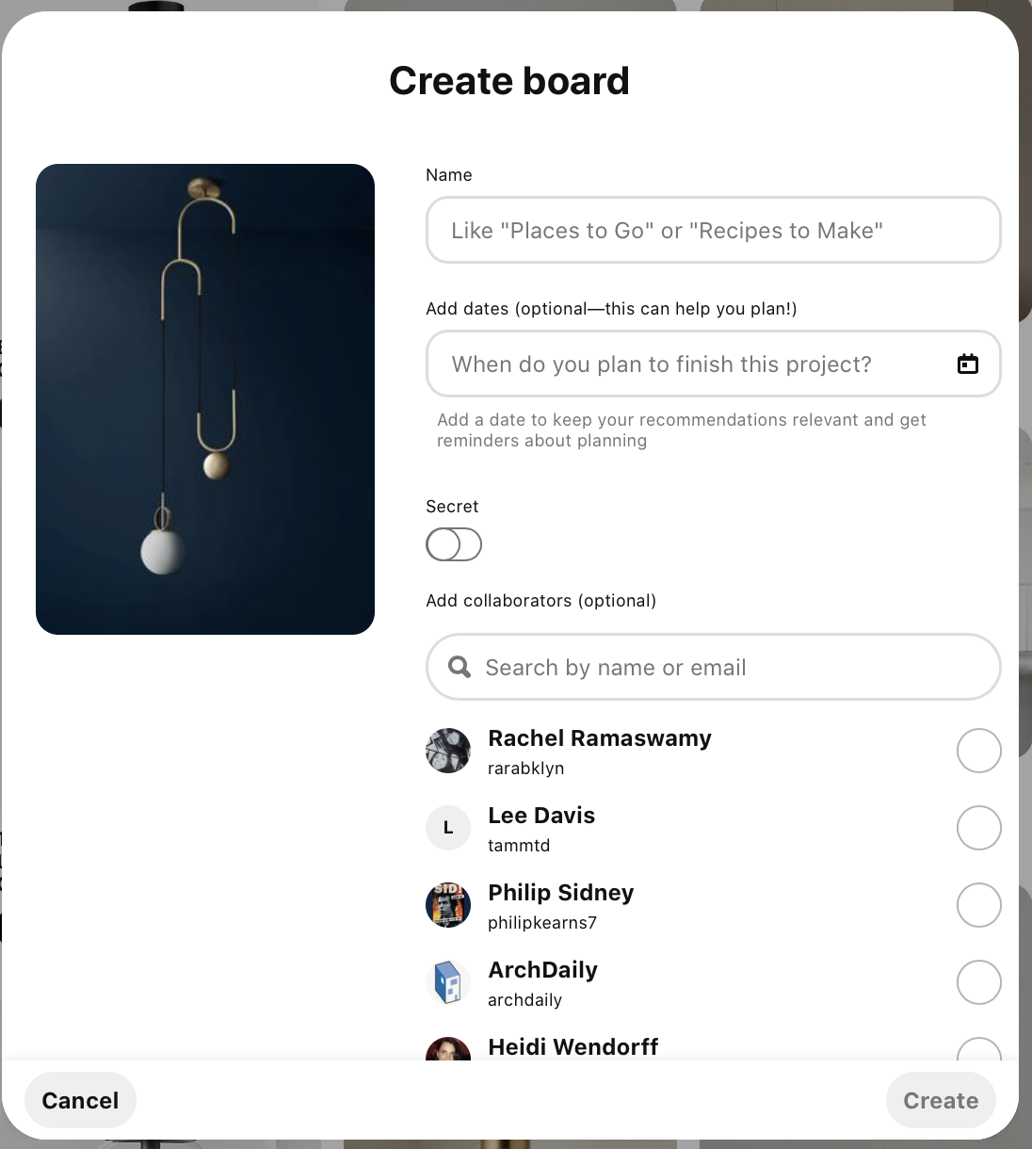
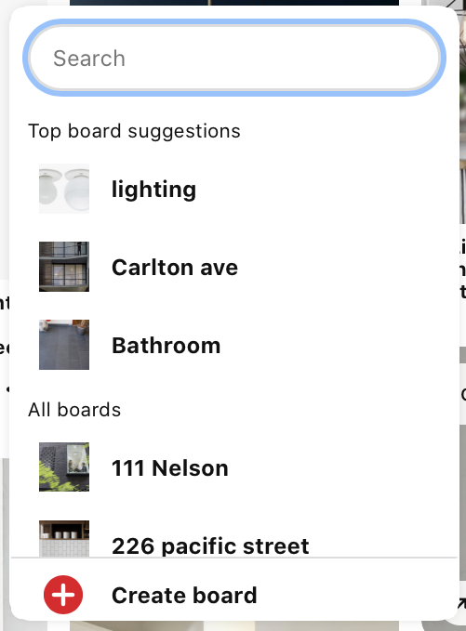
Creating your board
Click Create Board +
New Pop up – Name your board
i.e. Lighting - ARCH3512
Can set a date and add collaborators
Once it is created; it will be in your
list of boards

