Slide 1
Brooklyn-Queens Expressway

Slide 2
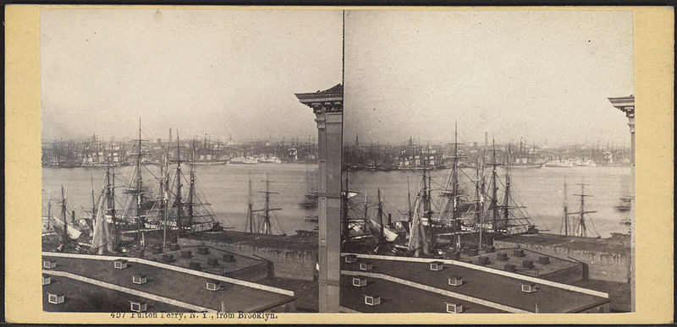
Before the BQE
The neighborhood’s proximity to Manhattan invited wealthy business people working on Wall Street in 1814 to cross the river and settle in the Heights. The introduction of the wealthy initiated a transformation of the desolate neighborhood when brownstone houses and mansions were erected.
Robert Fulton’s ferry began the transformation of Brooklyn Heights in 1814. The business people of Wall Street, such as bankers, and lawyers, travelled on the ferry to Brooklyn Heights and built rows of mansions.
The majority of residents in Brooklyn Heights were wealthy people who valued the institutions of fine arts and so museums, an athenaeum, and the Philharmonic society were established between 1853 and 1857.
By 1940, Robert Moses, an influential city parks commissioner, declared the Heights a slum as only seedy hangouts and bars dominated the neighborhood.

Slide 3
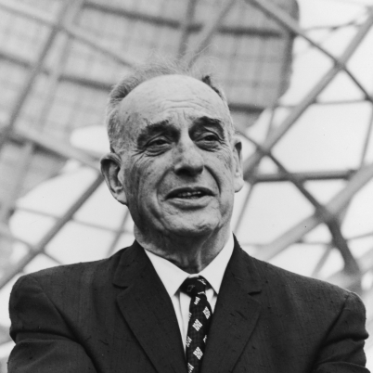
Robert Moses “Master Builder”
Played a larger role in shaping the physical environment of New York State than any other figure in the 20th century.
Robert Moses originally proposed to build the BQE through the heart of Brooklyn Heights
Brooklyn Heights became New York’s first commuter town in the early 19th century when a new steam ferry service provided reliable service to Wall Street.

Slide 4
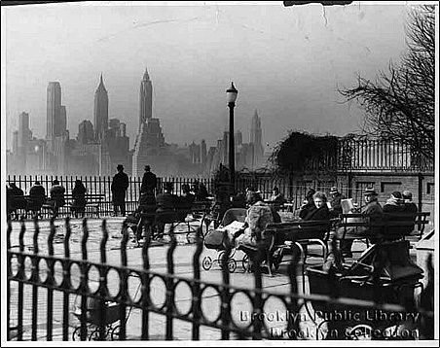
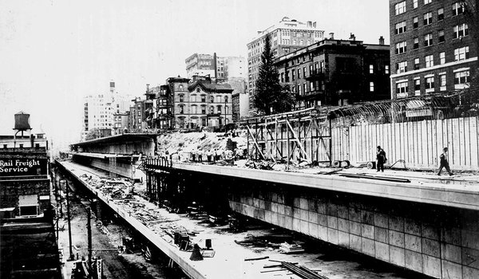
Main Purpose
Was built to accommodate both commercial and non-commercial traffic.
The BQE was intended not only to relieve congestion on local streets but also to aid industry and business by shortening transportation time between the boroughs.

Slide 5
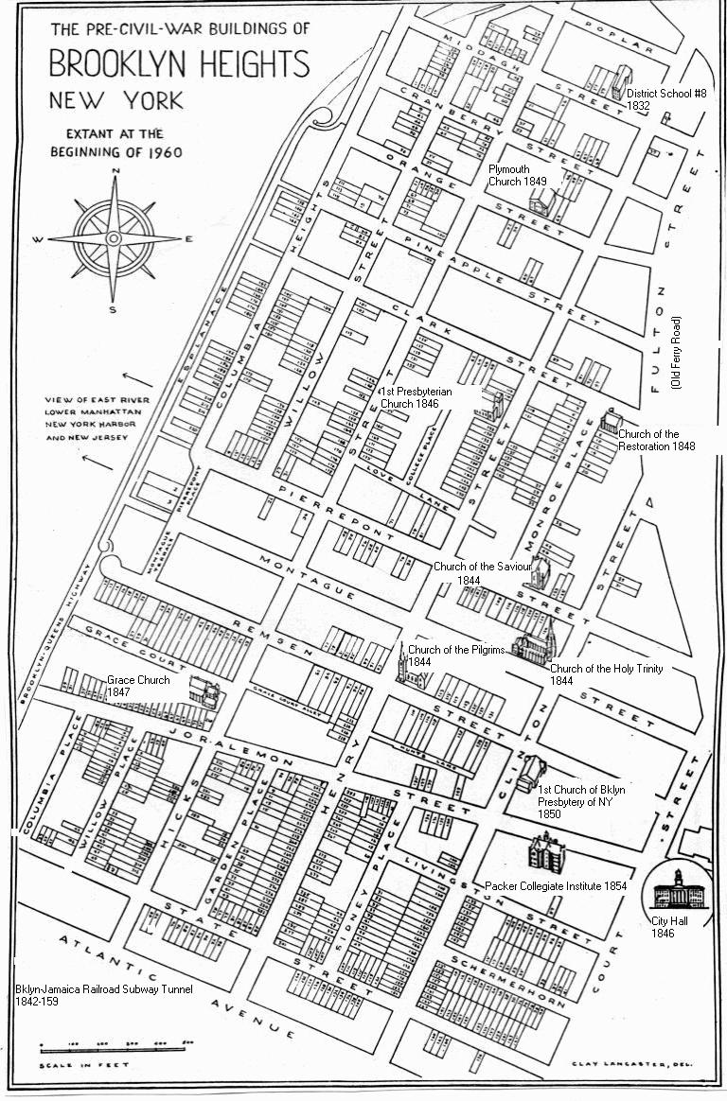
Brooklyn Height’s Reaction
The locals were enrages with the idea of Robert Moses proposal of the bqe, even with the promenade, but still local were not happy.
The householders of the 1940s who lived on the bluff resented the intrusion of the road, even with a park on top, since they would lose privacy with the public traipsing back and forth along what had been their backyards.
When the B. Q. E. opened in 1950, John Cashmore, borough president, predicted that the road-top park would soon be “as popular with Brooklyn residents as the boardwalk at Coney Island.”
Some residents were horrified at this prospect, decrying the “nightmare” of “promenaders peering into windows of homes and hoodlums shouting unseemly language.”

Slide 6
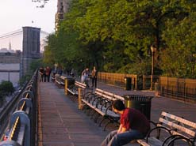
Brooklyn Heights Today
Brooklyn-Queens Expressway, commonly referred to by its simple acronym BQE, extends south from the Grand Central Parkway, from both LaGuardia Airport in the east and the Triboro Bridge from the west.
And yet now, and probably even then, the Promenade is a big part of the reason the neighborhood commands (almost) the highest prices in the borough.
Brooklyn-Queens Expressway under Brooklyn Heights is perhaps the most daring and ingenious, a cantilevered structure narrowly threaded between waterfront warehouses and mansions high above, incidentally creating one of New York’s great parks, the Brooklyn Heights Promenade.
It opened to the public in October 1950 and has been a magnet for local residents and visitors alike for over half a century.

Slide 7
Sources
http://observer.com/2011/05/houses-of-the-holy-sabbath-rules-have-brooklyn-homes-selling-for-big-bucks/#axzz2serKCfr4
http://observer.com/2012/01/brooklyn-heights-hated-the-promenade-almost-as-much-at-the-b-q-e/#axzz2serKCfr4
http://eastriverhistory.webs.com/brooklynqueens/brheights.htm

