Slide 1
The Sheshu Family house
Architect: Richard Perez
LOT 7
ML9-7
MATERIAL | USE | SQ. FT. | MATERIAL COST | INSTALLATION COST
COR. STEEL | EXT. FINISH | 1,733.02 SF. | N/A | N/A
REC. WOOD | EXT. FINISH | 638.44 SF. | $1,915.32 | $5,426.74
 | FLOORING | 924.36 SF. | $2,773.08 | $7,857.06
MARBLE | KIT. FLOOR | 111.96 SF. | $1,044.59 | $1,539.45
 | BTHRM WALL | 250.90 SF. | $2,340.90 | $1,539.45
TERRAZZO | BTHRM FLOOR | 147.86 SF. | $2,957.20 | $1,628.50
GLASS | EXT. FINISH | 246.47 SF. | $2,218.23 | $2,218.23
MISC. | FRONT DOOR | N/A | $96.00 | $179.96
 | INT. DOORS(9) | N/A | $198.00 | $1,619.64
 | ADA TOILET | N/A | $71.00 | $138.43
 | TOILET | N/A | $121.00 | $138.43
 | BATH TUB | N/A | $369.00 | $249.62
 | LAVATORY | N/A | $199.00 | $206.42
 | KIT. SINK | N/A | $99.95 | $206.42
 | BASE CABINET | N/A | $169.00 | $1,042.54
 | REFRIGERATOR | N/A | $898.20 | $182.83
 | STOVE(ELECTRIC) | N/A | $359.10 | $85.00
TOTAL |  |  | $15,829.57 | $24,258.72
 |  |  | TOTAL CONST. COST | $40,088.29
CORRUGATED STEEL-FACADE
http://www.123rf.com/photo_5640157_corrugated
-steel-sheet-useful-as-a-background.html
RECYCLED WOOD-FAÇADE/FLOORING
http://www.featurepics.com/online/
Recycled-Wood-Bark-Board-Pictures247527.aspx
MARBLE TILES-KITCHEN FLOOR
http://www.homeadditionplus.com/Ceramic%
20Tile%20Underlayments.htm
MARBLE TILES-BATHROOM WALLS
DESIGN CONCEPT – ENERGY . PRECISION . DELICATE
SHESHU FAMILY – construction estimate
http://professional-consultants.us/professional
-consultants/Unit%20161_info/Property_161.htm
GLASS- WINDOWS
http://www.franklinartglass.com/shop/category
.aspx/restoration-glass/45/
SOUNDPROOFING-STUDIO WALLS
http://www.thomasnet.com/articles/plant-facility-
equipment/How-to-Soundproof-a-Room
TERRAZZO-BATHROOM FLOORING
http://www.123rf.com/photo_12900786_rough
-terrazzo-floor-background.html

Slide 2
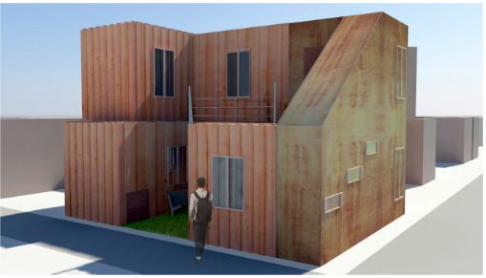
The Sheshu Family house
Architect: Richard Perez
LOT 7
ML9-7
IS IT PRACTICAL?
DESIGN CONCEPT – ENERGY . PRECISION . DELICATE
MY HOUSE
NITYAH BHORRA’S HOUSE
PROS
AESTHETICALLY PLEASING
NOT TOO MANY CUTS TO THE CANTAINERS
FOLLOWS ITS CONCEPT
HAS ALL THE SPACE REQUIRED FOR A FAMILY TO LIVE CONFORTABLY
PROS
EASTHETICALLY PLEASING
CONTAINER RATIO SEEM APPROPRIATE FOR HIS FAMILY SIZE
SPACES SEEM WELL LAID OUT
CONCEPT GOES WELL WITH THE HOUSE DESIGN
CONS
USED TOO MANY CONTAINERS COMPARED TO FAMILY RATIO
EXTERIOR WOOD PANELLING WOULD TAKE TOO LONG TO INSTALL
WOULD TAKE TOO LONG TO BUILD IN AN EMERGENCY SITUATION
COMERCIAL SPACE IS TOO SMALL
TOO EXPENSIVE AND OVER DESIGNED FOR RELIEF HOUSING
CRAMPED BEDROOMS
CONS
BATHROOMS NOT ADA ACCECIBLE
WOULD TAKE TOO LONG TO BUILD IN A EMERGENCY SITUATION DUE TO THE CUTS IN THE CONTAINERS
SMALL SECOND FLOOR
MATERAILS CHOSEN WOULD MAKE IT TOO EXPENSIVE

