Slide 1
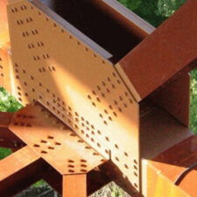
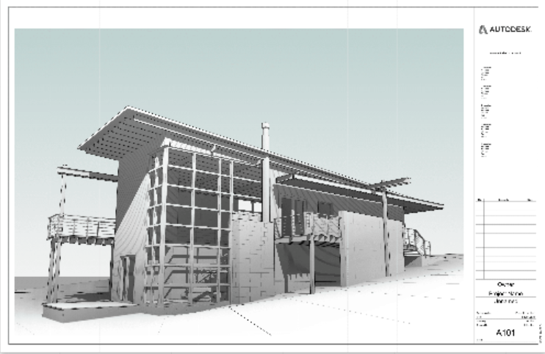
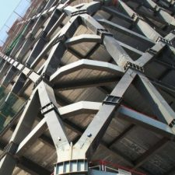
ARCH 2431 Building Technology III Steel Assembly & Building Information Modeling (BIM) with Revit Tutorial 1.03 – Revit Plotting
Prof. Paul C. King, Course Coordinator Pking@CityTech.Cuny.Edu
Prof. Blake Kurasek Bkurasek@CityTech.Cuny.Edu
Prof. Justin Sherman Jsherman@CityTech.Cuny.Edu
Prof. Jieun Yang Jyang@CityTech.Cuny.Edu
1.5

Slide 2
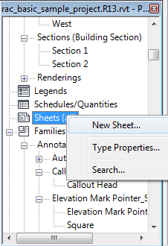
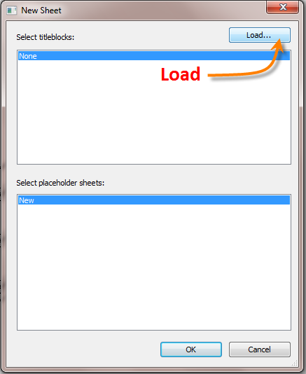
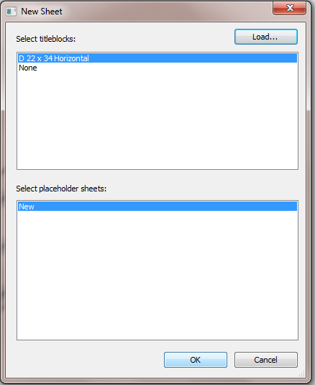
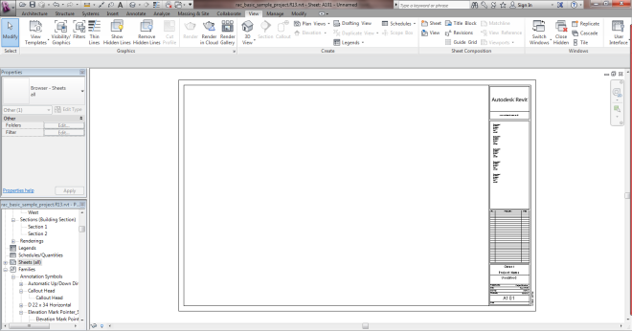
Create a New Sheet
Scavenger Hunt
Sheets
New sheet
Add Views
Plotting
PDF to 11x17 paper
PDF to MIRO posting
PDF to Blackboard

Slide 3
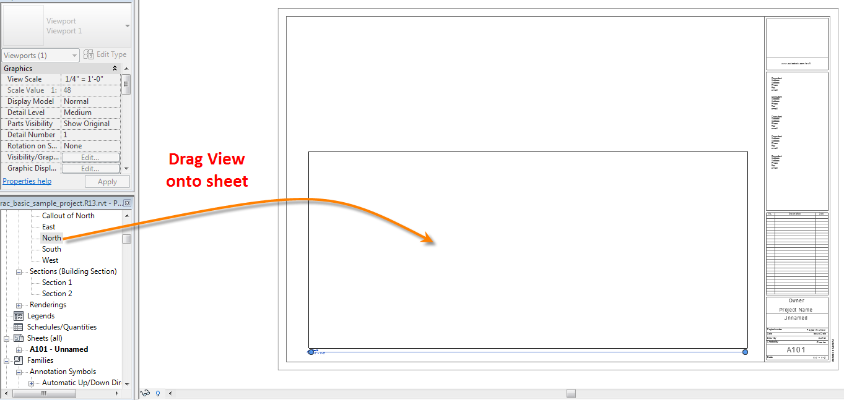
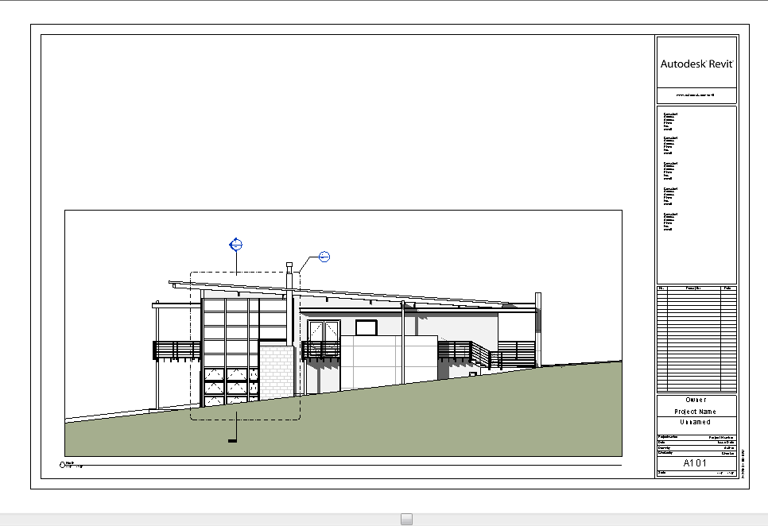
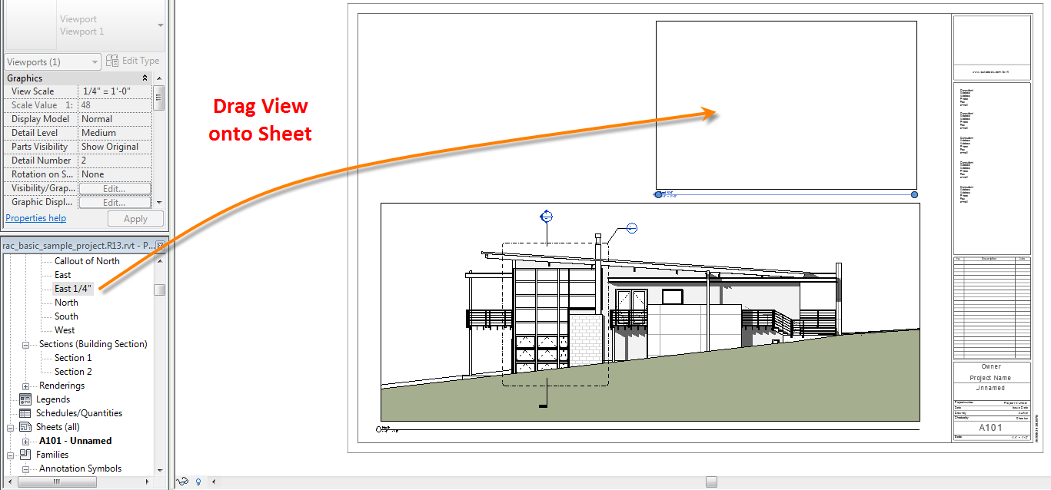
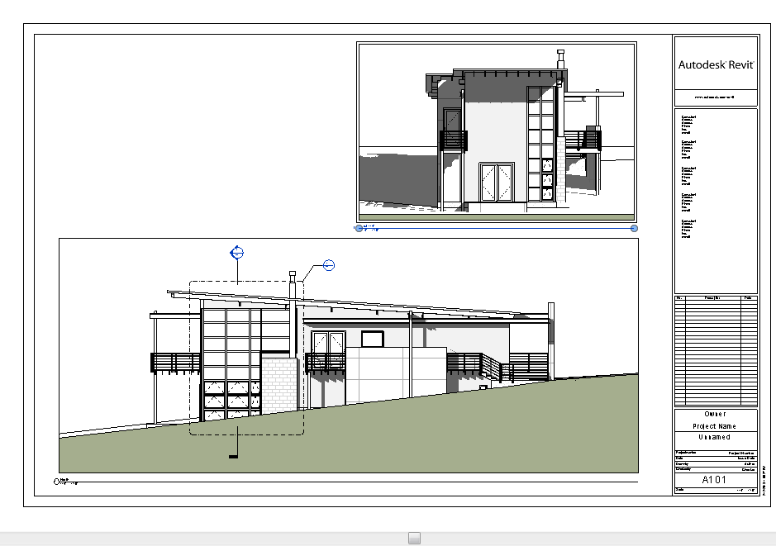
Adding Views to a Sheet
Scavenger Hunt
Sheets
New sheet
Add Views
Plotting
PDF to 11x17 paper
PDF to MIRO posting
PDF to Blackboard
Each view can only be associated with one sheet
See creating duplicate views
Remember to update the titleblock with your name and photo – name the sheet

Slide 4
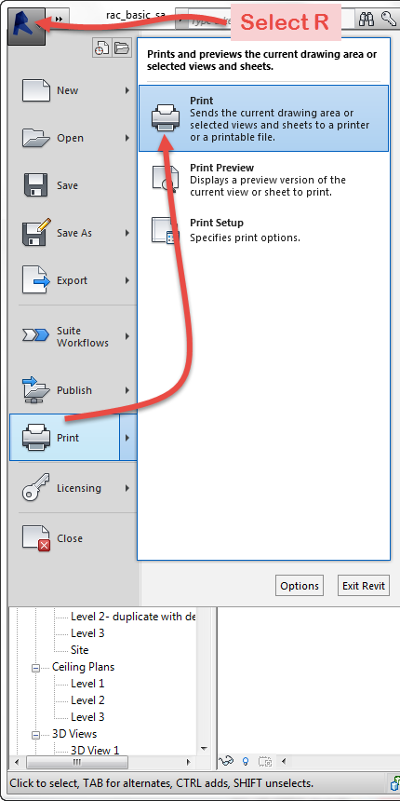
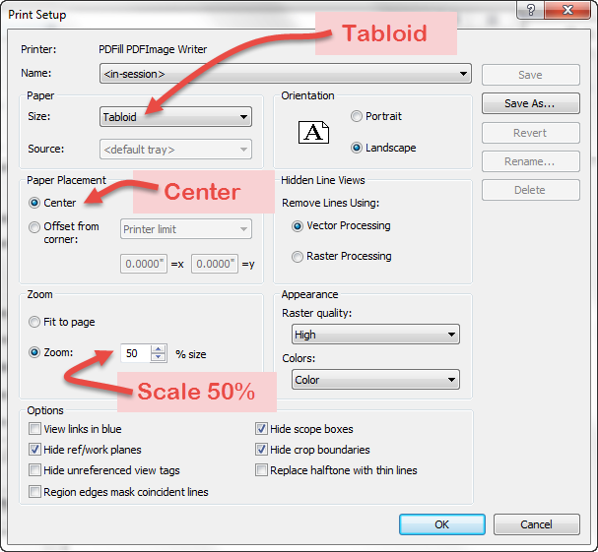
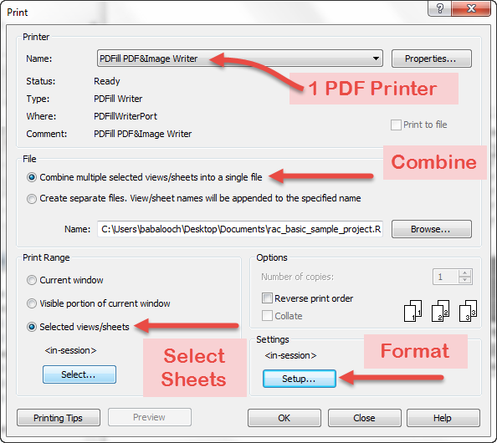
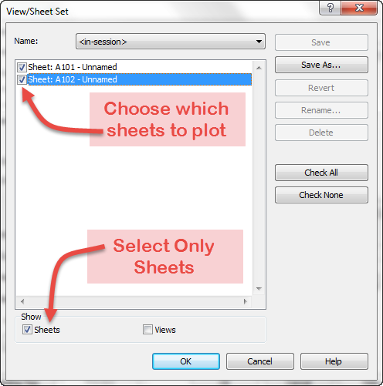
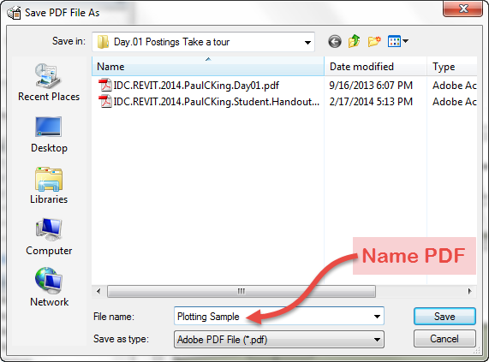
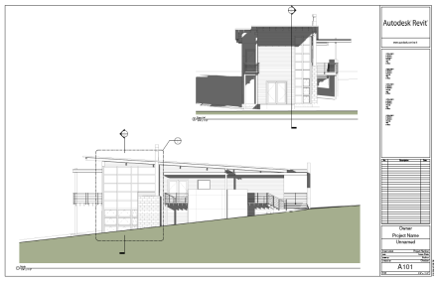
To Plot to PDF & then to 11 x 17 paper
Scavenger Hunt
Sheets
New sheet
Add Views
Plotting
PDF to 11x17 paper
PDF to MIRO posting
PDF to Blackboard
If you need to download a PDF printer look for one at https://download.cnet.com
Printing to 11 x 17 paper
Print / Select a PDF Printer
Select Multiple Sheets
Combine into single PDF
22 x 34 to Tabloid - Landscape
Center and Scale to 50%
(50% means 11 x 17)
Next print the PDF to the printer

Slide 5
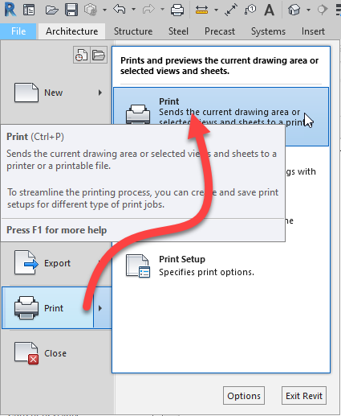
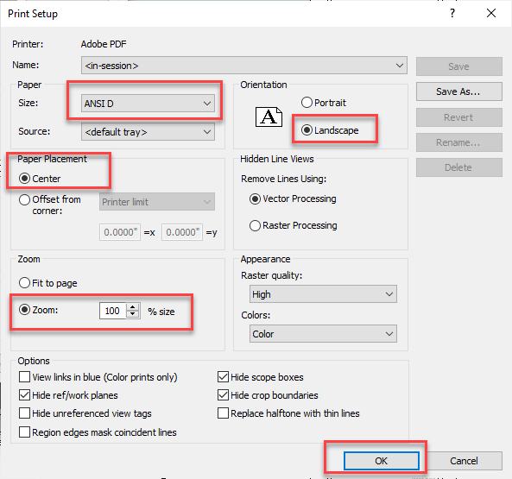
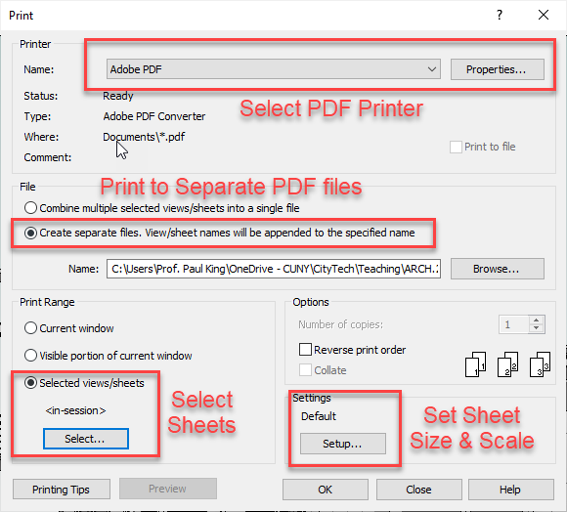
To post to MIRO - Plot as separate PDF’s
Scavenger Hunt
Sheets
New sheet
Add Views
Plotting
PDF to 11x17 paper
PDF to MIRO posting
PDF to Blackboard
If you need to download a PDF printer look for one at https://download.cnet.com
Print / Select a PDF Printer
Select separate Sheets
ANSI D (22 x 34) Landscape
Center and Scale to 100%
Then print the PDF
Next post your individual PDF’s into the MIRO board

Slide 6
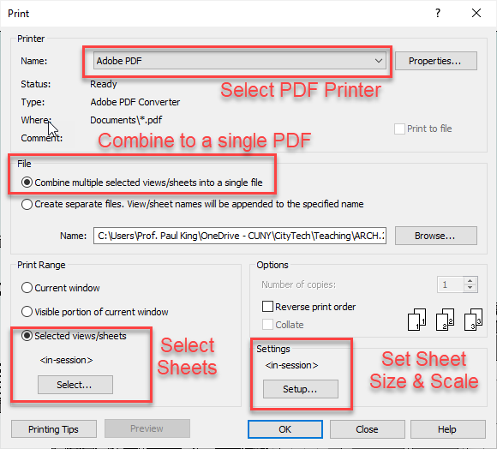
To post to Blackboard- Plot as one PDF
Scavenger Hunt
Sheets
New sheet
Add Views
Plotting
PDF to 11x17 paper
PDF to MIRO posting
PDF to Blackboard
If you need to download a PDF printer look for one at https://download.cnet.com
Print / Select a PDF Printer
Select Combine to single file
ANSI D (22 x 34) Landscape
Center and Scale to 100%
Then print to a single PDF
Make sure the file is named properly
Upload your Revit file and PDF to Blackboard

