Slide 1
AHASAN HAQUE
HONEYCOM STONE PANEL ALUMINUM PANEL

Slide 2
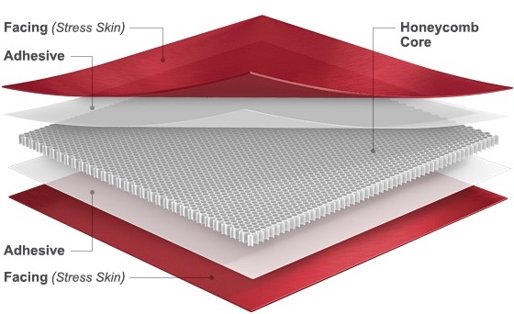
HONEYCOMB STONE PANEL

Slide 7
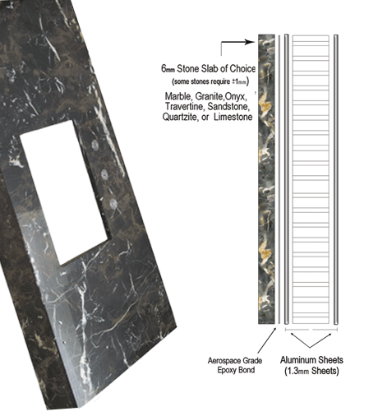
HONEYCOMB STONE PANEL
Typically 5 layers: Skin, adhesive, honeycomb core, adhesive, skin. Materials with high tensile and compression strength are best suited to being skins, i.e. aluminum, steel, fiberglass. Adhesive varies widely by application: high strength, high temp, low temp, etc.
Honeycomb Core: A variety of honeycomb cores are available per design requirements.

Slide 8
Typical Panel Options
Skin Materials:
• Aluminum
• Stainless Steel
• High Pressure Laminate
• Glass/Epoxy Prepreg
• G10 Fiberglass
• For other materials, please contact us.
Skin Finishes:
• Clear Epoxy Primer
• Mill Finish
• Bond and/or Paint Ready
• Decorative
• Powder Coat
• For other finishes, please contact us.
Honeycomb Cores:
• Aluminum (Commercial and Aero/Military Grade)
• Stainless Steel
• Nomex
(Commercial and Aero/Military Grade)
•Kevlar (Aero/Military Grade)
• Polypropylene
• Polycarbonate
Adhesives:
• Commercial grade toughened epoxy
• Cost-effective
• Service Temperatures up to 180°F.
• Modified Epoxy Film Adhesive
• Service Temperature options up to 400°F.
• Multiple weights available
• Can be MIL spec or ASTM certified
• Other adhesive types available by request.
Sizes:
• Thickness: 1/8"– 3" standard
• Width: 48" and 60" standard
• Length: Up to 190" standard

Slide 9
PROS:
Variety and Design: stone veneer products are, at their most basic, cement. It is the design, color and molding that the cement goes through that makes it look like natural stone so much so that only a true expert would be able to tell the difference. There are a number of processes that produce a variety of designs and colors to suit any style or preference people are looking for, giving you more to work with when using this type of material.
Being lightweight, manufactured stone veneer products are easier to work with and given you more options as to where and how you want to install manufactured stone veneer products. This means that this material can be used with masonry, wood frame or metal structures. They don’t need foundation support either.
Durability: As long as your manufactured stone veneer products are used, installed and maintained correctly, you can rely on them to last a very long time.
Cons:
Improper installation of this type of veneer can result in severe damage, often immediately after installation, therefore it is very important that you hire a professional to do the work for you. Otherwise the result will be severe water damage.
Exposure to certain elements will reduce the aesthetic appearance of stone veneer. Such things as harsh chemicals, paint thinners, de-icing salts, and cleaning solvents can scar and stain the surface or result in discoloration. In general though, manufactured stone veneer products are hardy.
Manufactured stone veneer products may not be the best to use in swimming pools, as chlorine can cause discoloration.

Slide 10
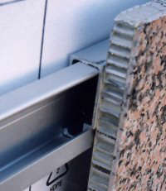
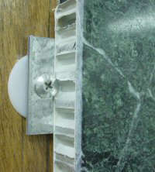
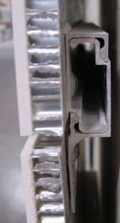
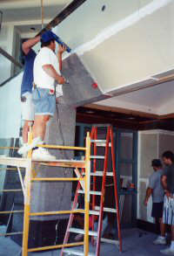
INSTALLATION
Interlocking Channel System
Joint Interlocking Channel System
Anchor Plate
Adhesive Attachment

Slide 11
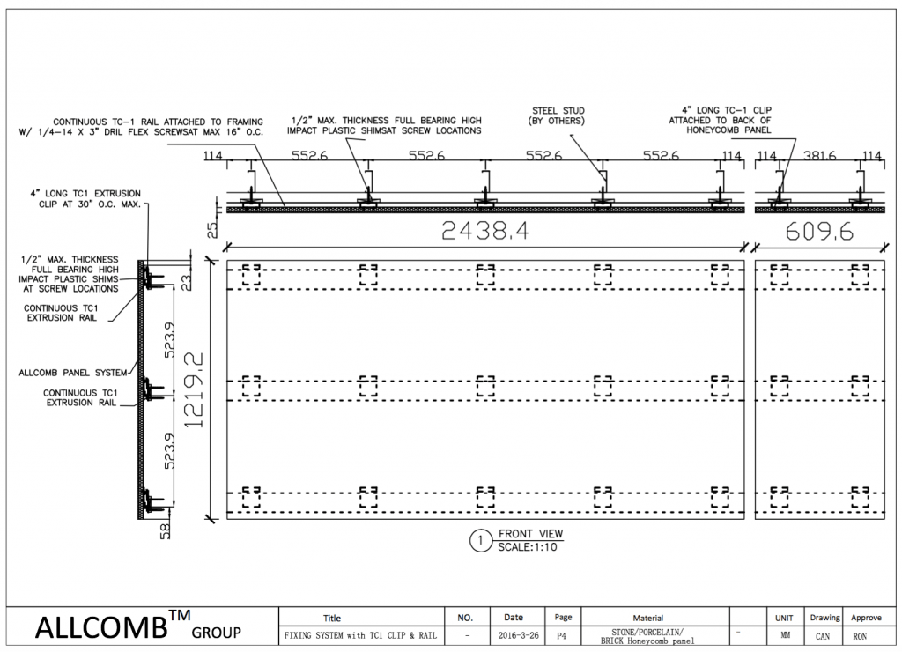
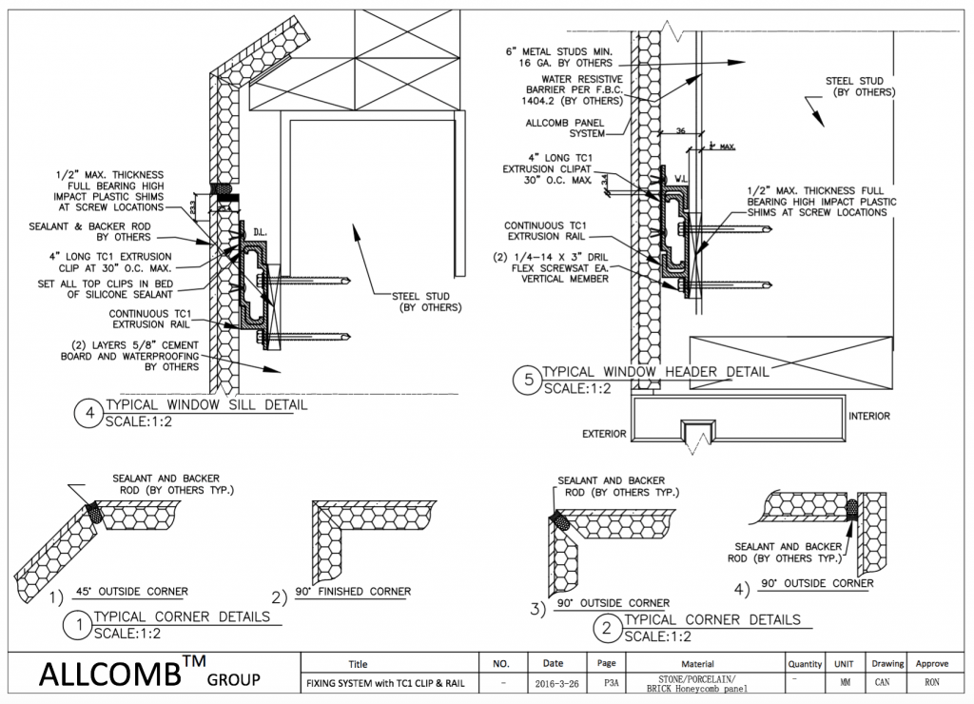
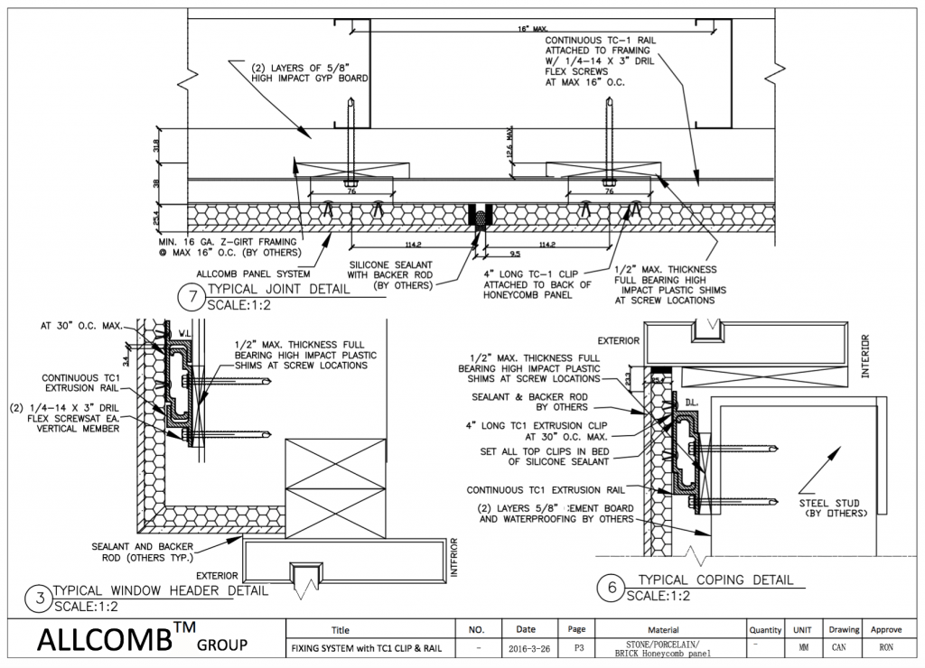

Slide 12
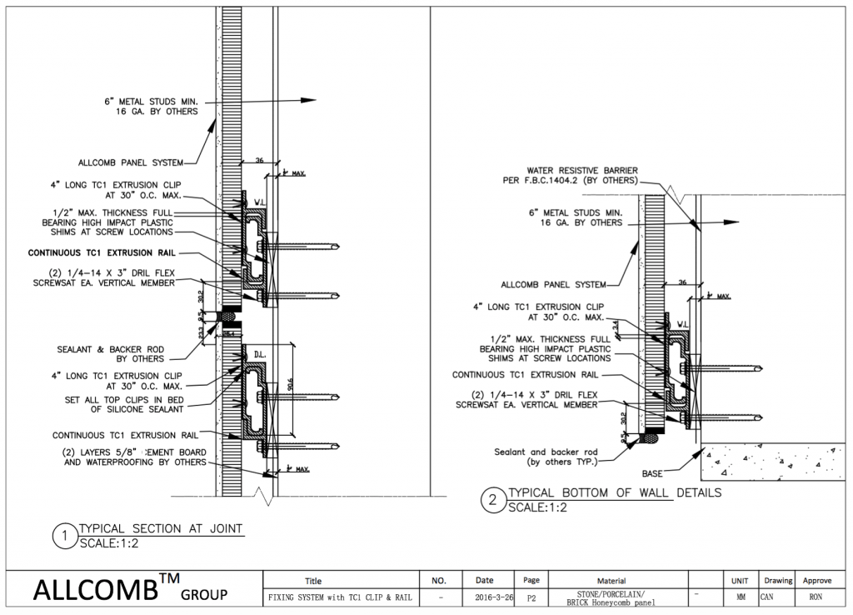
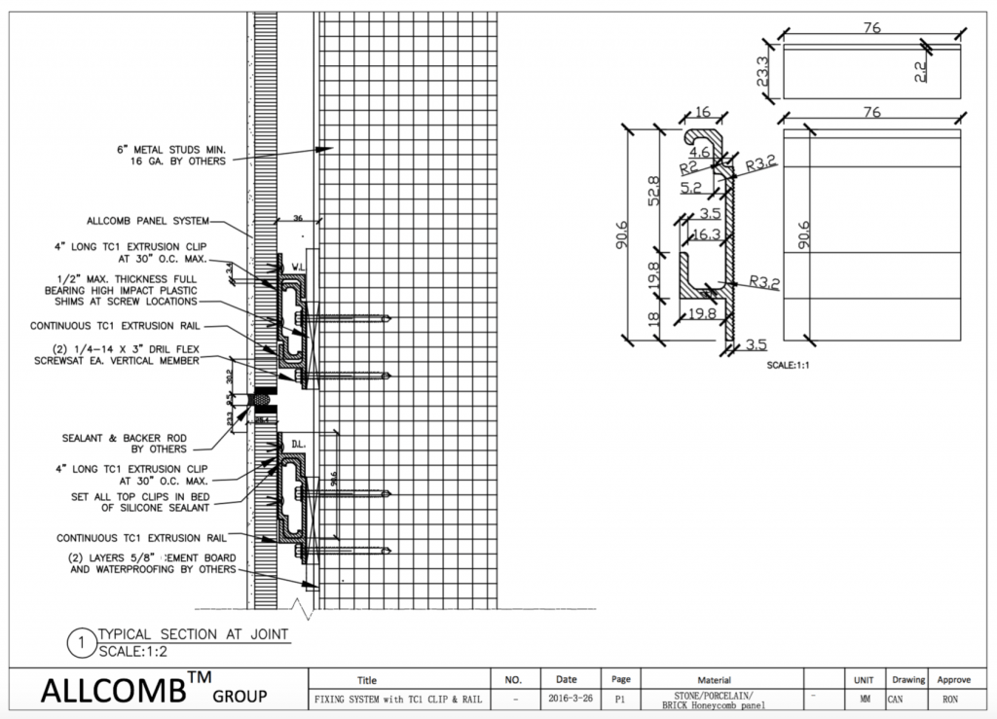

Slide 13
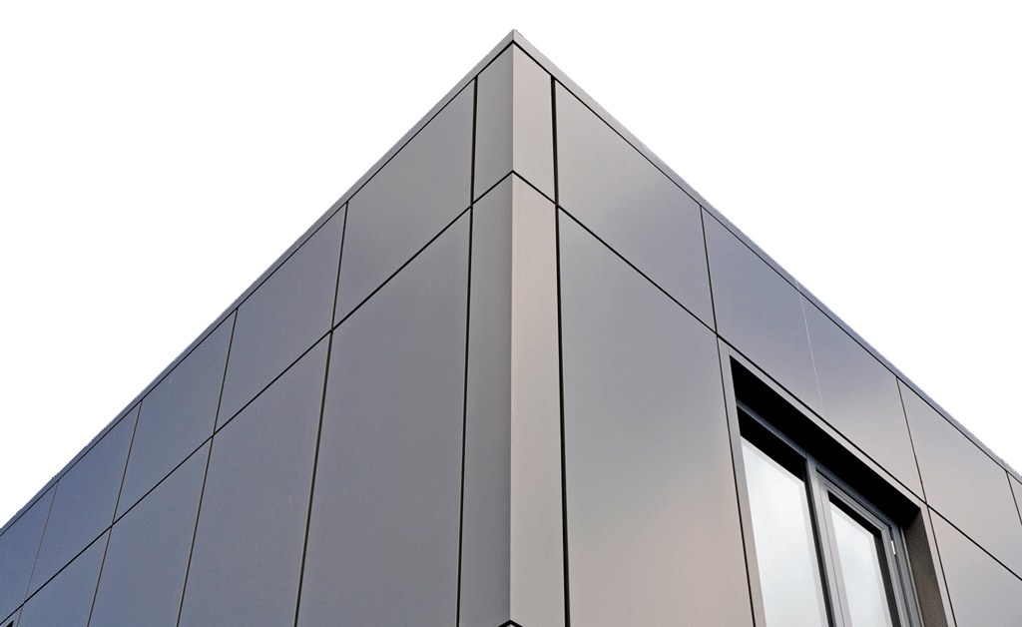
ALUMINUM PANEL

Slide 18
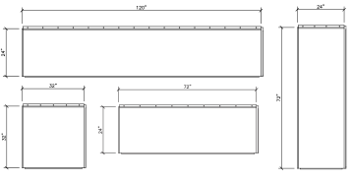
Panel Sizes:
System Depth:
1 1/4” nominal
Material:
Aluminum
Material Thickness:
.080" standard (other gauges available)
Panel Joints:
1/2' nominal standard (1/8' to 1" available)
Finish:
Clear, Bronze, Champagne and Black Anodized
Weight:
Less than 2 pounds per square foot

Slide 19
GENERAL INSTALLATION SEQUENCE
1.Install and caulk the appropriate flashing/trims.
2.Measure and cut the first panel
3.Place and plumb the first panel
4.Throug -fasten the cut edge.
5.Install clips and fasteners along the factory edge of the panel at the girt locations
6. Apply sealant pigtails.
7.Field caulk the second panel.
8.Place and engage the second panel.
9.Install clips and fasteners along the factory edge of the panel at the girt locations.

Slide 22
Pros:
One of the Most Eco-Friendly Materials
Excellent Durability and Overall Value
Ideal for Majority of North American Regions
Can Be Easily Insulated for Improved Temperature- and Sound-Resistance
Cons:
Homes on the Coast or in Wet Climates
Homes in Very Hot Climates
Low Budget is a Primary Concern

Slide 23
Work Cited
http://www.dri-design.com/products/anodized-aluminum/#sizes
https://www.englertinc.com/images/stories/wallpanels/IMP_Related/Englert_Combined_IMP_Installation_Guide.pdf
http://www.monarchmetal.com/products/easy-panel-system-wide-channel/
http://www.mbci.com/products/wall-products/
http://www.usgdesignstudio.com/

