Slide 1
Photoshop Tools
A presentation by: Gabriel Buensuceso & Anibal Flores

Slide 2
Introduction
Basic Photoshop
Adjustment and Non-Adjustment tools
Sharpen and Unsharpen mask tools
Channels palettes
Hot keys (shortcuts)
Resizing images and canvases
Multi-layered documents
How do I create a layer?
What does it mean to be layered?

Slide 3
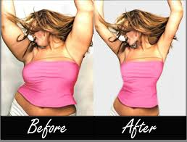
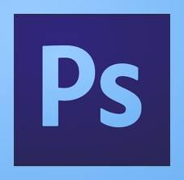
What is Photoshop?
Adobe Photoshop is a graphics editing program developed and published by Adobe Systems
Used mainly by graphic artists
Runs on both Mac and PC systems.

Slide 4
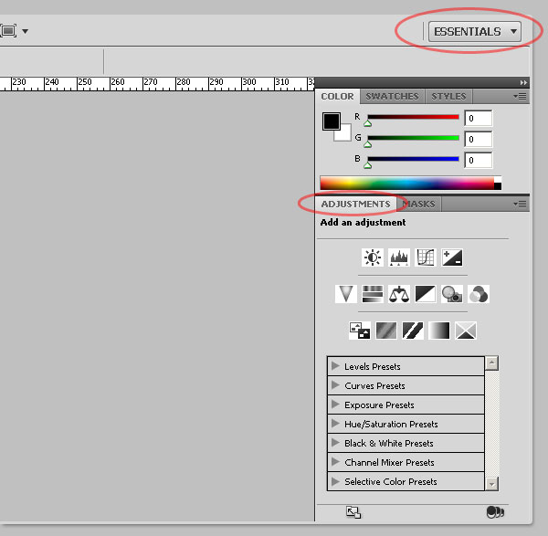
Adjustment & non-adjustment tools
The Adjustment tool is a quick and easy way to edit any picture or image.

Slide 5
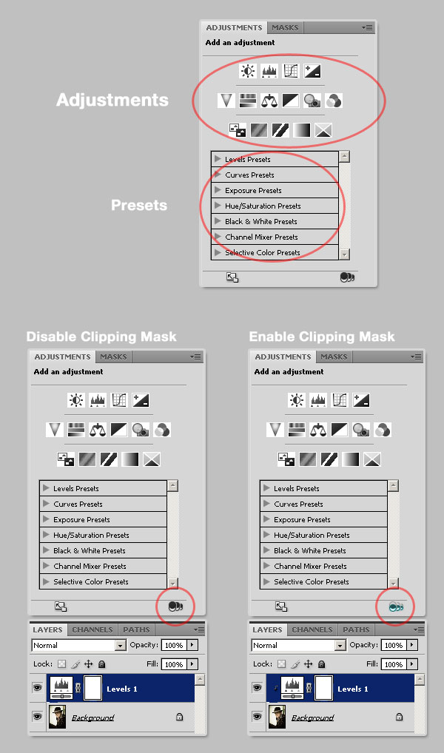
Adjustment & non-adjustment tools (cont’d)
Edits colors, saturations, mix colors, levels, channels, gradients on a single interface.

Slide 6
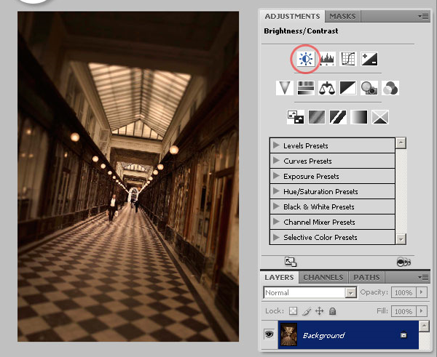
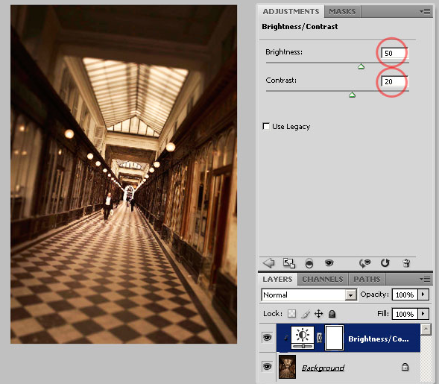
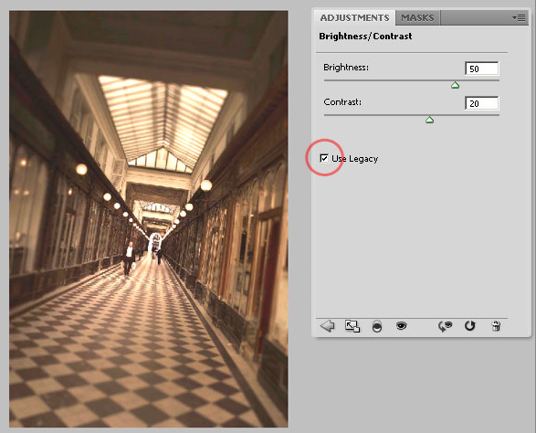
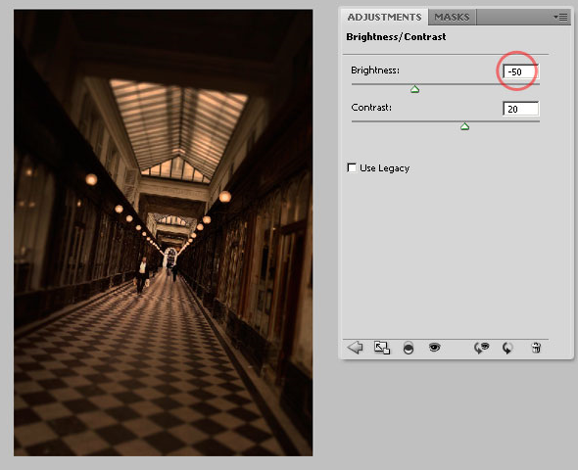
Adjustment & non-adjustment tools (cont’d)
Brightness and Contrast
Edits the tonal range of an image.
The Legacy box is recommended because it affects every pixel in the image

Slide 7
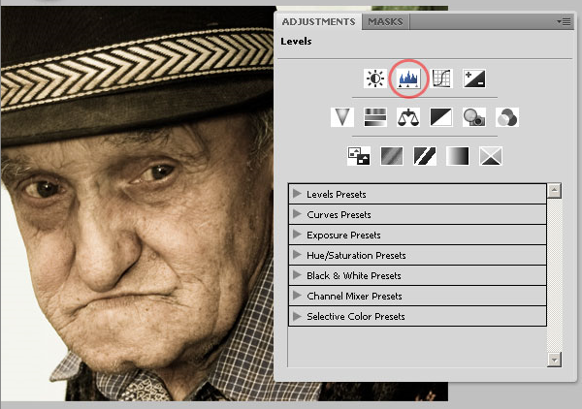
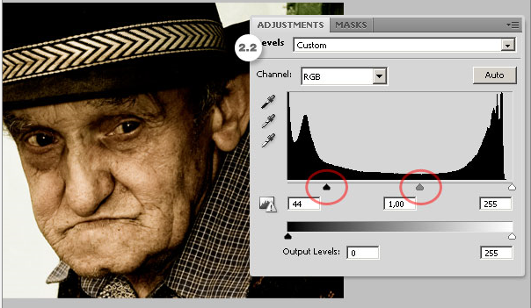
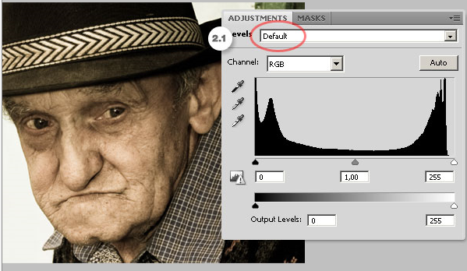
Adjustment & non-adjustment tools (cont’d)
Levels
One of the most used tool in Photoshop
Easily adjusts the color and tonal range.

Slide 8
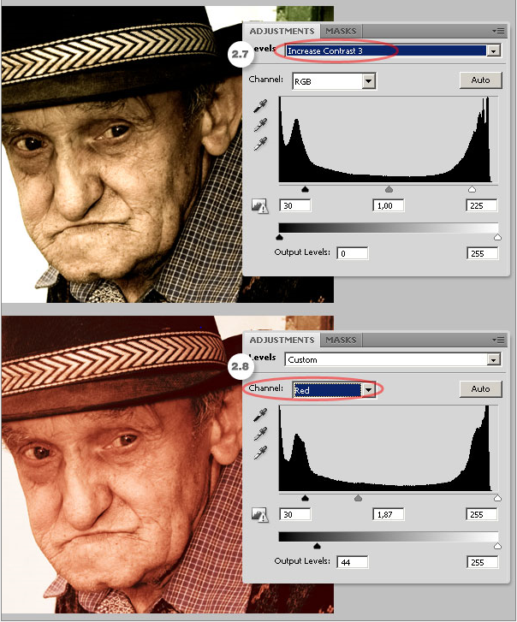
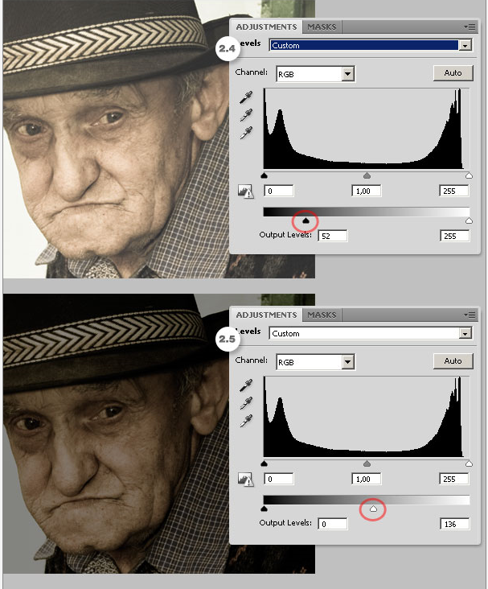
Adjustment & non-adjustment tools (cont’d)

Slide 9
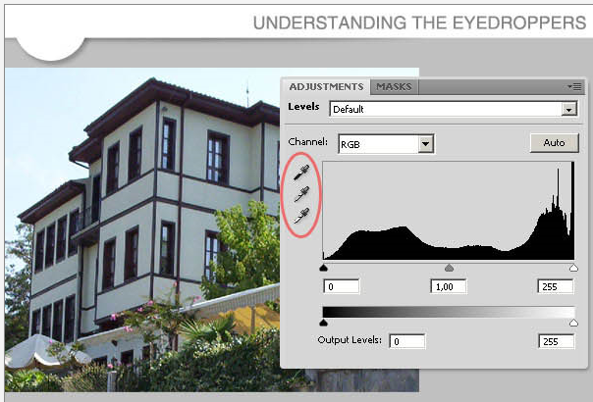
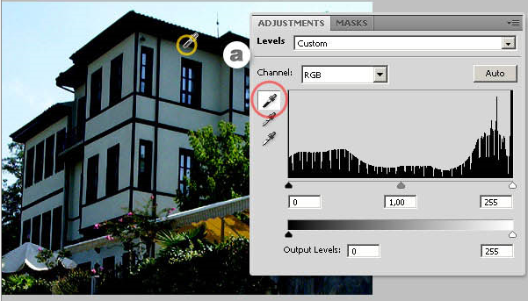
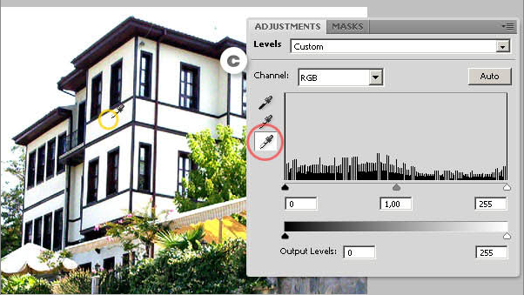
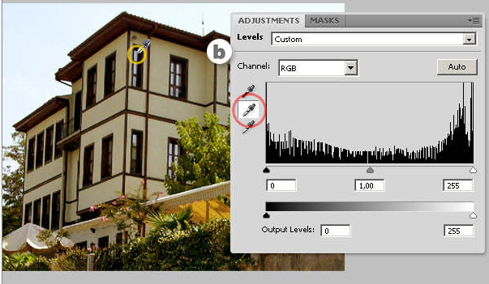
Adjustment & non-adjustment tools (cont’d)
Eyedropper Tool
Neutralizes the colors on the histogram.
By clicking anywhere in the image, a black, gray, and white point setting will appear and auto-adjusts the colors.

Slide 10
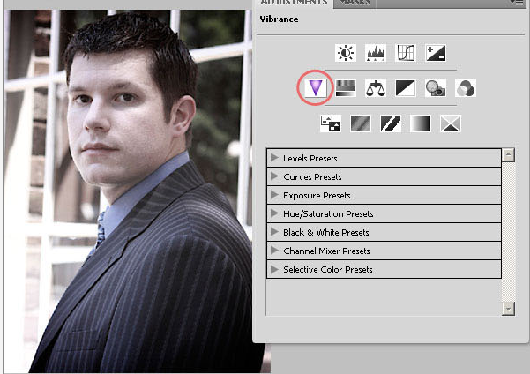
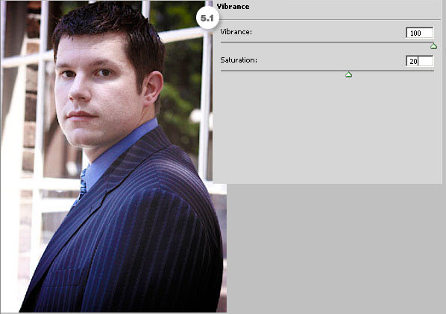
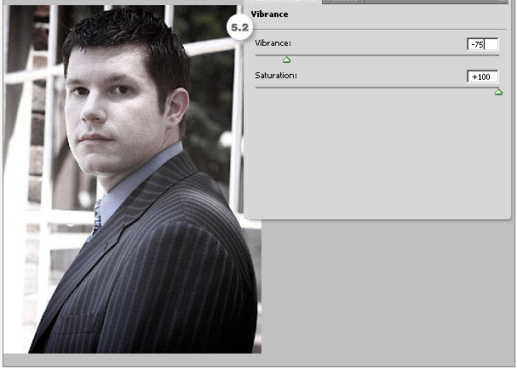
Adjustment & non-adjustment tools (cont’d)
Vibrance
Easily edits the color saturation
This adjustment increases the saturation of less-saturated colors more than the colors that are already saturated.

Slide 11
Hot keys (shortcuts)
Hot keys are shortcuts created by pressing the keys on the keyboard. Each letter has a corresponding tool in Photoshop.
V Move tool
M Rectangular Marquee
L Lasso
J Red Eye Tool
H Hand Tool
C Crop Tool
B Brush Tool
Z Magnifier / Zoom
P pen Tool
Y History Tool
E Eraser Tool
Ctrl + S Save
Ctrl + O Open
Ctrl + P Print
Ctrl + C Copy
Ctrl + X Cut
Ctrl + V Paste
Ctrl + N New Document
Ctrl + ‘+’ Zoom In
Ctrl + ‘-’ Zoom Out
Ctrl + A Select All
Ctrl + D Deselect

Slide 12
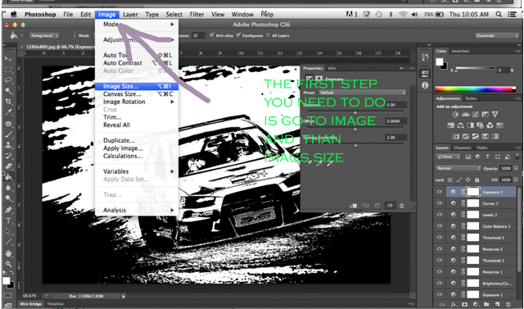
Resizing the image and canvas
Resizing the canvas changes the crispness of the image after editing.
Resizing an image in Photoshop is said to be the easiest facet of the program.
It, however, is key to keeping a crisp and clear image

Slide 13
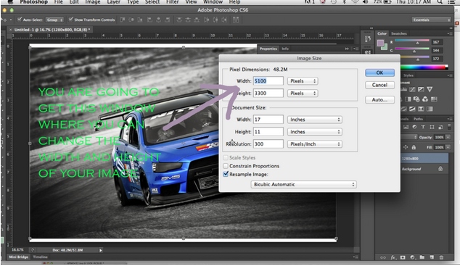
Resizing the image and canvas (cont’d)

Slide 14
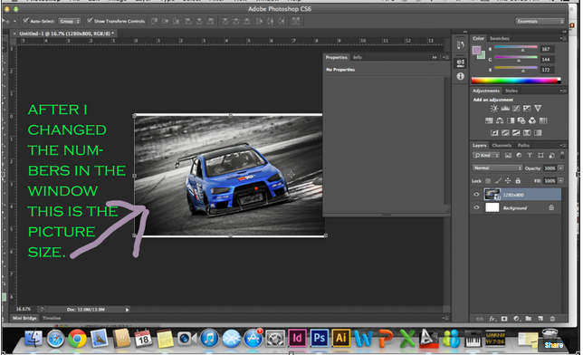
Resizing the image and canvas (cont’d)

Slide 15
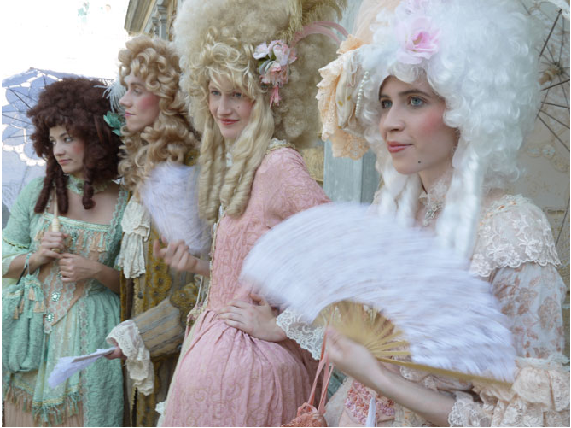
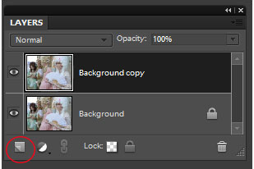
Sharpen & unsharpen mask tools
The Sharpen Tools allows you to sharpen portions of the image although it introduces nasty artifacts into the image.
The CS5 edition has “Protect Detail” in replace of the sharpen tool.

Slide 16
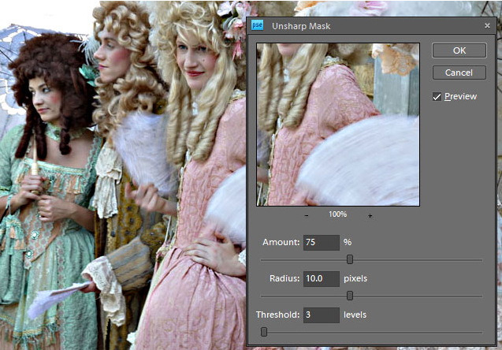
Sharpen & unsharpen mask tools (cont’d)
Amount – sharpness as a percentage
Radius – the pixels wide the sharpen will affect
Threshold – how much sharpness is given

Slide 17
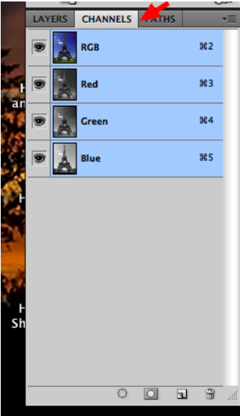
Channels pallete
Channels store the color information of an image
They can also store selections which can help with manipulating graphics in some powerful ways.

Slide 18
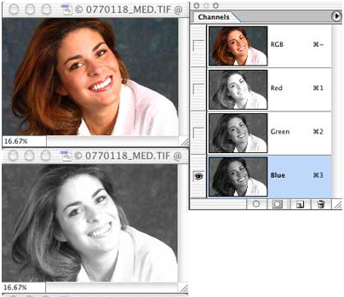
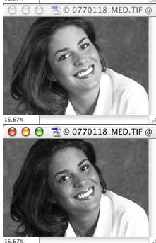
Channels pallete (cont’d)

Slide 19
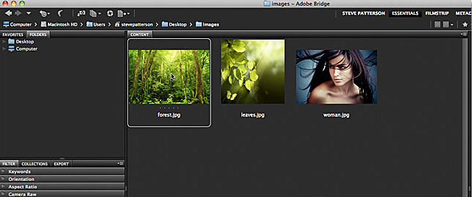
Multi-layered documents
Photoshop images tend to be created with different layers.
Numerous images are used as different layers to be combined or blended with one another.
Prepare images to be combined

Slide 20
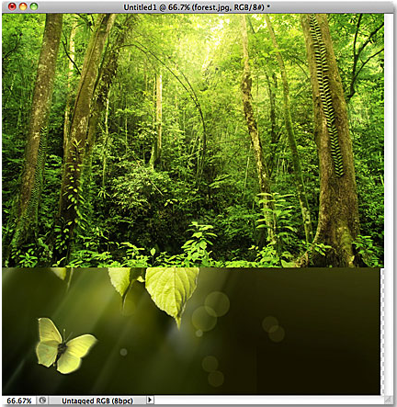
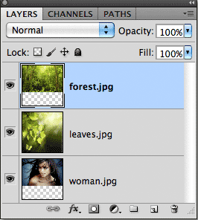
Multi-layered documents (cont’d)
Load the images to Photoshop with a layer each picture.

Slide 21
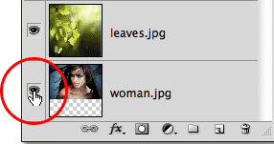
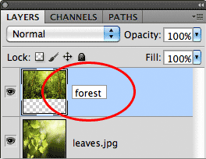
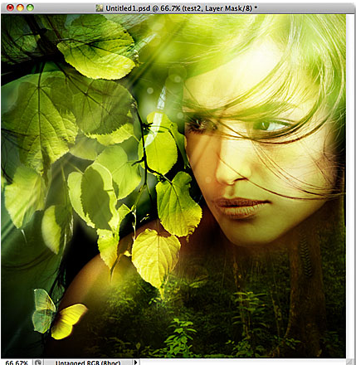
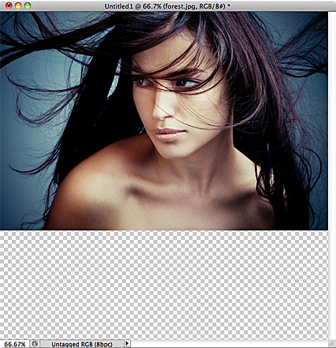
Multi-layered documents (cont’d)
With the use od blend and adjustment tools you can combine the layers.

Slide 22
Thank You!
¡Gracias!
謝謝!
धन्यवाद
Salamat!
Спасибо!
شكرا لك.

