Slide 1
Illustrator
Carlin Baez
Jorge Cornejal
Edisson Garcia

Slide 2
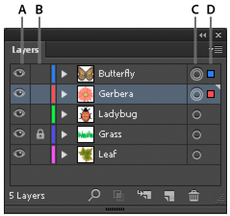
How to Use LAYERs
Illustrator's layers allow you to simplify your work. With layers, you can modify, edit, hide or delete one layer of content while the other layers remain intact.
With Layers you can move items into them, or move elements from one layer to another at any time.
The layer icon is shown above within the red circle.
Afterwards, one would see the layer come up, which one
can modify it name by clicking its name twice. As one
adds more layer the color will chance automatically,
which purpose is to prevent confusion with the items
that are in a separate layer.
Visibility column Indicates whether items in the layers are visible or hidden (blank space), or whether they are template layers or outline layers.
Edit column Indicates whether items are locked or unlocked. The lock icon indicates that the item is locked and cannot be edited; a blank space indicates that the item is unlocked and can be edited.
Target column Indicates whether items are targeted for
application of effects and edit attributes in the Appearance panel. When the target button appears as a double ring icon
(either or ), the item is targeted; a single ring icon indicates that the item is not targeted.
Selection column Indicates whether items are selected. A color
box appears when an item is selected. If an item, such as a layer
or group, contains some objects that are selected and other objects
that are unselected, a smaller selection color box appears next to the
parent item. If all of the objects within the parent item are selected,
the selection color boxes are the same size as the marks that appear
next to selected objects.
A. Visibility column B. Edit column
C. Target column D. Selection column

Slide 3
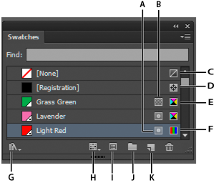
Swatch Pallet
Swatches are named colors, tints, gradients, and patterns. The swatches associated with a document appear in the Swatches panel. Swatches can appear individually or in groups.
Choose Window > Swatch Libraries > [library name].
In the Swatches panel menu, choose Open Swatch Library > [library name].
In the Swatches panel, click the Swatch Libraries Menu button , and choose a library from the list.
A. Spot color
B. Global color
C. Fill or stroke of None
D. Registration swatch (prints on all plates)
E. CMYK symbol (when document is open in CMYK mode)
F. RGB symbol (when document is open in RGB mode)
G. Swatch Library Menu button
H. Show Swatch Kinds Menu button
I. Swatch Options button
J. New ColorGroup button
K. New Swatch button

Slide 4
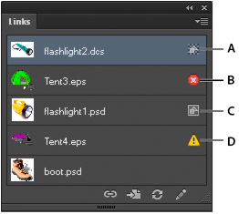
Link Images
When you place a graphic, you will see a screen-resolution version of the file in the layout, so that you can view and position it, but the actual graphic file may be either linked or embedded.
To display the panel, choose Window > Links.
Each linked file and embedded file is identified by name
A. Transparency interaction
B. Missing artwork
C. Embedded artwork
D. Modified artwork

Slide 5
Rgb/cmyk
When creating a new document you can select the colors mode clicking file> new
RGB : the visible spectrum can be represented by mixing red, green, and blue (RGB) colored light in various proportions and intensities.. These colors are used for lighting, television, and computer monitors.
CMYK: You can work with color values using the CMYK color mode, which represent cyan, magenta, yellow, and black. In CMYK mode the colors displayed are identical to the way they will
*Use CMYK when preparing a document to be printed using process inks.
Click advance settings ad toggle color mode desired

Slide 6
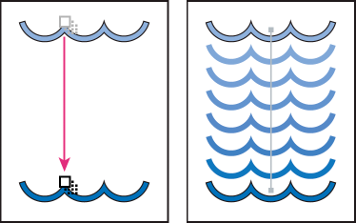
Blend tool
You can blend objects to create and distribute shapes evenly between two objects. You can also blend between two open paths to create a smooth transition between objects, or you can combine blends of colors and objects to create color transitions in the shape of a particular object.
To use blend tool >click object> blend
>blend objects. And select smooth
Example of using a blend to distribute shapes evenly between two objects
Example of using a blend to distribute color smoothly between two objects

Slide 7
Pixelate
To toggle this tool
click effect> pixelate
select the pixilation
mode desired.
The Pixelate effects are raster-based and use the document’s raster effects settings whenever you apply the effect to a vector object.
Color Halftone : Simulates the effect of using an enlarged halftone screen on each channel of the image. For each channel, the effect divides the image into rectangles and replaces each rectangle with a circle. The circle size is proportional to the brightness of the rectangle.
Crystallize : Clumps colors into polygon shapes.
Mezzotint: Converts an image to a random pattern of black-and-white areas, or of fully saturated colors in a color image. To use the effect, choose a dot pattern from the Type pop-up menu in the Mezzotint dialog box.
Pointillize Breaks up the color in an image into randomly placed dots, as in a pointillist painting, and uses the background color as a canvas area between the dots.

Slide 8
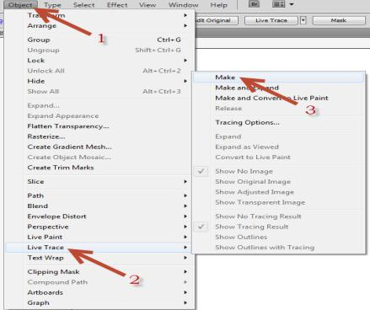
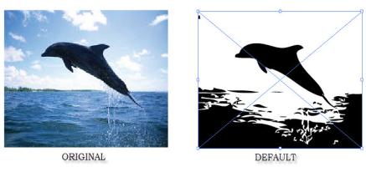
Live Trace
The command live trace is a powerful process that really gives the artist freedom to digitally experiment with an type of drawings.
1.OBJECT 2.LIVE TRACE 3.MAKE
Click the image > Object menu > Scroll down to Live trace > Click Make
YOU CAN CHANGE THE WAY THE IMAGE MAY LOOKS.

Slide 9
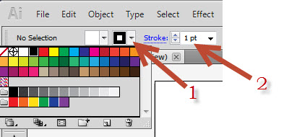
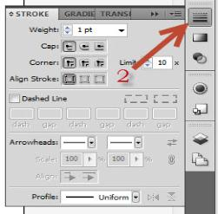
Stroke Panel
A stroke can used to show the visible outline of an object, path or an edge of a live paint group. Using the stroke panel you can control the width and color of a stroke.
1.STROKE COLOR 2.LINE WEIGHT
Click stroke icon to change the color > Click stroke to change line weight
1.COLOR 2.SELECT LINES, LINE WEIGHT
AND ALIGNMENT

Slide 10
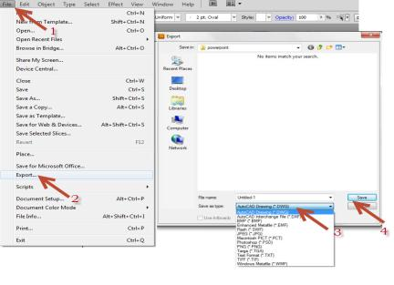
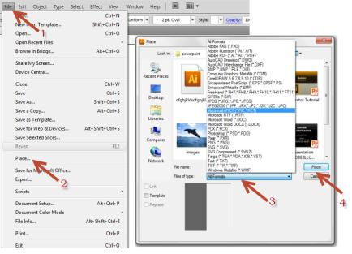
Export & Import
The export and import command helps you in several ways. Export is used to convert files from adobe illustrator into an Autocad drawing or even a JPEG. The command import (place) is used to place different type of files into adobe illustrator.
1.FILE 2.EXPORT 3.FILE TYPE 4.CLICK SAVE
Click file > Export > Click on the type of file > Save
Click file > Place > Click on the type of file > Save
1.FILE 2.PLACE 3.FILE TYPE 4.CLICK PLACE

Slide 11
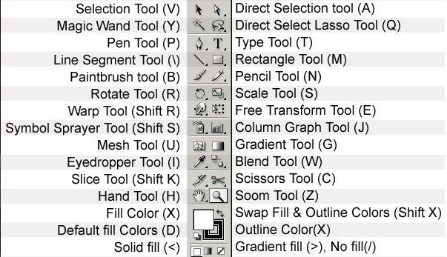
Hot Cues (Short Cuts)
These are the shortcuts that would help you to manage your work while one is doing a certain project and one can navigate to tools in a faster manner.
These are the shortcuts ….→
* Make sure you are off the command before processing to your next shortcut

