Slide 1
Still Animation
Screen captures from Revit

Slide 2
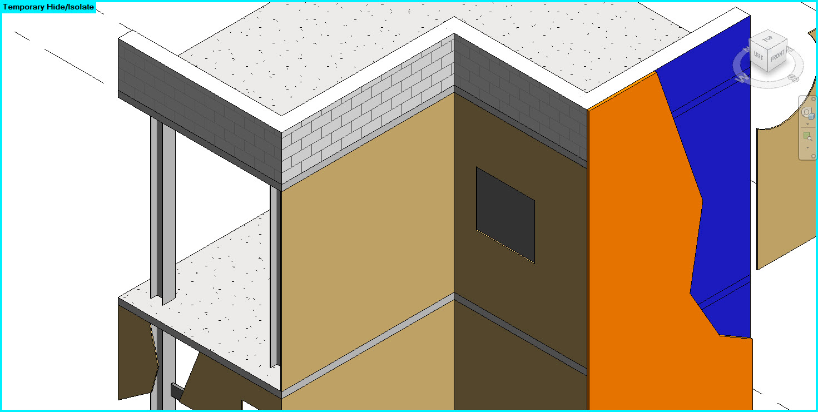
Slide 1 – slabs and structure

Slide 3
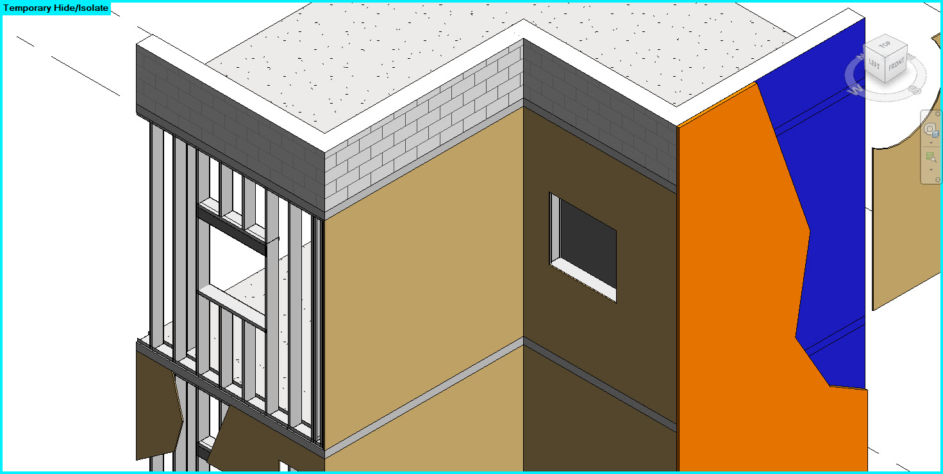
Slide 2 – 8” metal stud frame

Slide 4
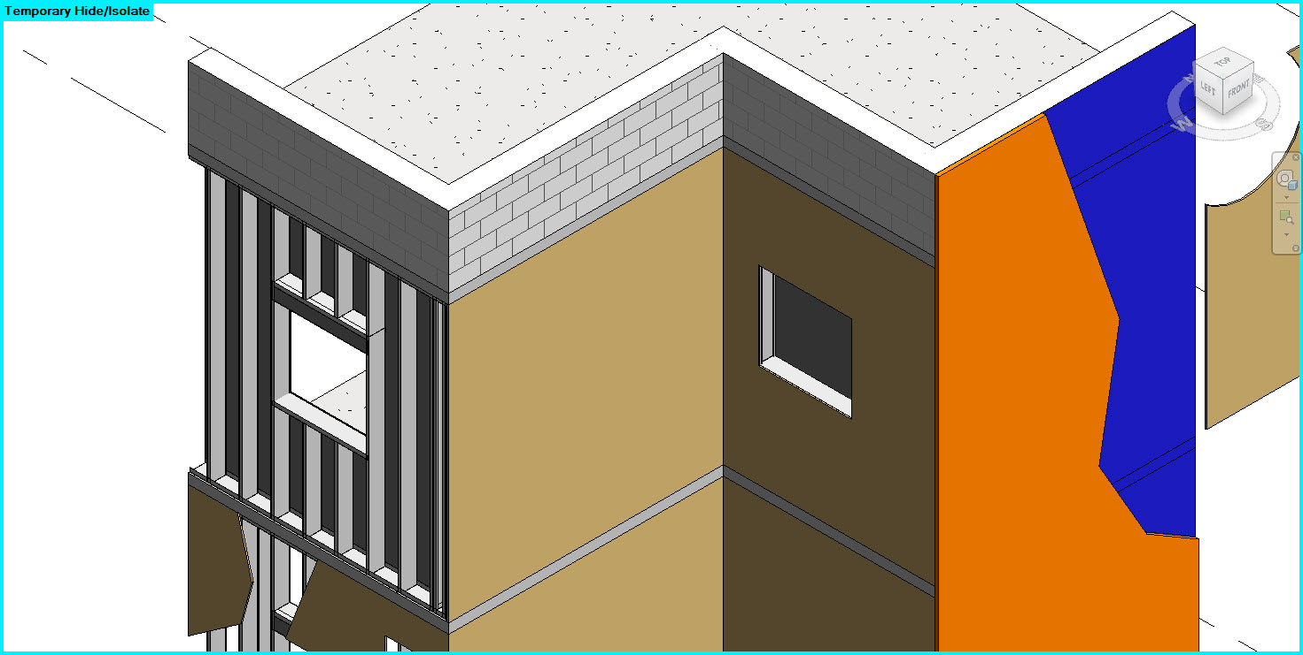
Slide 3 – 5/8” gwb on the inside

Slide 5
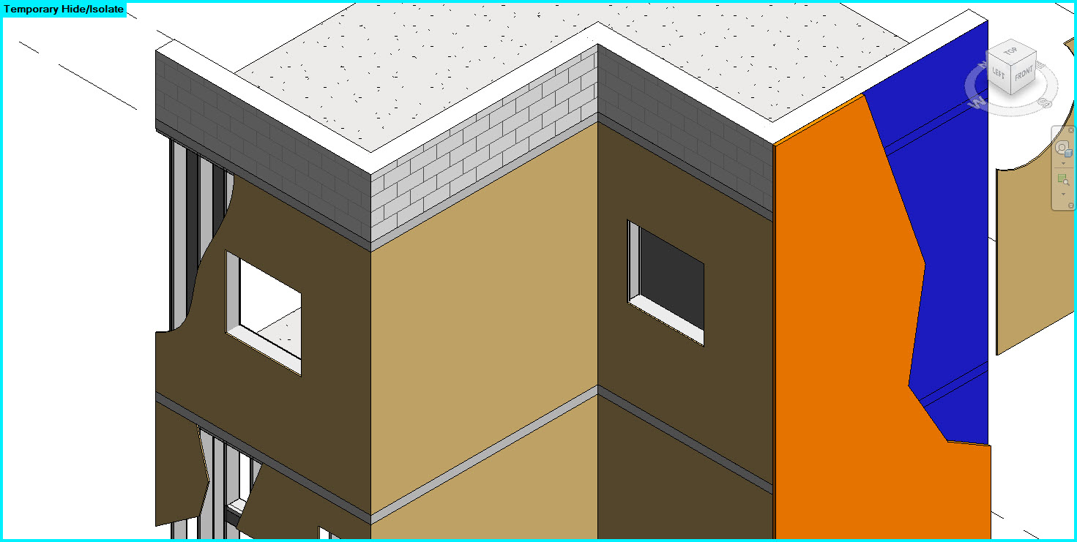
Slide 4 – sheathing on the outside

Slide 6
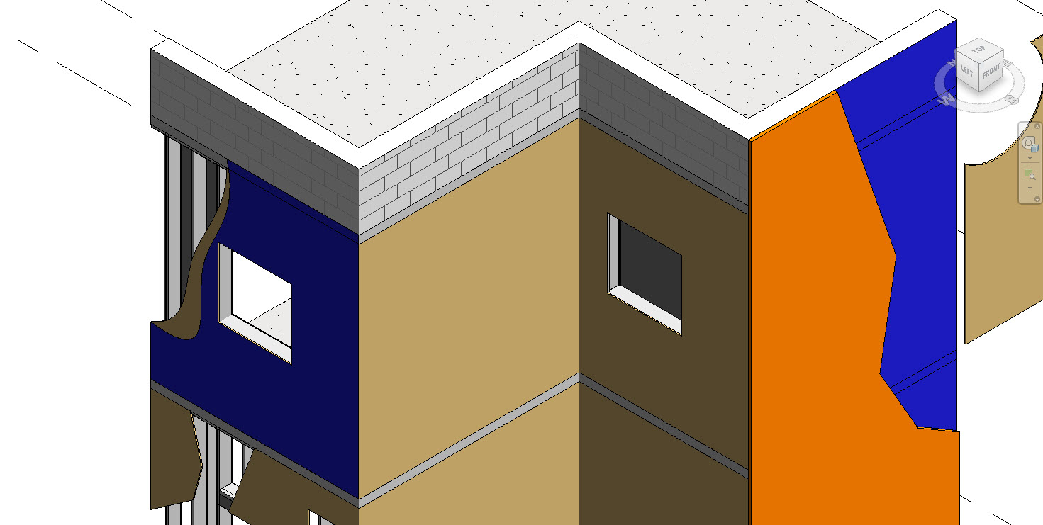
Slide 5 – waterproofing layer

