Slide 1
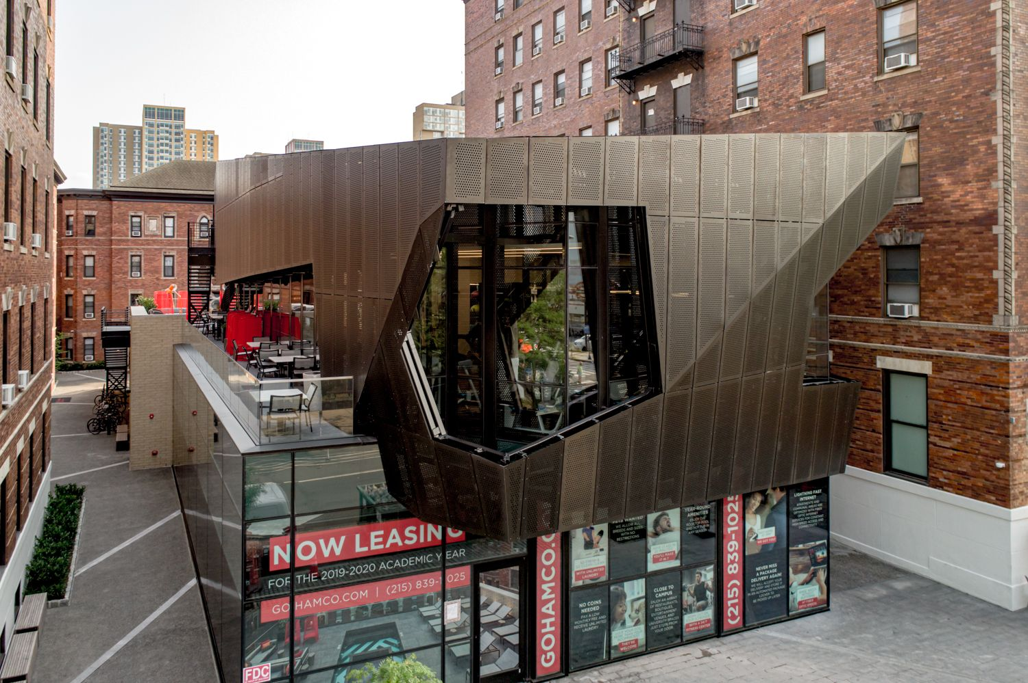
Name: Juan Dirsio Class:ARCH.2431 Professor: Paul King Juan Dirsio, Daniel Perez, Joshua Rodriguez
Façade Materials

Slide 2
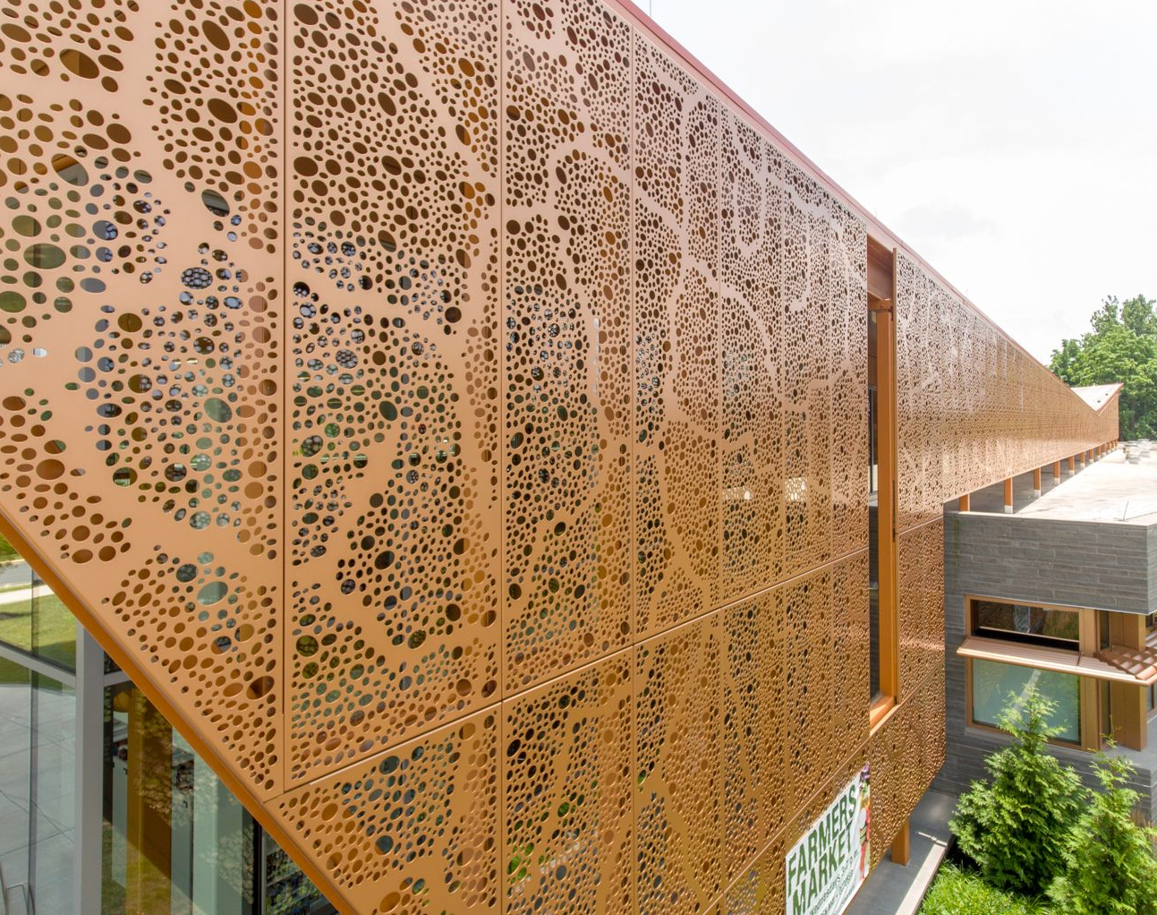
H-Clad HD System
By: Hendrick Architectural
1 7th Ave, Carbondale, PA 18407
Features
• Aluminum panel thickness of .125” or .190”
• Standard panel widths of 36”, 42” or 48”
• Standard panel lengths of 72”, 96” or 120”
Patterns:
Perforated or Lasered Patterns
Materials:
Aluminum

Slide 3
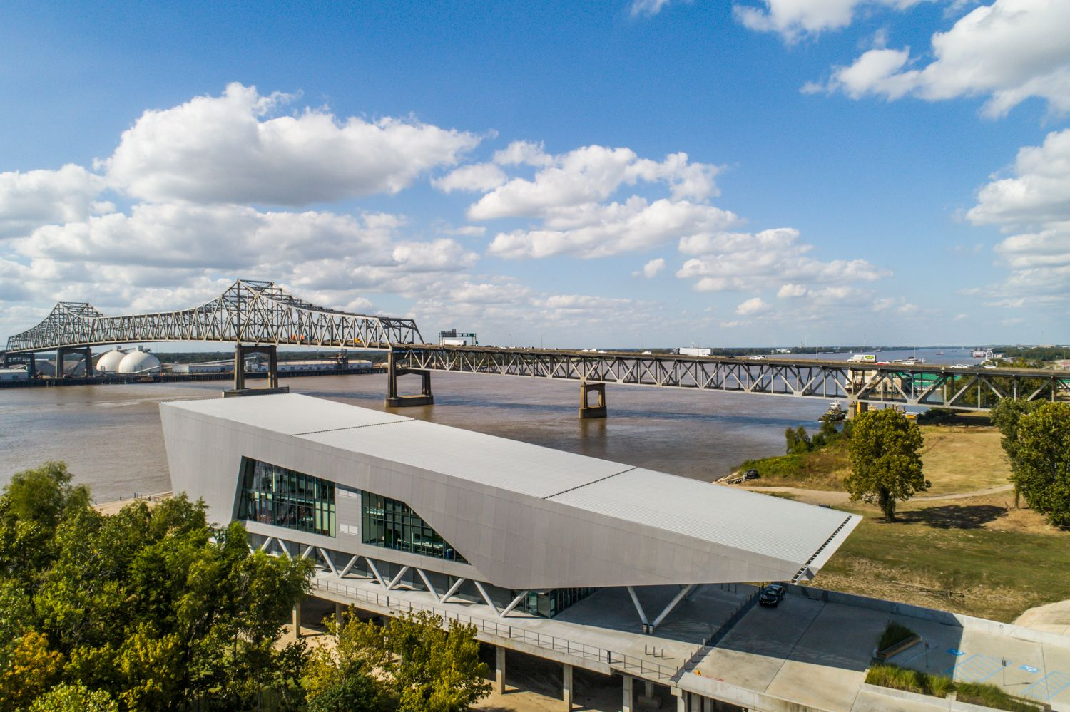
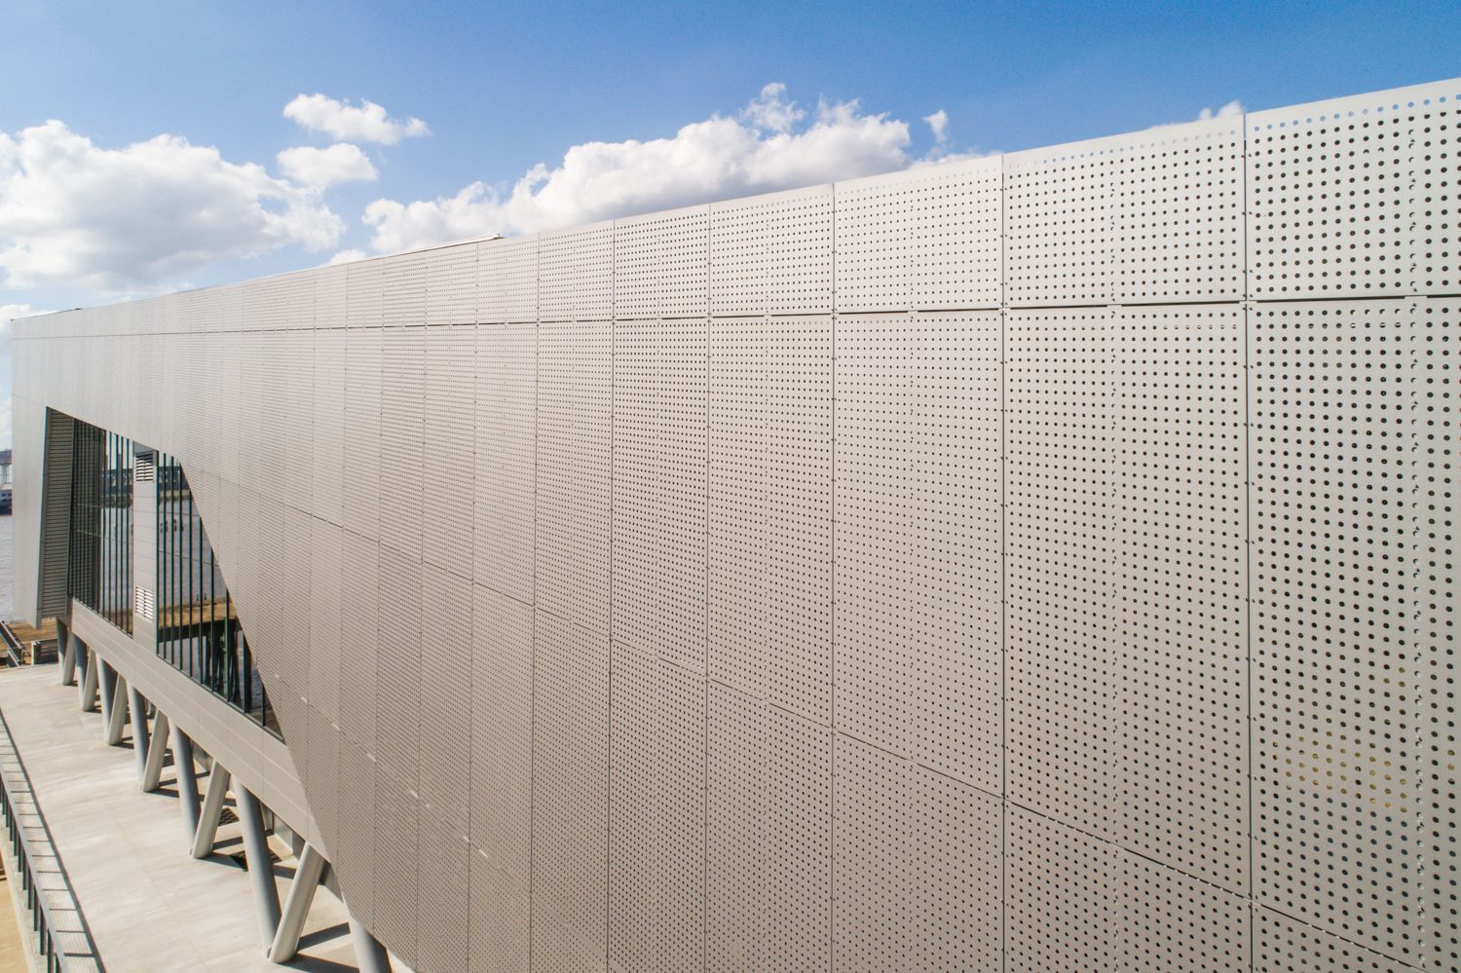
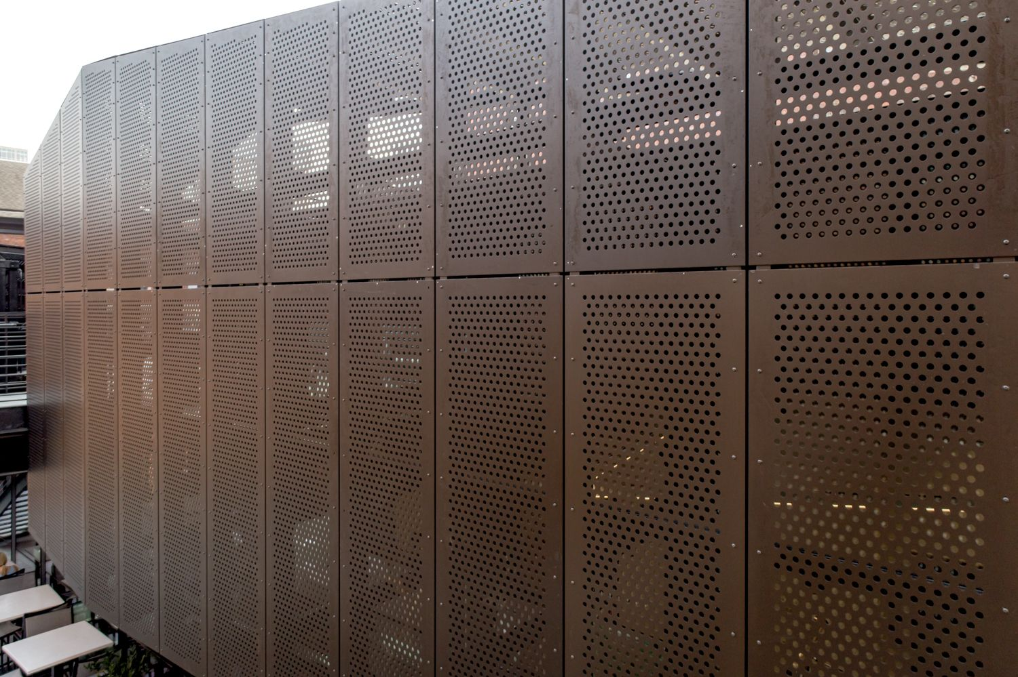
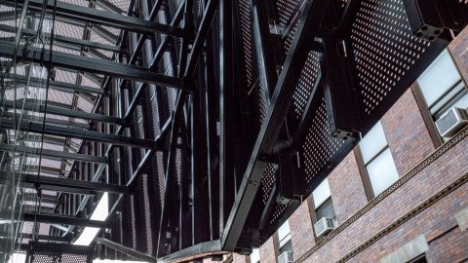
Opaque Material – Case Study
The Water Institute of the Gulf Baton Rouge, LA
Court Assembly 39th St, Philadelphia, PA

Slide 4
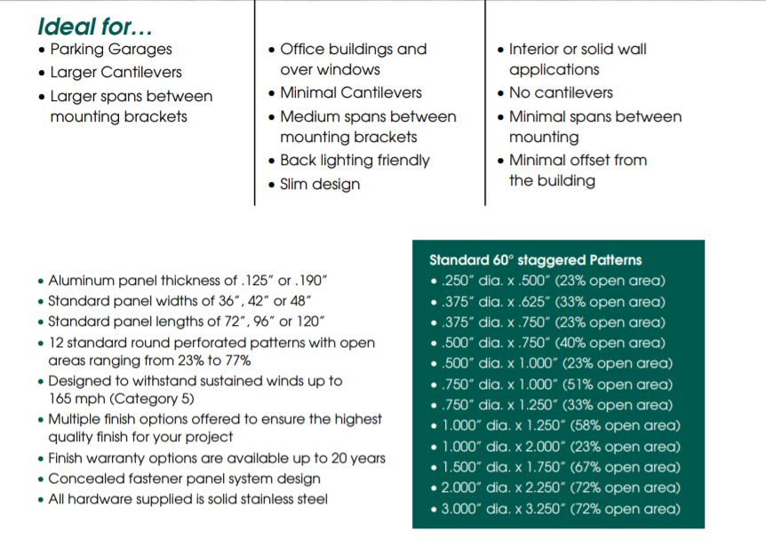
Model Types

Slide 5
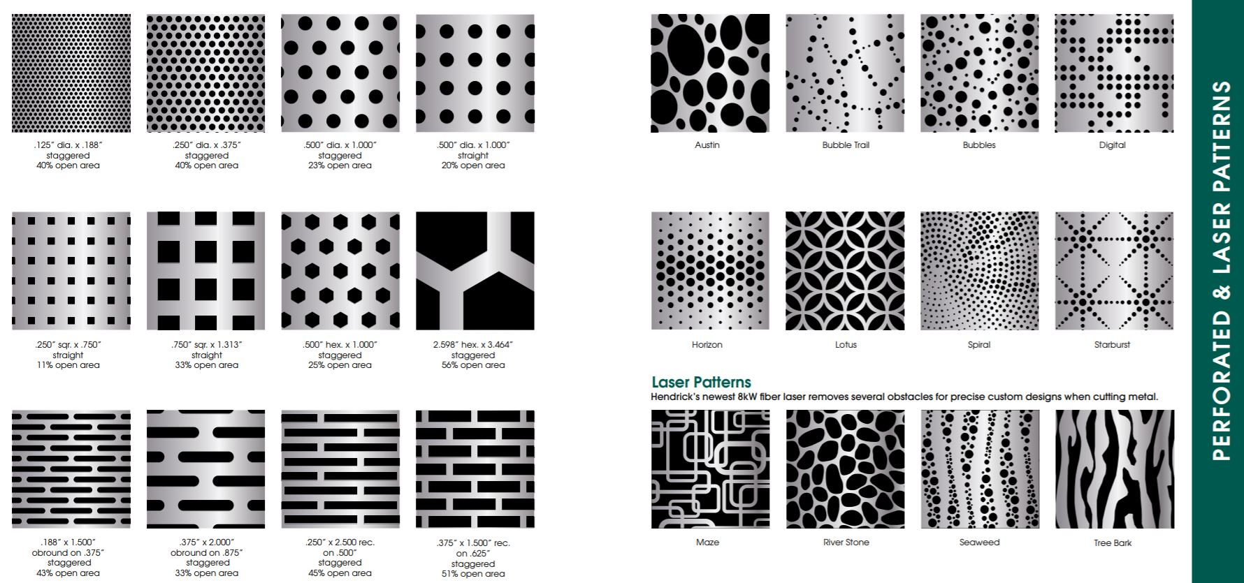

Slide 6
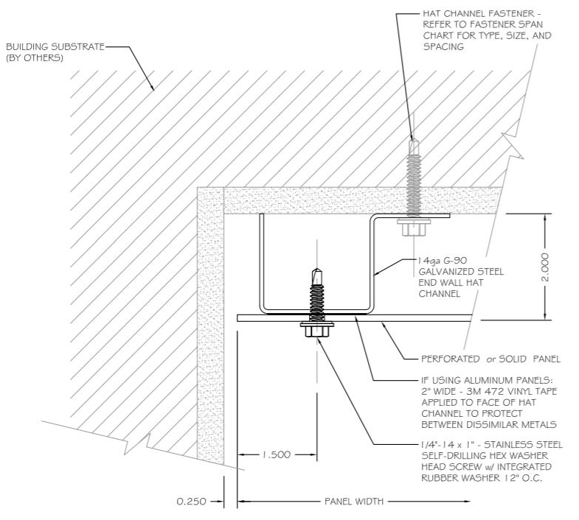
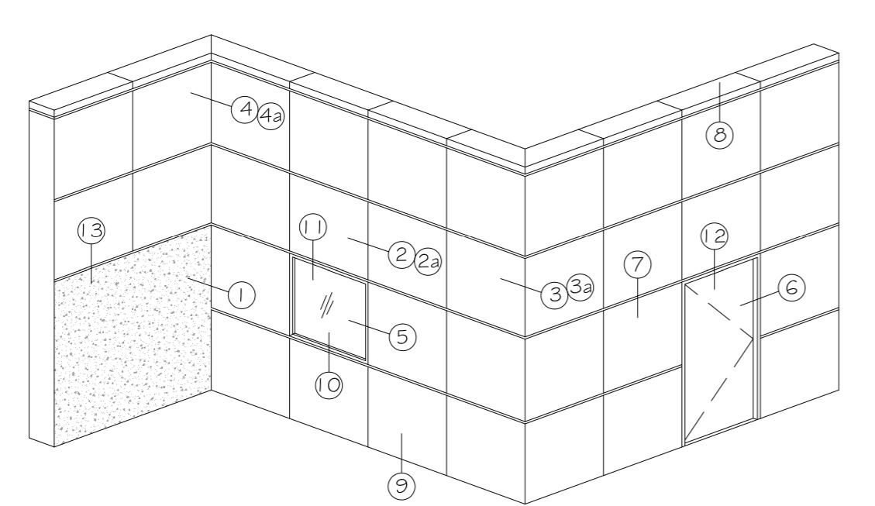
Plan /3D Detail Corners

Slide 7
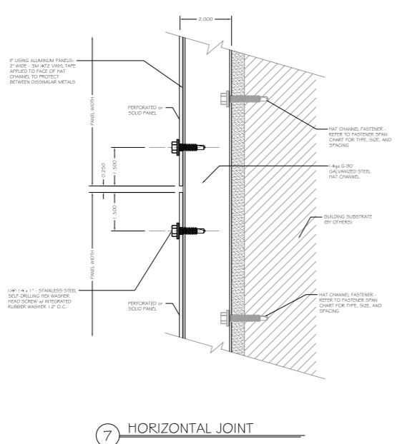
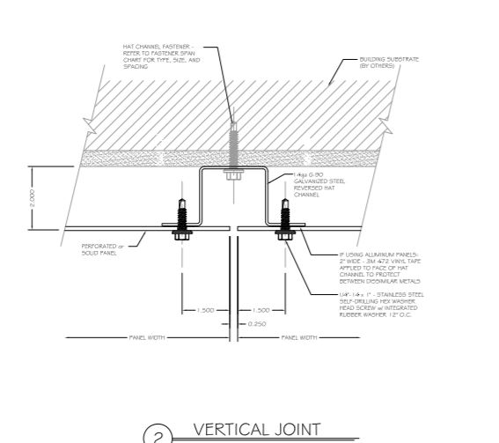
Joints

Slide 8
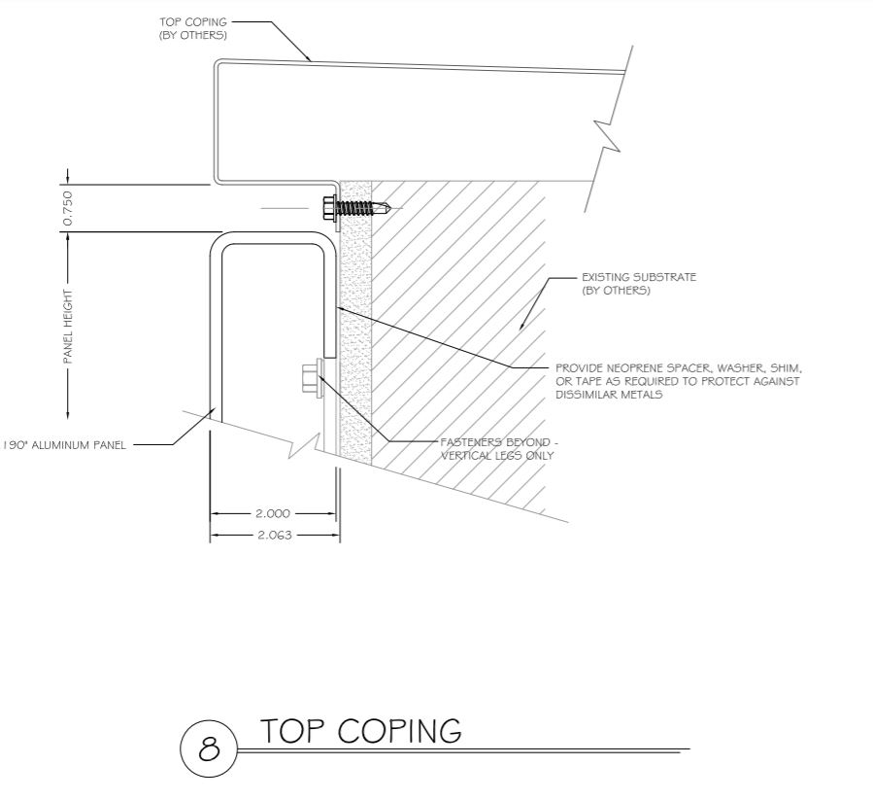
Elevation Top/Bottom Assembly

Slide 9
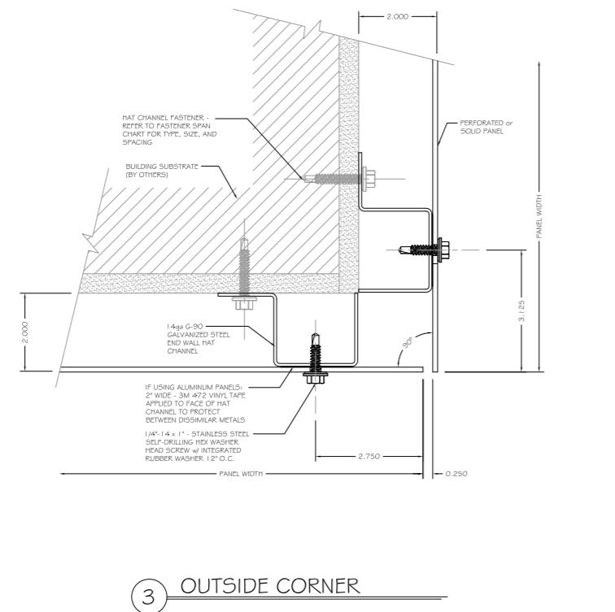
Inside/Outside Corners

Slide 10
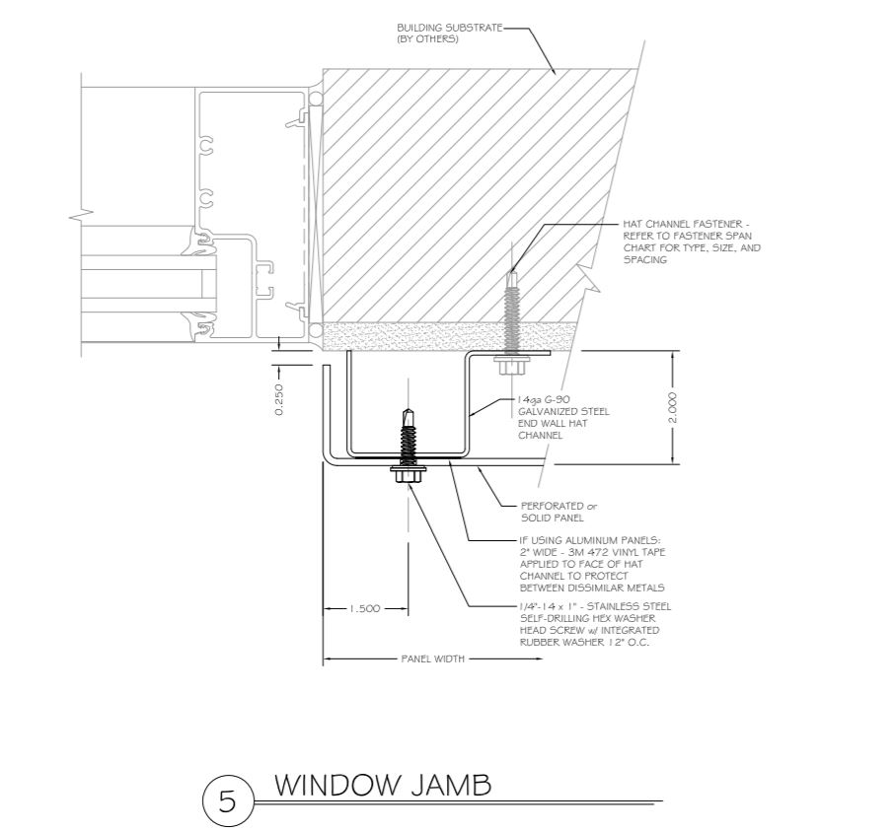
Window Connections

Slide 11
Material Options and Spans

Slide 12
Links
Company Site
http://www.wausauwindow.com/index.cfm
Unit
http://www.wausauwindow.com/index.cfm?pid=44&pageTitle=Product%20Detail&prID=25
http://www.wausauwindow.com/resources/files/Wausau_3in.Face_Superwall_Binder_Details.pdf
Video
https://www.youtube.com/watch?v=rQHZLT82hcE

Slide 13
Video

Slide 14
Curtain Wall Company: Wausau Model: Super Wall™(3”) Features
Wausau’s flagship curtainwall product line
4 3/4”, 6 1/4”, 7 1/4”, 8 1/4” or 10 1/4” frame depths
Several frame depths including cladding for steel tubes
2 1/2” or 3” exterior sight line - Many accent covers available
3/8” thermal separation
The Wausau Suprewall (3”Trim Cover)

Slide 15
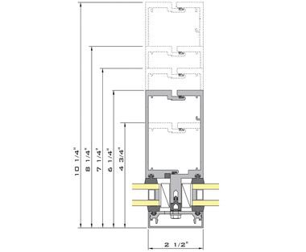
Wausau Super wall

Slide 16
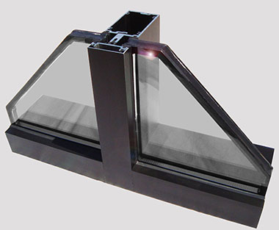
Tee/Pocket Photos

Slide 18
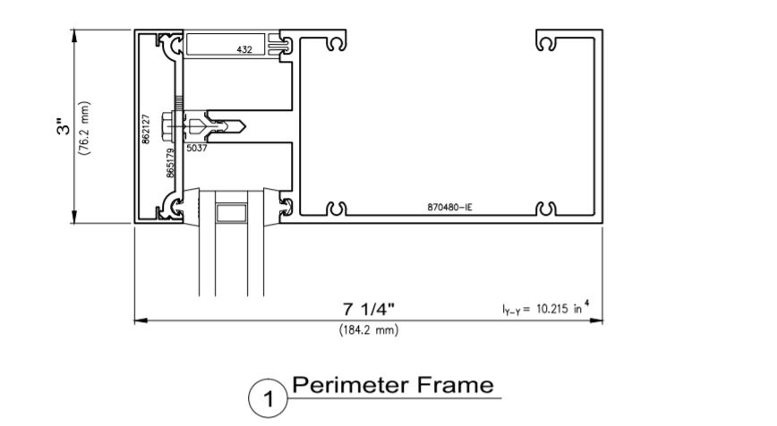
Window Frame Plan
The Wuhan 3” Super Wall features windows thickness from 1/4” to 1 1/8” with various sizing Trim Cover

Slide 19
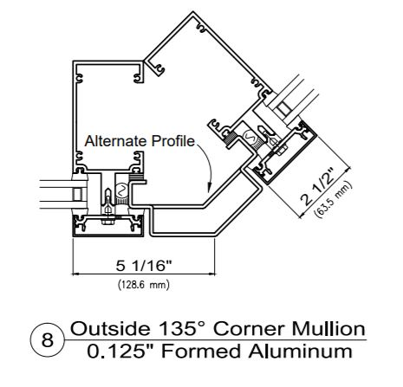
Angle Inside/Outside Corners

Slide 20
90 Degrees In and out Corners

Slide 21
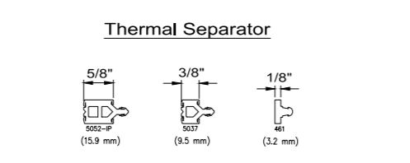
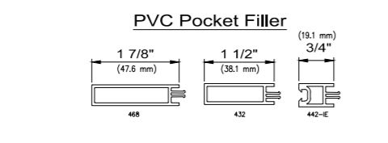
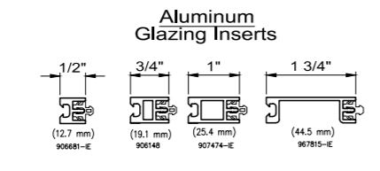
Miscellaneous Parts

Slide 22
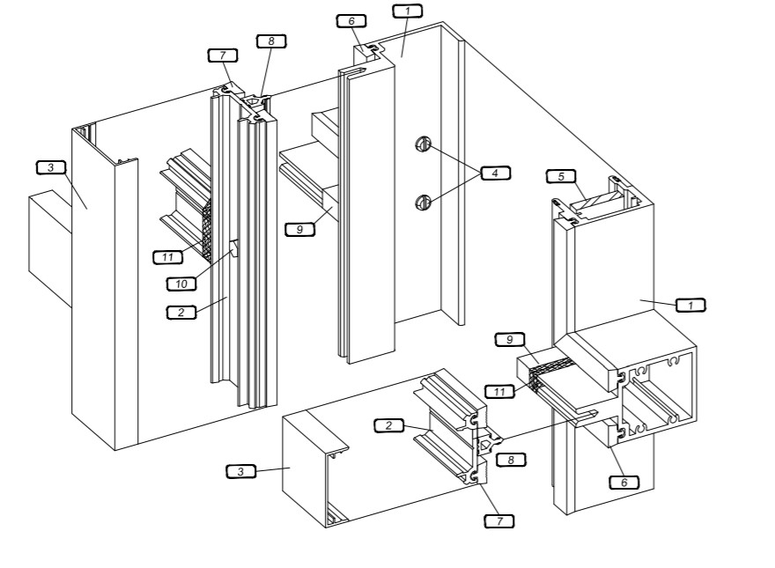
A Trim Cover will be placed following exterior glazing gasket and Thermal Separator onto a Base Plate.
Exploded View
Assemble View

Slide 23
A Perimeter will be installed to secure the window. The Fully assemble unit well then be anchor in to place.

Slide 24
Links
Company Site
https://www.hendrickcorp.com/architectural/
Unit
https://www.hendrickcorp.com/architectural/products/arch-cladding/
file:///C:/Users/juand/Downloads/perforated_metal_wall_panels_-_exposed_fastener_system_details%20(4).pdf
Video
https://www.youtube.com/watch?v=G_tMFgYcOaI

Slide 25
Video

