Slide 1
Façade Material Presentation
Victor Centeno
ARCH2431 - Btech 3 SP2020
Prof. Paul King
Team Members: Richard Lee & Estarlin De La Rosa

Slide 2
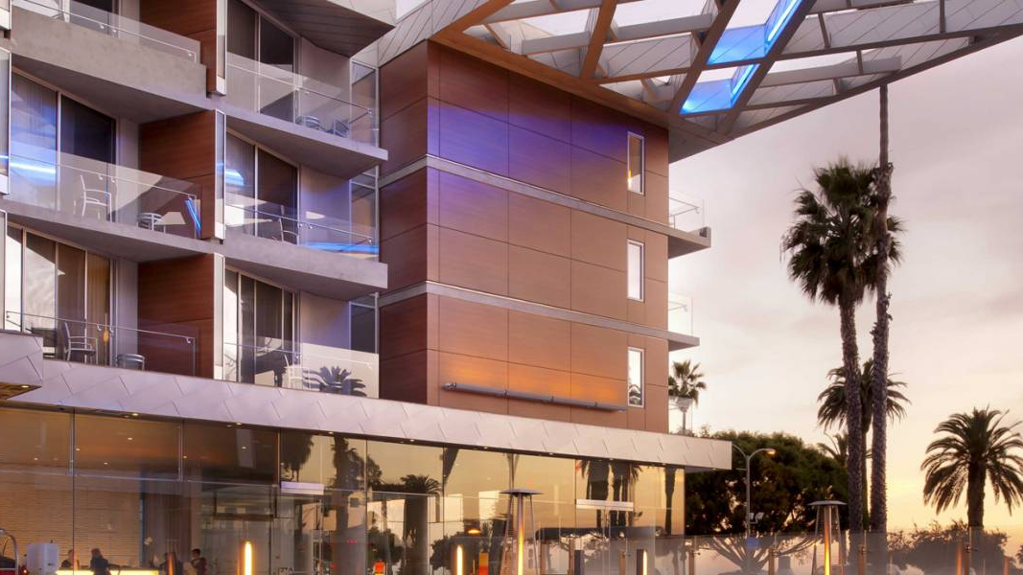
Opaque Material – Case Study
Shore Hotel – Santa Monica, United States

Slide 3
Detail Information
https://www.trespa.info/en/documents/Meteon/General-guidelines-fixing-systems?r=10

Slide 4
https://www.trespa.info/en/documents/Meteon/General-guidelines-fixing-systems?r=10

Slide 5
https://www.trespa.info/en/documents/Meteon/General-guidelines-fixing-systems?r=10

Slide 6
https://www.trespa.info/en/documents/Meteon/General-guidelines-fixing-systems?r=10

Slide 7
https://www.trespa.info/en/documents/Meteon/General-guidelines-fixing-systems?r=10

Slide 8
https://www.trespa.info/en/documents/Meteon/General-guidelines-fixing-systems?r=10

Slide 9
https://www.trespa.info/en/documents/Meteon/General-guidelines-fixing-systems?r=10

Slide 10
https://www.trespa.info/en/documents/Meteon/General-guidelines-fixing-systems?r=10

Slide 11
https://www.trespa.info/en/documents/Meteon/General-guidelines-fixing-systems?r=10

Slide 12
https://www.trespa.info/en/documents/Meteon/General-guidelines-fixing-systems?r=10

Slide 13
https://www.trespa.info/en/documents/Meteon/General-guidelines-fixing-systems?r=10

Slide 14
https://www.trespa.info/en/documents/Meteon/General-guidelines-fixing-systems?r=10

Slide 15
https://www.trespa.info/en/documents/Meteon/General-guidelines-fixing-systems?r=10

Slide 16
https://www.trespa.info/en/documents/Meteon/General-guidelines-fixing-systems?r=10

Slide 17
https://www.trespa.info/en/documents/Meteon/General-guidelines-fixing-systems?r=10

Slide 18
https://www.trespa.info/en/documents/Meteon/General-guidelines-fixing-systems?r=10

Slide 19
Opaque Material - Videos
https://youtu.be/VZQ9gsz1o60?t=42
https://youtu.be/QEp9V1OV3Qc?t=48

Slide 20
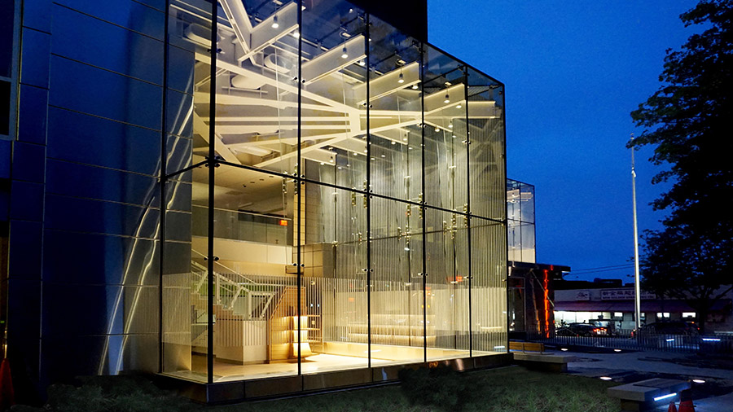
Glass Curtain Wall Material - Case Study
Queens Public Library Elmhurst

Slide 21
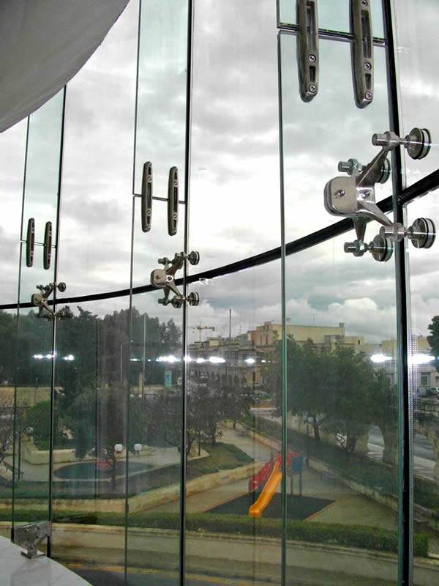
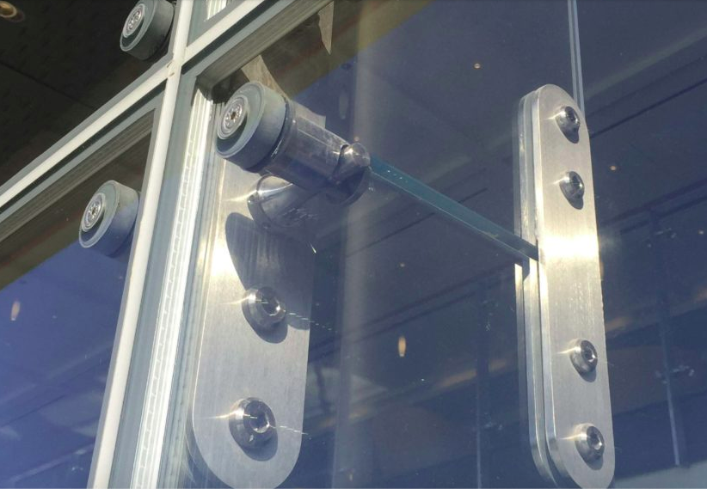
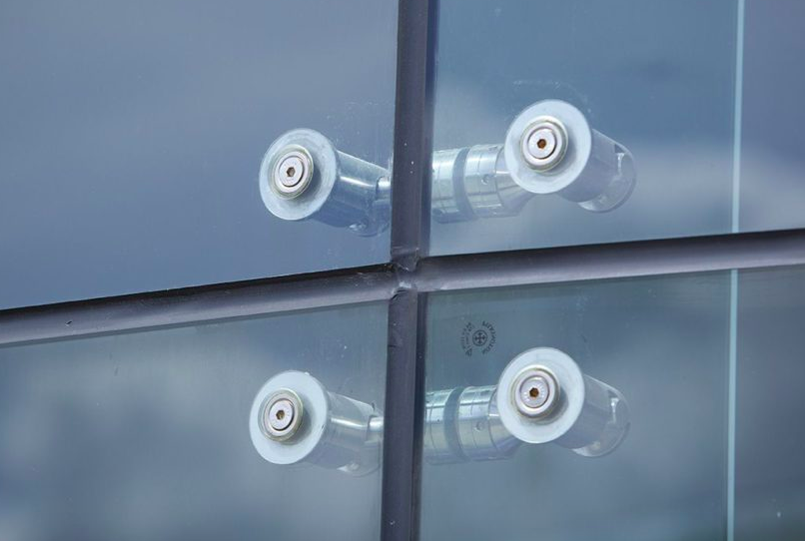

Slide 22
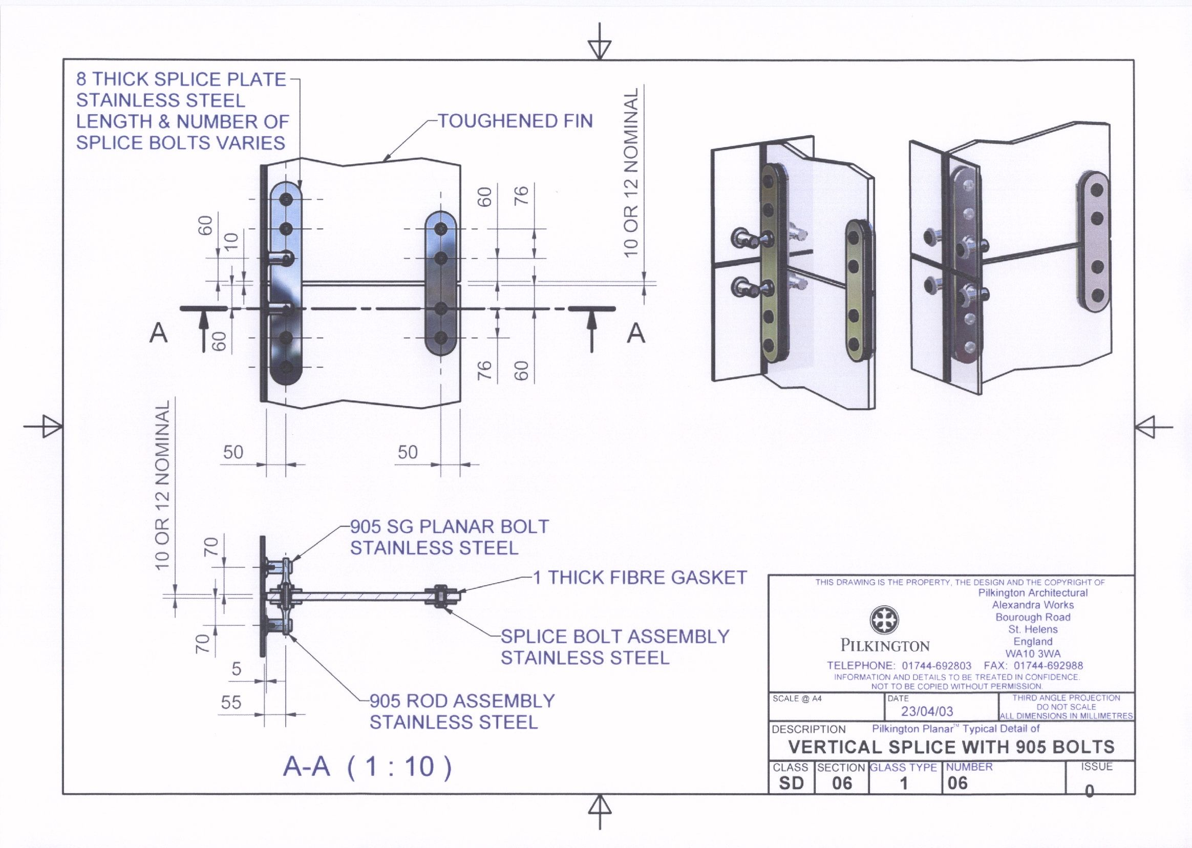
https://www.wwglass.com/pilkington-planar/

Slide 23
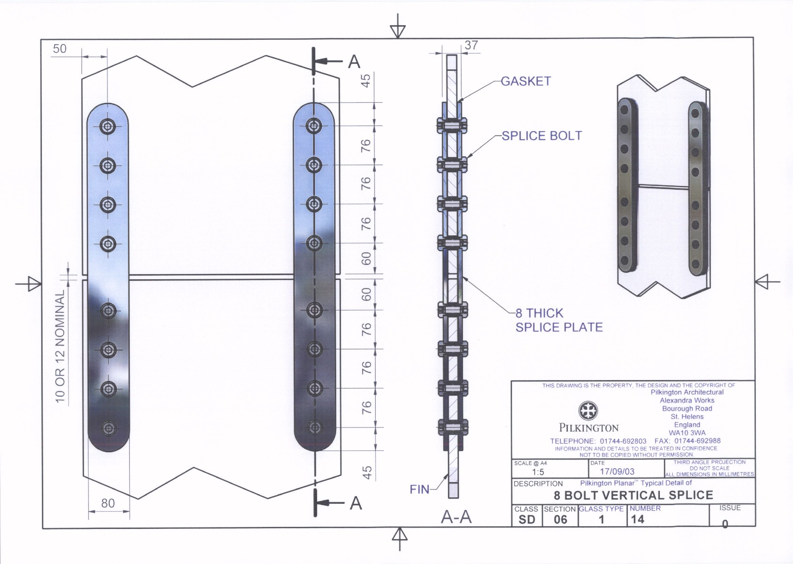
https://www.wwglass.com/pilkington-planar/

Slide 24
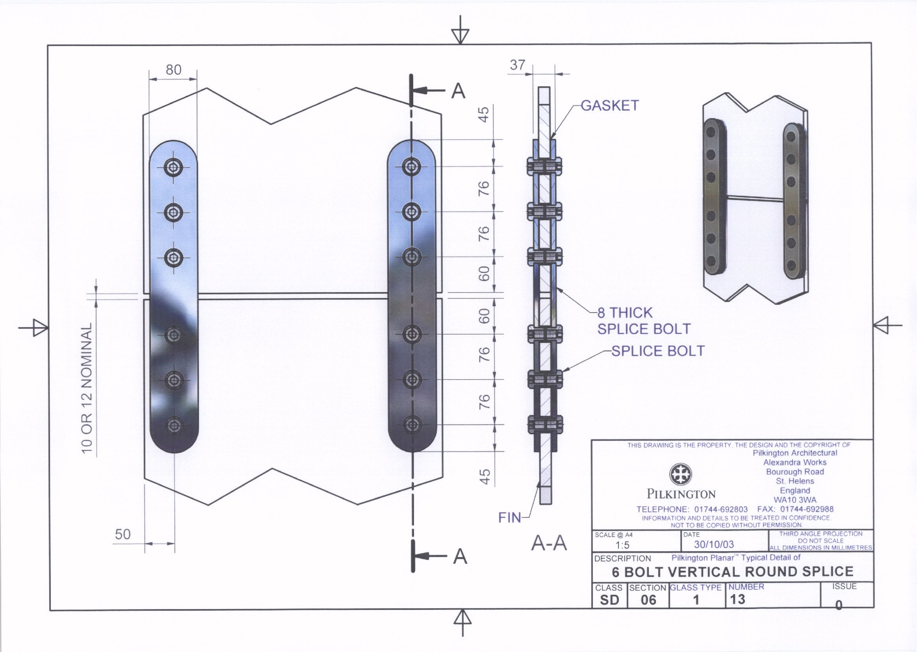
https://www.wwglass.com/pilkington-planar/

Slide 25
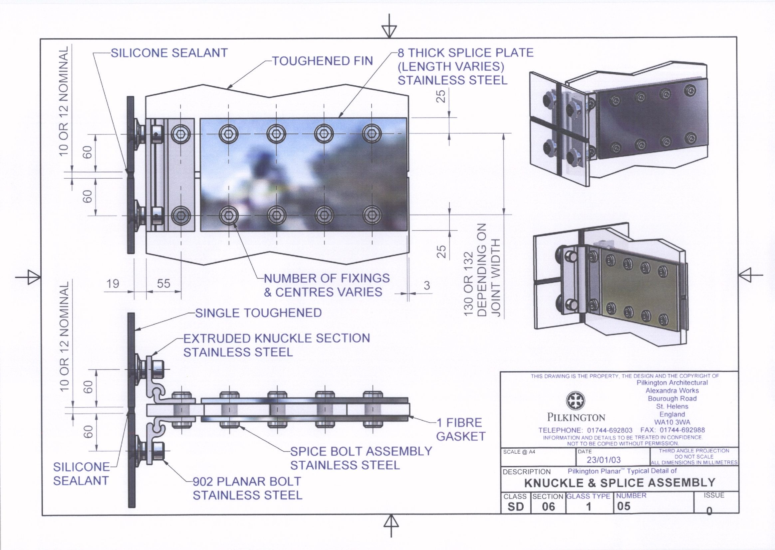
https://www.wwglass.com/pilkington-planar/

Slide 26
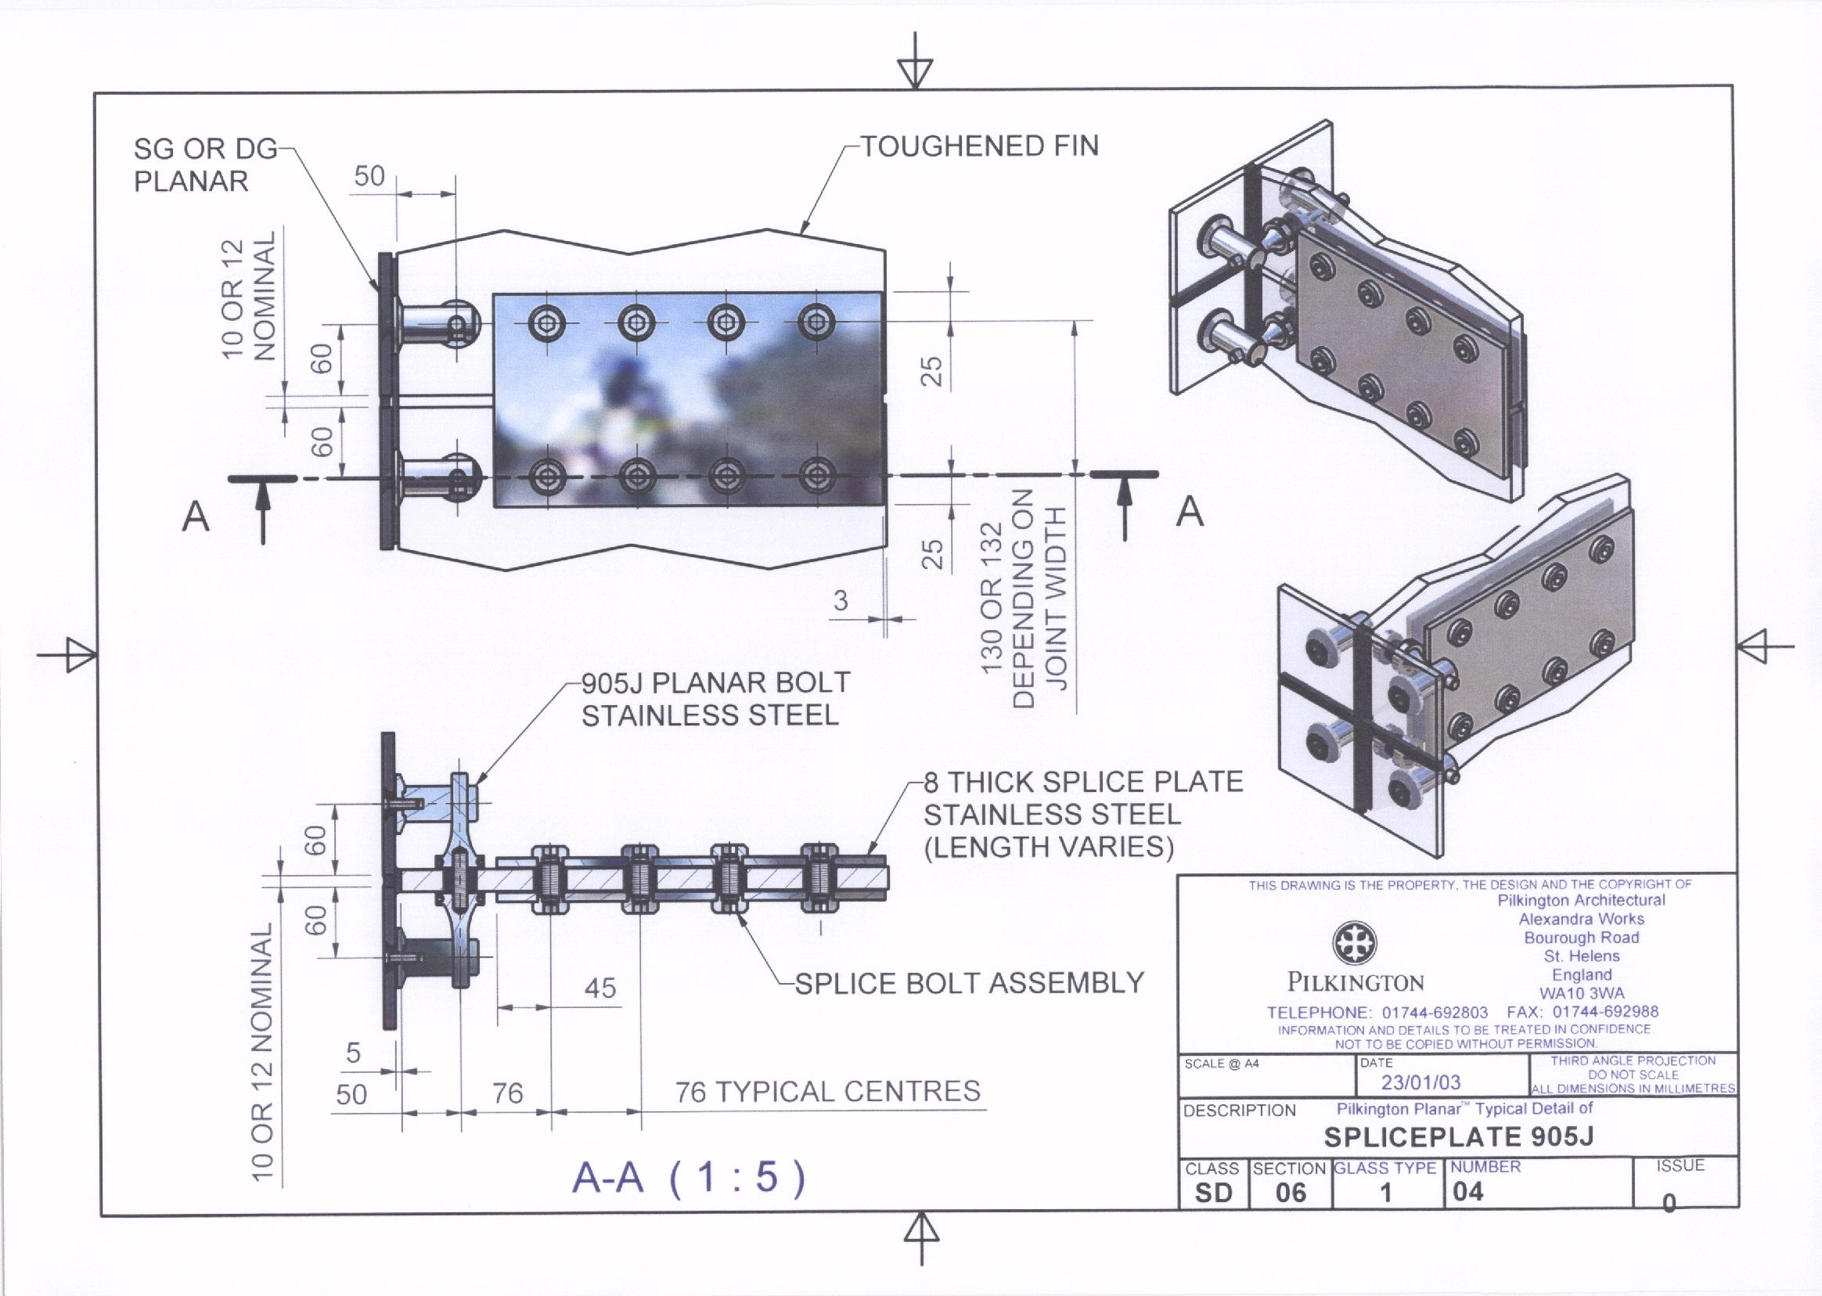
https://www.wwglass.com/pilkington-planar/

Slide 27
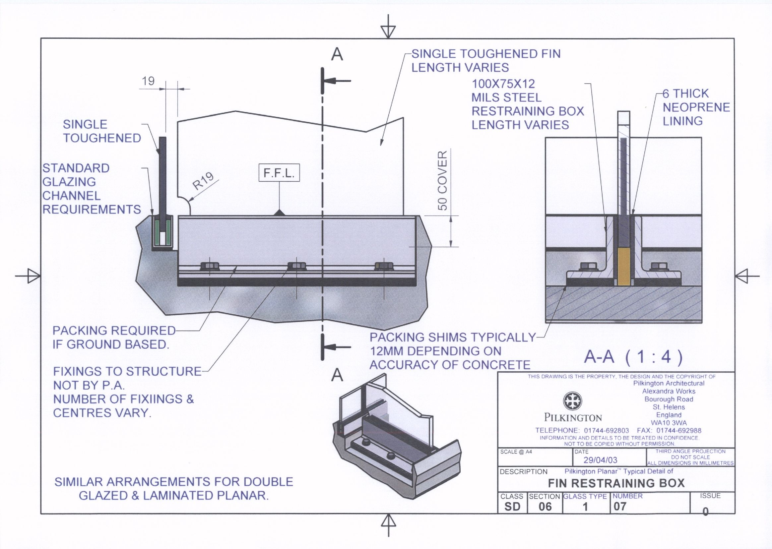
https://www.wwglass.com/pilkington-planar/

Slide 28
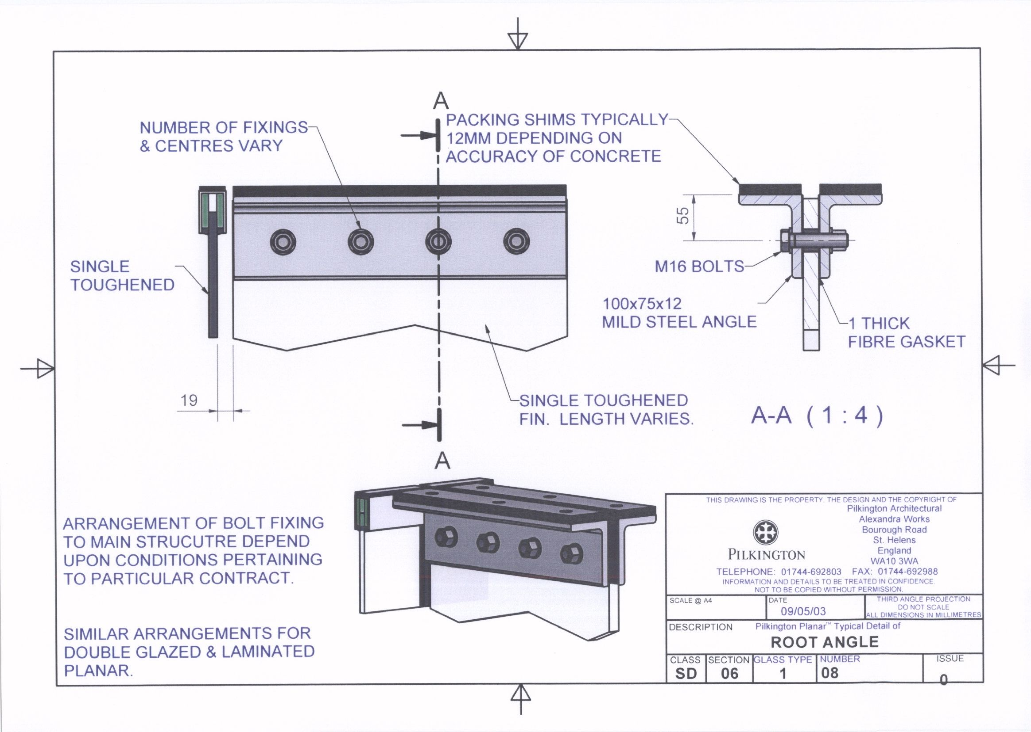
https://www.wwglass.com/pilkington-planar/

Slide 29
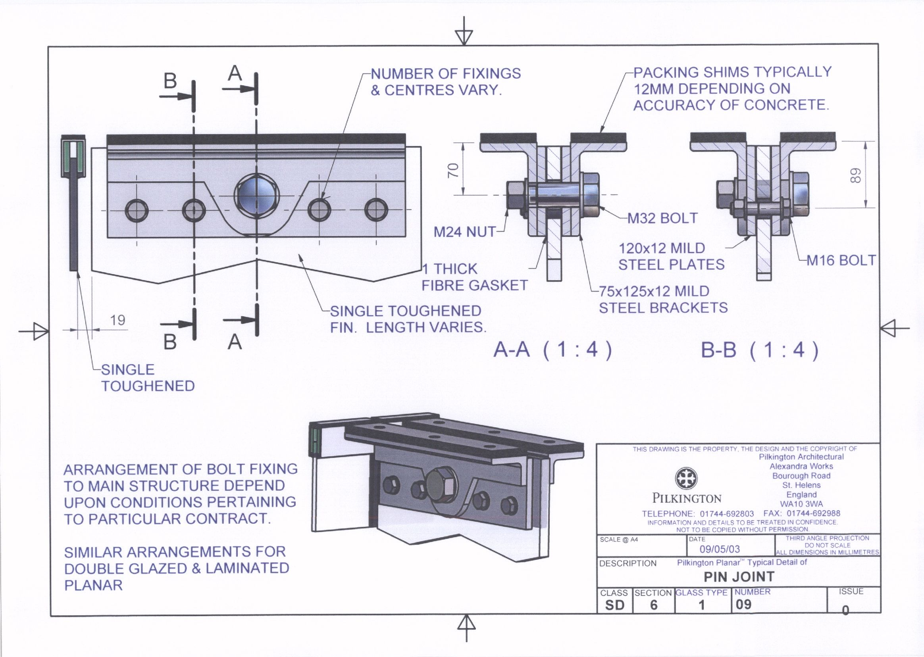
https://www.wwglass.com/pilkington-planar/

Slide 30
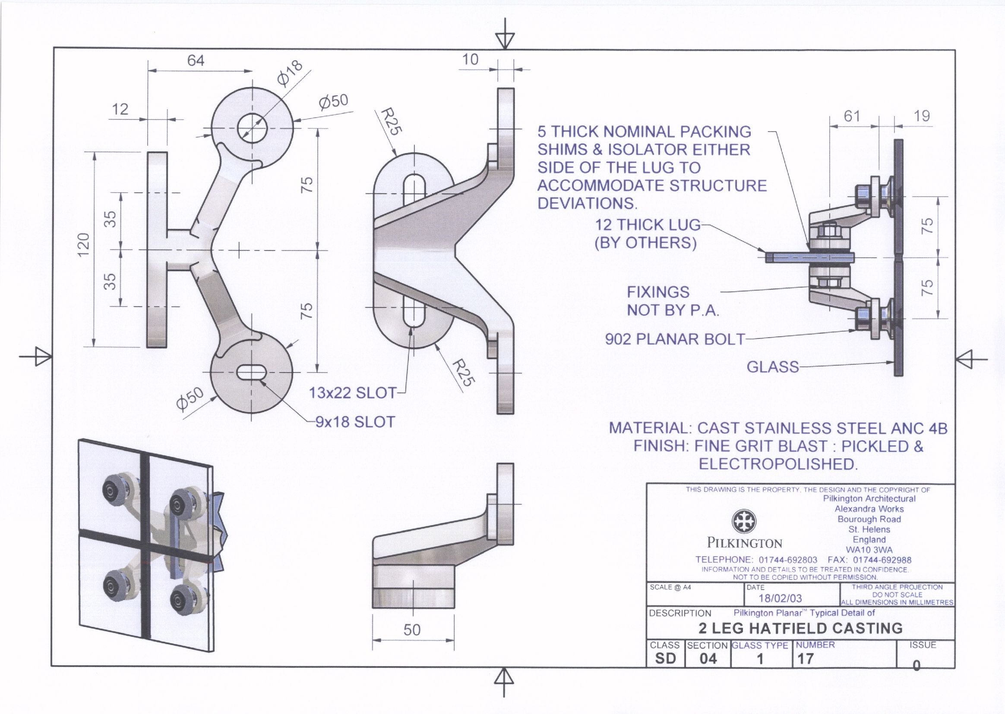
https://www.wwglass.com/pilkington-planar/

Slide 31
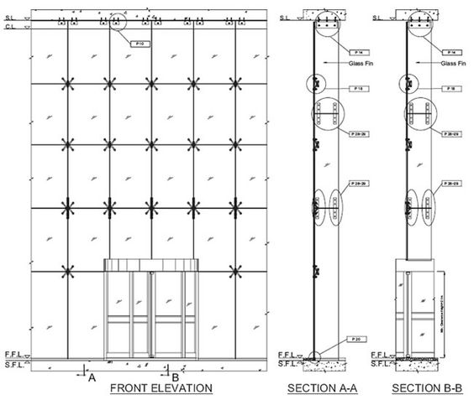

Slide 32
Glass Curtain Wall Material - Videos
https://www.youtube.com/watch?v=KnGRXsQ-CEU
https://youtu.be/YZiSUrwP6oc?t=5
https://www.youtube.com/watch?v=HbZ-QEZx8gk

