Slide 1
CORE STUDY
TABLE OF CONTENTS
SUSTAINABILITY
FRAMEWORK FOR SUSTAINABLE DEVELOPMENT DIAGRAM
DEFINITION OF CORE
MATERIALS
GLASS
CONCRETE
STEEL
CHARACTERISTICS:
SHAPE
PLACEMENT

Slide 2
SUSTAINABILITY
DEFINITION: A FORM OF DEVELOPMENT THAT MEETS THE NEEDS OF THE PRESENT WITHOUT COMPROMISING THE ABILITY OF FUTURE GENERATIONS TOMEET THEIR OWN NEEDS (CHING 1.3)

Slide 3
FRAMEWORK FOR SUSTAINABLE DEFVELOPMENT
PRINCIPLES:
REUSE RESOURCES
REDUCE RESOURCE CONSUMPTION
PROTECT NATURE
FOCUS ON QUALITY
RESOURCES:
LAND, MATERIAL, WATER ENERGY ,ECOSYSTEMS
PHASE:
PLANNING, DEVELOPMENT
CONSTRUCTION, MODIFICATION, MAINTENANCE
MODIFICATION, DECONSTRUCTION, DESIGN
CHING 1.03

Slide 4
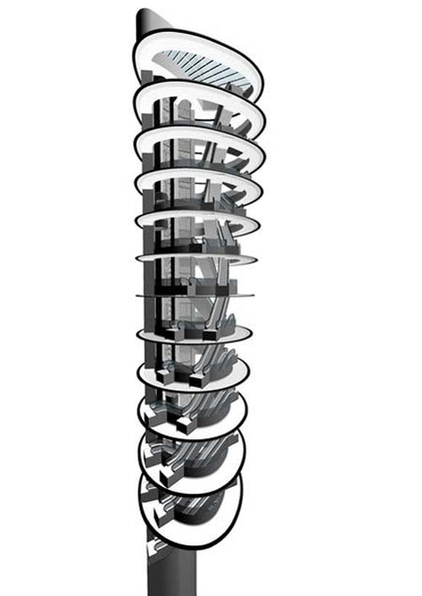
DEFINITION OF CORE
THE CENTTRAL OF ARTERIAL PART OF A MULTISTORY BUILDING THAT INTEGRATES FUNCTIONS AND SERVICE NEEDS FOR STABLISHED OCCUPANTS. NORMALLY THESE AREAS ARE ELEVATORS, TOILETS, AND STAIRS

Slide 5
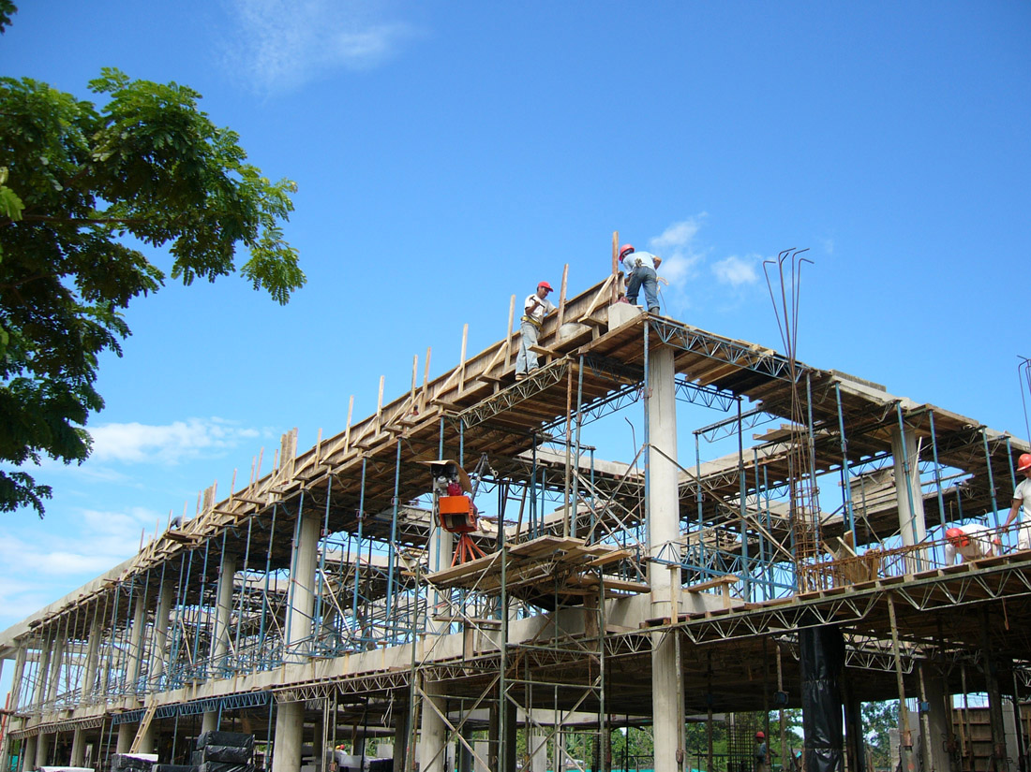
MATERIALS
THE MOST COMMON MATERIALS THAT ARE USED TODAY IN CONSTRUCTION ARE:
CONCRETE
STEEL
GLASS

Slide 6
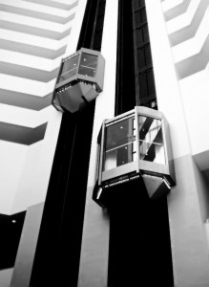
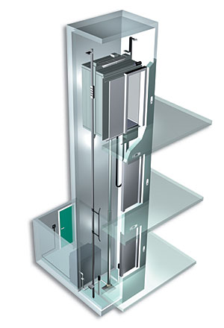
CHARACTERISTICS
SHAPE

Slide 7
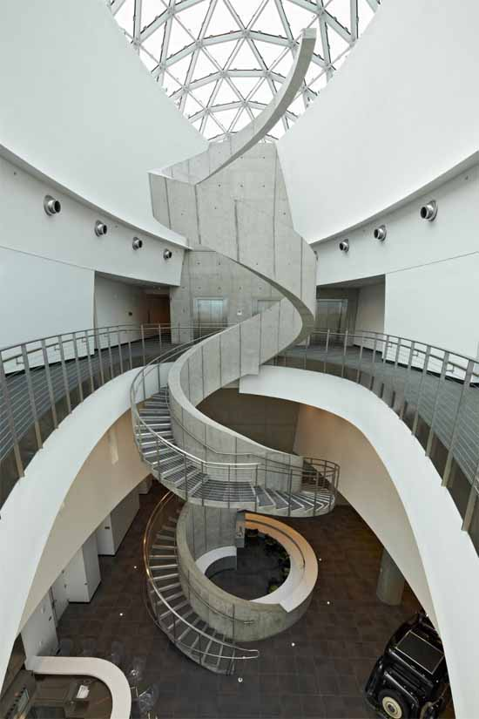
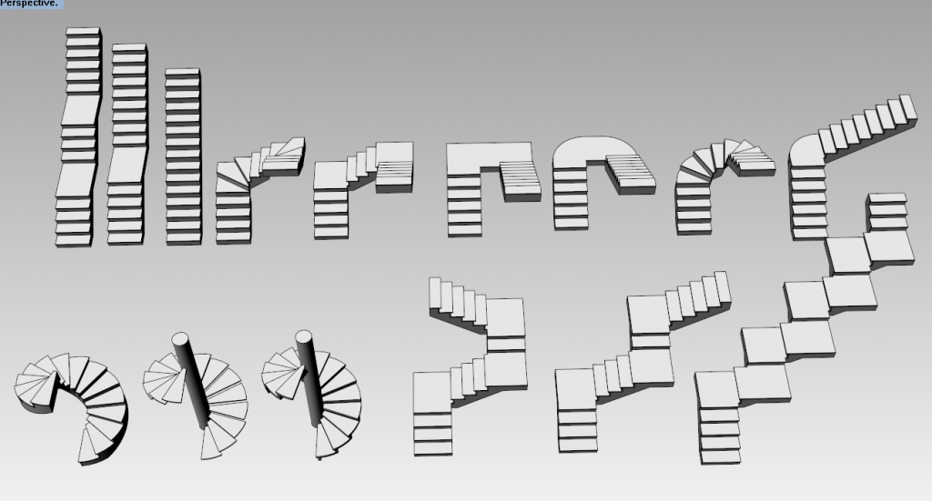
SHAPE

Slide 8
PLACEMENT
STAIRS AND ELEVEATORS SHOULD BE PLACED AT THE MOST TRANSITED AREAS.
WE HAVE TO CONSIDER THE DISTANCE FROM THE ELEVATORS TO A SPECIFIC ROOM OR LAB.
EMERGENCY STAIRCASES ARE NEEDED IN ALL FLOORS AND MORE THAN ONE REQUIRED.
STAIRS AND ELEVATORS CAN BE PLCED IN THE CENTER OF THE STRUCTURE OR IT CAN BE MOVED TO THE SIDES

