Slide 1
GEMINATION
Ann Paul-Augustine

Slide 2
WHAT IS GEMINATION?
Developmental disturbance that occurs during the cap stage of the tooth development.
Unsuccessful division of one single tooth germ.
Large SPLITTED CROWN (DETECTED AS A CLEFT IN THE INCISAL SURFACE)
“Twinning” only in the crown giving the appearance of a broader tooth.
common root, hence normal tooth count.
Usually occurs in the maxillary and mandibular central incisors in either dentition.
Radiographic features reveal single rooted tooth with a common enlarged pulp cavity.

Slide 3
Possible causes of gemination
Vitamin deficiency
Hormonal irregularities
Any type of infection or inflammation near the tooth bud during the time of tooth development
Increased intake of medicines
Any hereditary disease
Radiation therapy causing injury to the growing tooth germ.

Slide 4
Clinical presentation
Difficulty in chewing and injury to nearby structures.
Eruption of adjacent teeth obstructed.
Large crown – symmetry in the arch compromised.
Notch in the teeth may be an esthetic concern if the teeth involved is an anterior teeth.
Split in the crown provides a niche for plaque and bacteria.

Slide 5
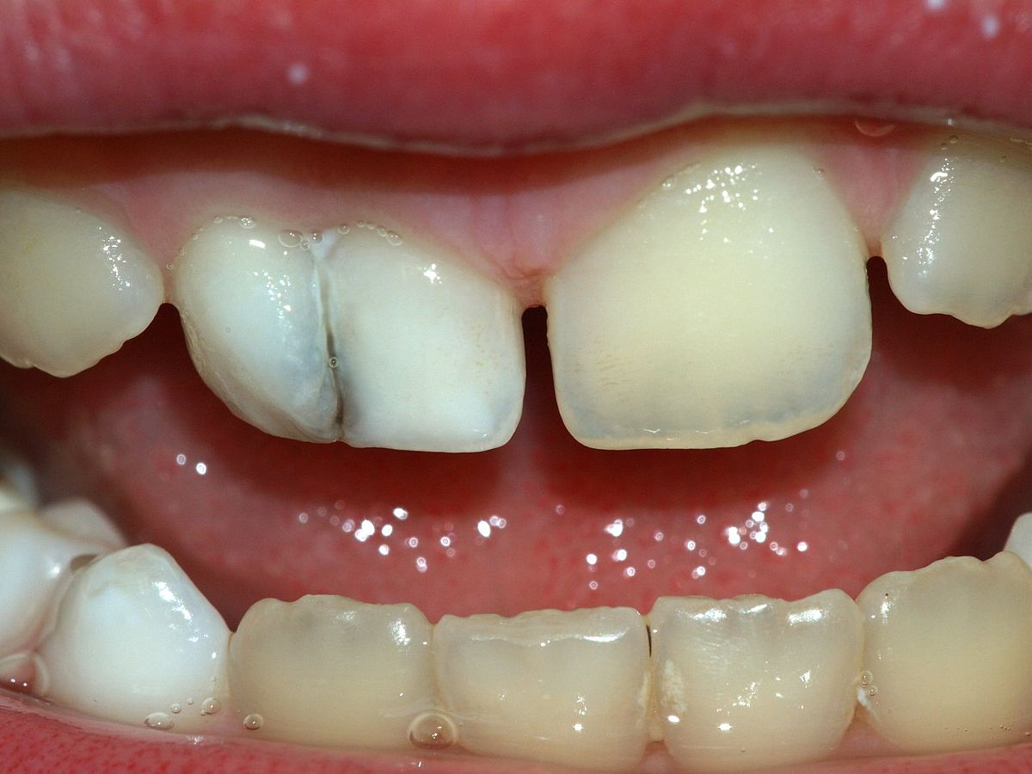
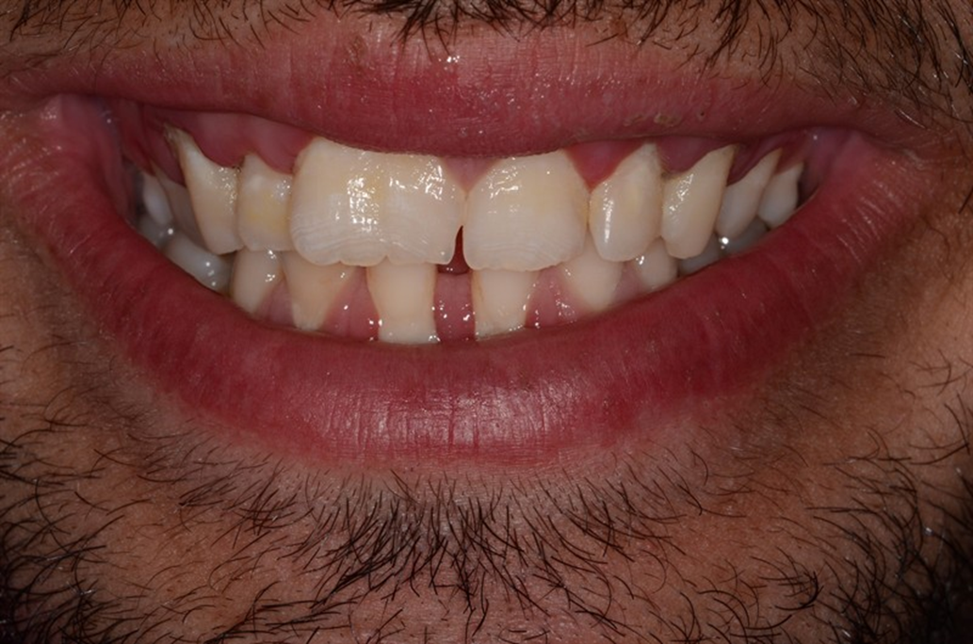

Slide 6
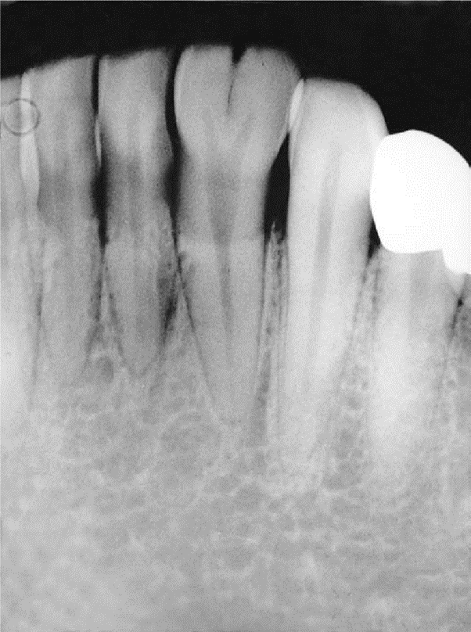

Slide 7
Role of dental hygienist
Cleft in the teeth can be restored and reshaped with a tooth colored restorative material to decrease plaque accumulation.
Reducing the mesiodistal width of the teeth and restoring the teeth with a porcelain crown after endodontic treatment if needed.
If tooth is compromised, extraction of teeth and a fixed partial denture is recommended.
If patient is unwilling to seek these recommendations, strict oral hygiene practice should be advised.
.

