Slide 1
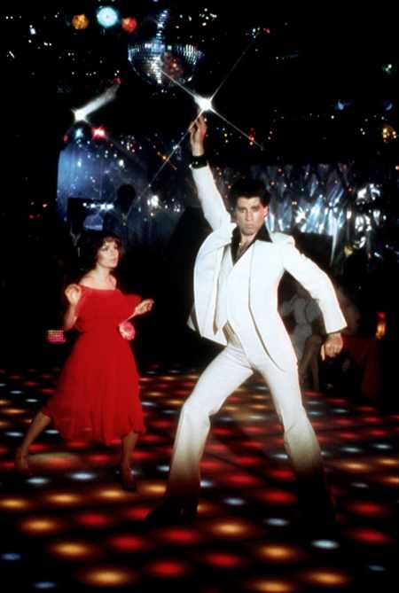
Saturday Night Fever
Anthony
Denise
Amber
Adji
Stacei
Film released in 1977, reflecting 70s costume wear.

Slide 2
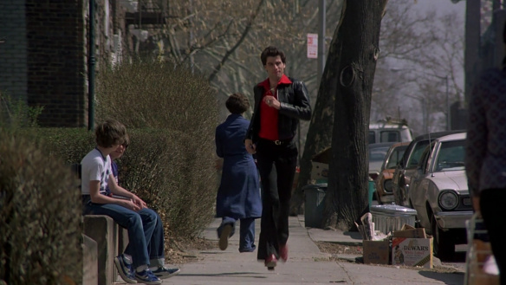
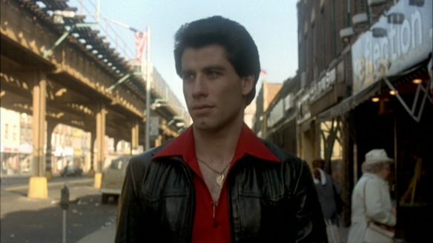
Opening Scene
In the opening scene, Tony is seen wearing a black & red outfit.
The outfits consist of Angel’s flight pants (disco staple), collared shirt with the collared worn outside the coat lapels, unbuttoned to show the gold chain, and some heel shoes (known as the boogie shoes)
Tony is seen wearing a black leather jacket and red, wearing bold colors.

Slide 3
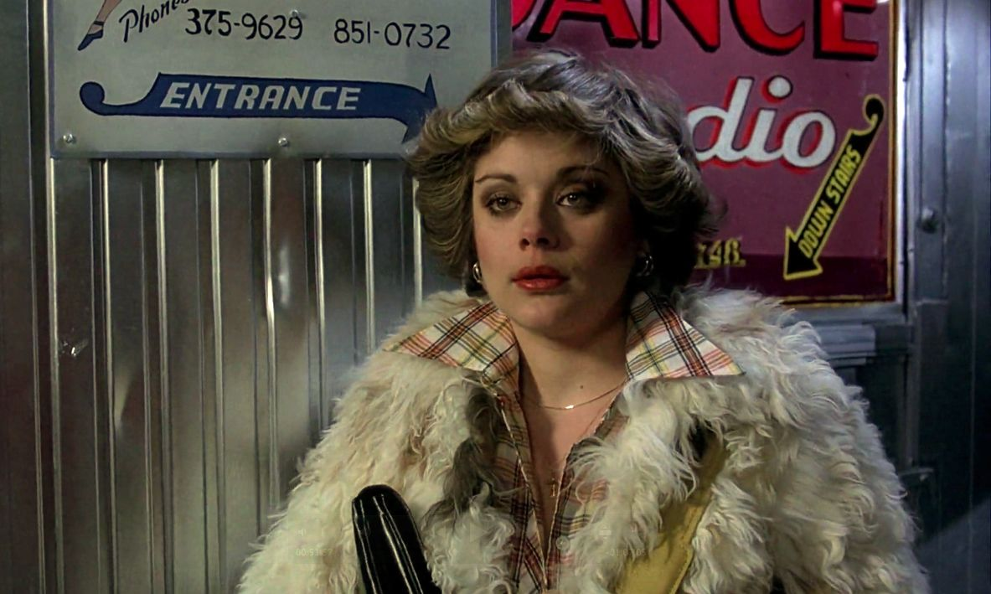
Anette’s rejection outfit
In this scene Annette was shown dressed in a plaid button down and a fur jacket.
This showed us a masculine garment styled in a feminine way.
Plaid and button downs are still unisex classics still till this day.
Fur bomber jacket has definitely made a huge comeback in fashion but never really goes out of style!

Slide 4
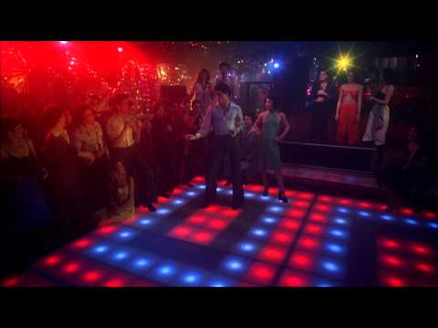

Slide 5
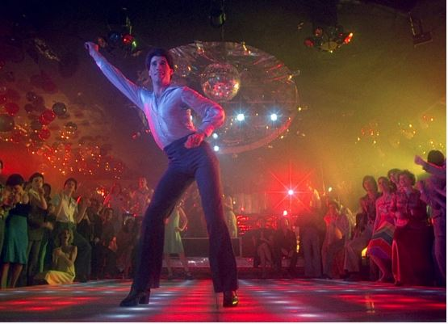
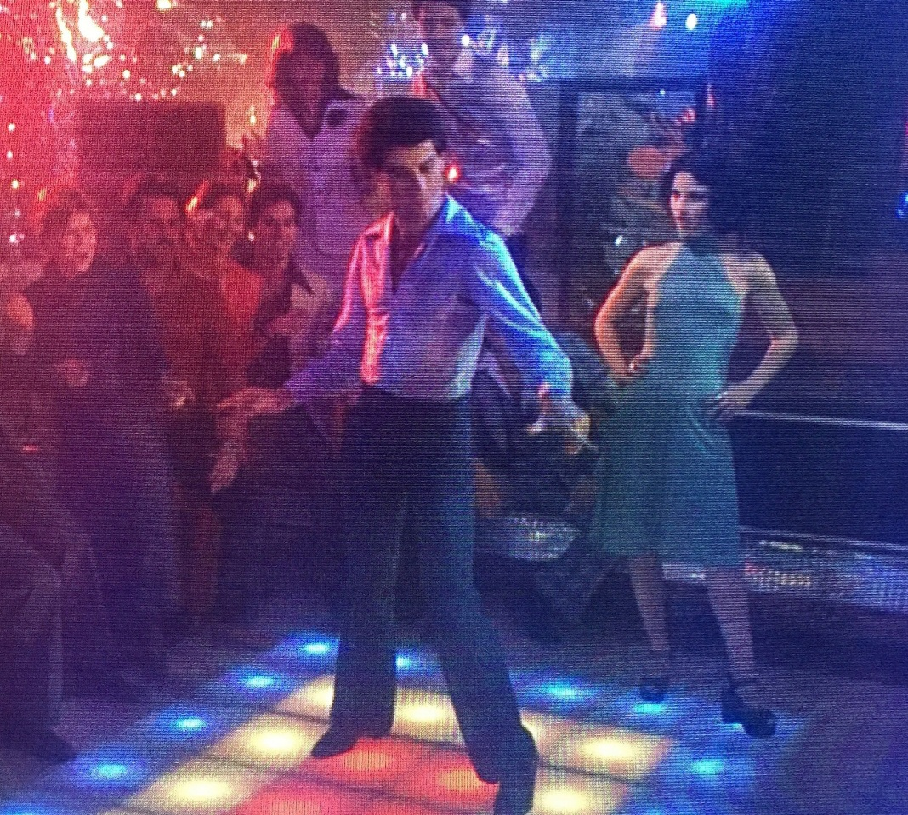
“Should be Dancing” Dance scene”
Tony wears softer colors in the nightclubs.
Throughout the movie he kept the same silhouette,
fitted top paired with Angel’s flight pants.
Tony’s top is satin and his pants are polyester,
common fabrics of that era.
His outfit is lighter and glitters more
than his audience creating contrast.
Tony’s outfit is accessorized by heeled dancing shoes.

Slide 6
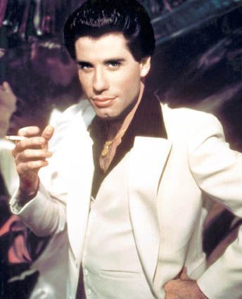
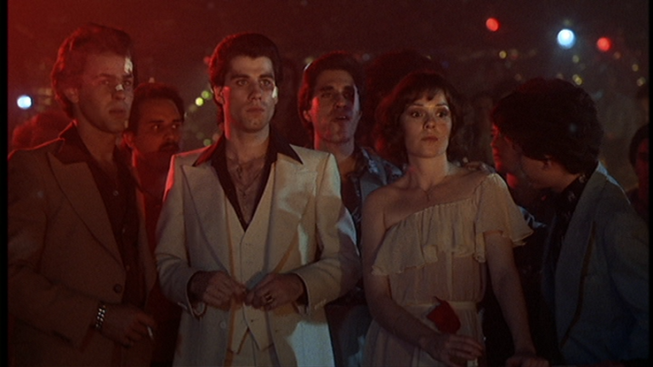
Tony Manero dress analysis
For the big dance, Tony decides to wear a 3 piece white suit with a black shirt.
Tony’s costume arc from dark to light. He has an epiphany and realizes he needs to change his life around.
In the beginning of the movie, he seen wearing black and in the ending of the movie, he’s wearing white.

Slide 7
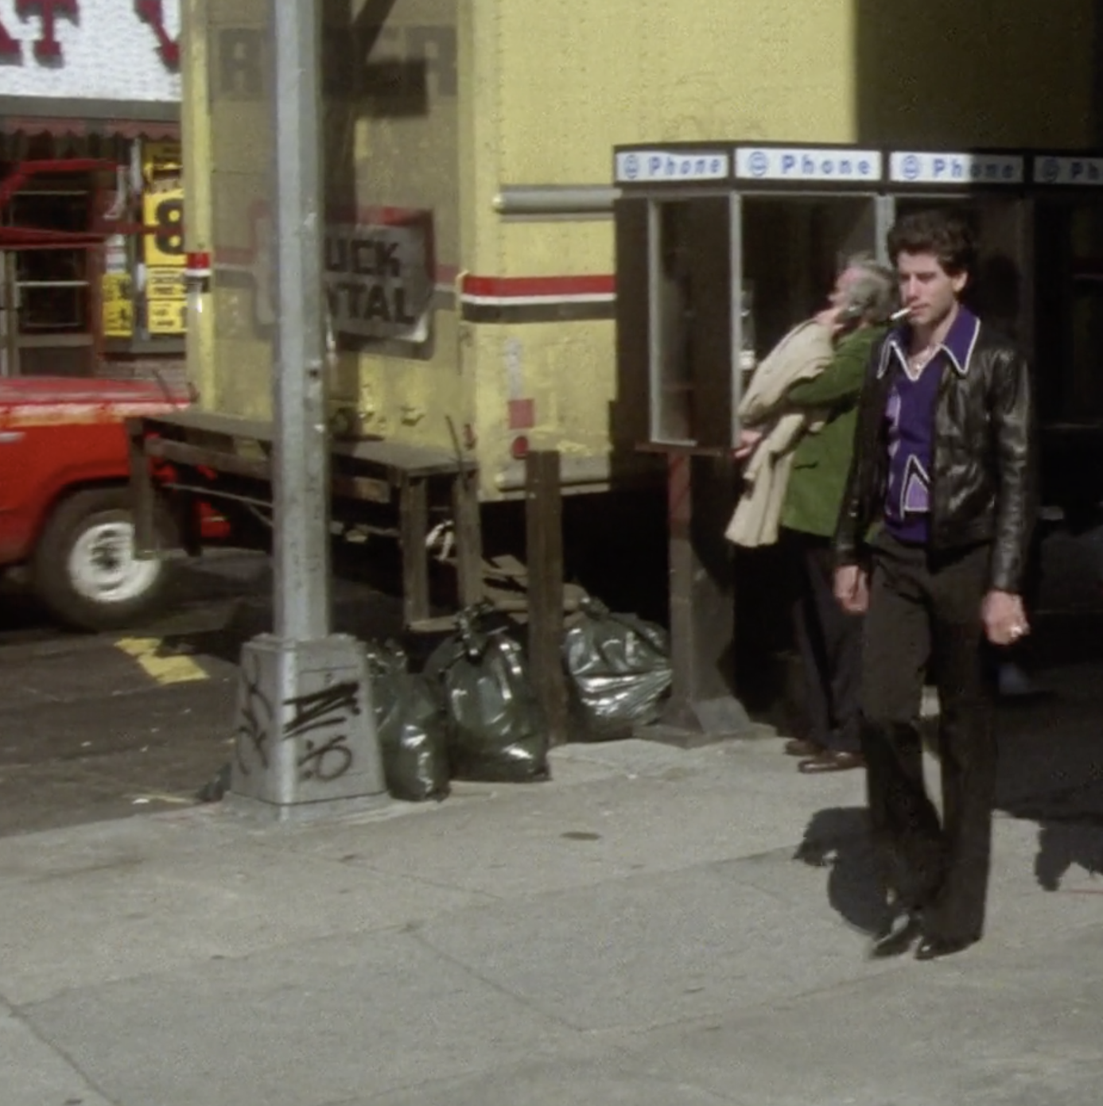
Quitting Scene
In this scene Tony is wearing a black and purple outfit
Kept colors neutral & purple shirt acted as a statement with bold color
Black flared pants, leather jacket, pointed heeled boots, and wide collared shirt with white trimming
Tony seen wearing different interpretations of this outfit several times throughout the film

Slide 8
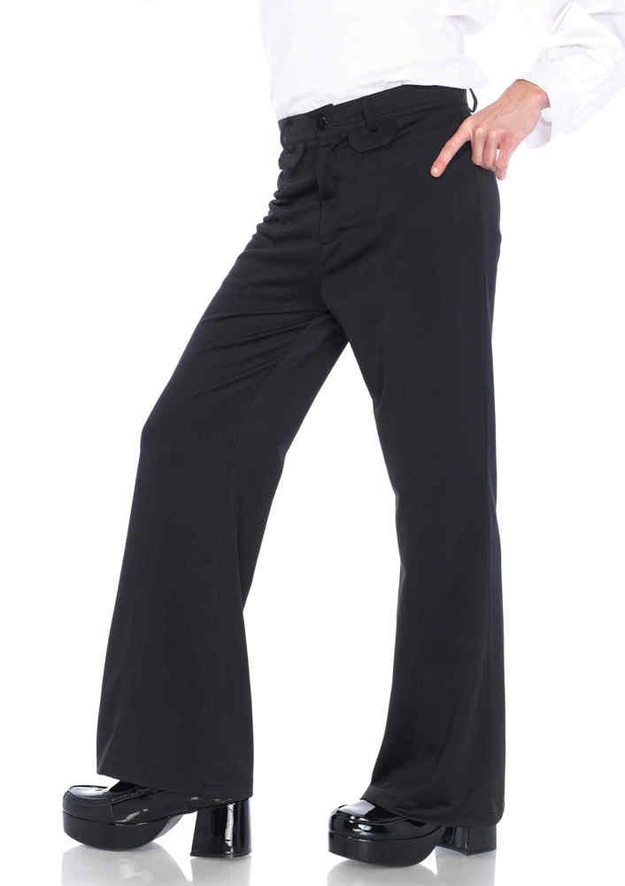
Angel Flight Pants
These tight fitting polyester men's pants were usually bell-bottomed and accompanied by platform shoes.
This style was made to show a bulge and attract the attention of the audience.

Slide 9
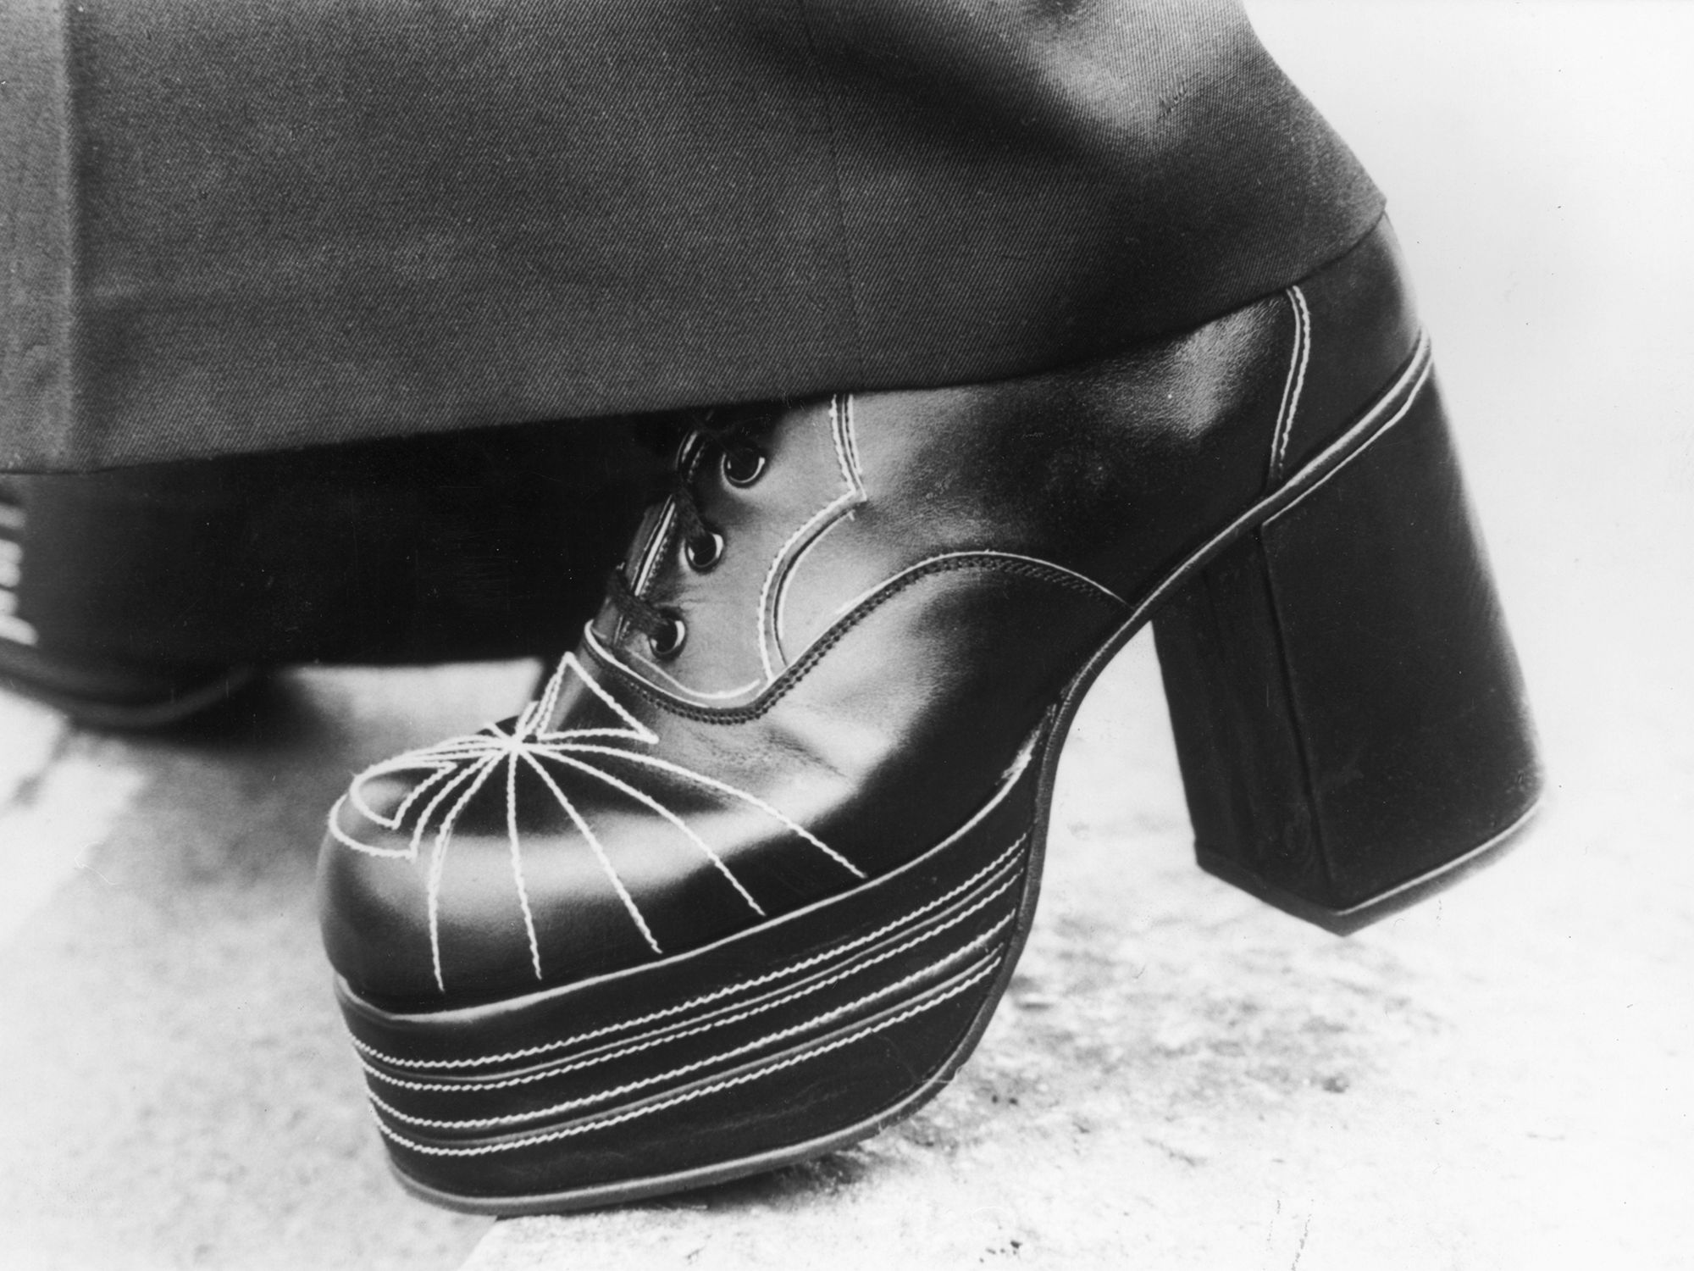
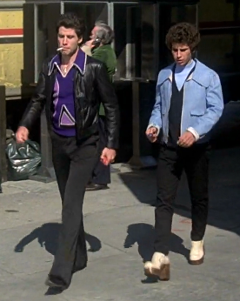
Bobby C heeled shoes
Men heeled shoes was also a great significance to the fashion projected throughout the movie.
Heeled shoes seemed to always be worn mostly with the “Angel flight” pants.
This garment gives more height and make the person stand out more.

Slide 10
Summary of Fashion in the 70s
Feminie Silhouettes such as:
-Tight fitted tees
-Bell Bottoms (Angel flight pants)
Heeled and platform shoes
Midi skirts
Bright & Bold colors

