Slide 1
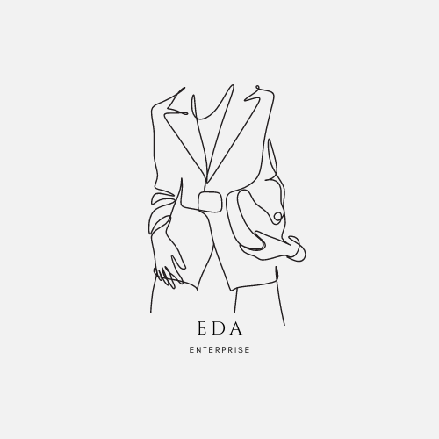

Slide 2
Double-Breasted Suit Jacket (Trend Forecast)
By :
Historian : Emmanuel Koko
Textile Specialist : Daisy Magdaleno
Color Forecaster : Anthony Mota

Slide 3
What is a
Double-breasted suit jacket?
A double breasted suit jacket
Is a formal oriented jacket that features
An overlap of two panels. The panels are then
accompanied by a minimum of four buttons
Featured around the belly area, some of which are not functional.

Slide 4
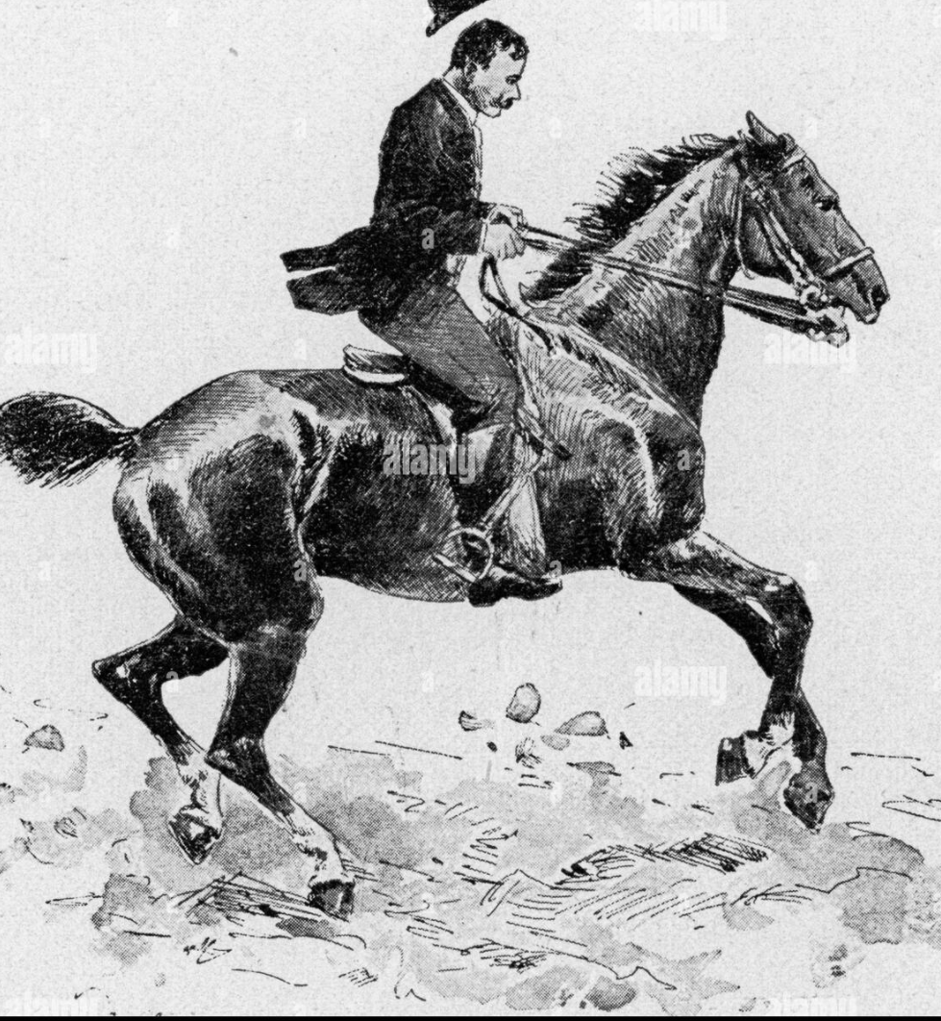
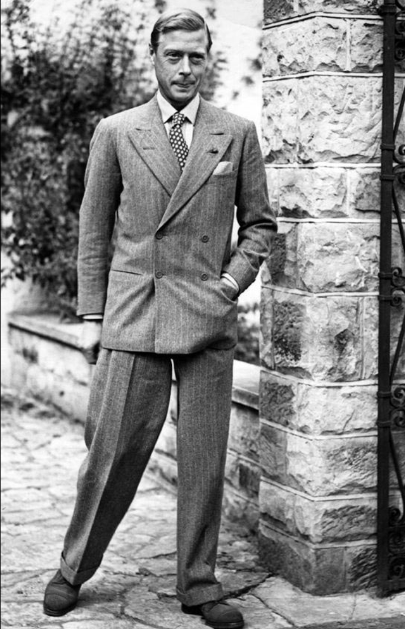
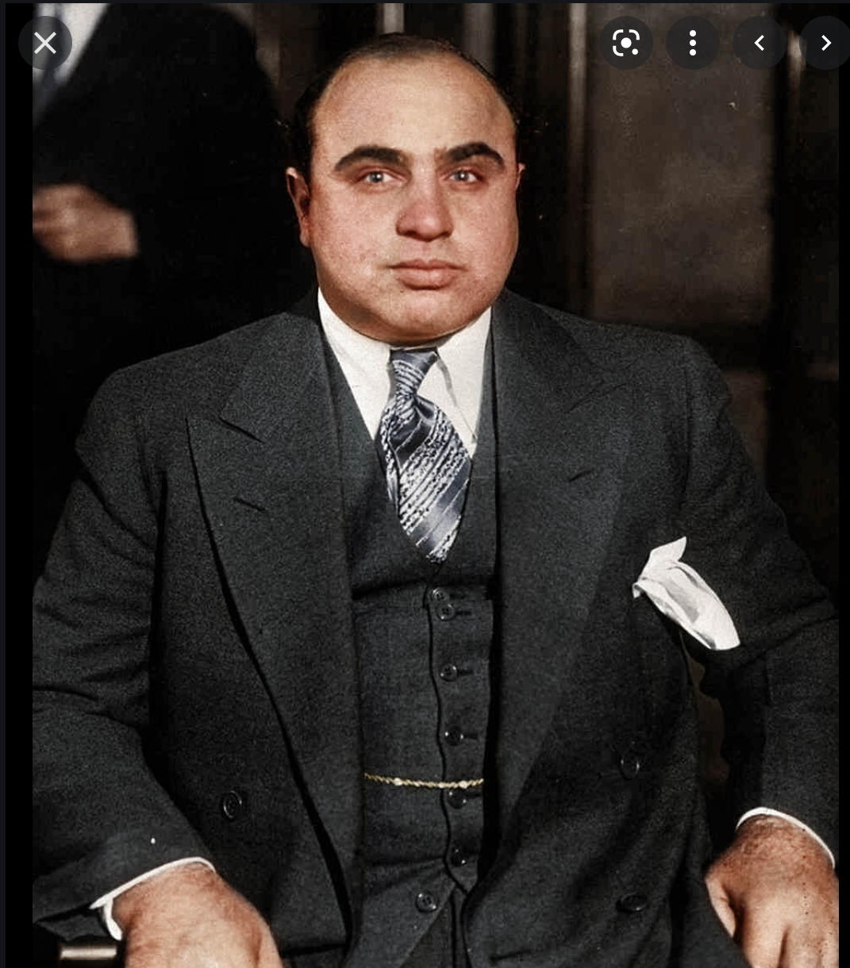
History
The double-breasted suit jacket first garnered popularity in the early 1900s. At the time it was not considered formal wear due to the nature it was worn in. British naval officers in addition to athletes would sport the jacket. The suit jacket was often times compared to the reefer jacket which featured a long tail.

Slide 5
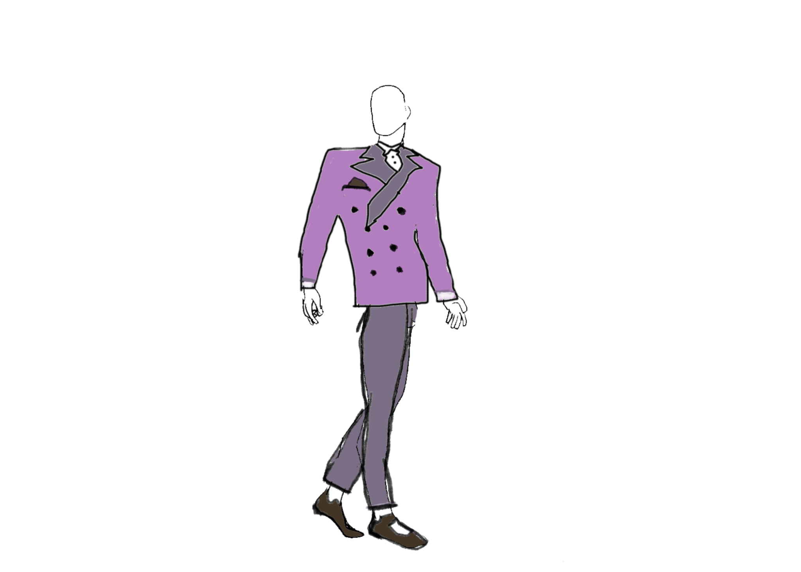
Trend # 1 : Bold Trend
The cut and style of the present day double breasted suit jacket features eye-catching colors and patterns and buttons that may even surpass the classic four or six. The lapels have also changed dramatically as the cut looks like a deeper v shape, allowing the chest area to become more prominent.
Notes:
Materials:

Slide 6
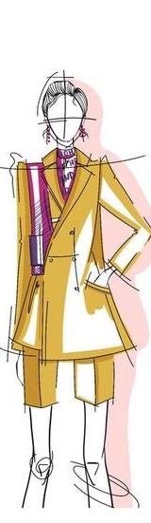
Trend #2: Comfort Suit
A great blend of warmth and function that works equally well in Zoom meetings
2x6 button
Functional pockets
Bright pastel color

Slide 7
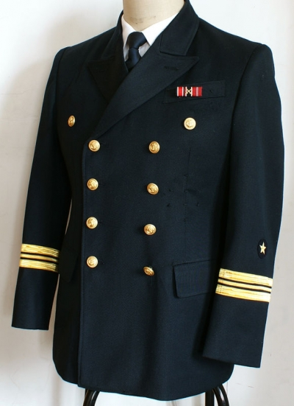
Trend #3 : Reefer Jacket
The double breasted suit was originally designed for sporting purposes of the British aristocracy in the late 19th century. The double breasted suit was influenced after the naval reefer jacket. The reefer jacket was worn by sailors of the british navy.
Notes:
Materials:
A traditional reefer coat was rich in Melton wool and good quality modern reefers will also boast a high Melton wool content. Melton wool goes through a ‘fulling’ process which adds moisture, heat, friction and pressure. This results in a wool with fibres that have been densely packed together, similar to wool that has been felted. But because the nap of Melton wool is then heavily brushed, the resulting feel is super soft. While a modern reefer jacket should have a high Melton wool content, many manufacturers now add a small amount of polyester to reefers which helps reduce pilling.
Although the original reefer jackets were designed for use at sea, they are not waterproof. But because wool is naturally water-repellent, a reefer jacket with a high wool content will be able to withstand a light shower.
https://www.dufflecoatsuk.co.uk/blogs/news/what-is-a-reefer-jacket
“Reefer” was referring to the sailors who would climb the rigging of a ship, and would wear such a coat that was reasonably short, it’s length just sitting below the hips, it also had a slight flare to the skirt allowing for ease of movement.
https://histclo.com/style/suit/sailor/sailorr.html

Slide 8
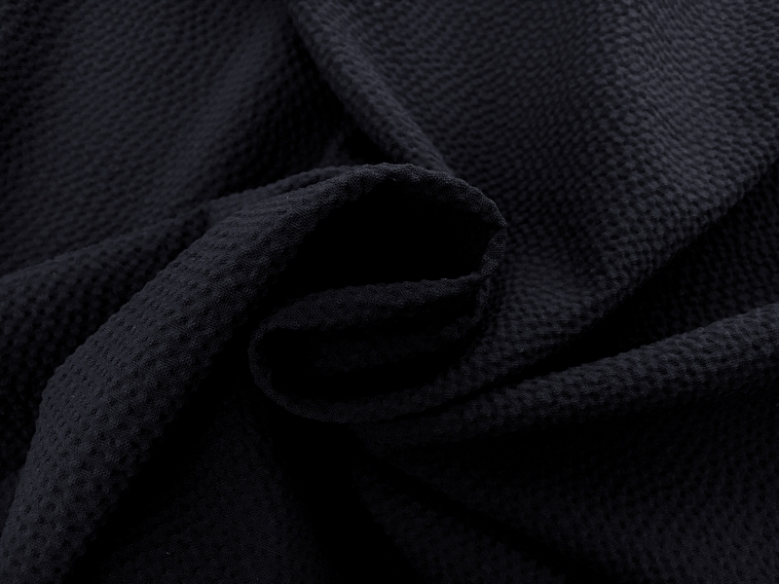
Material
Formal
Structured fitting silhouette with box shoulders
Referring back to 1980s suit
Mix of dark and bright colors
Wool & silk are main fabrics
Italian Stretch Virgin Wool Seersucker in Navy - For warm days
Notes:
These days, serious men are expected to dress like heads of state, which means a dark suit for all occasions, even in the sweltering heat of midsummer.
https://www.thedailybeast.com/long-live-the-seersucker

Slide 9

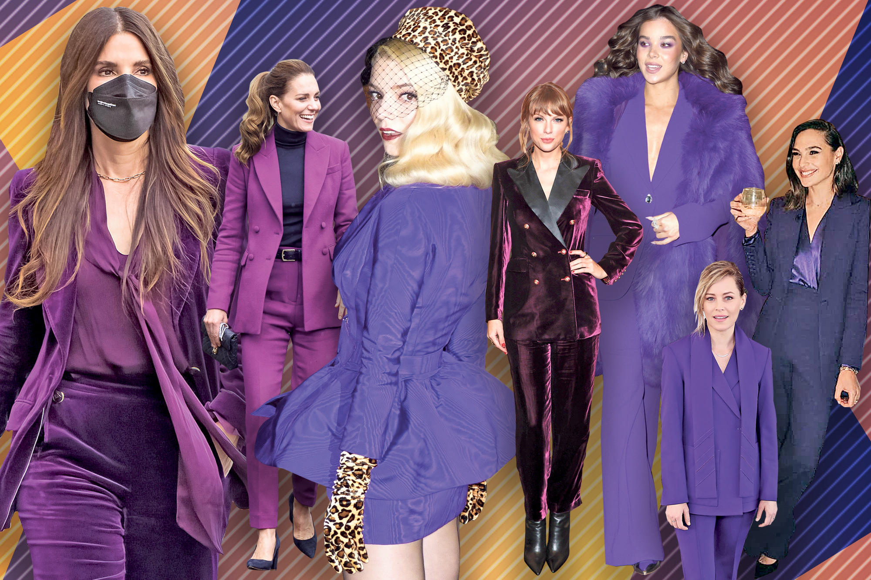
What to look forward to in the upcoming years :

