Slide 1
PowerPoint
Enhancements
CMCE 1155
Prof. N Anderson

Slide 2
Review Principles for a memorable presentation
Explain Techniques
Review Enhancements
Critique and Edit your presentation
Submit Presentation
Learning Objectives:
Submission Requirements (end of class):
1. Printed copy of Notes Pages (see print option)
2. Digital copy of PPT to: Prof.N.Anderson@gmail.com

Slide 3
Creating a Memorable Presentation
People can’t effectively read and listen a the same time
1 point per slide
Main point at top
Don’t overwhelm short term memory
Put content in small chunks
3-4 concepts at a time
Less is more; Simple, easy to read slides
People remember pictures more than words
Use visuals to help people remember, understand, or persuade
Tell and Show method

Slide 4
Creating a Memorable Presentation
1 point per slide
Main point at top
1. People can’t effectively read and listen a the same time
Source: Presentation Xpert and Ellen Finkelstein for http://powerpointinfo.blogspot.com

Slide 5
Creating a Memorable Presentation
2. Don’t overwhelm short term memory
Put content in small chunks
3-4 concepts at a time
Less is more
Simple, easy to read slides
Source: Presentation Xpert and Ellen Finkelstein for http://powerpointinfo.blogspot.com

Slide 6
Creating a Memorable Presentation
3. People remember pictures more than words
Use visuals to help people remember, understand, or persuade
Source: Presentation Xpert and Ellen Finkelstein for http://powerpointinfo.blogspot.com

Slide 7
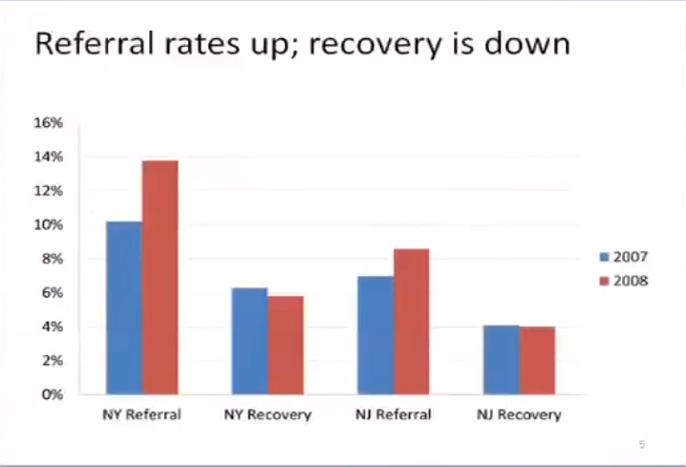
Techniques:
1. Effective Layouts
2. Key Lines
3. Simplify Images

Slide 8
4 Effective Slide Layouts
Source: Presentation Xpert and Ellen Finkelstein for http://powerpointinfo.blogspot.com
Notes:
Slide Area: Edit Slide
Slide Navigation:
Notes: Presentation notes

Slide 9
Source: Presentation Xpert and Ellen Finkelstein for http://powerpointinfo.blogspot.com

Slide 10
Source: Presentation Xpert and Ellen Finkelstein for http://powerpointinfo.blogspot.com

Slide 11
Source: Presentation Xpert and Ellen Finkelstein for http://powerpointinfo.blogspot.com

Slide 12
Source: Presentation Xpert and Ellen Finkelstein for http://powerpointinfo.blogspot.com

Slide 13
Key Lines
Source: Presentation Xpert and Ellen Finkelstein for http://powerpointinfo.blogspot.com

Slide 14
Simplify
your images

Slide 15
Enhancements
Hyperlink
Action Buttons
Transition Effects
Animation Effects
Inserting a Video

Slide 16
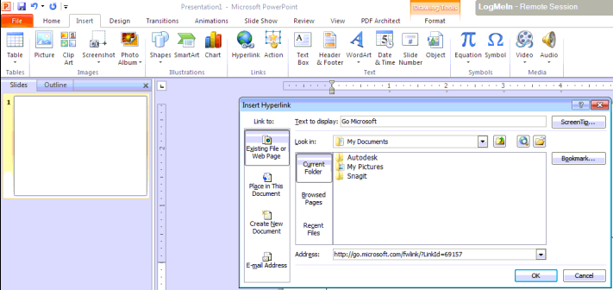
Hyperlink
Create a link to a web address, email, file, or location within the presentation. Edit Address and Display Text

Slide 17
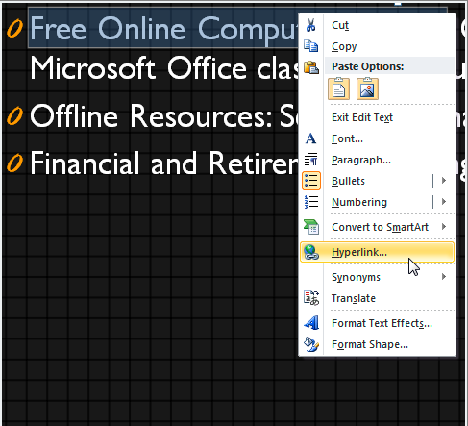
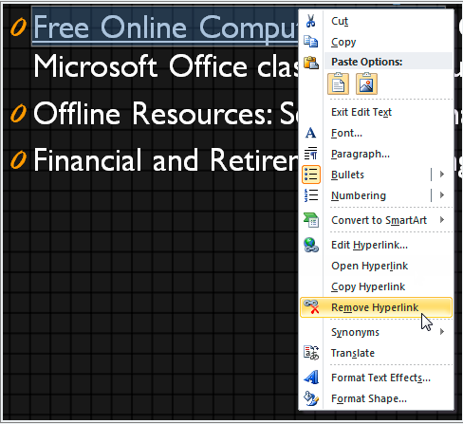
Hyperlink within Existing Image or Text

Slide 18
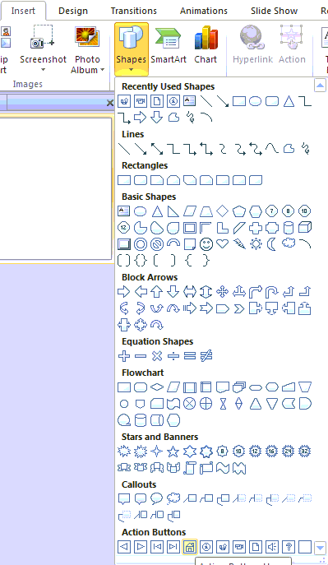
Action Buttons
An interaction graphic that triggers an action, such as displaying another slide or opening a file, and are particularly helpful for adding navigation interactivity to your presentation

Slide 19
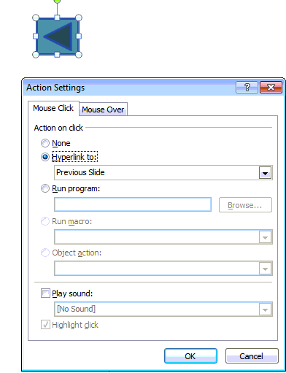
Insert Action Button
Insert Shape - Symbol - Action

Slide 20
Change Appearance of an Action Button
Click Drawing Tools Format tab.
Change color, style, etc.
Edit shape.

Slide 21
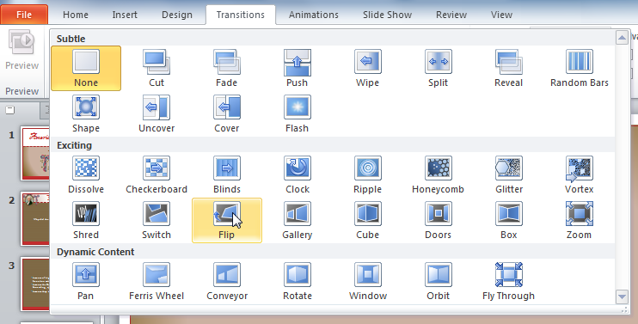
Transition Effects
Add motion effects that, when in Slide Show View, add movement to your slides as you advance from one to another. Each slide can use 1 transition effect.

Slide 22
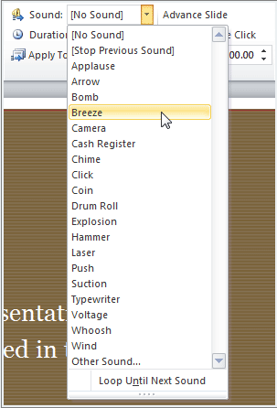
Customizing Transition Effects
Modify Duration:
Timing group
Apply To All
Add Sound
Remove: None

Slide 23
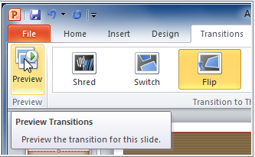
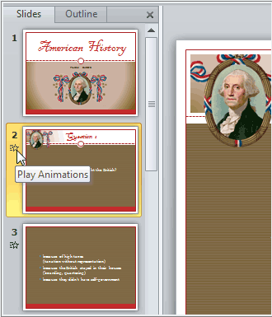
Preview a Transition
1. Preview on the Transitions tab
2. Click the star Play Animations icon on the Slides tab

Slide 24
Animating Text and Objects
Animate text or objects in a slide to draw the audience’s attention to specific content or make the slide easier to read.

Slide 25
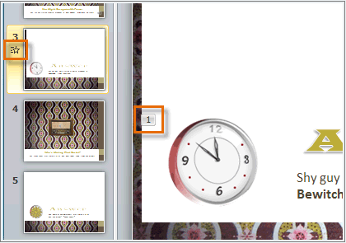
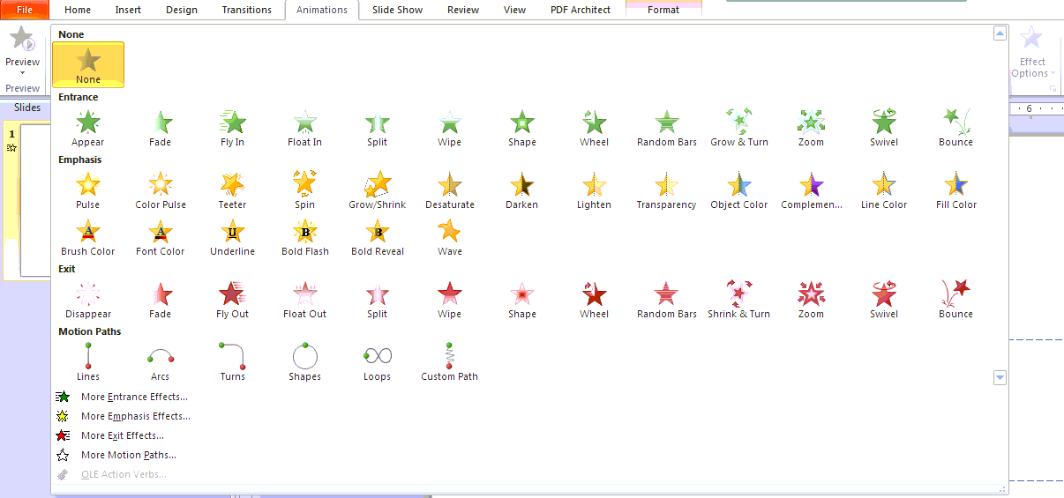
Create an Animation
Select an Object.
Click Animations tab.
Some effects will have Effect Options.

Slide 26
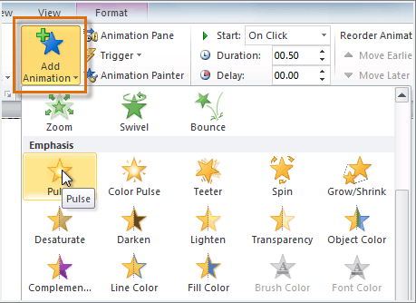
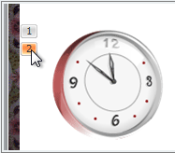
Working with Animations
Add multiple animations with Add Animation command.
Copy animations with Animation Painter.
Reorder Animations.

Slide 27
Insert a Video
Insert a video from a file on your computer or from a web site with video icon on Insert tab.
Inserting a Video
<object width="560" height="315"><param name="movie" value="http://www.youtube.com/v/ZzJq6UOuHBo?hl=en_US&amp;version=3"></param><param name="allowFullScreen" value="true"></param><param name="allowscriptaccess" value="always"></param><embed src="http://www.youtube.com/v/ZzJq6UOuHBo?hl=en_US&amp;version=3" type="application/x-shockwave-flash" width="560" height="315" allowscriptaccess="always" allowfullscreen="true"></embed></object>

Slide 28
Edit a Video
Editing a Video
<object width="560" height="315"><param name="movie" value="http://www.youtube.com/v/7C9N8dftLlg?hl=en_US&amp;version=3"></param><param name="allowFullScreen" value="true"></param><param name="allowscriptaccess" value="always"></param><embed src="http://www.youtube.com/v/7C9N8dftLlg?hl=en_US&amp;version=3" type="application/x-shockwave-flash" width="560" height="315" allowscriptaccess="always" allowfullscreen="true"></embed></object>

Slide 29
Rehearse and TEST!
View slide show, including all animations and effects to make sure they work correctly

Slide 30
Presentation Checklist
Title Page
All required topics have been covered
Cite references
Slide titles are clear and convey your main point
Content is given in small chunks, not overwhelming
Visuals enhance your presentation, not detract from it
Enhancements support your message, not fluff

