Slide 1
PowerPoint
A visual and graphic application for creating presentations
CMCE 1155
Prof. N Anderson

Slide 2
Learning Objectives:

Slide 3
Quick Launch Toolbar
Ribbon, Tabs
Workspace
Window Areas
Notes:
Slide Area: Edit Slide
Slide Navigation:
Notes: Presentation notes

Slide 4
Outline Navigation View
Notes:
Modify text in multiple slides quickly

Slide 5
Starting a presentation
Notes:
Open new: Blank presentation
Slide Area:
1. background (auto white)
2. layout- holds content
3. content- insert text, images, graphs/charts

Slide 6
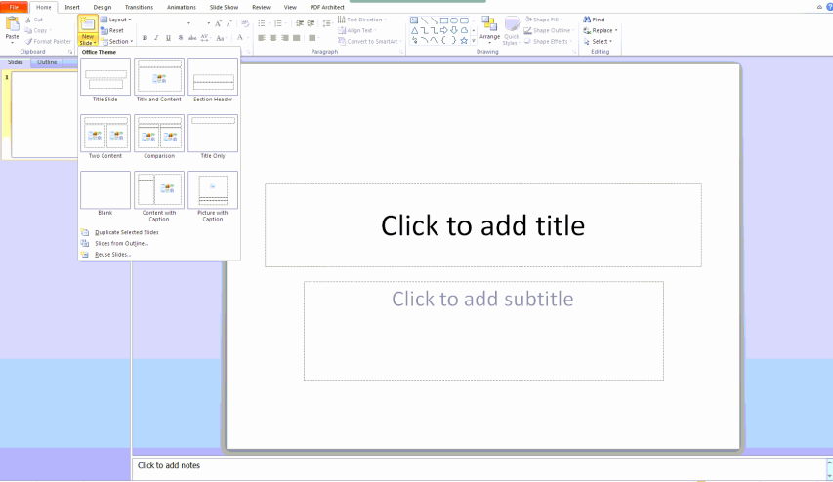
Adding Slides
(Ctrl + M)
Notes:
New Slide Icon
New Slide Dropdown- layout options

Slide 7
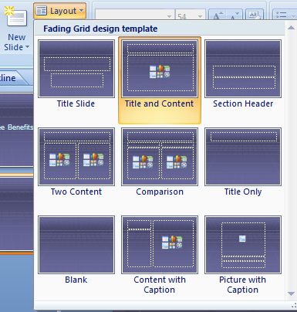
New Slide Layouts

Slide 8
Slide Master
Notes:
Used for all new slides after editing of the slide master

Slide 9
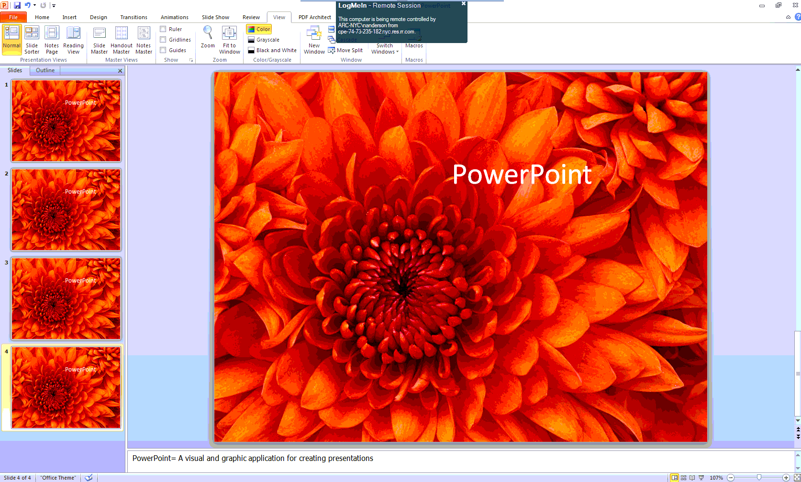
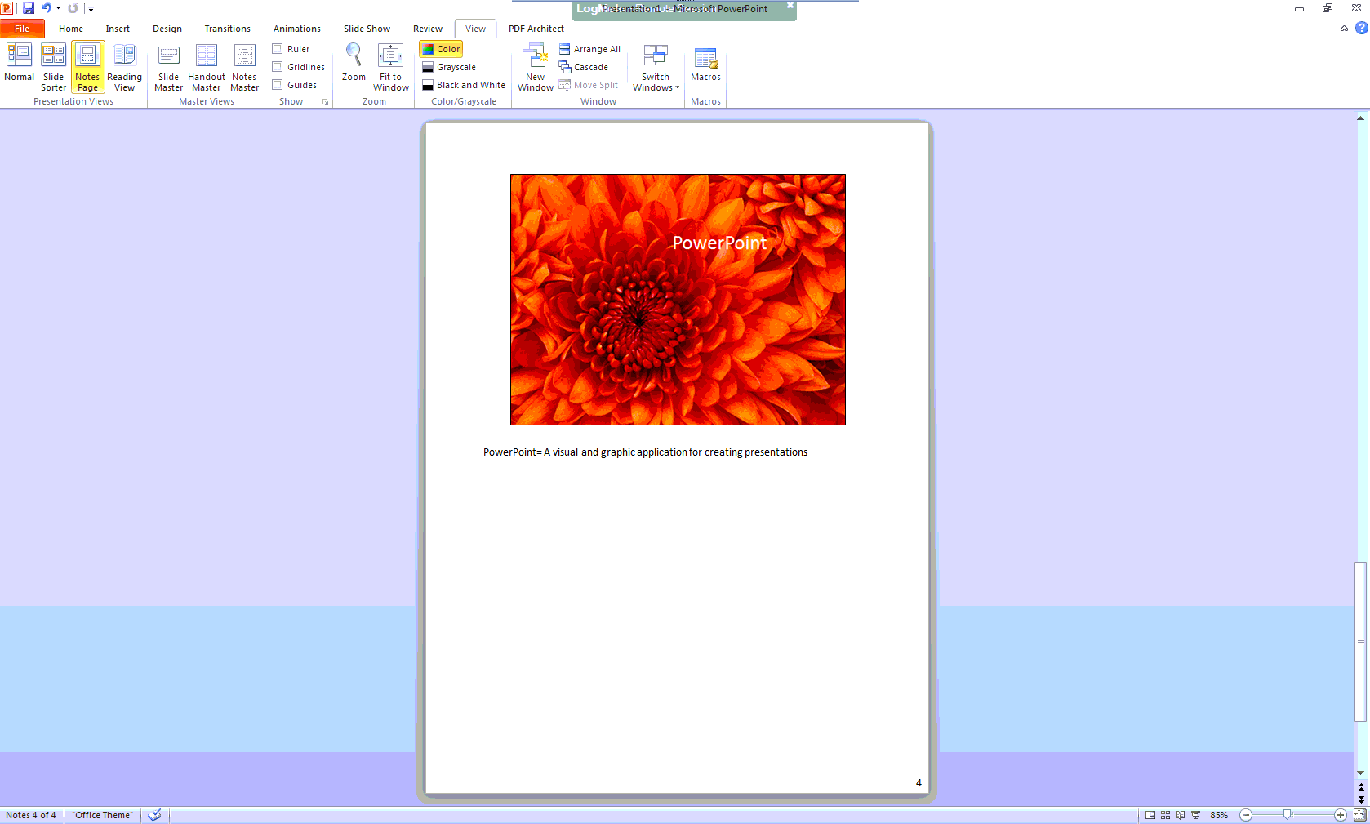
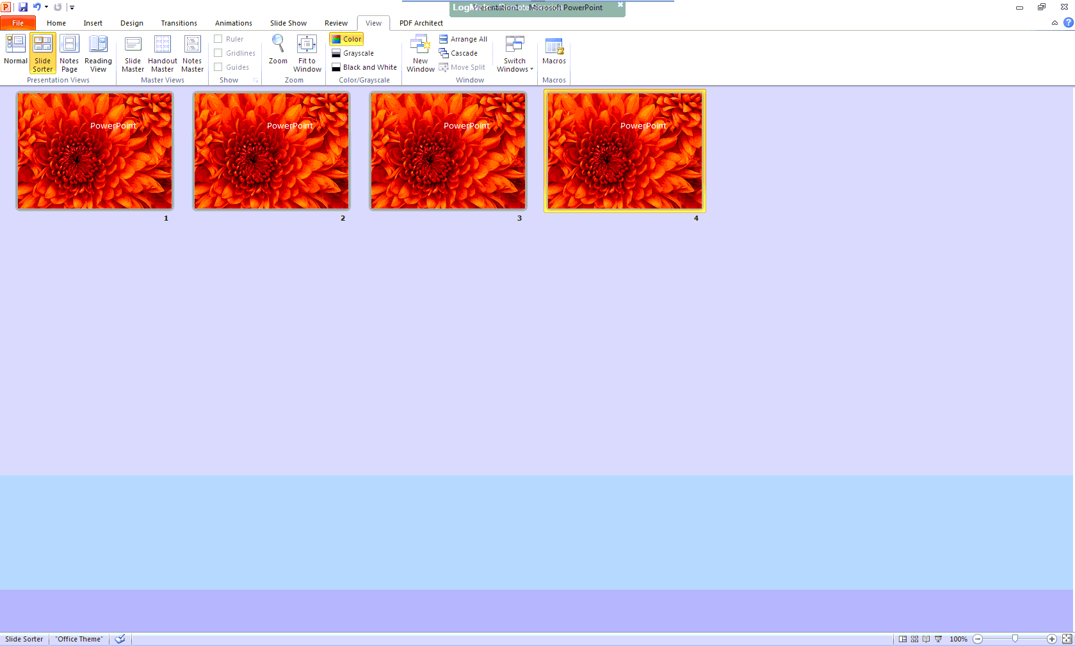
Views
Normal
Notes Page
Slide Sorter
Reading View
Notes:
Normal- Editing slide
Slide Sorter- Viewing slide sequence, rearrange, view as a whole, apply slide show effects
Notes- print as handout, use for presentation tool
Reading- View presentation within entire window
Views Taskbar at lower right corner

Slide 10
Normal View: Gridlines, Rulers, Zoom

Slide 11
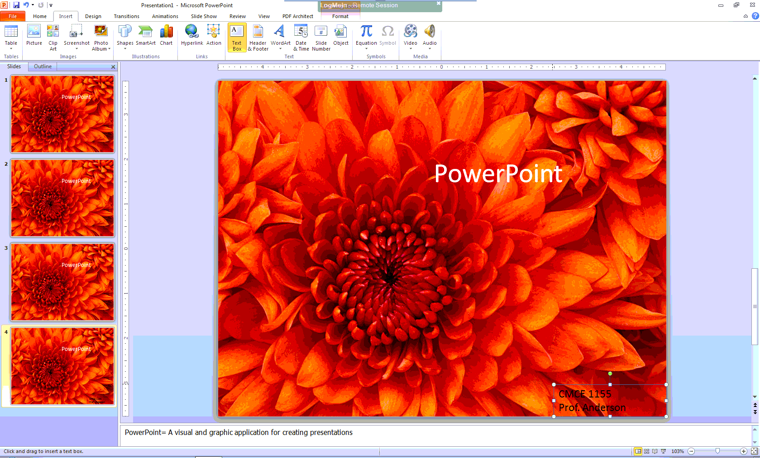
Inserting Text

Slide 12
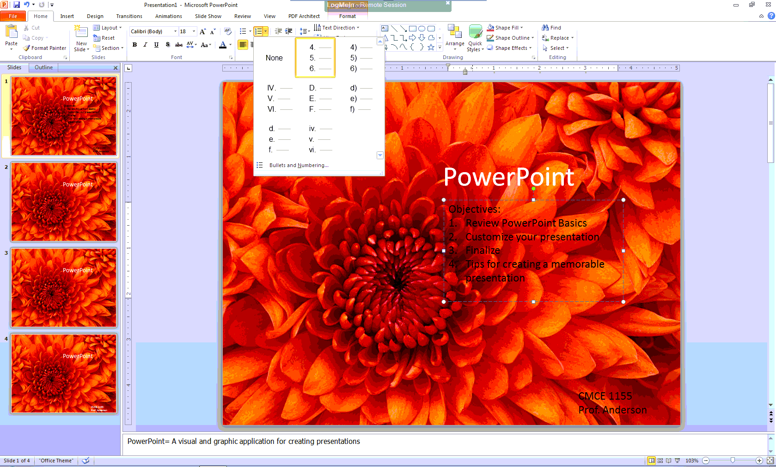
Insert Bulleted or Numbered Lists

Slide 13
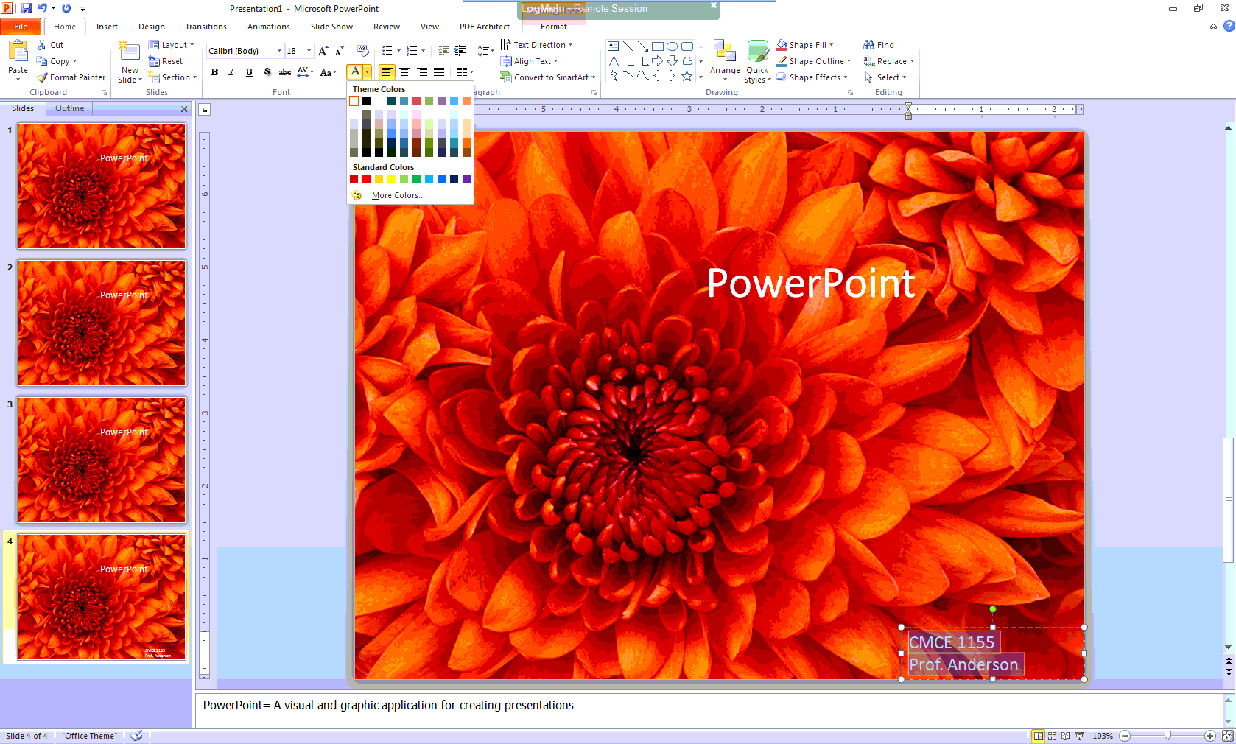
Formatting Text

Slide 14
Format Painter

Slide 15
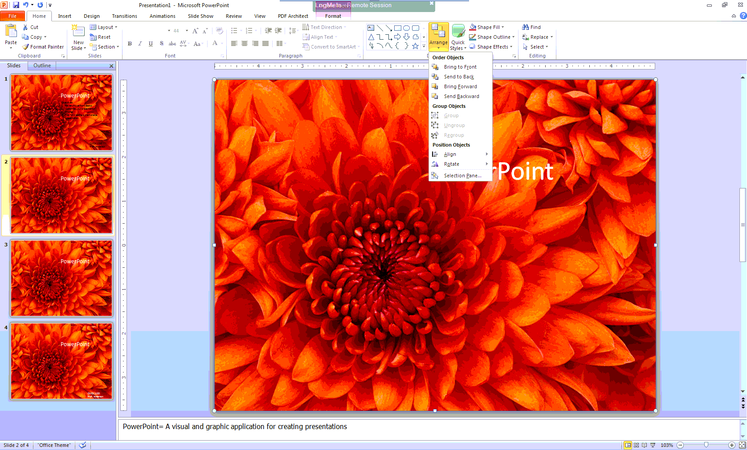
Arranging Objects
Bring to Front
Notes:
Group
Order
Position

Slide 16
Inserting Graphics
Image Sources
Microsoft Stock
Stock.xchng: http://www.sxc.hu/home
Flickr Creative Commons: http://www.flickr.com/creativecommons/
Take your own pictures!

Slide 17
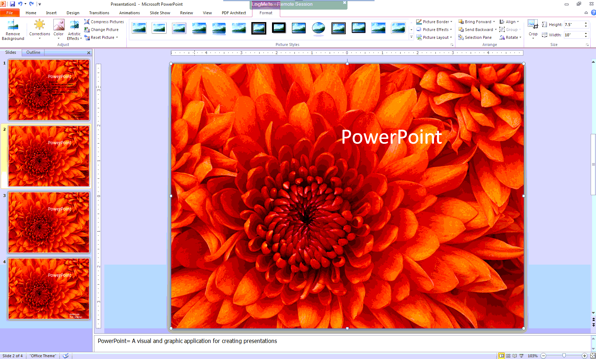
Formatting Images

Slide 18
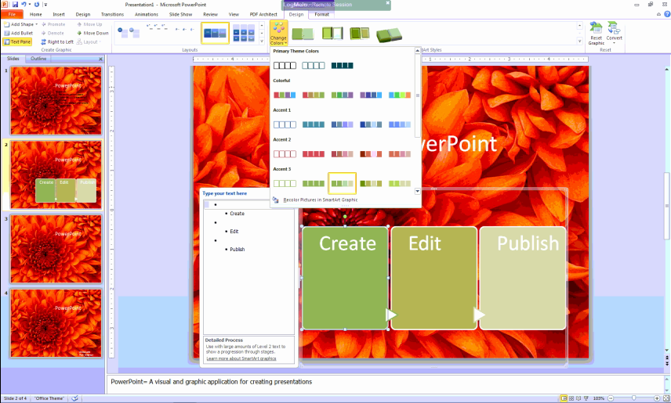
Smart Art
Using simple graphics to make information easier to understand

Slide 19
Proofread!!!

Slide 20
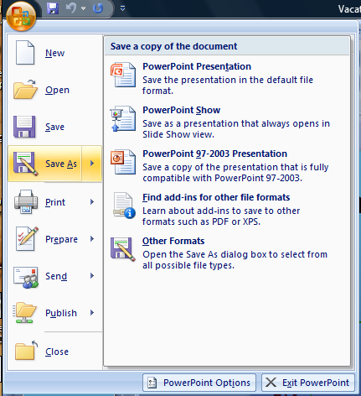
Saving Options

Slide 21
Send and Save

Slide 22
Creating a Memorable Presentation

Slide 23
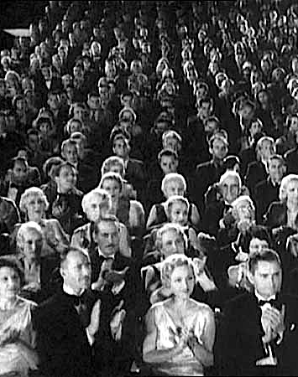
Know your audience!

Slide 24
Information Literacy Rubric

