Slide 1
Introduction
Computer Basics
Professor N Anderson
CMCE 1155
Class Objectives
Describe basic computer components
Identify proper use of internet and search tools
Explore infographics
Assignment 01: Preparation for Resume
Find at least two job postings or internships to which you are interested in applying.
Notes:
Partial map of the internet
Node = ip address

Slide 2
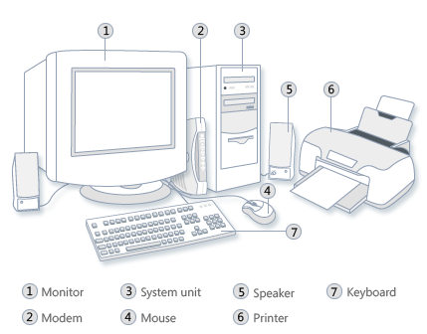
Basic Components
Input
Processing
Output
Notes:
Hardware (physical components) vs software
Which component is used for:
Input
Processing
output

Slide 3
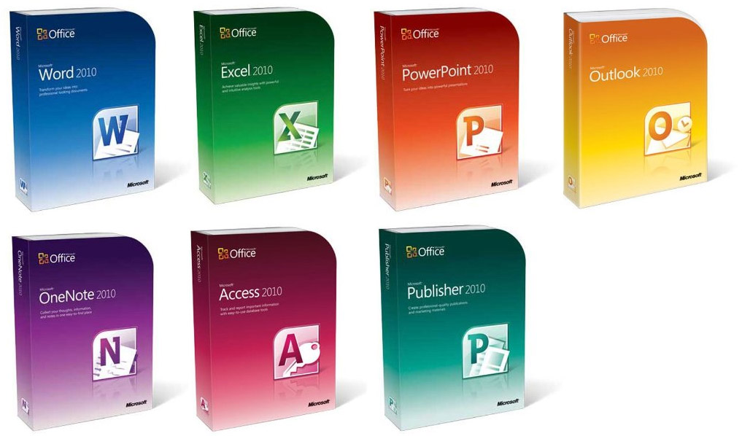
Software
Office Productivity Suite:
Documents, Spreadsheets, Presentations, Databases, Charts, Graphs
Notes:
Software: instructions that directs a computer’s processor to perform specific operations.
Ex: programs, procedures, algorithms, and documentation concerned with operation of a data processing system
Name a few softwares used in engineering?
Productivity Suite: collection of productivity programs intended to be used by knowledgeable workers

Slide 4
Professionalism
Notes:
not only behavior, appearance
+ work documents
Well organized
Concise
What are some characteristics of a professional?

Slide 5
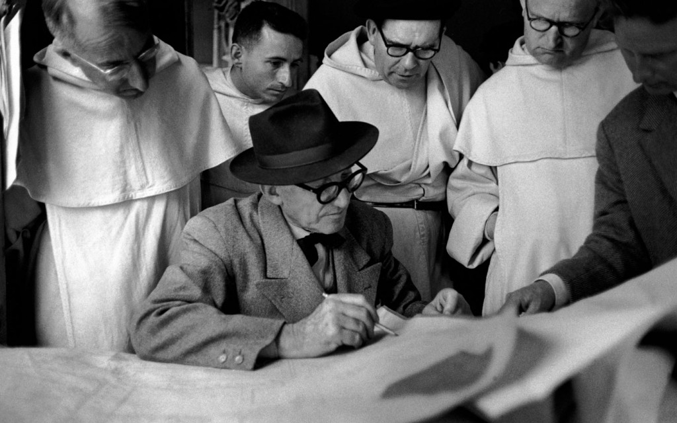
Professional Documents
How to create a professional looking document
Notes:
Objectives:
Clear
Concise
Legible
Easily understood
Convey your message

Slide 6
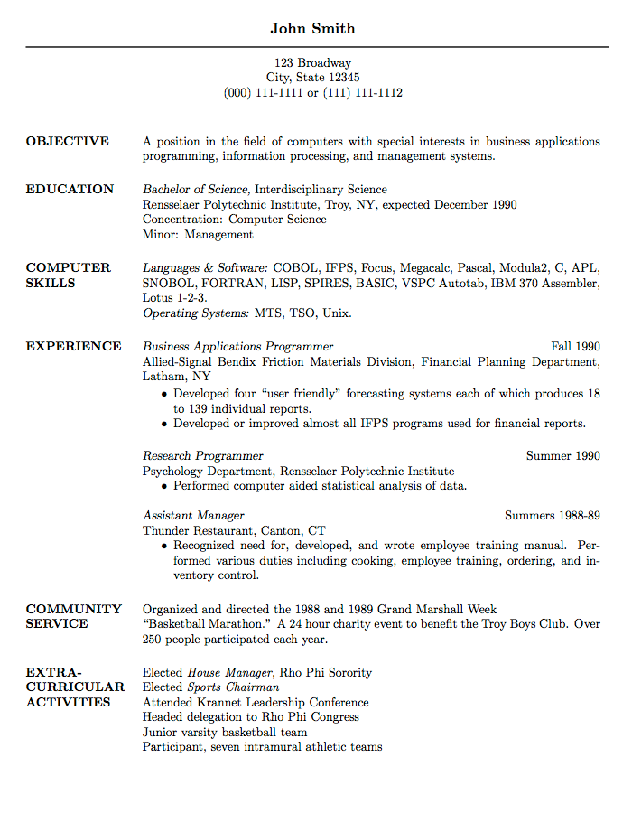
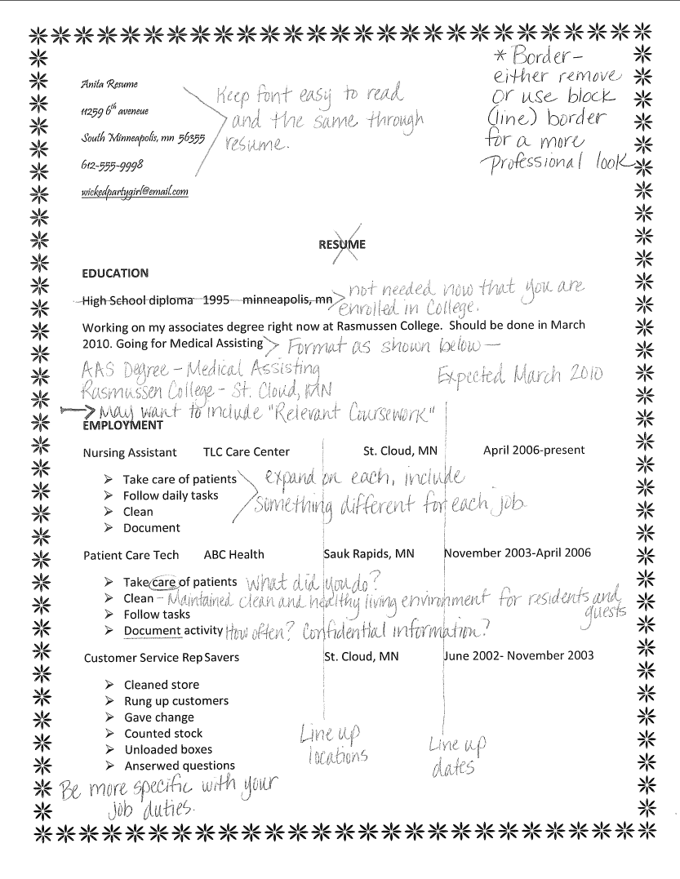
Who would you hire?
Notes:
Students compare

Slide 7
Considerations
White space
Headings
Highlighting
Graphics
Fonts
Simple, Clear,
and Consistent
Notes:
Consider:
White space- clear, uncluttered
Headings- Prominent, direct readers, consistent format
Highlighting- Bold for emphasis
Graphics- Interesting, attractive, communicate idea
Fonts- simple, 2-3 types max
Simple, Clear, Consistent

Slide 8
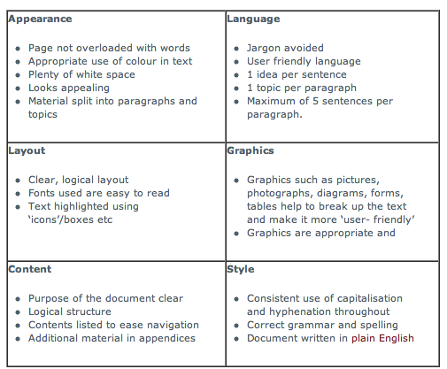
Business Writing
Business writing: the good, the bad and the ugly

Slide 9
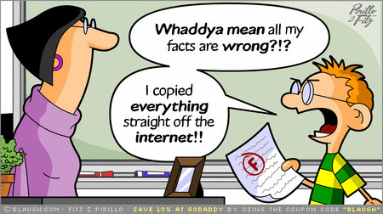
Using the Internet
Don’t believe everything you read!
Evaluate your sources:
Who is responsible for the site?
What type of site is it? What type of information is given (essays, advertisements, etc)
Where can you find more information? Are there resources cited?
Why was the site created?
Example:
http://www.whitehouse.net/
http://www.whitehouse.gov/

Slide 10
Tips for Searching the Internet
If you know the source of the information
Think logically about the information needed then determine appropriate source
I need the zip code for Boston: http://www.usps.gov
I need to find a tax form: http://www.irs.gov
Use a subject specific resource
Provide information on a particular topic or for a particular purpose
Helpful once a specific topic has been selected
Ex: Newslink.org, Hoovers.com
Use library database
Use a search engine
Develop a search strategy to find information quickly and effectively: map of information you are looking for
Select Keywords
Use: AND, OR, and NOT to refine search query
“Phrases”
Relevancy of results: You may need to start over, look for other keywords to narrow your search or that you may want to exclude
Ex: Google, Bing

Slide 11
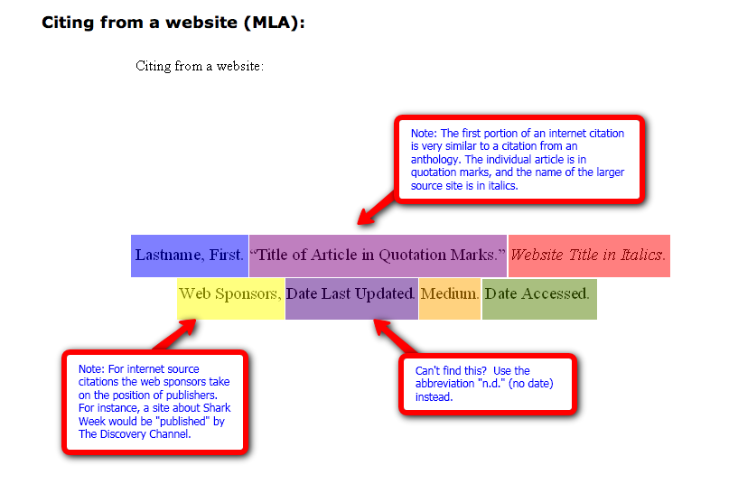
Give credit when due!
Cite your references:
MLA Formatting
Easybib

