Slide 1
Clinical Decision Support: New Solutions For A New Process
Alison Miller, RN
Director of Nursing

Slide 2
Mission
Adoption of a clinical decision support system and computerized provider-order-entry system in this facility to improve medication administration safety and prescriber accuracy, and to improve patient outcomes

Slide 3
Overview
“…we have identified three threads important in nursing informatics: basic computer skills, informatics knowledge, and information literacy.”
Linda Thede, PhD, RN-BC

Slide 4
Nursing Informatics: The Future of Nursing

Slide 5
Nursing Informatics
Electronic Health Records (EHR)
Medication Administration Records (MAR)
Clinical Decision Support Systems (CDSS)
Computerized Provider Order Entry (CPOE)
Positive Patient Identifier (PPID)
Radio Frequency Identifier (RFID) Bracelets
Financial Systems

Slide 6
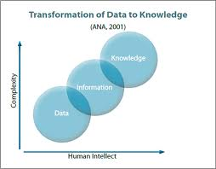

Slide 7
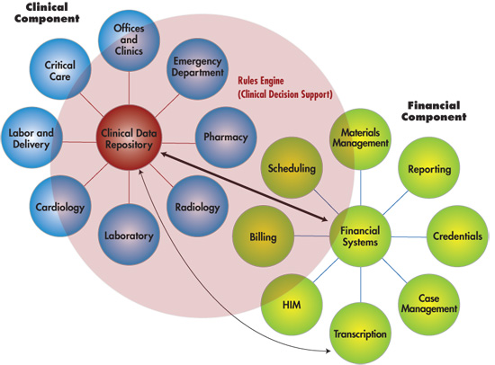
Clinical Decision Support

Slide 8
Definitions
“Decision support is a computer application that uses a complex system of rules to analyze data and presents information to support the decision-making process of the knowledge worker” (Thede & Sewell, 2012, p. 354).

Slide 9
“Clinical decision support systems link health observations with health knowledge to influence health choices by clinicians for improved health care.”
Dr. Robert Heyward
Centre for Health Evidence

Slide 10
CPOE
Allergies
Correct dosages
Correct administration routes
Correct frequency of administration
Drug-drug interactions
Drug-disease interactions

Slide 11
Support for CDSS and CPOE

Slide 12
According to a systematic review on CDSS by Bright et al (2012):
“Modest evidence from academic and community inpatient and ambulatory settings showed that locally and commercially developed CDSSs had lower treatment costs, total costs, and reduced costs compared with control groups and other non-CDSS intervention groups” (p. 37).

Slide 13
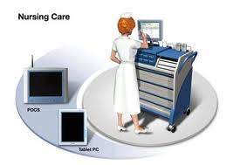
“Decision support systems help in diagnosis by providing a dictionary of health problems to the clinicians or by displaying background information about specific patients. It also provides assistance with diagnosing a patient’s condition, guide to proper drug usage, [and] reminders to administer preventive services to give patients at a specific time” (Rajalakskhmi, et al, 2011, 43).

Slide 14
Technical Specifications

Slide 15
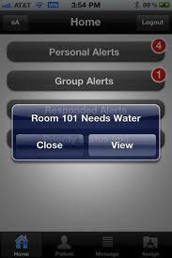
Prescriber Guidance
Ordering the correct product in the correct manner
Decision Alerts
Pop-up boxes
Flags
Highlighted text
Customizable Windows
No Overrides
Physicians cannot continue
without addressing issue

Slide 16
Goals for 2013
Assess needs of clinical staff in CDSS
Implement CDSS/CPOE system
Assess outcomes of implementation
Patient safety outcomes
Return on investment
Gain feedback from clinical staff on new system
Implement changes suggested by users

Slide 17
References
Bright, T.J., et al. (2012). Effect of Clinical Decision-Support Systems. Annals of Internal Medicine, 157(1), 29-43.
Chaffee, B., & Zimmerman, C. (2010). Developing and implementing clinical decision support for use in a computerized prescriber-order-entry system. American Journal of Health-System Pharmacy, 67(5), 391-400.
Exact Data. (2008). Clinical Decision Support Systems. Retrieved from: http://www.exactdata.net/applications/clinical-decision-support-systems/
Rajalakshmi, K., Mohan, S., & Babu, S. (2011). Decision Support System in Healthcare Industry. International Journal of Computer Applications, 2642-44.
Thede, L. (January 23, 2012). Informatics: where is it? OJIN: The Online Journal of Issues in Nursing: 17(1).
Thede, L.Q. & Sewell, J.P. (2012). Informatics and Nursing: Opportunities and Challenges. Philadelphia, PA: Wolters Kluwer Lippincott Williams & Wilkins (354).

