Slide 1
Welcome to American Government

Slide 2
Key features of the American system:
A FEDERAL SYSTEM: A system that combines a national government with state governments, where each level has powers that the other cannot encroach on (unlike a unitary system, where the national government has exclusive power).
FEDERALISM: Any aspect of the relationship between national and state levels of government, sometimes cooperative, sometimes conflictual.
A GOVERNMENT OF ENUMERATED POWERS: The national government has only those powers that are listed in the Constitution.

Slide 3
Chapter 1: American Government and Civic Engagement
What is governance?
What is democracy?
What is representation?
What is civic engagement?
The nature of power in America: pluralist theory vs. elite theory.

Slide 4
Chapter 2: The Constitution
Philadelphia Convention, 1787
Ratification campaigns, 1787–88
The Constitution: the making of an enduring plan of governance

Slide 5
Chapter 3: Federalism
What makes the U.S. government a federal system?
National government and state governments, where each level has its own powers that the other level can’t encroach on.
The term federalism applies to any aspect of the relationship between national and state governments. This includes:
--cooperative fiscal federalism, where the national government dispenses money to the states, sometimes with conditions; and
--conflicts and power struggles, as with sanctuary cities in the Trump years and, historically, all aspects of civil rights.

Slide 6
Chapter 4: Civil Liberties
The Bill of Rights (originally just a limit on national power)
--freedom of religion
--freedom of speech and press
--rights of accused persons
--right to privacy (including abortion)
Essence of civil liberties: freedom from intrusion and interference from government
The 14th Amendment: tool for empowering federal courts to enforce these amendments over the states.

Slide 7
Chapter 5: Civil Rights
essence of civil rights: protection of specific groups that have a historic struggle for equality and respect
close connection of civil rights and federalism, especially where African-Americans are involved
Fourteenth Amendment vs. “states’ rights”
Topic includes the civil rights of non-whites, women, persons with disabilities, LGBTQ persons, and others.

Slide 8
Chapter 6: Public Opinion
How to design a valid poll
Gallup polls
political socialization: Where do we get our political and social values from?
conspiracy theories and populist thinking

Slide 9
populism—a style of political campaign rhetoric that emphasizes:
--a sense of struggle of ordinary Americans against treacherous power elites. Those power elites may be of an economic, political, or cultural nature.
--romantic memory of a time in the past when virtue, patriotism, and diligence were rewarded; sense of having been robbed of those times by treacherous elites.
Today’s populist nationalism, or authoritarian populism (as represented by Trump and his support base): a narrative of the nation being under siege by sinister forces, external and internal, including liberalism and so-called “political correctness”; perception that the nation has been made weak and needs to be made strong again by a strong leader.

Slide 10
Chapter 7: Voting and Elections
Voting rights: A key issue of federalism.
Campaign finance law: What can and cannot be regulated?
Primary elections: Run purely by the parties, not mentioned in the Constitution.
General elections: Popular vote to affect the electoral vote. Note that nowhere does the Constitution require a popular vote for the president; it solely creates the electoral college.
Elections are still run by the states. All the federal government does is prohibit certain kinds of discrimination.

Slide 11
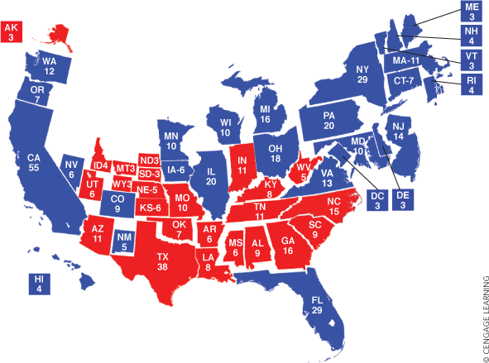
Notes:
This is the map of the 2012 election, when Barack Obama triumphed over Mitt Romney. Note that Obama got the electoral votes of Wisconsin, Michigan, Ohio, Pennsylvania, and Florida.

Slide 12
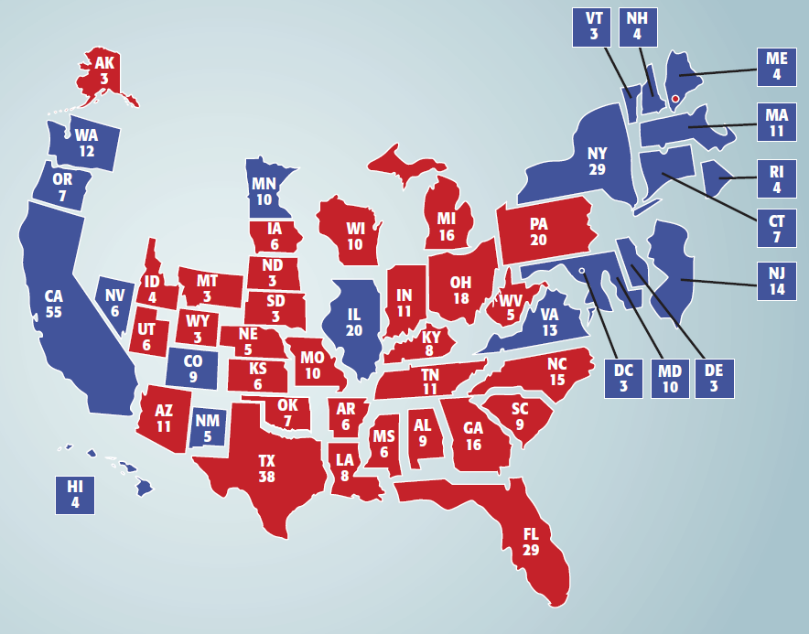
9.1 State Electoral Votes in 2016
Figure 9-1 shows the number of electoral votes per state in 2016
Notes:
This is the map of the 2016 election, when Donald Trump beat Hillary Clinton, to most people’s surprise. Note that Trump won the electoral votes of Wisconsin, Michigan, Ohio, Pennsylvania, and Florida.

Slide 13
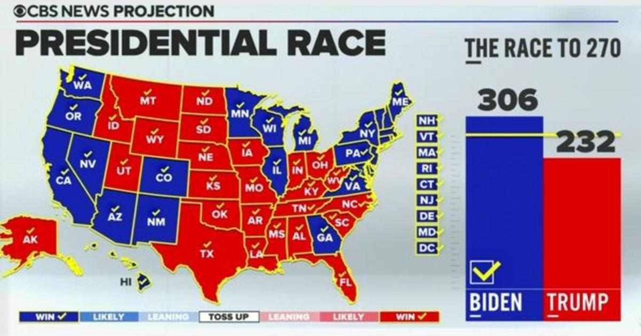
Notes:
This is the map of the 2020 election, when Joe Biden defeated Donald Trump. Note that Ohio and Florida, previously considered battleground states, stayed red, giving their electoral votes to Trump, while Michigan, Wisconsin, and Pennsylvania flipped back to blue with Biden. Note also that Arizona and Georgia, previously considered secure Republican states, went for Biden, thus becoming battleground states.

Slide 14
Chapter 8: The Media
What is media, and how has it changed in the new cyber age?
How can media influence events?
Just how “biased” is the media?

Slide 15
Chapter 9: Political Parties
The Constitution does not mention parties at all.
Parties throughout history
Federalists vs. Democratic Republicans
Whigs vs. Democrats
Democrats vs. Republicans
Today’s Democratic Party: moderates, liberals, and progressives
Today’s Republican Party: Trump’s continuing influence and the party’s potential identity crisis

Slide 16
Chapter 10: Interest Groups
Pluralist vs. elite theory of power
Different types of interest groups:
--direct self-interest (business, labor, farm) --ideological
Methods of influencing policy
--direct lobbying: interacting with lawmakers
--indirect lobbying: mobilizing voters
--litigation (court cases, as with the NAACP and the ACLU)

Slide 17
Chapter 11: Congress
What’s in the Constitution, and what isn’t?
The powerful influence of political parties
Two key functions of standing committees:
--marking up legislation
--holding investigative hearings (congressional oversight of the bureaucracy)
The current situation with parties and legislation

Slide 18
Chapter 12: The Presidency
limited powers, unlimited expectations
growth of the presidency since George Washington (with special attention to FDR)
The recent presidency: from Obama to Trump to Biden

Slide 19
Chapter 13: The Federal Judiciary
federal courts and state courts
federal district courts, circuit court of appeals, Supreme Court
Judicial review: the power of the courts to strike down federal and state laws
the partisan battle for the nation’s soul in judicial appointments

Slide 20
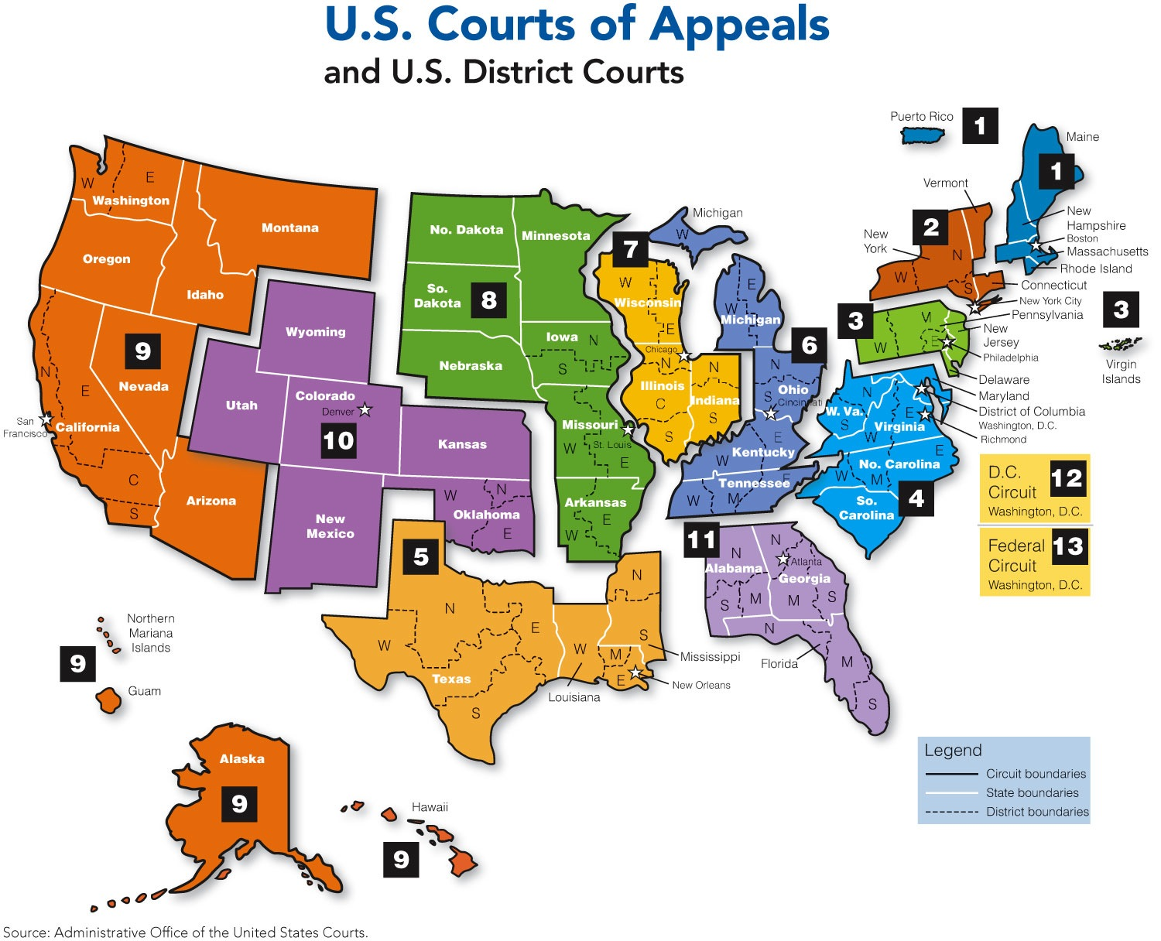

Slide 21
Chapter 15: The Bureaucracy
theory of sociologist Max Weber
current bureaucracy: cabinet departments, presidential agencies, regulatory agencies
Spanish word, burrocracia

Slide 22
Chapter 16: Domestic Policy
economic policy: classical economics vs. Keynesian economics (close connection with Republican and Democratic Party ideologies, respectively)
social welfare policy:
--two conflicting visions of liberty
--fiscal federalism in action

Slide 23
Chapter 17: Foreign Policy
from Cold War to “War on Terror”
the legislative and executive branches: who does what in foreign policymaking
liberal internationalism vs. “America First”

Slide 24
IMPORTANT TURNING POINTS
1776: Declaration of Independence
1787: Writing of the Constitution
1789: Birth of the new government
1861-65: American Civil War
1868: Ratification of the 14th Amendment
1917-18: America in World War I
1933-41: The New Deal
1941-45: America in World War II
1945-91: The Cold War
2001: The 9/11 attack and the start of the War on Terror
2008: Election of Obama
2016: Election of Trump
2020: Election of Biden

Slide 25
Recent events and current issues:
--the 2020 elections: the White House and Congress
--the January 6th insurrection and its fallout
--the bipartisan infrastructure act and the Build Back Better bill
--the pullout from Afghanistan
--changes in state voting laws
--the Supreme Court and ideology
--outlook for the 2022 congressional elections

