Slide 1
How the Presidential Election Works

Slide 2
Constitutional provisions for the presidential election:
No reference to political parties.
No reference to direct election.
(Exception: 24th Amendment outlawing poll taxes.)
Electoral College: created in Article II, modified in 12th Amendment.
Original plan: Runner-up in electoral vote to be vice-president. New plan: Separate balloting for president and vice-president. How did this reflect the existence of political parties?
Special contingency if no candidate has a majority: House chooses president (one state one vote); Senate chooses vice-president.

Slide 3
PRESIDENTIAL PRIMARIES
Run jointly by each state’s government and the national and state party committees, subject to federal anti-discrimination laws.
National nominating conventions began in 1832. Over many decades, the direct primary system evolved, with delegates chosen by popular vote.
Rules differ between parties and between states, and are very unwieldy, contradictory, and constantly changing.
A few states still have caucuses: voters show up at local conventions, hear speeches, and vote there.

Slide 4
Primaries and caucuses choose delegates to the party’s national convention.
Up until the 1970s, the party elites controlled the nominations. They still have some influence.
Two key functions of the convention:
--nominate candidates for president and VP
--write the party platform (often involving conflict between sectors of the party)

Slide 5
Electoral College system: Each state’s legislature decides how the electors will be chosen.
Each state’s electors equal number of Representatives (variable) plus Senators (two each).
Actual practice: each state’s electors go to winner of popular vote, usually winner-take-all (exceptions: Maine and Nebraska).

Slide 6
Battleground states: states that have many electoral votes and are not securely Democratic or Republican, which get the most attention from the campaigns.
In the electoral college system, the winner of the popular vote can lose the electoral vote.
Thought question: Is more democratic necessarily better?

Slide 7
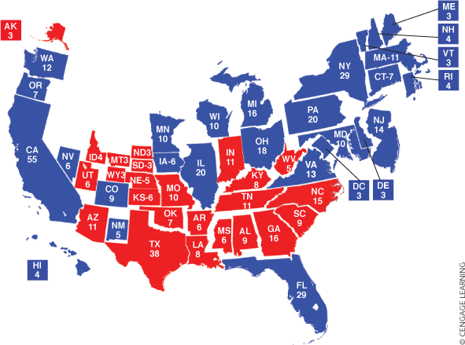

Slide 8
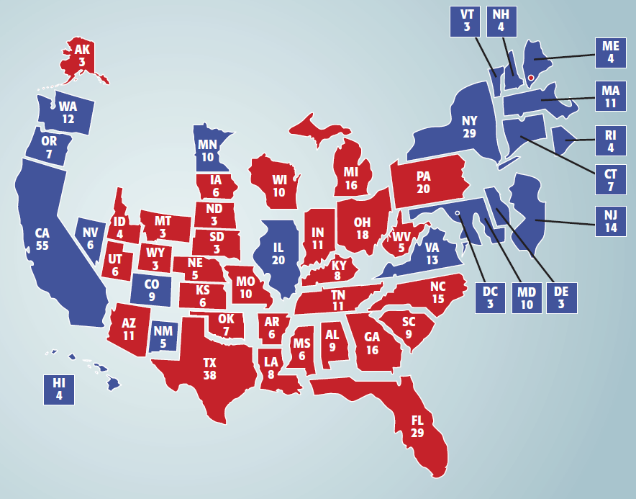
9.1 State Electoral Votes in 2016
Figure 9-1 shows the number of electoral votes per state in 2016

Slide 9
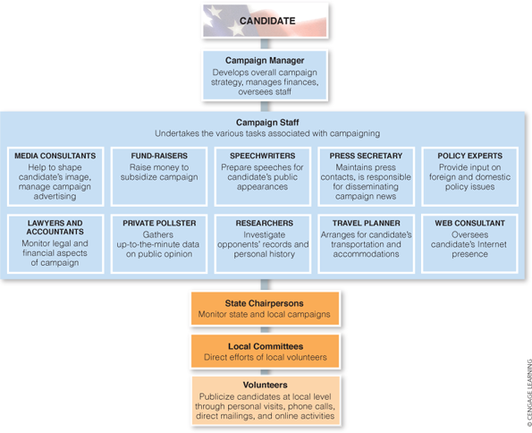

Slide 10
Rove innovation in 2004: micro-targeting of supporters, geographically.
Obama innovation in 2008: much greater use of E-mail and websites than before, for campaigning and fund-raising.
Sanders innovation in 2016: calling on supporters to contribute a small amount, which adds up to a lot
Now: Both parties and their candidates use these methods.
Features:
--making it easy to donate with one click.
--giving recipients a sense of personal contact with the candidate, or the president.

