Slide 1
STEVEN PAUL JOBS
By Alessandro Lombardo Jr.

Slide 2
Born and Died
Steve Jobs was born on :
February 24, 1955
And passed away on :
October 5, 2011
At the age of 56

Slide 3
STEVE JOBS EARLY YEARS
Job’s birth parents met at the University of Wisconsin, where Job’s Syrian-born father, Abdulfattah "John" Jandali (Arabic) , taught, and where his mother, the Swiss Catholic, Joanne Carole Schieble was his student. They were the same age because Jandali had "gotten his PhD really young." Schieble had a career as a speech language pathologist. Jandali taught political science at the University of Nevada in the 1960s, and then made his career in the food and beverage industry, and since 2006, has been a vice president at a casino in Reno, Nevada.

Slide 4
STEVE JOBS EARLY YEARS
Jandali, who was teaching in Wisconsin when Jobs was born, said he had no choice but to put the baby up for adoption because his girlfriend's family objected to their relationship. In December 1955, ten months after giving up their baby boy, Schieble and Jandali married. In 1957 they had a daughter, Mona. They divorced in 1962, and Jandali lost touch with his daughter. Her mother remarried and had Mona take the surname of her stepfather, so she became known as Mona Simpson

Slide 5
STEVE JOBS EARLY YEARS
Jobs was adopted at birth by Paul Reinhold Jobs (1922–1993) and Clara Jobs (1924–1986), an Armenian American whose maiden name was Hagopian. According to Steve Job's commencement address at Stanford, Schieble wanted Jobs to be adopted only by a college-graduate couple. Schieble learned that Clara Jobs hadn't graduated from college and Paul Jobs had only attended high school, but signed final adoption papers after they promised her that the child would definitely be encouraged and supported to attend college. Later, when asked about his "adoptive parents", Jobs replied emphatically that Paul and Clara Jobs "were my parents." He stated in his authorized biography that they "were my parents 1,000%."Unknown to him, his biological parents would subsequently marry (December 1955), have a second child, novelist Mona Simpson, in 1957, and divorce in 1962.

Slide 6
Steve Jobs Teen years
When Steve arrived in Homestead High School, he enrolled in a popular electronics class. McCollum later recalled of one time when his pupil Steve called up Bill Hewlett himself, co-founder of HP, to get spare parts for his homework, and even a summer job at HP’s factory. Steve’s entrepreneurial skills showed up early in his life indeed.

Slide 7
Steve Jobs Teen years
A couple of years later, Woz and Steve started their first entrepreneurial venture. It was 1972, and on US campuses, there was a lot of talk about “phone phreaks.” They were early computer hackers that managed to build “blue boxes” — little devices that fooled AT&T’s long-distance switching equipment, and allowed you to make phone calls for free

Slide 8
How Steve started apple
To get the necessary $1,000 to start building the first boards, Steve sold his Volkswagen van, and Woz his HP 65 calculator. They thought about how to call the new company, and couldn’t come up with a good name, until one day, Steve said that they would call it Apple if they didn’t find anything better. And they didn’t — so Apple Computer was born.

Slide 9
Early days in Apple
The day he finished work on his first computer, Woz started working on an improved design, the future Apple II. The Apple II was based on the Apple I’s design, but in many ways it was a huge breakthrough
First, it ran a lot faster with half as many chips. It also was the first computer that could produce color, with any color TV you would plug it into. It could handle high-resolution graphics and sound, and had a BASIC interpreter built-in. In short, it was the first computer that anybody who knew the BASIC programming language could use: it had what it took to launch the personal computing revolution.

Slide 10
The Future of Apple
In many ways, the Apple II was both the start and the symbol of the personal computer revolution of the early 1980s. Although there were many competing personal computers on the market — such as the Commodore PET or Radio Shack’s TRS-80 — the Apple II clearly set itself apart very early on, and soon embodied the personal computer in the public consciousness. It was all over the media, and its sales skyrocketed throughout 1978, 1979 and 1980.

Slide 11
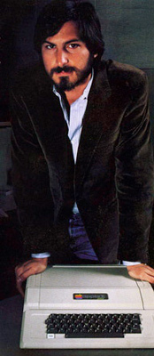
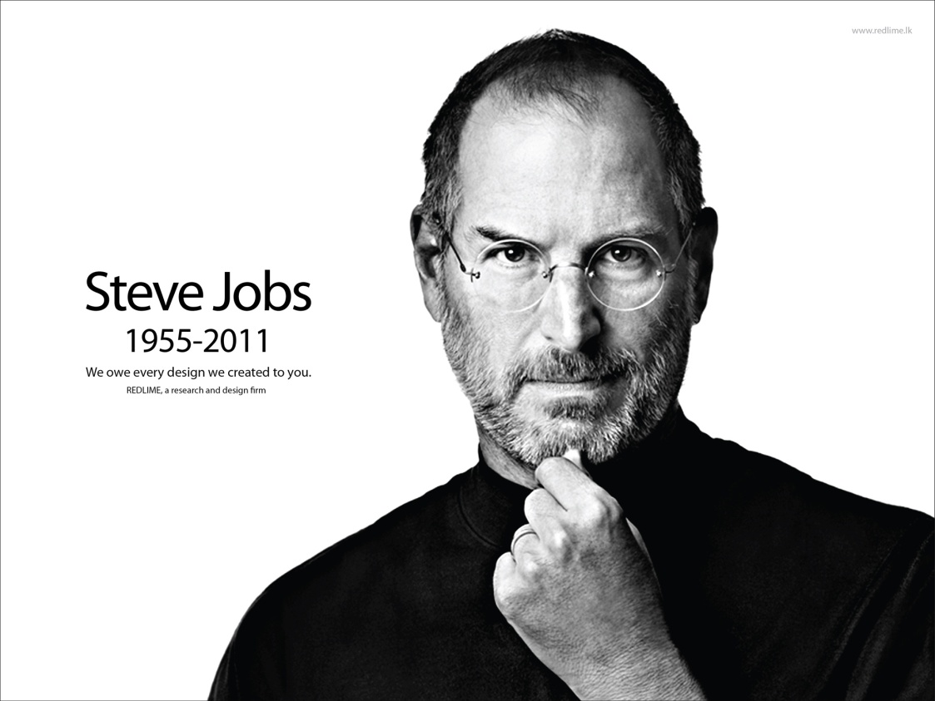

Slide 12
Information gathered from
http://en.wikipedia.org/wiki/Steve_Jobs
http://allaboutstevejobs.com/

