Slide 1
Theories of Health Behavior & Theory of Behavior Change

Slide 2
What is a “health behavior?”
Smoking
Exercise
Eating
Hydrating
Washing hands
Condom use
Wearing seatbelt
Taking the stairs
Using cell phone while driving
Going to the doctor
Getting a vaccination
Just about anything you can think of (or do!)

Slide 3
Theories:
Theories of health behavior explain why we may engage in a behavior:
Social cognitive
Health belief model
Theory of planned behavior
A theory of behavior change explains how we change behavior:
Transtheoretical model of change (TTM)
What is the #1 reason why people don’t change their behavior?

Slide 4
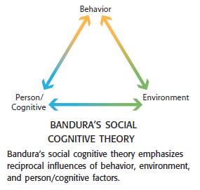
Social Cognitive Theory (SCT)
Learning about the health behavior from experience:
Direct: engaging in the behavior
Vicarious: observe others engaging in the behavior
Persuasory: judgments of others about the behavior (implicit)
Inferred: comes to conclusion on your own (deduction)
Self Efficacy
-how we judge our ability to engage in the behavior successfully
Reciprocal Determinism →

Slide 5
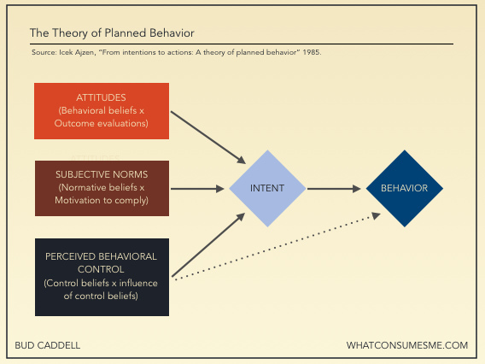
Theory of Planned Behavior (TPB)

Slide 6
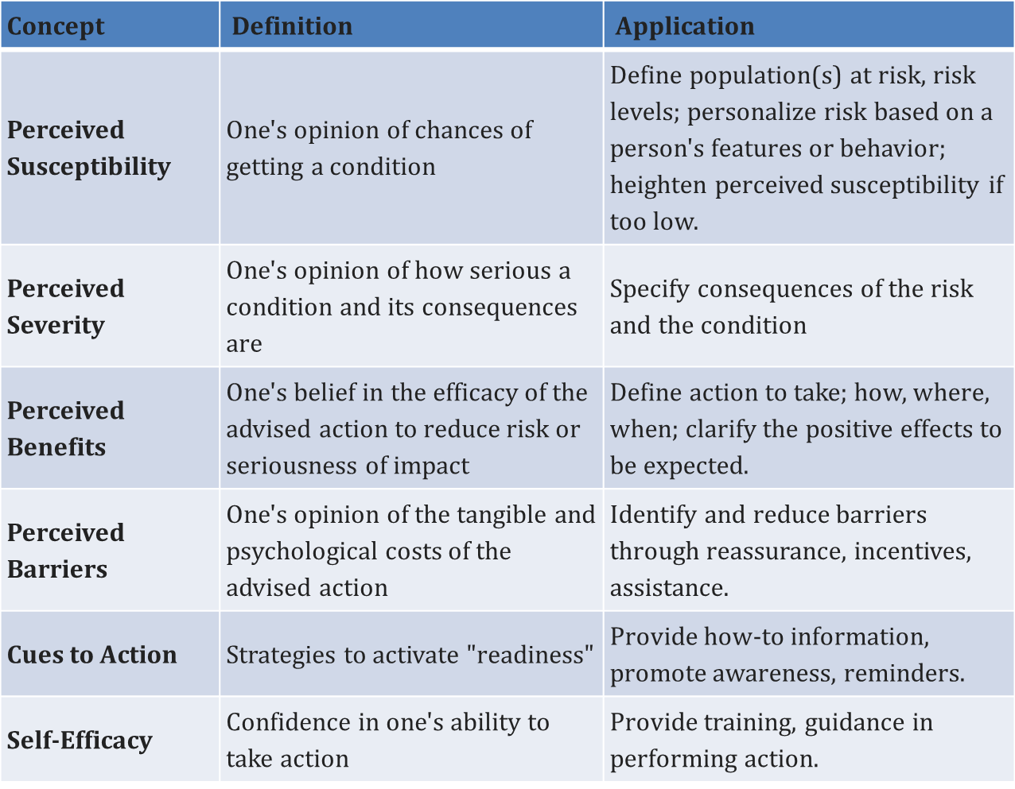
Health Belief Model (HBM)

Slide 7
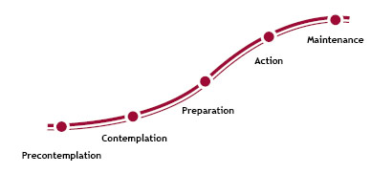
Transtheoretical Model of Behavior Change (TTM)

Slide 8
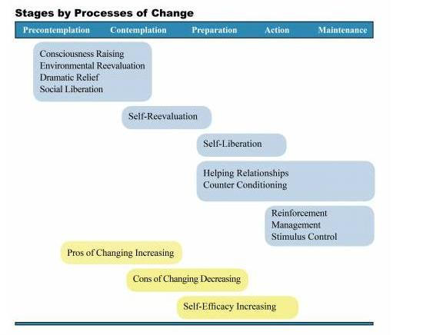
Advancing through the Stage of Change

Slide 9
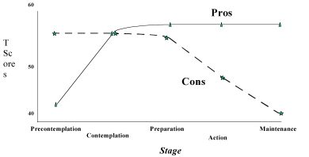
Pros and Cons: TTM

Slide 10
Ecological Approach: Other factors that influence health behaviors
Individual/personality
Gender
Knowledge
Peer groups/social networks
Media exposure
Policies
Health care systems
Superfund/hazardous waste site

Slide 11
Society and the Promotion of Health Behaviors
Goal: “encourage people to adopt a belief that will lead to behavior change”
Four P’s:
Promotion (who to target)
Product (what are we promoting?)
Place (where are we promoting?)
Price (at what cost?)
**PhotoVoice Assignment for Thursday!**
Does NYCCT promote health behavior? How? Show me!

