Slide 1
Stress and Coping
What causes stress? Illness as a source of stress; Stress as a cause of illness; What are different types of stress? Biopsychosocial, individual, environmental sources of stress; What’s cognitive coping? What’s behavioral coping? Is high risk behavior a good form of coping?

Slide 2
What causes stress?
Everything!
Stress is a subjective experience
(we will discuss appraisal later)
What are some of your current stressors?
Two-way street:
STRESS → ILLNESS
(CHRONIC) ILLNESS → STRESS

Slide 3
Different Types of Stress
Daily life hassles
Good stress (focus) vs. bad stress (fear)
Microaggressions
Catastrophic events and PTSD
Loosely related to high risk health behaviors
Comorbidity- meaning and relevance

Slide 4
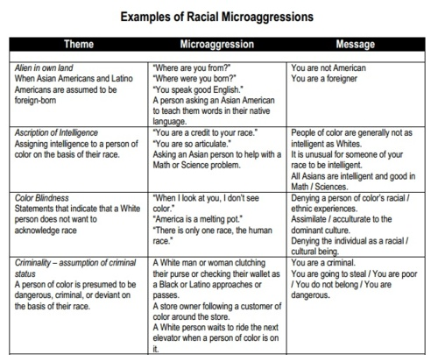
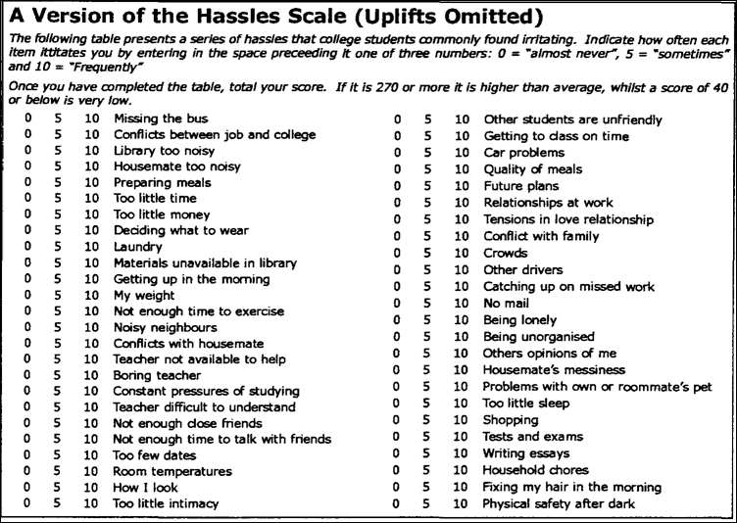
Microaggressions & Daily Hassles

Slide 5
Biopsychosocial, Individual, and Environmental Sources of Stress
Biopsychosocial
Diathesis-Stress model of disease
E.g., schizophrenia, depression, alcoholism
Individual
Personality type
E.g., Type A, Type D
Environmental
Psychosocial events
E.g., illness of loved one, death of loved one, suicide, poverty, workplace responsibilities

Slide 6
COPING: Cognitive Coping
COPING= What we do (our response) in the presence of stress
Cognitive coping= what we think in the presence of stress
Engagement (obtain information) or Disengagement (minimize discomfort)
These terms can describe both cognitive and behavioral coping
Two types of Cognitive Coping:
Problem-focused
Emotion focused

Slide 7
COPING: Behavioral Coping
Exercise and stress
Music (interesting one!)
Humor
Social support (buffering)
Spirituality/religion/traditions

Slide 8
Stress can lead to high risk behavior…
This is a form of behavioral coping…poor behavioral coping
Stress and eating
Stress and sleep deprivation
Sexual behaviors (escape)
Substance abuse (escape)

Slide 9
Positivity and Stress
Stress can be positive (focus)
Positive attitude can reduce perceptions of stress
More positivity than stress is a form of illness prevention
How stressed are you? (LIVEWELL ASSIGNMENT)
Patients Voices:
As a class let’s assess both the sources of stress and coping mechanisms displayed in these Patient’s Voices of people living with HIV/AIDS

Slide 10
Stress: Definitions and Theories
How do we define stress? How do we appraise stress? What are the three theories of stress? What can animal-studies tell us about our stress?

Slide 11
Stress
Stressful stimulus: An external event that provokes a response
Stressful response: Physical or emotional reaction to stimulus
1) Acute time-limited stressors
2) Brief naturalistic stressors
3) Stressful event sequences
4) Chronic stress (daily stressor build-up)
5) Distal stressors

Slide 12
Example of Distal Stressors
Passing on Experience of Trauma to Offspring
Study: In Black Men, Internalized Racism Speeds Up Aging

Slide 13
Stress Appraisal
Cognitive Appraisal
(how we make sense of events and deem them as stressful or not)
A) Primary Appraisal
Initial thought: is this event harmful or not?
B) Secondary Appraisal
Determination of resources: do I have what it takes to cope?
C) Cognitive reappraisal
Reappraising as the event continues/develops
Stressfulness depends on our perceptions (open to interpretation)
The same situation may be appraised differently based on mood, health, motivation, presence of others, etc.

Slide 14
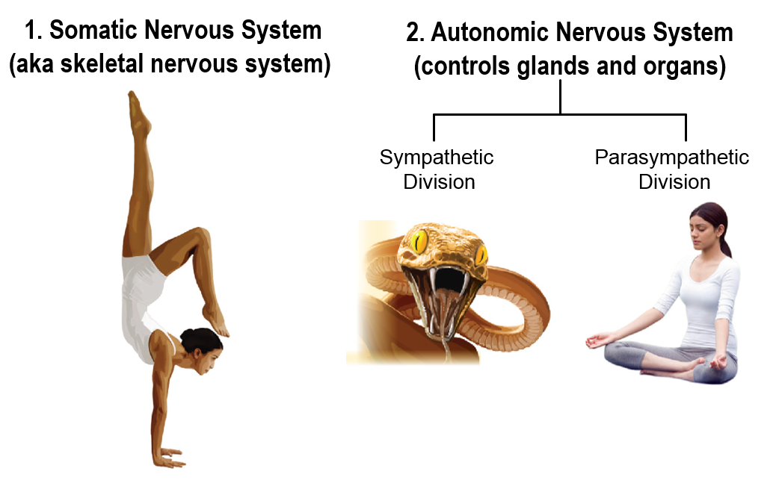
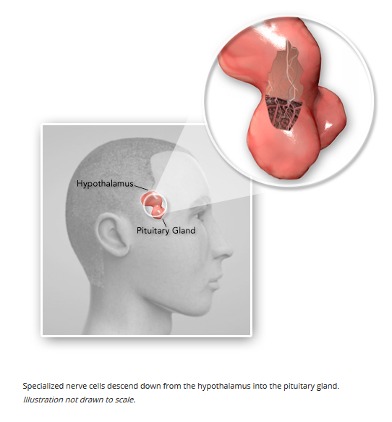
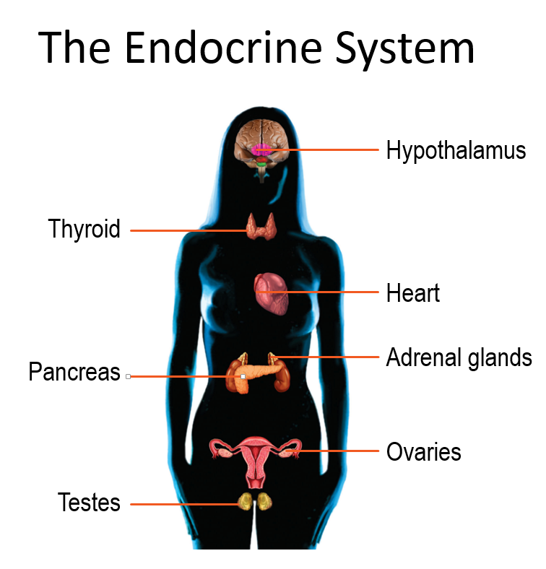
Systems Involved…

Slide 15
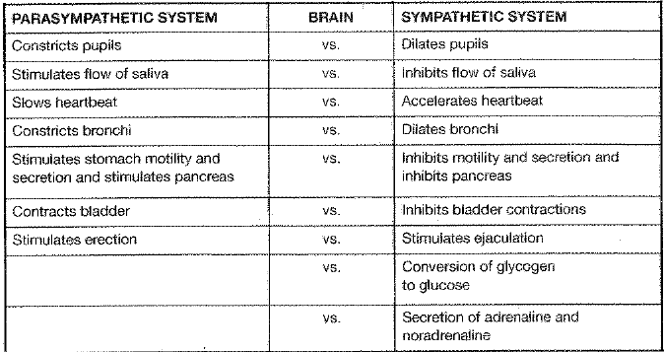
Fight or Flight Response

Slide 16
Stress Response: All the Players
Stressors activate the immune system (within minutes <hour)
Hypothalamus: leader of the stress response
Adrenal gland secretes epinephrine and norepinephrine (FIRST RESPONDERS) as instructed by Hypothalamus
Hypothalamus secretes corticotrophin-releasing hormone (Stress hormone: CRH)
CRH tells neighbor (pituitary gland) to secrete adrenocorticotrophic hormone (ACTH)
ACTH signals the release of glucorticoids (LONG TERM RESPONDERS)
Glucorticoids relate to decreases in lymphocytes (one of the two types of cells in body’s immune system)
Lymphocytes help attack foreign organisms (viruses, bacteria) in the body, so a decrease is seen as bad.

Slide 17
Stress, the Immune System, and Disease: Glucorticoids and Lymphocytes (The Benefits of Animal Studies)
Altering immune functioning can happen 2 ways:
Chronic Stress → reduction of white blood cells (lymphocytes) and poor/supressed immune system
Acute stress → redistribution of white blood cells (lymphocytes go elsewhere, specifically skin) results in overactive immune system
If chronic stress is not permanent, then eventually body’s immune system will return to normal. (Same for repeated acute stressors)
Problems (diseases) occur when…
Chronic stress remains
Glucorticoid level remains high (decreasing lymphocytes)
The sympathetic nervous system remains activated

Slide 18
Stress and Disease
Overactive Immune System → body may attack its own tissues, causing an allergic reaction or diseases such as Lupus, Multiple Sclerosis, or Rheumatoid Arthritis (all chronic)
Underactive/supressed Immune System → promote bacterial infection, eruption of dormant virus, or reproduction of cancer cells
Looking ahead….
HIV/AIDS: Stress and negative emotions speed the transition from HIV to AIDS
Stress predicts a faster decline in those living with AIDS
Education, support groups, and effective coping mechanisms are an important part to treating the disease(s)

