Slide 1
Health and Quality of Life
Biopsychosocial model of well-being

Slide 2
Introduction to Health Psychology
Health psychology is concerned with the psychology of a range of health-related behaviors, including healthy eating, the doctor-patient relationship, a patient's understanding of health information, and beliefs about illness.
The biopsychosocial model views health and illness as the product of biological characteristics (genes), behavioral factors (lifestyle, stress, health beliefs), and social conditions (cultural influences, family relationships, social support).

Slide 3
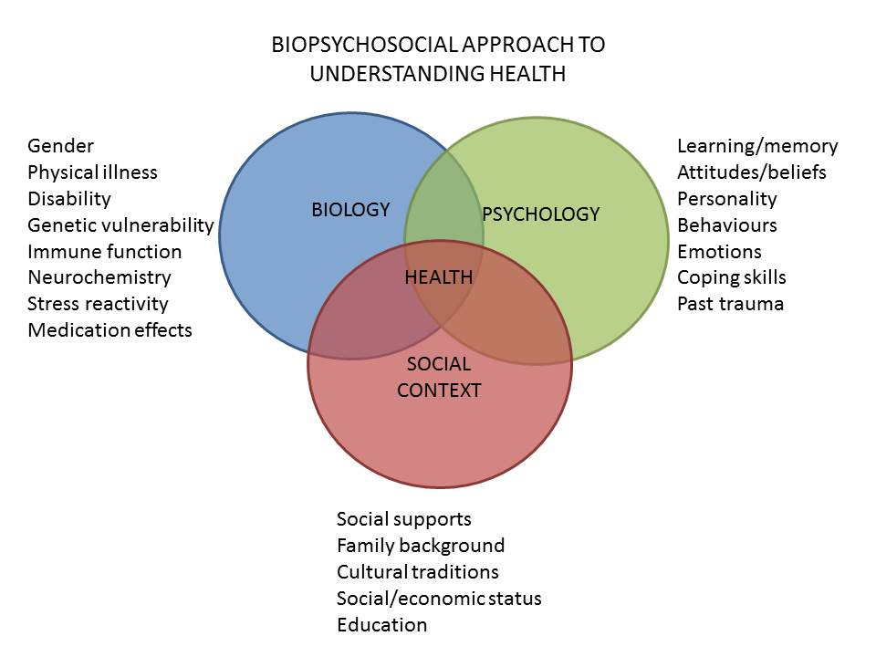

Slide 4
Biopsychosocial Model: Biological Factors
Disease
Microorganisms
Vaccines
Limitations of looking to biology alone to explain well-being:
More than just physical explanations of illness
Problem (dysfunction) based

Slide 5
Biopsychosocial Model: Psychological Factors
Emotions
Immune system via nervous system
Emotional impacts on health
Negative/positive emotions
Health behaviors

Slide 6
Biopsychosocial Model: Sociological Factors
Socioeconomic status and Income
Family and culture (shared behaviors)
Political histories
Country of origin
Historical and current policies

Slide 7
Sub-disciplines of Health Psychology
Clinical health psychology (CIHP) refers to the application of scientific knowledge, derived from the field of health psychology, to clinical questions that may arise across the spectrum of healthcare.
Public health psychology (PHP) is population oriented, investigating potential causal links between psychosocial factors and health at the population level.
Community health psychology (CoHP) investigates community factors that contribute to the health and well-being of individuals in their communities.
Critical health psychology (CrHP) is concerned with the distribution of power and the impact of power differentials on health experience and behavior, healthcare systems, and health policy.

Slide 8
Health is negatively impacted by many aspects of quality of life, such as poverty, poor nutrition, lack of access to education, lack of leisure time, increased stress, and social isolation.

Slide 9
Nutrition
Food is fuel for the body. Cells use nutrients from food to sustain cellular functioning.
Nutritional requirements include macronutrients (such as carbohydrates, proteins, and fats), and micronutrients (such as vitamins, minerals, and amino and fatty acids) in order to maintain proper function.
Malnutrition is caused by both excess food consumption and insufficient food consumption. Both can result in disease and disorders within the body and mind.

Slide 10
Exercise
Physical exercise is any activity that enhances or maintains physical fitness and mental function.
Exercise can come in many forms but usually falls into one of three types: flexibility (affects joint mobility), aerobic (affects cardiovascular function), and anaerobic (affects muscle strength).
The benefits 0f exercise for the body include weight maintenance, injury and disease prevention, and improved functioning.

Slide 11
Substance Use
Substance abuse is the habitual use of drugs in dangerous amounts or situations. Both legal and illegal drugs can be used in a harmful manner.
Extended drug use can lead to tolerance, dependence, and withdrawal.
Extended abuse of substances can cause detrimental physical and mental effects including heart, liver, and cognitive problems as well as depression, anxiety, and psychosis.
Substance abuse is associated with higher rates of suicide.

Slide 12
Measuring Health-Related Quality of Life (HRQOL)
Broad outcome measures designed to measure physical, emotional, and social dimensions of health (McDowell & Newell, 1996).
No one definition of HRQOL is agreed upon, but generally assessed with generic measures (e.g., Short-Form 36) or disease-specific measures (e.g., Quality of Life in Epilepsy Scale-10 (Ware & Sherbourne, 1992; Cramer et al., 1996).
Notes:
Introduce the concept of HRQOL and its measurement.
There are varying definitions for HRQOL.
There are many ways and scales with which to measure HRQOL depending on one’s needs. Generally, each scale has its advantages and disadvantages that make it more or less advantageous to use depending on the scenario in question. See the provided link for a database of QOL scales.

Slide 13
Core Healthy Days Measures
1. Would you say that in general your health is excellent, very good, good, fair, or poor?
2. Now thinking about your physical health, which includes physical illness and injury, for how many days during the past 30 days was your physical health not good?
3. Now thinking about your mental health, which includes stress, depression, and problems with emotions, for how many days during the past 30 days was your mental health not good?
4. During the past 30 days, for about how many days did poor physical or mental health keep you from doing your usual activities, such as self-care, work, or recreation?
Notes:
These are the 4 core Healthy Days measures (HRQOL-4) used in the Behavioral Risk Factor Surveillance System (BRFSS) and the National Health and Nutrition Examination Survey (NHANES).
While there are other Healthy Days measures that are sometimes included in these surveys (Activity Limitations module (4 questions), Healthy Days Symptoms module (5 questions)) (see http://www.cdc.gov/hrqol/hrqol14_measure.htm), these are 4 core questions that are most widely used.

Slide 14
Interventions that can Improve Quality of Health

