Slide 1
Scientific Method and Research Types
Basic and Applied Research

Slide 2
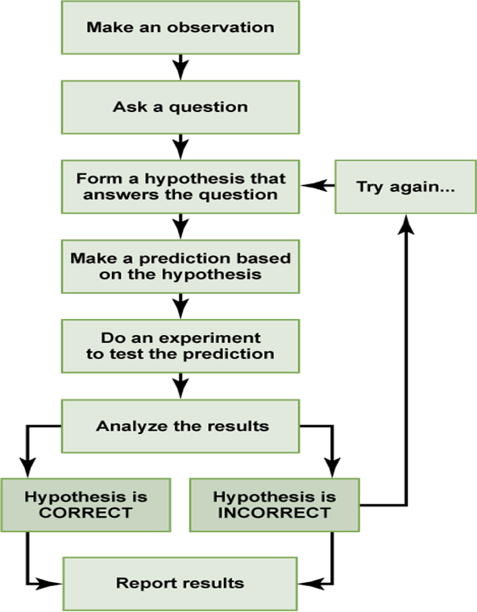
Notes:
The question asked is either “basic” or “applied”
“Try again…” NEVER with the same data set
*data mining*
Literature review is ESSENTIAL
It’s the “educated” piece of an “educated guess”
Data can be analyzed in a NUMBER of ways
The type of analysis MUST be determined before the research is conducted
Results are to be interpreted in the context of previous literature
If you are ADDING something to the existing conversation, you PUBLISH results (regardless of hypothesis correctness)

Slide 3
Setting up your Hypothesis
Independent variable
The first domino to fall
Dependent variable
Is related to or “caused” by the Independent variable
“If, then” wording helps to identify these variables
Use the term “cause” RARELY (only in experiments)
Confounding variables (IMPORTANT TO KEEP IN MIND!)
Think of the phrase “above and beyond”
It’s like preparing yourself in advance for criticism of others
Example… physician racism and # of doctor’s visits relationship

Slide 4
Modes of Collecting Data
Observation, Case Studies, Surveys/Interviews

Slide 5
Observation
Observation differs from most other forms of data collection--researcher does not manipulate variables or directly question participants.
The advantages of observation:
observing natural behavior
refining hypotheses
allowing for observation of behavior that cannot be produced in an artificial environment for ethical or practical reasons.
The disadvantages of observation:
studies do not produce quantitative data
do not allow for cause and effect statements
may be very time consuming
can be prone to researcher bias.

Slide 6
Case Studies
Case studies allow for the development of novel hypotheses
provide detailed descriptions of rare events
explore the intricacies of existing theories of causation.
Case studies cannot directly indicate cause and effect relationships or test hypotheses
findings from case studies cannot be generalized to a wider population.
Famous case studies, like that of Phineas Gage, and researchers using case studies, like Jean Piaget, have helped establish entire fields of psychology.
Phineas Gage helped researchers understand the relationship between brain areas and personality
Piaget developed a model of development based on his studies.

Slide 7
Surveys and Interviews
The survey method of data collection is likely the most common of the research methods.
The benefits of this method include low cost, large sample size, and efficiency.
The major problem with this method is accuracy: since surveys depend on subjects' motivation, honesty, memory, and ability to respond, they are very susceptible to bias.
You CAN and MUST combat bias in a number of ways
Power analysis
Language
Incentive
Transparency
Sampling methods
A researcher must have a strong understanding of how to properly frame survey questions in order to gather reliable and relevant information.
Psychological measurement is its own discipline--- reliable measures are certain
Reliability AND validity

Slide 8
Types of Research
Descriptive, Correlational, Experimental

Slide 9
Descriptive Research
Descriptive studies do not test specific relationships between factors
they provide information about behaviors and attributes with the goal of reaching a better understanding of a given topic.
Descriptive research is a useful method of gathering information about rare phenomena that could not be reproduced in a laboratory or about subjects that are not well understood.
Descriptive research is an example of “basic” research

Slide 10
Correlational
Defined as: “the extent to which 2 or more things differ similarly”
There are some instances where experimental research is not an option for practical or ethical reasons.
correlational research is used to determine if two (or more) variables are related.
Correlations can be used to make predictions about the likelihood of two (or more) variables occurring together.
Correlation does not imply causation.
Just because one factor correlates with another does not mean the first factor causes the other or that these are the only two factors involved in the relationship.
Remember, confounding variables and directionality
Only an experiment can establish cause and effect.
Correlations can be POWERFUL despite being able to prove cause and effect--- correlations can also be meaningless. It’s a balancing act!

Slide 11
Experimental Research
Experiments are generally the most precise studies and have the most conclusive power.
They are particularly effective in supporting hypotheses about cause and effect relationships.
However, since the conditions in an experiment are somewhat artificial, they may not apply to everyday situations.
A well-designed experiment has features that control random variables to make sure that the effect measured is caused by the independent variable being manipulated.
These features include random assignment, use of a control group, and use of a single or double-blind design.
SAMPLING is CRUCIAL to experimentation
An experimenter decides how to manipulate the independent variable while measuring the dependent variable.
In a good experiment, only the independent variable will affect the dependent variable.
Confounding variables (other Independent variables) ideally get ruled out OR their effects are reduce by the manipulated IV

Slide 12
Broadly Defined Types of Research
Qualitative
Quantitative
Mixed-methods
Meta-analysis
Literature Review

Slide 13
Ethical Guidelines (Human Research)
Ethical guidelines that govern the use of human subjects in research are a fairly new but important construct developed in response to unethical and harmful experiments such as the Tuskegee syphilis experiment.
As a result of various unethical experiments carried out in the United States in the 20th century, several organizations were put in place to help monitor clinical research involving humans.
At most colleges and universities, institutional review boards (ethics committees) are formally chosen to approve, review, and monitor bio-medical and behavioral research involving humans.
Key ethical guidelines include the assurance of confidentiality, informed consent, and debriefing.

