Slide 1
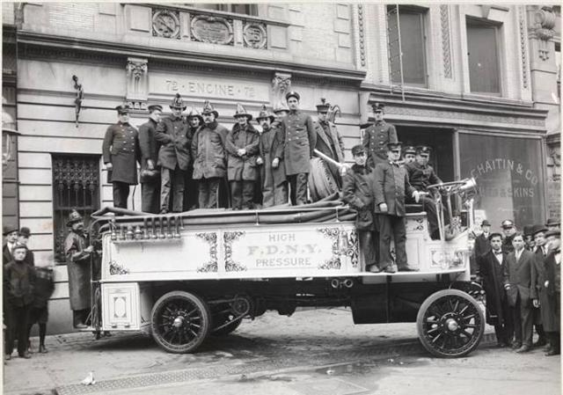
Brooklyn Fire Department
By: Frank A. Smith

Slide 2
1772
First elections for Fire Department members was on April 2nd, 1772

Slide 3
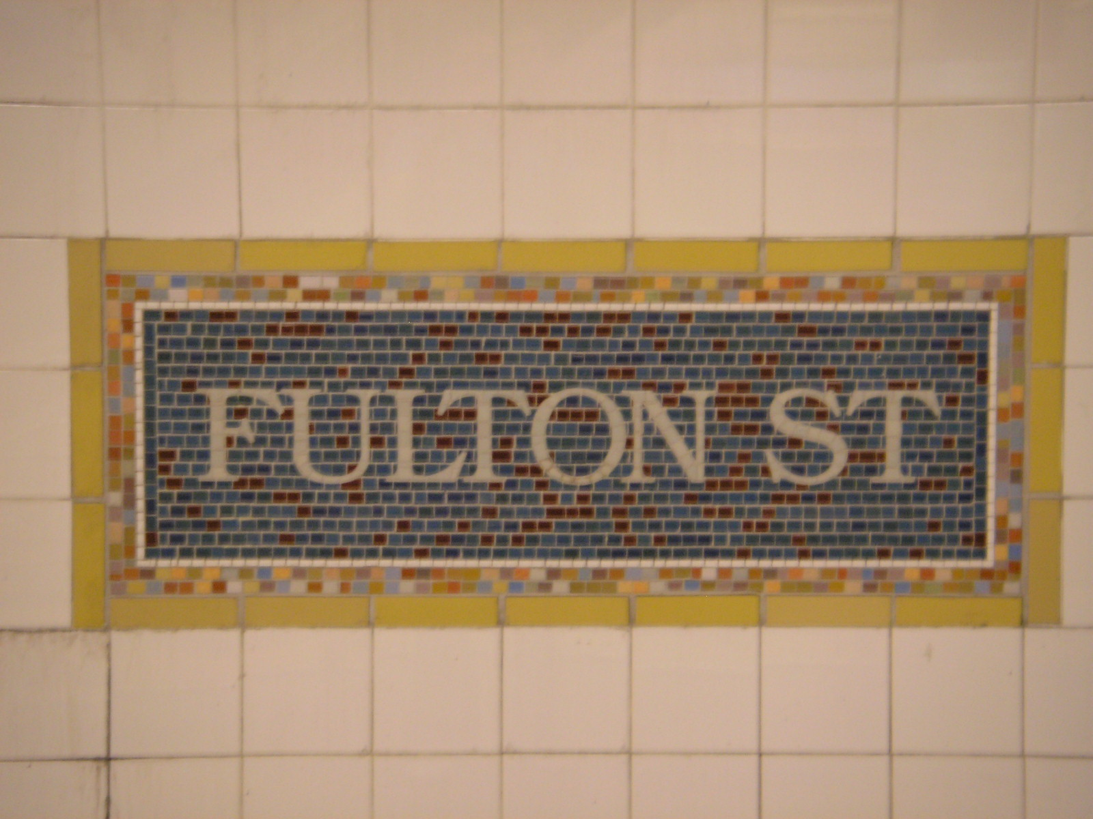
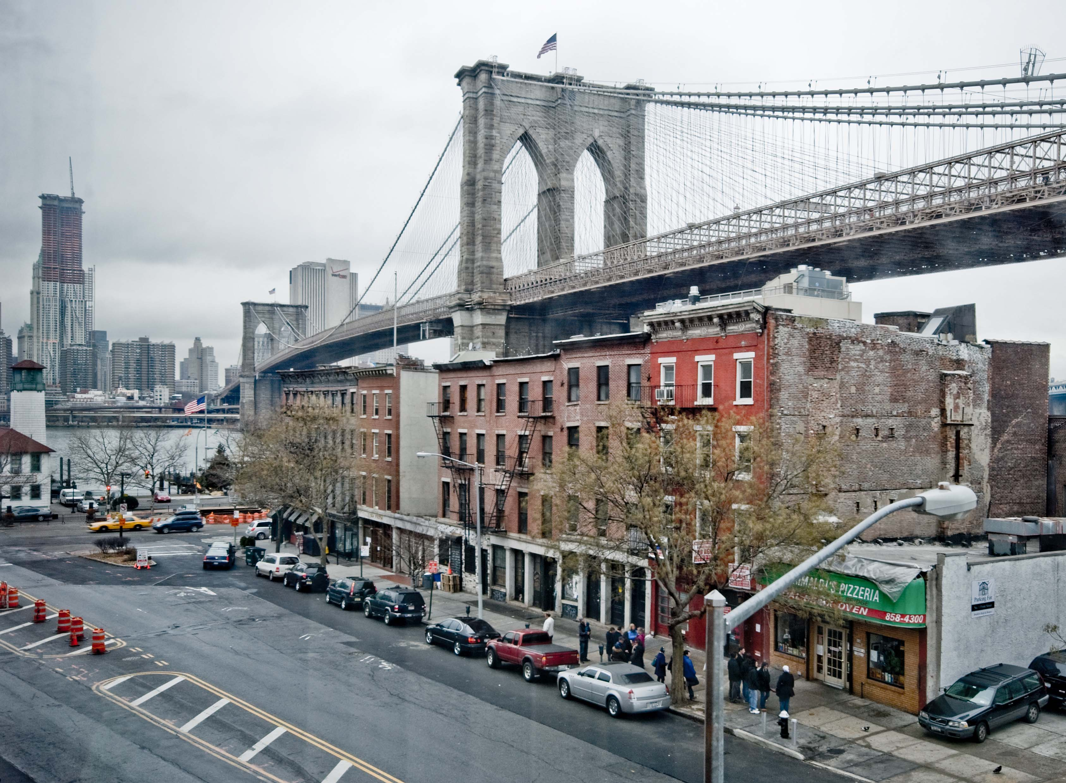
1785
Meeting at the home of Margot Moser on what is now Fulton Street to reorganize the Fire Department after the war.

Slide 4
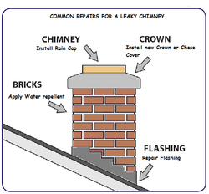
1789
First fire law: April 1st appointed Chimney inspection

Slide 5
1788
A Brooklyn fireman received no pay, but legislature exempt members from serving on “highways” mending and preparing roads, from hurry, and militia except when in imminent danger.

Slide 6
1794
Crown all dwelling homes must have two five buckets ready for use, at expense of the home owners.
Bell was brought over to home of Jacob Remson close toe modern day Brooklyn Navy yard.

Slide 7
November 16, 1806
The Long Island intelligencer reports “greatest fire which ever visit the city, an act of incendiarism” by William Cromwell and Martin Hill, both under the age of fifteen in order to rob a couple of store fronts on the waterfront.

Slide 8
1817 &1818
First Hook and Ladder established to consist of fifteen people and one captain
The fire bell was removed to Middagh street near Henry Street, afterwards to the building called the Eastern Market, in Sands Street between Bridge and Gold

Slide 9
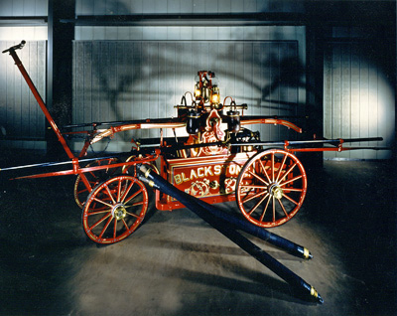
1824 & 1825
1824: The Brooklyn fire department consisted of just four engine companies and one hook and ladder company
1825: June 25th, $1400 allocated for the use of an engine and a house , located selected to be on the south side of Concord street between Adams and Pearl street
Fire engine 1825

Slide 10
September 9th, 1848
“The Great Brooklyn Fire” Starting at George Drew’s upholstery at 122 Fulton Street it destroyed eight blocks and more the 200 buildings encompassed Henry, Pineapple, Sands and Washington streets.
“The Greatest Firemen’s fight” During the Great fire the engines had to receive water from the river, placed on Fulton street, the firemen would “wash” or intentionally over flow other companies engines. This led to a fight between three fire companies which was so bad the military from the Navy yard had to break it up, all while the fire continued to move downtown.

Slide 11
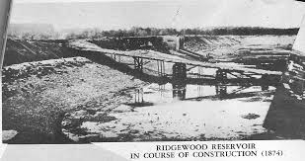
November 18, 1858
The Ridgewood reservoir is completed, which helps to bring water from the Adirondack mountains to Brooklyn. This gave the Brooklyn firemen a new weapon in fighting fires. Before this water could only be pump from the east river.

Slide 12
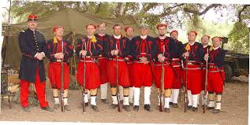
April 15th, 1861
President Lincoln asked for 75,000 volunteers to defend the union.
On April 30th,1861 the first New York Zouaves 1,200 men in total, made up of mostly volunteer firemen headed to Washington D.C to help the cause. The New York Zouaves suffered losses in battles Williamsburg, Bull run, and Gettysburg.

Slide 13
1865
The Brooklyn Volunteer fire department was abolished by a state act which created the Metropolitan fire district and the Metropolitan Fire Department. This gave control of New York and Brooklyn fire departments to the Governor.

Slide 14
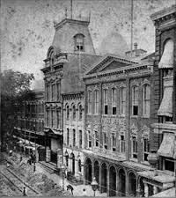
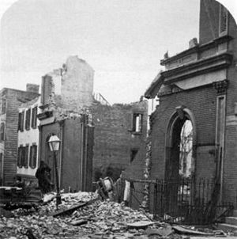
December 5^{th,} 1876
The “Brooklyn Theater Fire”, more than 300 hundred people were killed in this conflagration.
This fire had a big impact on Brooklyn society and fire code. Legislature for theaters to have better evacuation plans and sprinklers was made to avoid future theater fires.

Slide 15
1898
The greater city of New York is consolidated. The Brooklyn fire department is combined with the New York City department. Making the FDNY and officially ended the Brooklyn fire department.

Slide 16
Interactive map Notice arrow pointing to biggest circle, which was The Brooklyn Great Fire.

