Slide 1
Minimal Marking, Effective Tutoring
Writing Across the Curriculum
Alicia Andrzejewski

Slide 2
Activity
Read through the student paper once without making any marks.
Free write: what concerns would you work with the writer on and how?
Discussion

Slide 3
Higher Order Concerns
Thesis statement
Quality of argument/ideas
Evidence used correctly
Logic of conclusions
Use of topic sentences
Organization of paper
Follows assignment
Demonstrates understanding of course material

Slide 4
Lower Order Concerns
Spelling
Grammar (agreement)
Formatting (font, spacing)
Citation
Punctuation
Sentence structure
Vocabulary/word choice
Style

Slide 5
How do students perceive “marks” on their papers?
Students at Bunker Hill Community College, Boston, MA

Slide 6
Strategies to Encourage Student Autonomy
Let the student keep the pen
Be a coach as opposed to a judge
”At least do no harm” or let go of addressing every “mistake”
Recognize that students interpret most feedback as criticism
Frame comments in a forward-looking way

Slide 7
Session Goals: Motivating
Supportive Feedback
“You’ve done a great job at finding facts and quotes to support your argument”
“You have included facts that support your argument”

Slide 8
Session Goals: Supportive Feedback
Revision-Oriented Feedback
“Your supporting arguments need some development, but your thesis statement is clear and strong.”
Informational Feedback
“Most states do allow a waiting period before an adoption is final—Do you feel that all such laws are wrong?”
Technical Feedback
“Your use of verb tenses is often confused. Let’s review paragraphs 1 and 2 on page 4 and work through the errors there.”

Slide 9
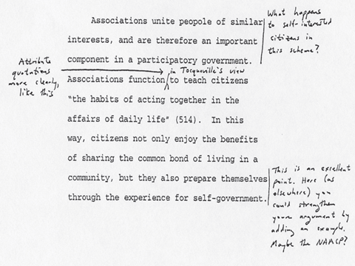
Supportive Responding on Paper (excerpted from K. Walk)
Notes:
LUCA
READ COMMENTS
Asks questions (starting a conversation)
points to ways of possible sources/new avenues
models correct citation

Slide 10
References
Bean, John C. Engaging Ideas. 2nd edition. San Francisco: Jossey-Bass, 2011.
Elbow, Peter. “High Stakes and Low Stakes in Assigning and Responding to Writing.” In Writing to Learn: Strategies for Assigning and Responding to Writing in the Disciplines, ed. Mary Deane Sorcinelli and Peter Elbow. San Francisco: Jossey-Bass, 1997.
Walk, Kerry. “Teaching with Writing: A Guide for Faculty and Graduate Students.” Princeton Writing Program: 30-40.

