Slide 1
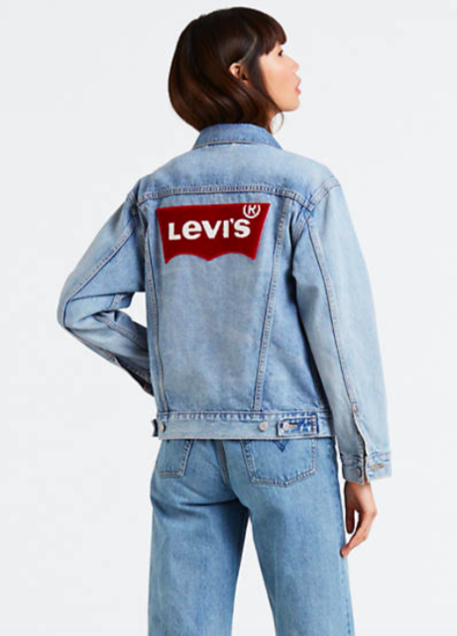
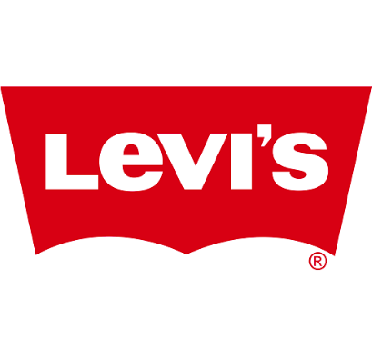
Alexia Hernandez, Ann Marie ,Brenda Mendez & Maria Mannan.

Slide 2
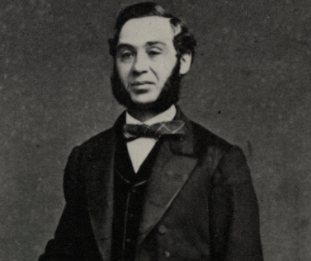
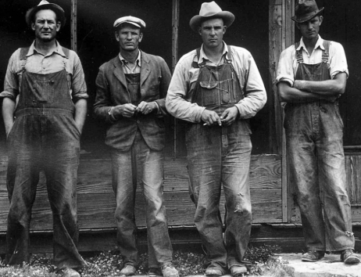
Brief History of Levi’s
In 1853, Levi Strauss, an immigrant from Bavaria, opened a dry goods company in San francisco at the height of California Gold rush. Whileper rivet reinforcement with tough denim, leading to the first manufactured waist overalls in 1873. The first overalls became part of basically this uniform that was worn by miners, cowboys, rebels, and rockstars. he was working, he had recognized a need among hardworking people: clothes built to endure anything. He and tailor Jacob Davis combined cop

Slide 3
Levi’s Mission Statement
Mission Statement: The mission of Levi’s Strauss & Co. is to sustain responsible commercial; success as a global marketing company of branded apparel. We must balance goals of superior profitability and return on investment, leadership market positions and superior products and services. We will conduct our business ethically and demonstrate leadership in satisfying our responsibilities for our communities and to society.
Vision Statement : When LS & Co. describe the future of Levi they are talking about building on the foundation they have inherited: affirming best of their Company’s tradition, closing gaps that may exist between principles and practices and updating some of their values to reflect contemporary circumstances.

Slide 4
Brand Audit
Were consumers really interested in premium brand denim and their prices?
How was Levi’s before becoming public? What were some of their downfalls? What happen after they went public?

Slide 5
Target Market
Demographics:Male and female age 20-35
College student or College grad
Income range 30,000-45,000
Psychographics:
Outgoing
spends a great deal at concerts and festivals
Listen to rock and hip-hop music
Time is spent with friends and family through
social media
Tech savvy
Are readers of US Weekly and GQ Magazine

Slide 6
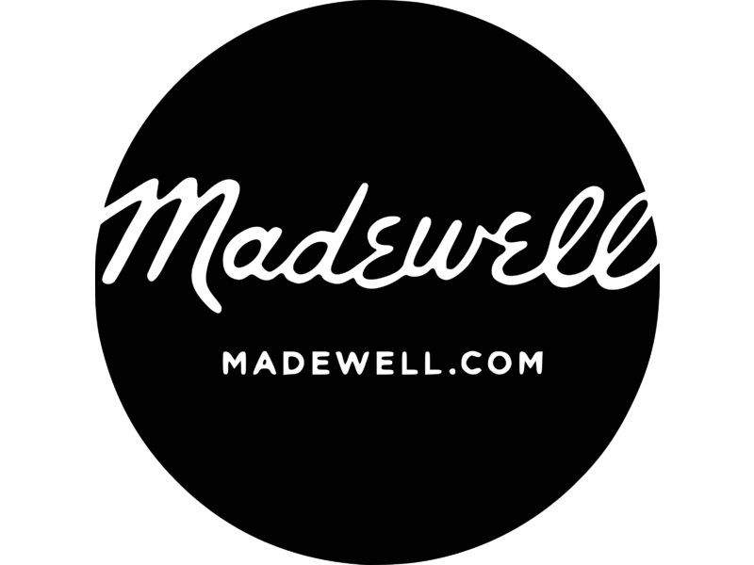
Top Competitors
Wrangler
Madewell
Everlane

Slide 7
Communicating, Launching and Evaluating the Brand
Ethical fashion is the recognition that there are human beings behind the clothes we wear. To make a real impact in the world, we need to change the way people think about clothes. Levi’s new approach will ensure its jeans are not just on trend but ethical and sustainable as well.
While companies are putting an image to the consumers that they’re not pretty or cool enough unless they change their appearance. This creates a false craving that leads to a cycle of hyper-consumption.
Instead, what we’re trying to do is encourage our consumer to be mindful that when they purchase a pair of jeans, the garment had an impact before they purchased it, in terms of people that made it and the waste that was involved in creating it.

Slide 8
Our Approach
Maintain a strong connection where we ensure that we have the fit you feel best in not the one you’ve been told to feel best in.
Contribute to sustainable denim production, including significantly reducing water use. We strive for our cotton to come from 100% sustainable sources.
Our Workers Well-being & protecting the rights of the people who make our products.
We have a life cycle assessment that looks at the impact at every stage of the process, all around the world. It’s also about educating the customer, telling them that there are better ways to take care of their clothes.
A simple message like this allows us to build a deeper connection and involve the consumer in a much bigger effort to consciously draw down on resource consumption.

Slide 9
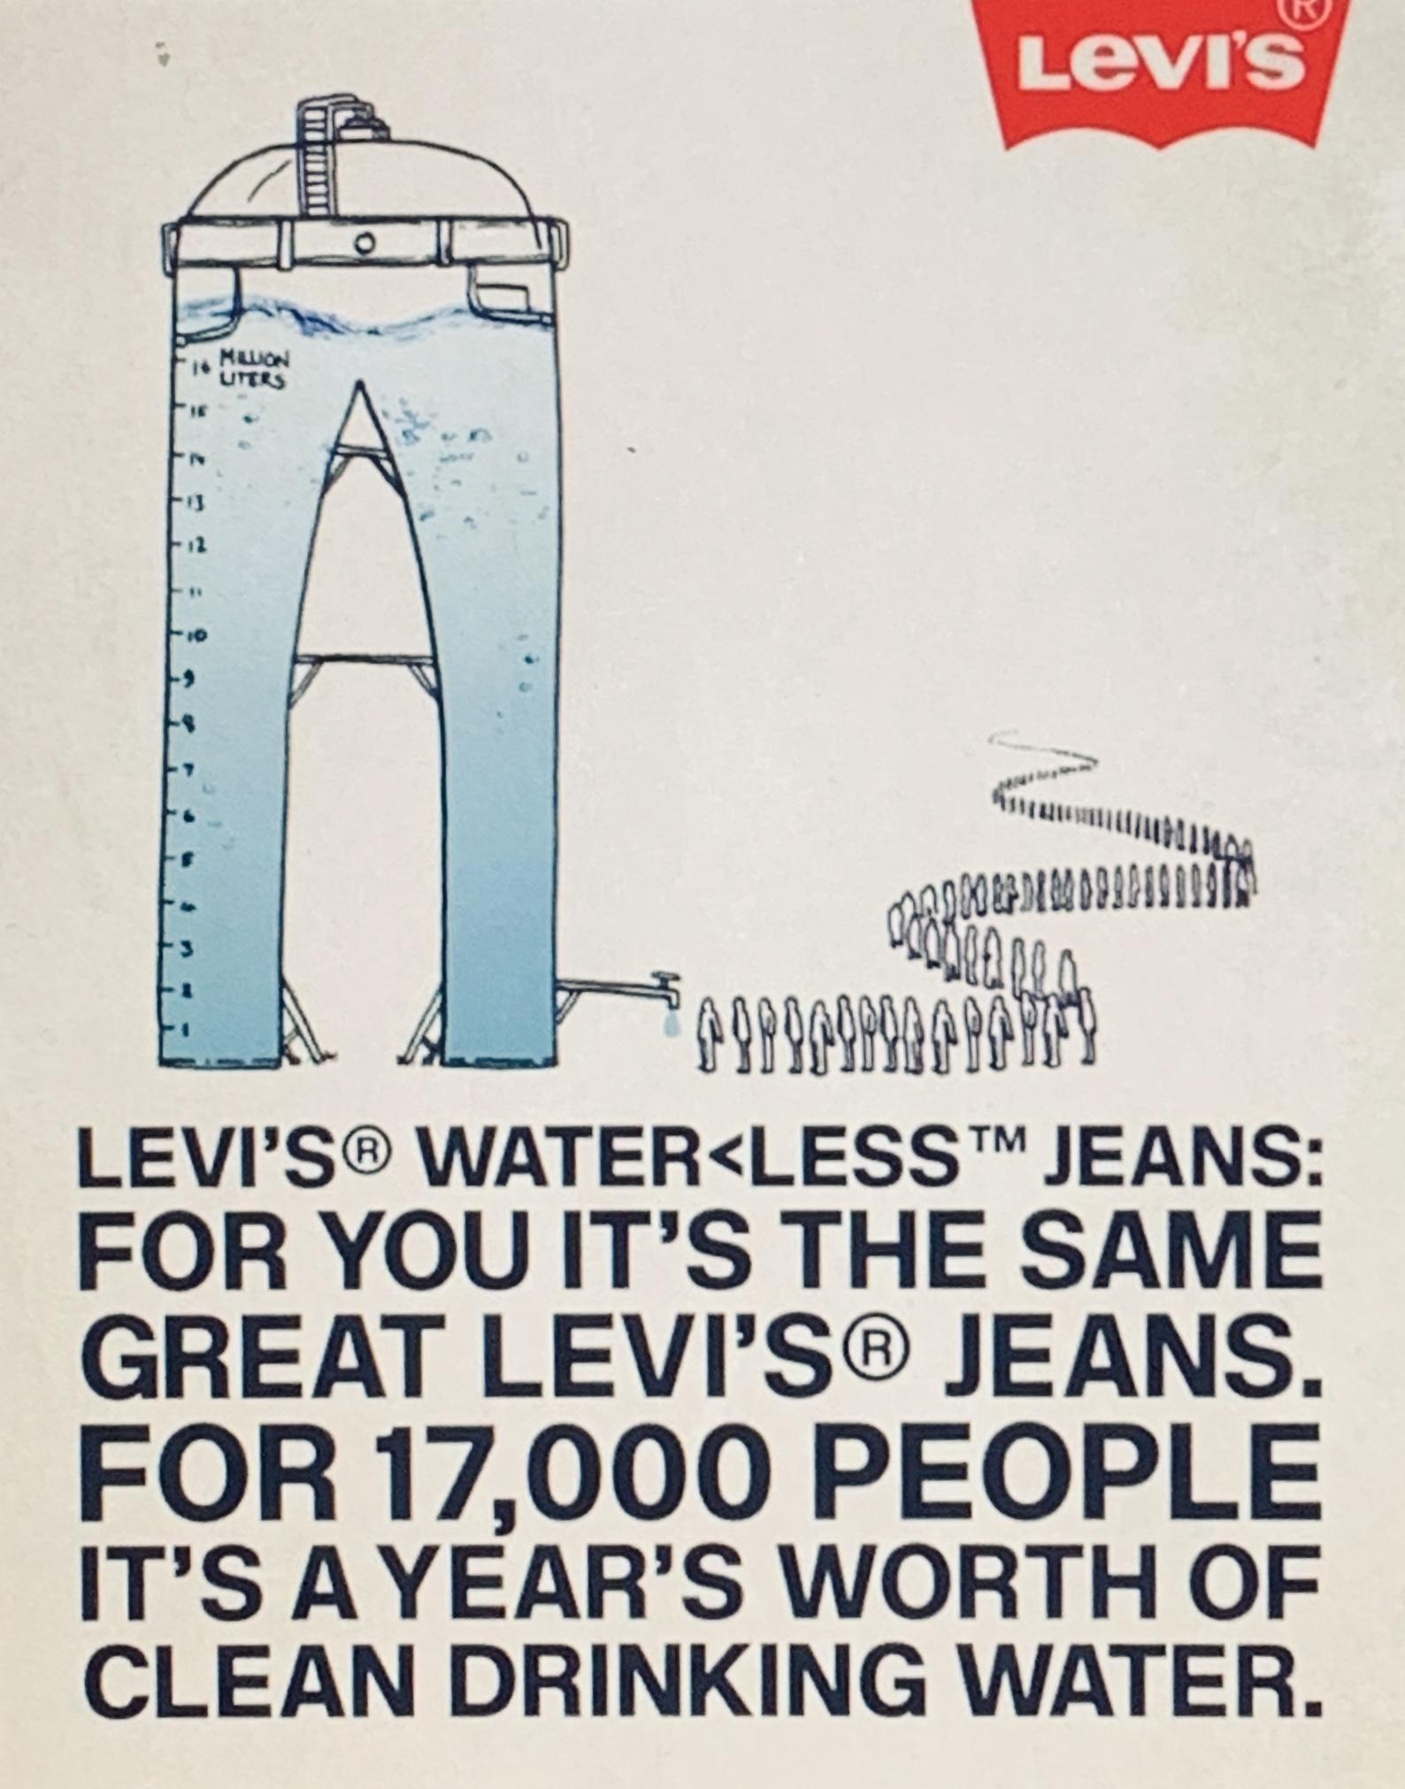
Promotion
Our promotional plan is all about sustainability and delivering the best quality products to target a new market.
Advertisements will be shown on social media with the intention of reaching wide number of consumers. Our objective is to reach and impact as many females in the continent of the United States. Our marketing will incorporate Ad Campaign, Fashion Shows, Store event, Influencers and Celebrity Endorsements.

Slide 10
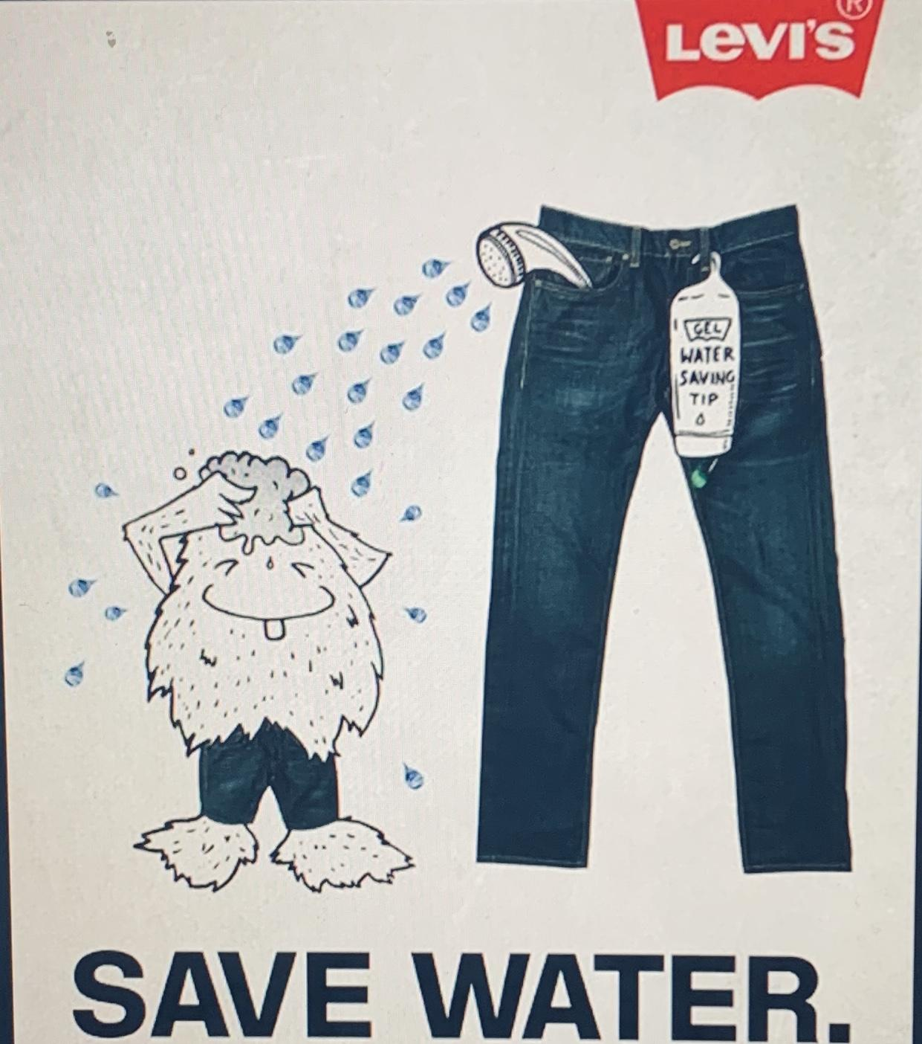
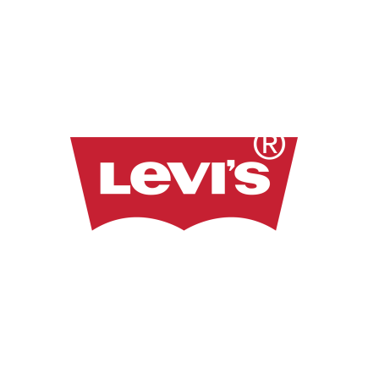
In the Ad campaign we will feature the use of Levi’s Water Less process that saved more than 1 billion liters of water in the manufacturing of its products.
The Ad Campaign will be titled “ Save the planet, make it last.” This will demonstrate how consumers can wash their jeans less often. From washing instructions to clothing recycling partnership with Goodwill donation centers.
M a k e i t l a s t !

Slide 11
Editorial Ad Campaign & Advertising
Editorial Ad Campaign
Model | $ 1,000.00
Photographer | $ 500.00
Staff | $ 200.00
Set | $ 300.00
ELUXE Magazine spread | $ 48,000.00
Luxiders magazine spread | $ 50,000.00
WWD magazine spread | $ 100,000.00
Total | $ 200,000.00
Advertising
Snapchat | $ 5,000.00
Instagram | $ 5,000.00
YouTube | $ 5,000.00
Facebook | $ 5,000.00
Total | $ 20,000.00

Slide 12
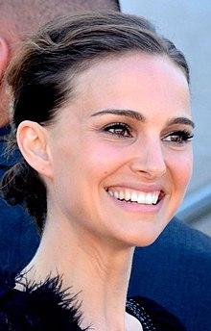
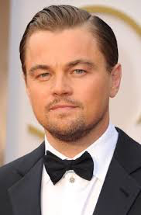
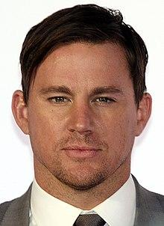
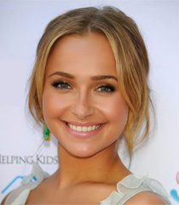
Celebrity Endorsements
There is no better advocate for ethical and sustainable fashion than Emma Watson. The actress consistently uses her celebrity status to incite change. Throughout her career she’s been a driving force of the movement. Her work includes collaborations with ethical brands She use her voice on social media about sustainable fashion in an attempt to convince us to make smarter choices about where we shop.
Other Popular celebrities are included such as Natalie Portman, Leonardo DiCaprio, Channing Tatum and Hayden Panettiere.

Slide 13
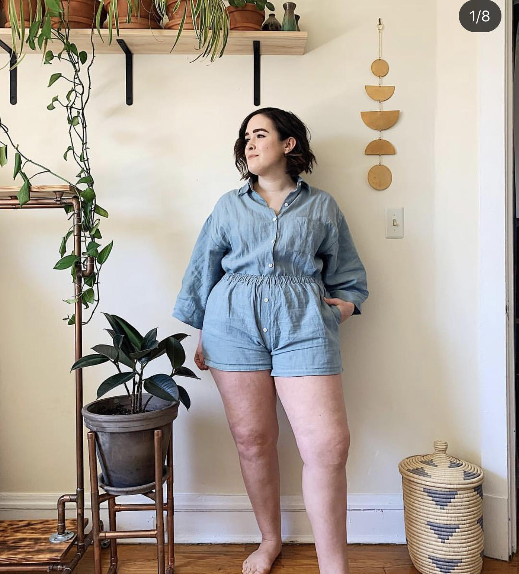
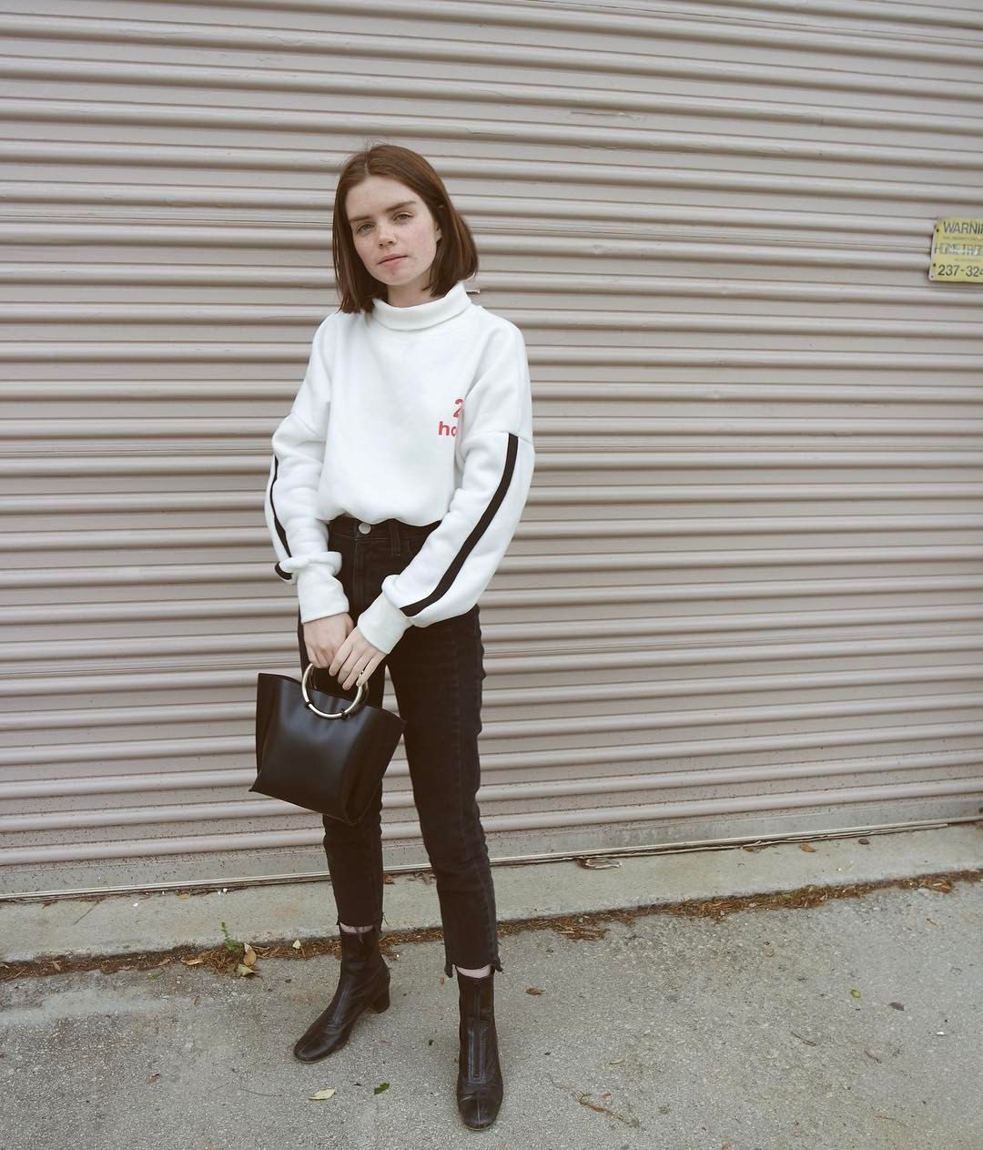
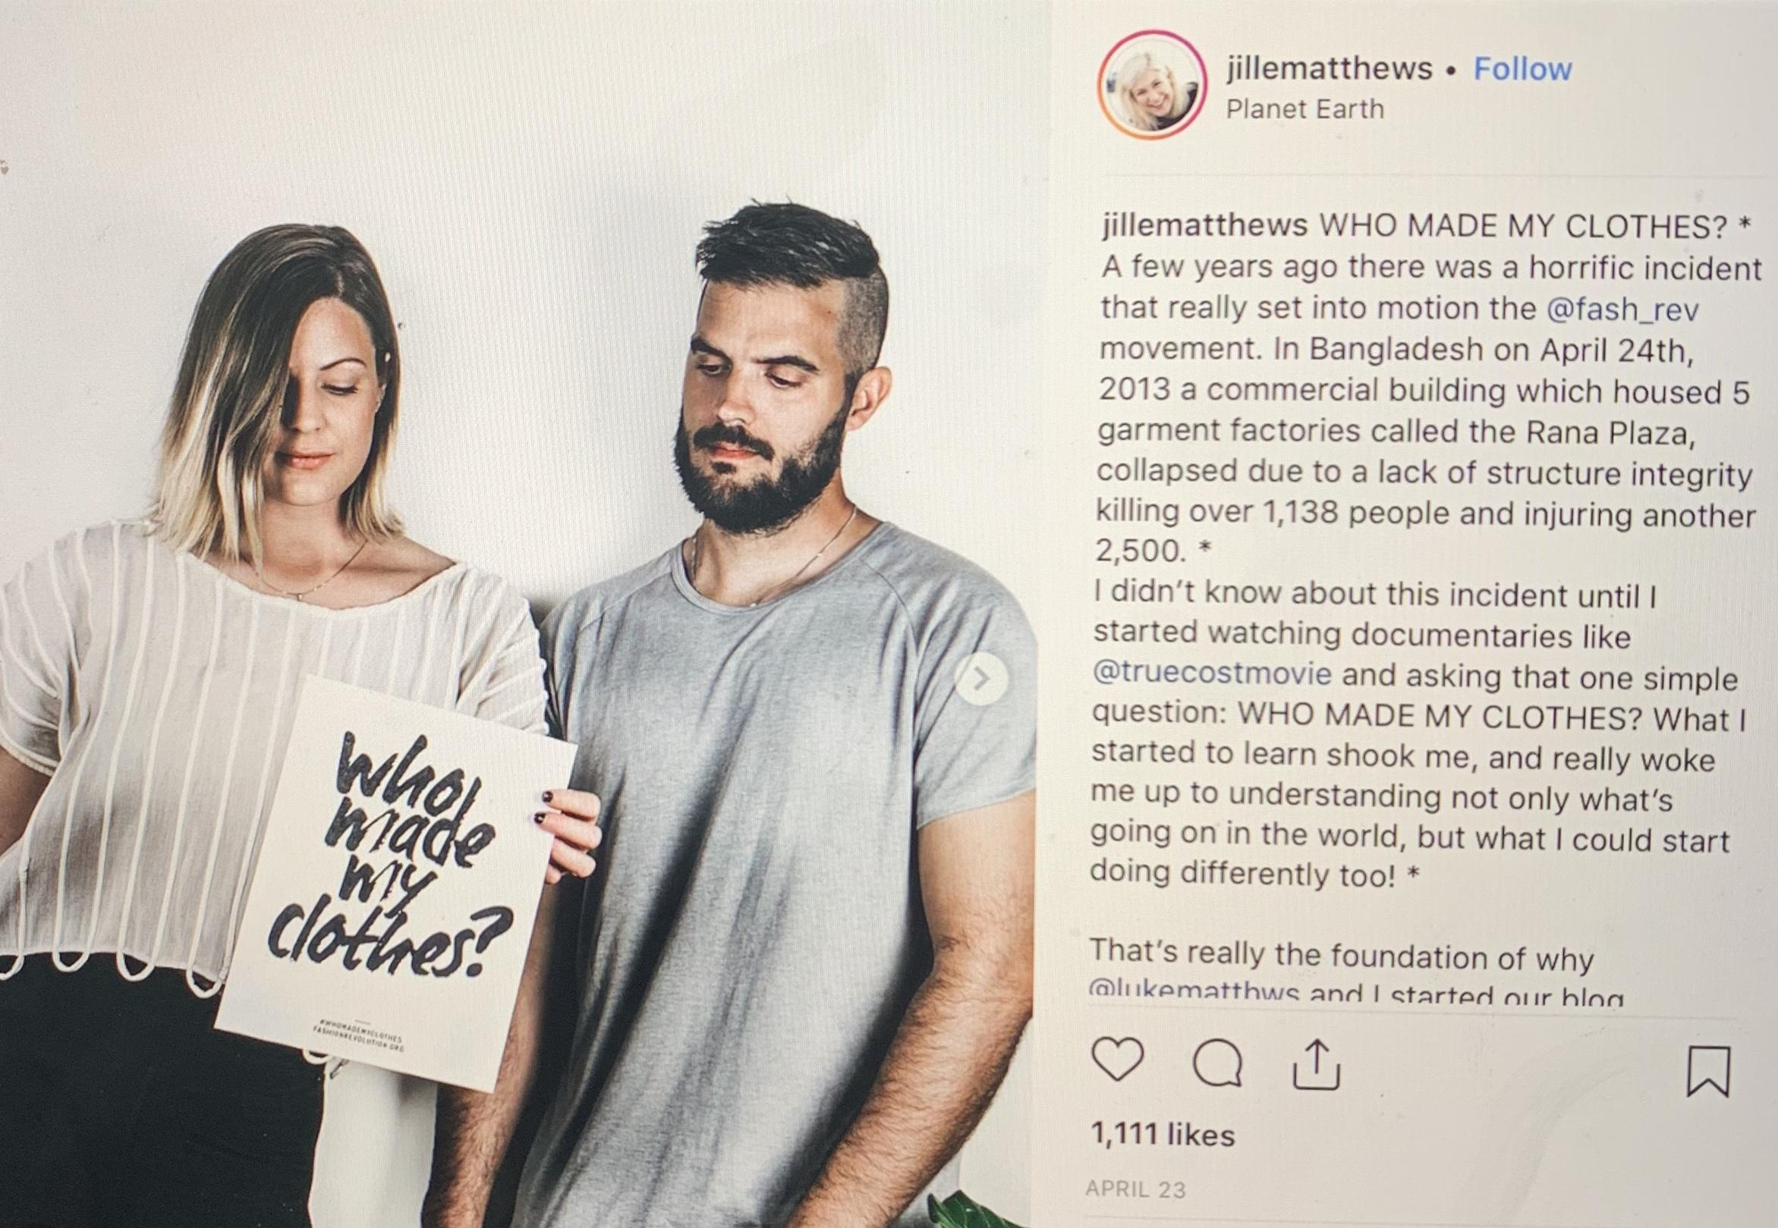
Levi’s will partner up with Micro
and Macro influencers
Shannon Buckley is another great influencer who writes that she is “exploring ethical clothing as a not-quite-plus-size person” living in Chicago.
Reese Blutstein, who's constantly putting pressure on brands to use less paper and cardboard in their packaging,
Jill Mathews and Luke Matthews promote in ethical, sustainable fair trade products and fashion.

Slide 14
Celebrity Endorsements & Influencers
Macro-influencer
Natalie | $ 8,500.00
Reese Blutsein | $ 24,000.00
Jille Matthews | $ 6,500.00
Bianca Valle | $ 21,000.00
Total | $ 6,0000
Celebrity Endorsements
Emma Watson | $ 200,000.00
Natalie Portman | $ 70,000.00
Lenardo DiCaprio | $ 100,000.00
Channing Tatum | $ 80,000.00
Hayden Panettie | $ 80,000.00
Total | $ 530,000.00
Micro-influencer
Shannon Buckley | $ 4,000.00
Lauren Singer | $ 3,000.00
Katie Roberts | $ 2,000.00
Luke Matthews | $ 1,000.00
Total | $ 10,000.00

Slide 15
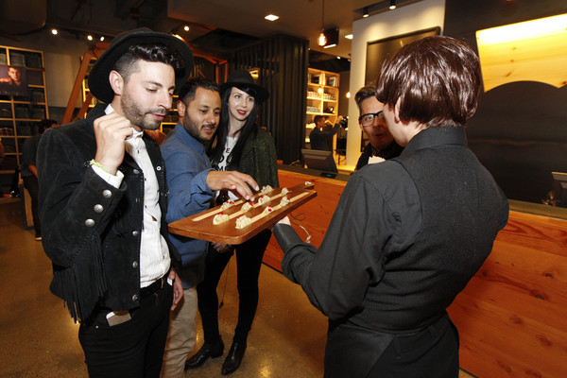
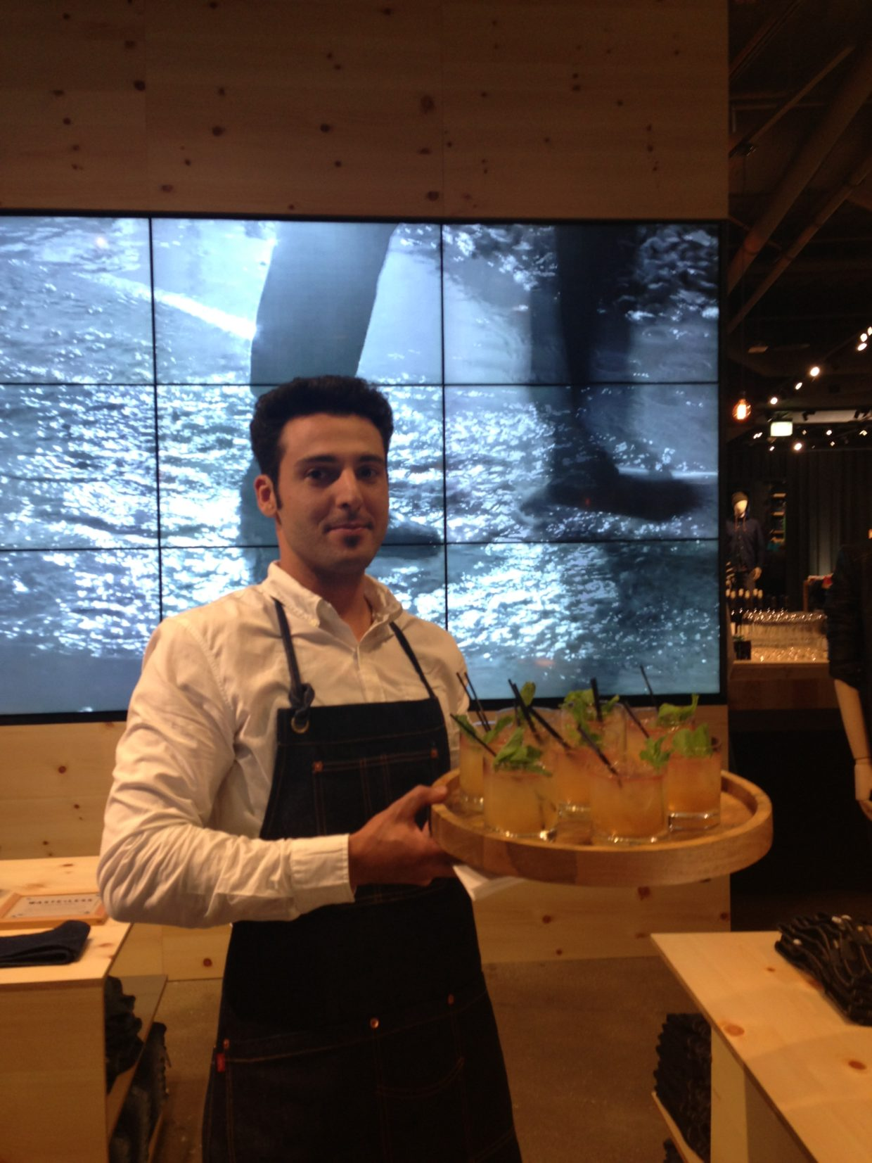
Events
Our store events is where everyone is welcome to celebrate our re-launch.
The brand will feature exclusive sustainable pieces from the latest collection. Consumers can bring in their favorite Levi’s® Denim or pick out something new to customize at the events. However Levis will also collect denim from any brand in any condition as long as it’s clean at any of our stores in the U.S. to recycle.
We will have screen printing designs by British artist Michael Gillette and complimentary cocktails by Moet Hennesy.

Slide 16
Fashion Show & In-store Event
Store Event
Seamstress | $ 500.00
D.J | $ 1,000.00
Patchwork | $ 2,000.00
Photo Booth | $ 1,500.00
Vegan Snack Stand | $ 2,000.00
Beverage Bar | $ 2,000.00
Spin the wheel | $ 200.00
Backdrop | $ 300.00
Decorations | $ 500.00
Total | $ 10,000.00
Fashion Show
Models | $ 100,000.00
Staff | $ 10,000.00
Decorations | $ 15,000.00
Venue | $ 30,000.00
Equipment | $ 15,000.00
Total | $ 170,000.00

Slide 17
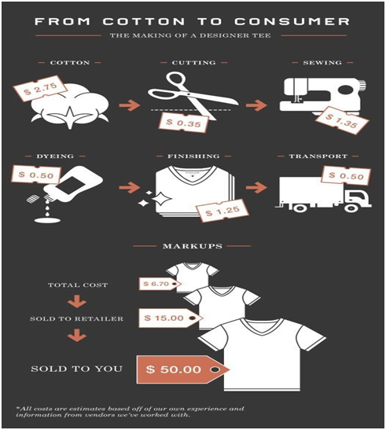
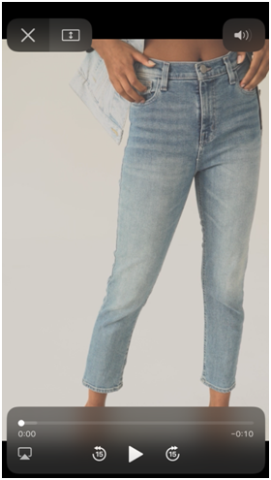
Recommendations for Levi’s
Creating a market based on sustainability
Sustainable Life Campaign: Advertising (commercials, ad, editorial, YouTube, social media outlets)
#TheEcoWay
Life of the Product
Collaborate with other sustainable brands
Transparent Pricing

Slide 18
Our goal is to attempt more positive exposures for a good cause within the community through Social media. Above all Levi’s is authentic and deeply committed to maintaining and reinforcing that authenticity.
Every one desires to connect with products that feel safe and certain. Levi’s clearly identifies its core purpose, attributes and value for everything it does. This resonates particularly with today’s influential young consumers.

