Slide 1
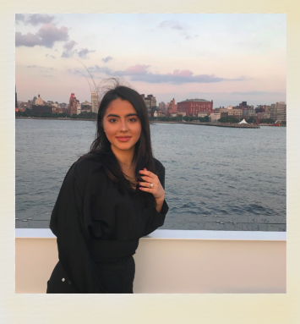
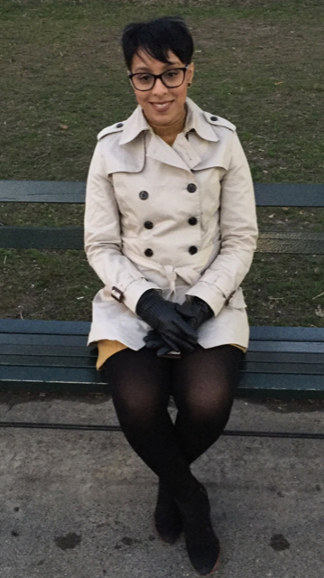
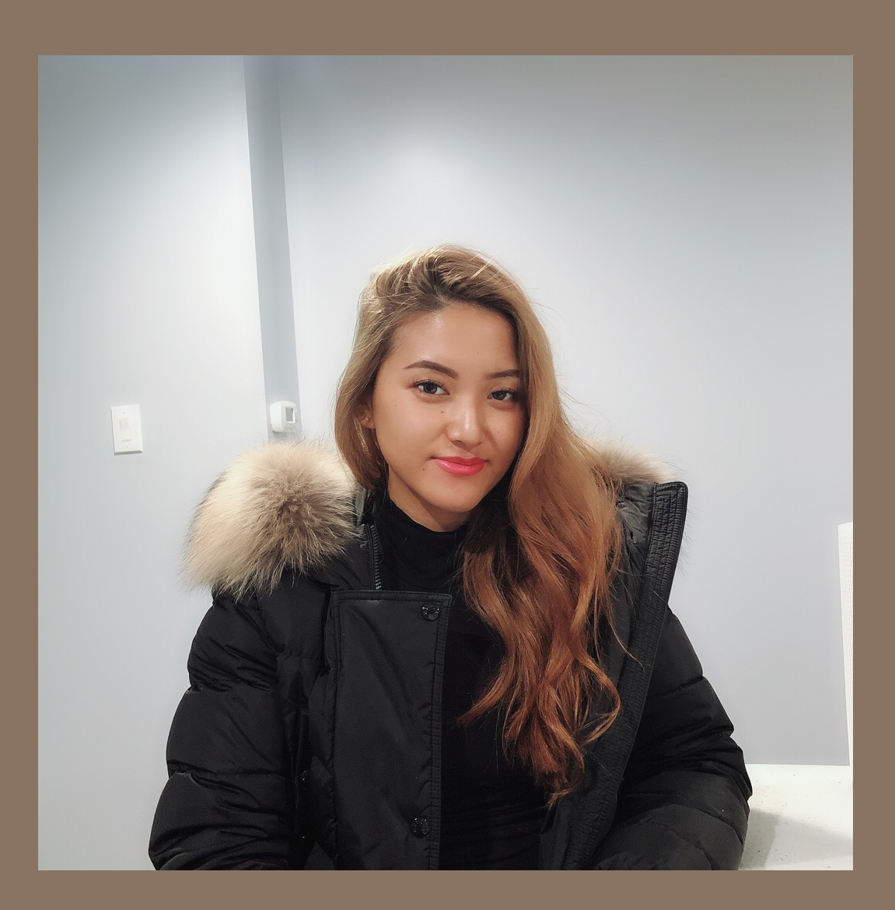
BikiniMe
🌴
🌴
🌴

Slide 2
Our Vision
The idea of Bikinime started in California 2015 when three girlfriends were in Malibu in a launching event for a local brand. Alexia Hernandez, Tenzin Chozin, and Brenda Mendez connected right of the back and had similar visions for a swimsuit brand. Therefore, they decided to create a brand who introduced perfect swimsuits for consumers who have a love for luxurious fabrics, fashion forward shapes, and cheeky bottoms. Our suits look great on everybody no matter what shape size you are. Bikinime is a global brand that goals to make every women feel beautiful and confident therefore we have decided to create size ranges from 0-14. Sustainability is what we strongly believe in and incorporate into all parts of the Bikinime process. We provide customers with the perfect fabrics and dyes that will make any women feel luxurious, bold, and confident.

Slide 3
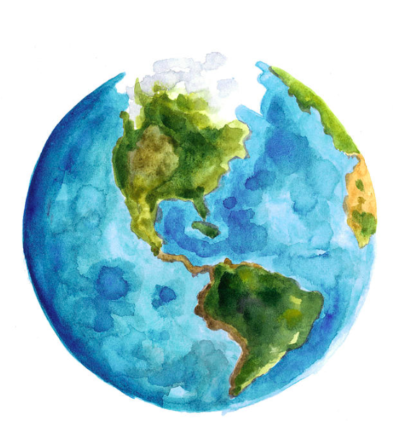
How do we do it, to keep our business relevant?
As a luxury swimwear brand, we understand the negative impacts the textile industry has on our planet, that is why we are known for our sustainability. We put sustainability at the core of everything we do. We invest in green building infrastructure to minimize our waste, water, and energy footprints. So the question is what do we do that makes us stand out and how do we do it?
Our Fabrics. Our Packaging
We Recycling Hangers & totes

Slide 4
BikiniMe’s Target Market
Demographics:
Women ages of 21-25
College Graduate
Income range:$80,000-$100,000
Psychographics:
Eco-friendly
Vegan lifestyle
Supports environmental causes
Athletic: Loves to work out and swim

Slide 5
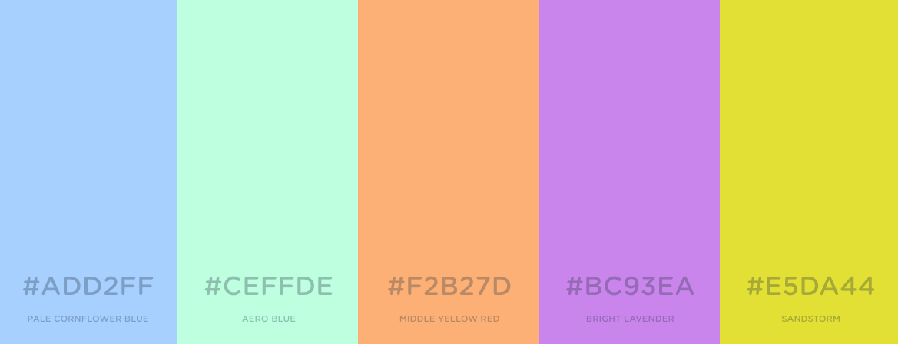
Color Story Spring/Summer 2020
Pale Blue- 001
Neo Mint-003
Tangerine-004
Lavender-
005
Golden Yellow-002
We will want to keep our colors neutral and pastel just because we are based in Los Angeles, California and it compliments everyones skin color and the versatility that we bring to the table. We want to be able to stay relevant to our consumer and keep up with our everyday competitors. Colors will always have a huge impact on trends and could also reflect or predict where the fashion industry or even the world is going. Neo mint will the trendiest color for 2020.

Slide 6
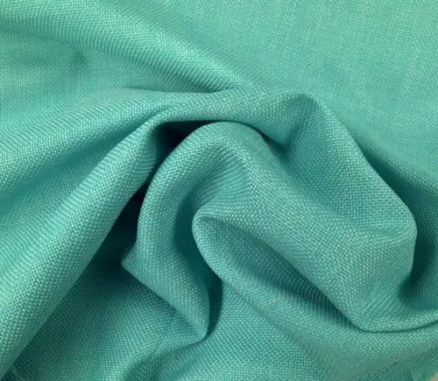
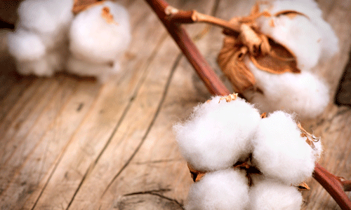
Our Sustainable Textiles
The fabrics that we will be choosing for our swimwear are Organic Cotton, Linen, Econyl, LYCRA, Acrylic.
Organic cotton is grown in a way that uses methods and materials that lessen the impact on our environment.
Linen is made from flax As a fabric it’s breathable, durable, lightweight, absorbent, antimicrobial, moth-resistant, and cool as in it lowers your body temperature in summer.
Econyl is sustainable alternative for nylon and it reduces less energy, water consumption, reduces air and water and soil contamination.

Slide 7
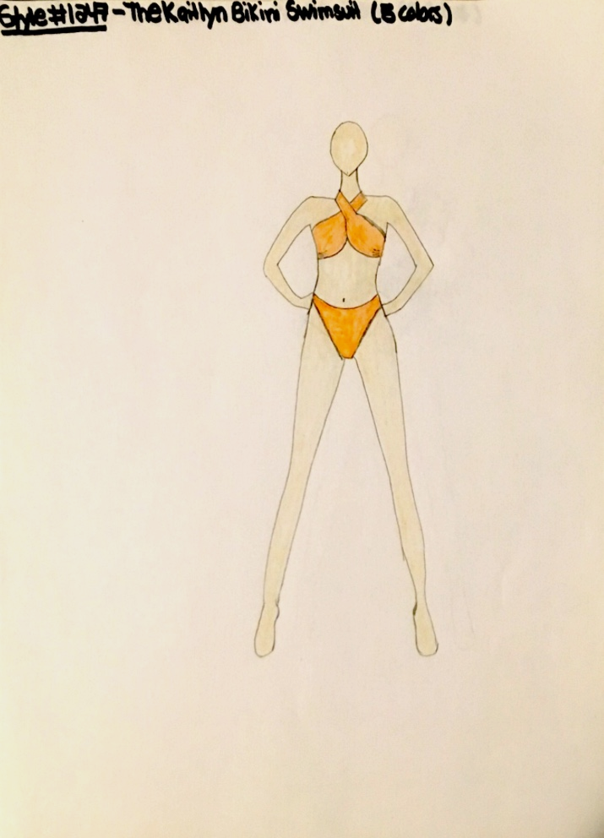
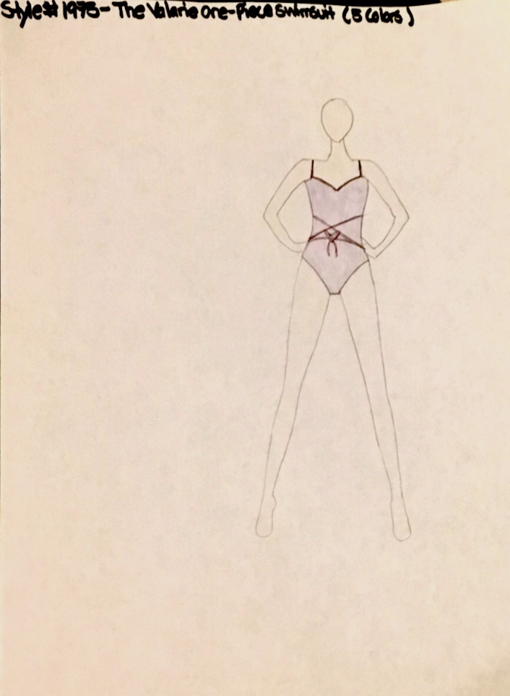
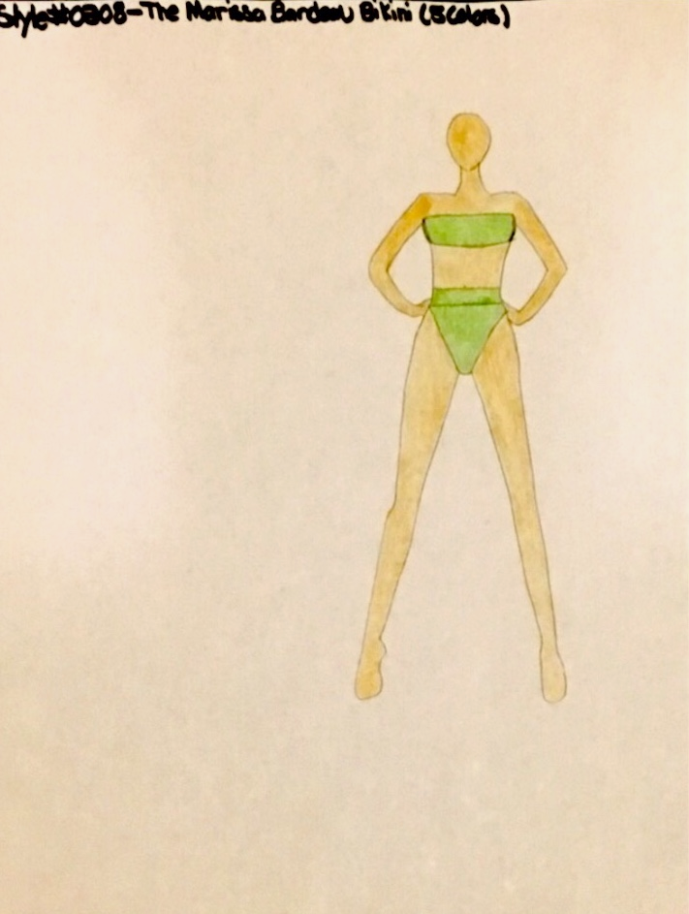
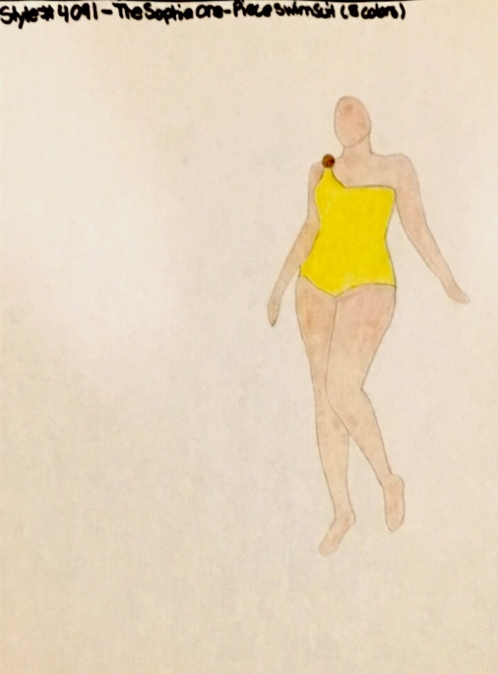
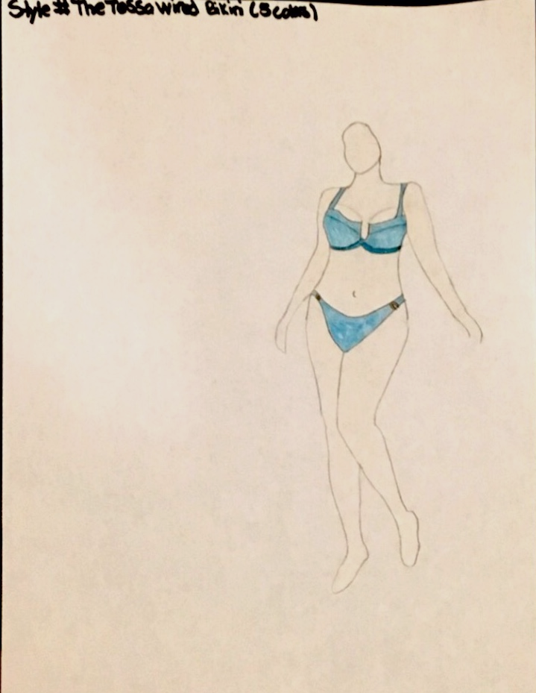
5 BikiniMe Styles
Style#1247 The Kaitlyn Bikini
Style #1975 The Valarie one piece swimsuit
Style #0808 The Marissa Bandeau Bikini
Style #4091 The Sophia One piece swimsuit
Style #4576 The Tessa Wired Bikini

Slide 8
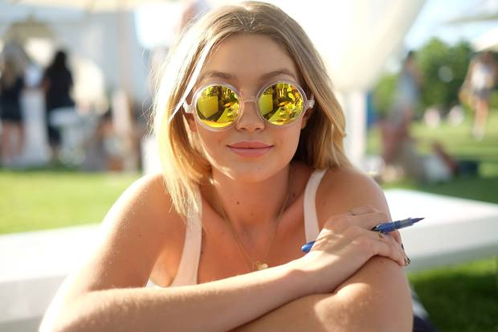
Brand Ambassador & Marketing Strategies
Gigi Hadid is the girl for our brand considering she spends most of her time in LA and grew up in Beverly Hills, usually seen roaming around with her close friends Kendall Jenner and Hailey Bieber.
Her circle of model friends and A-list celebs have received heaps of fame and publicity. Gigi also represents brands such as Tommy Hilfiger and has been acknowledged as one of the hottest models around.
Bikinime strives to reach customers through multiple platforms whether it’s through social media or campaign ads to collabs with local sustainable brands.
We are also hosting couple of events for the anniversary of our brand and will be inviting A-list celebs such as Kim Kardashian, Priyanka Chopra, Zendaya Coleman and social influencers such as Carli Bybel to promote the brand and those that support sustainability while living a luxury mindset

Slide 9
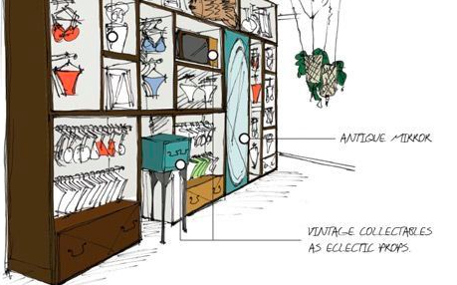
In store & e-commerce

Slide 10
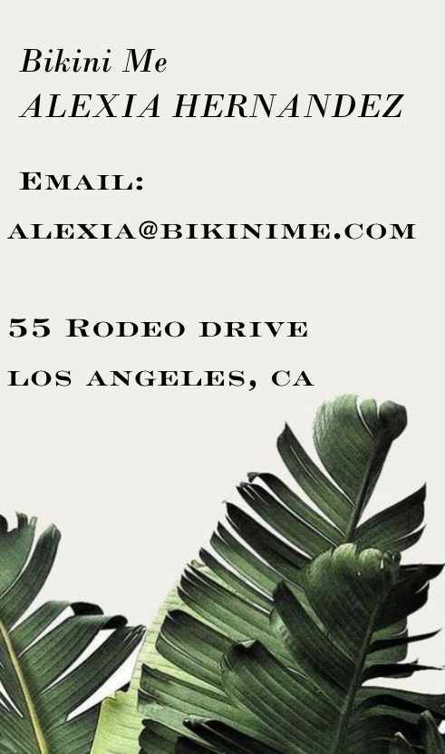
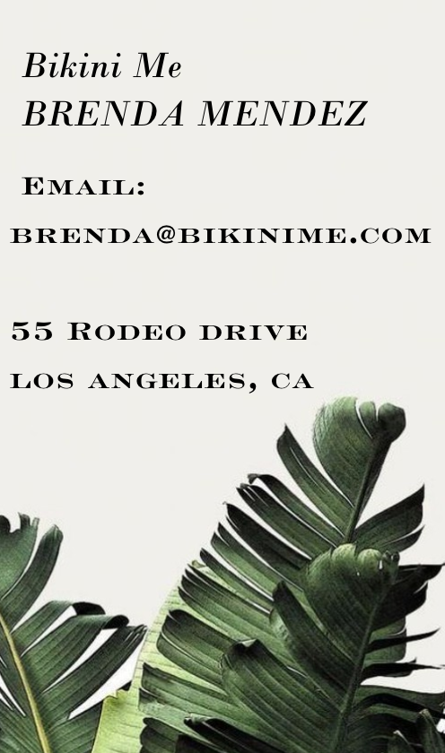
Thank You !

