Slide 1
Missoni
The Masterminds of of the Patterned Knit
By Alexia Hernandez
Notes:
Missoni is known for their signature bold and intricate knitwear, so often described as “wearable works of art” (). Having a hippy luxe feel this luxury brand never failed to go against their bohemian style.
It began in 1953 as a creative collaboration between husband and wife Ottavio and Rosita Missoni, and has now become an influential, unique global lifestyle brand().

Slide 2
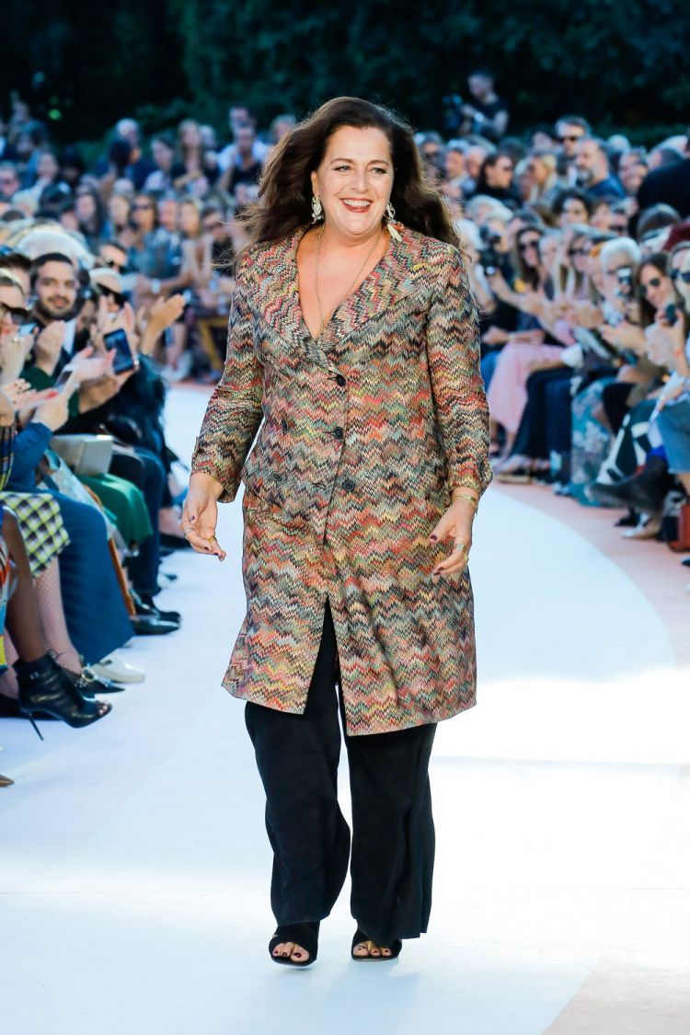
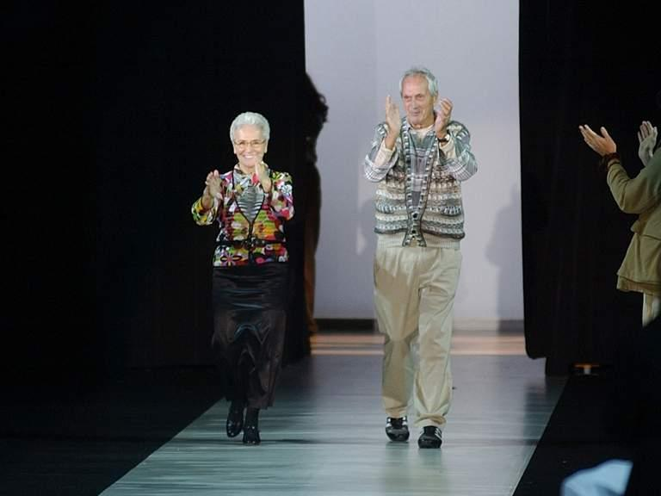
Founders & Creative Directors
Angela Missoni is the Creative Director and President of Missoni. She is the daughter of Ottavio and Rosita Missoni.
Founders Ottavio & Rosita Missoni.
Started their company in 1953 as a modest creative collaboration between husband and wife.
Notes:
Missoni started as husband and wife business partnership, but it was Ottavio Missoni who was always interested in creating sportswear for men. He developed an interest in knitted sportswear after returning to Italy in 1946 from the war (Burns, 2013). Missoni was making uniforms for the Italian track and field, basketball and water polo teams in the Olympics and that is when he met Rosita his future wife and business partner (Burns, 2013). In 1953 the brand Missoni was created.
The Creative Director and President now is Angela Missoni which is Ottavio and Rositas daughter. She counties to carry the legacy and contributions of her family and not fail her parents signature style and technique.

Slide 3
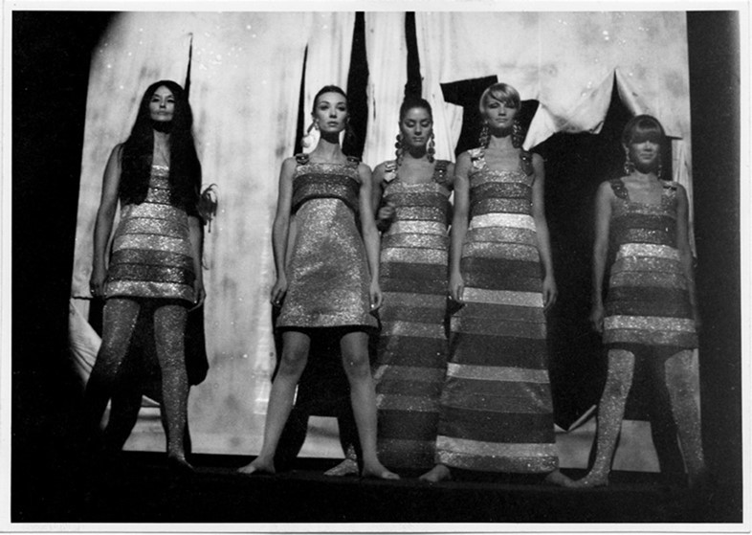
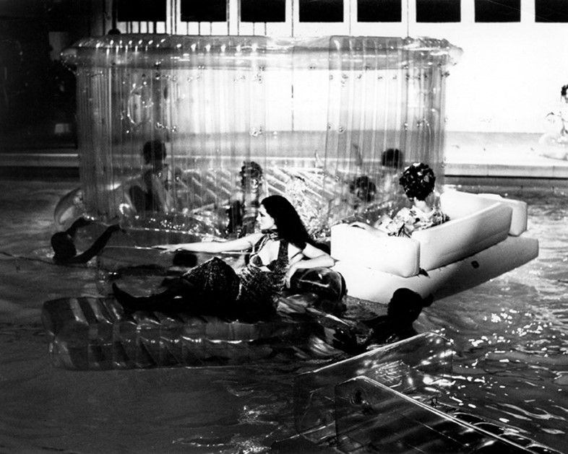
The Start of a Knitwear Revolution
In 1967, Missoni collaborated with Emanuelle Khanh on a collection that was shown in a swimming pool.
Missoni’s first catwalk show in 1966, which took place in Milan.
Caused a minor scandal when the models wore Missoni knitwear without any underwear, which became transparent under the fashion show lights.
Notes:
The ‘60s was a time of major creative growth. That’s when Missoni started to create their signature stripes which was what they were doing in 1958 and started to do a more complex stitching, plaids, jacquards, and the famous zig-zag motif (Burns, 2013). In 1962, the Missonis adapted the Raschel knitting machine, that was once used by Rosita’s grandparents to make hand-knitted shawls (Burns, 2013). Missoni went on to create lightweight, bright knit fabrics, plus innovations including: “knits quilted or boiled, space-dyed, the concept of color tones, reversible coats, and their favorite silky rayon-viscose blends” (Burns, 2013).
Missoni's first catwalk show took place in Milan in 1966. Missoni accidentally caused a minor scandal when the models wore Missoni knitwear without any underwear, which became transparent under the fashion show lights (Fury, 2018). In 1967, Missoni collaborated with a French stylist Emmanuelle Khanh on a collection that was shown in a swimming pool in Milan (Fury, 2018). In the picture you can see that there was chairs and a inflatable house in the middle. Emmanuelle husband was the creator of the inflatable chairs (Fury, 2018). All of a sudden the house went down and all the models went into the pool. This also created a scandal but people became more intrigued and interested in Missoni and saw them as different and risk takers (Yotka, 2016).

Slide 4
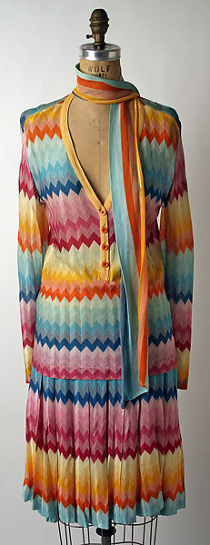
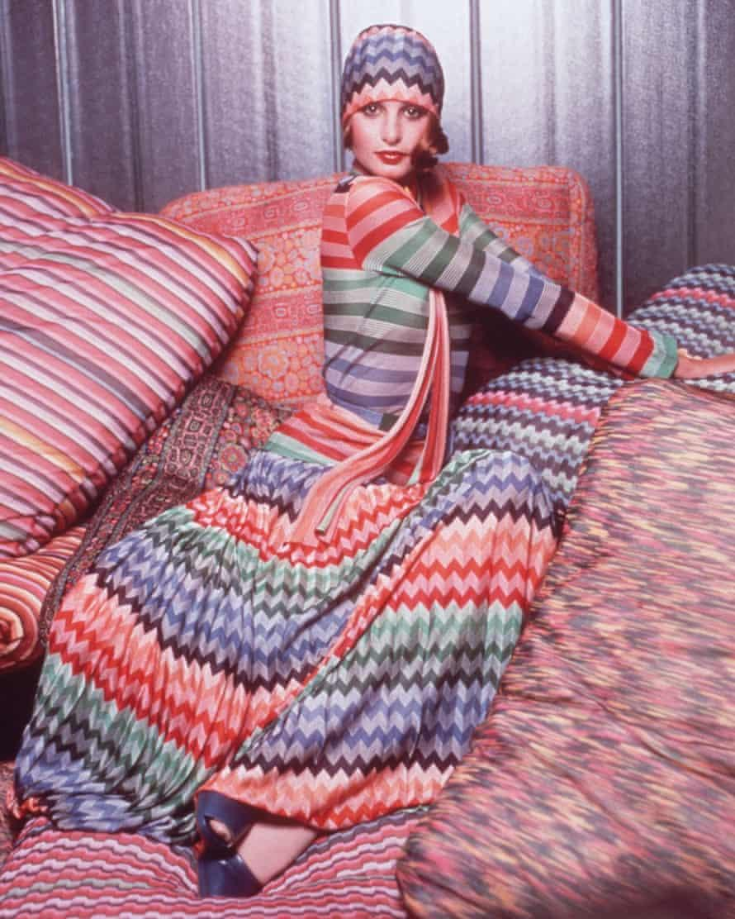
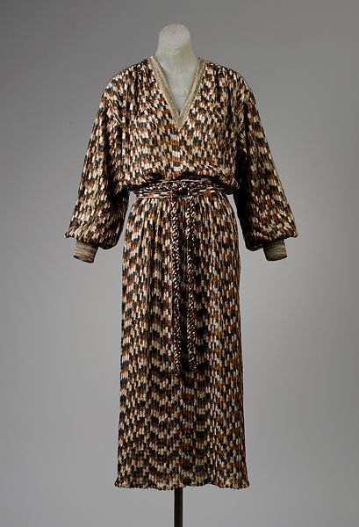
The 1970’s: Missoni’s Peak
 | 3:58 PM (0 minutes ago)
Designer: Missoni
Date: 1971
Culture: Italian
Materials: Silk
Acesssion Number:1981.340.3a,b
Designer: Missoni
Date: Fall/Winter 1978-79
Culture: Italian
Materials: Silk, Synthetic
Acession Number: 1984.589.5a. b
A classic Missoni outfit from 1970s.
Notes:
1970s was when Missoni was at its peak, the rust brown Missoni label was being recognized worldwide as a status symbol (Carrara, 2019). Along with their artisanal approach and color combinations. The Missonis also started to develop their expertise in striping, scalloping, waves, prints, and jacquard dots (Carrara, 2019).
Picture 1 (left) : Is a garment from the Met from 1971 and it is entirely made from silk. It has the signature zig-zag pattern as well as the bold rainbow colors that Missoni is known for.
Picture 2 (middle): is an editorial photo from a unknown magazine, where a model is seen wearing a classic Missoni garment in the 1970s.
Picture 3 (right): is a garment from the Met from 1978-79 from their fall/winter collection. It is a robed, long and V-Neck dress that has oversized sleeves and is cuffed. It is made from silk and synthetics, the synthetics is possible a fabric that resembles knit.

Slide 5
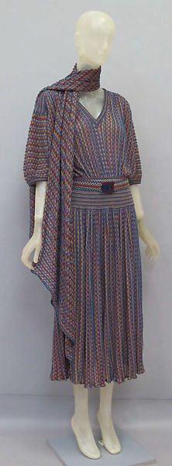
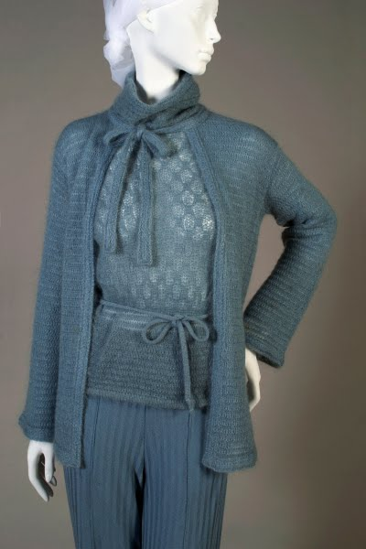
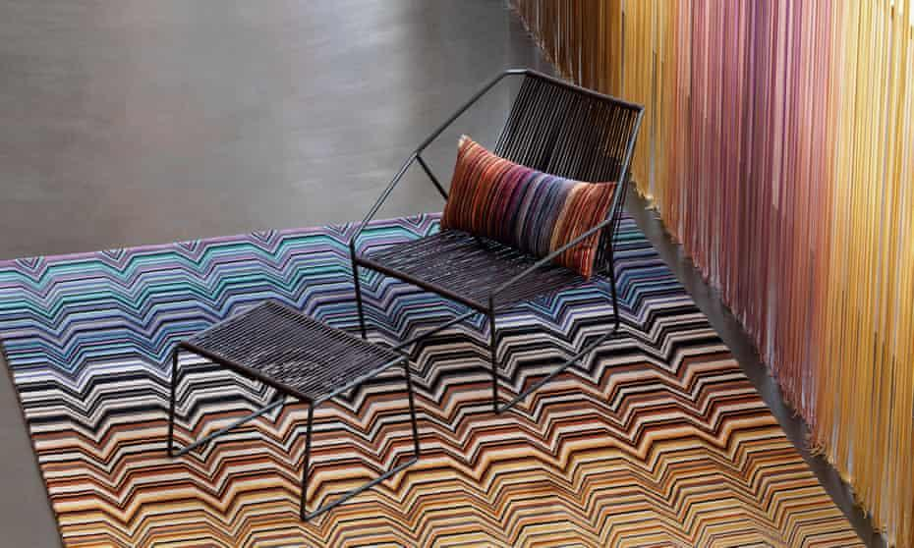
1980’s: Re-invent and Lifestyle
Missoni wanted to become more of a lifestyle brand, so Missoni fragrance was launched in 1982 which was followed by Missoni Home a year later. At this time you can now see Missoni’s patterns applied to almost everything – from a crochet knit bikini to a scented candle.
Designer:
Missoni
Date: ca. 1980
Culture: Italian
Materials: Linen,synthetics,Nylon
Accession Number:2010.486.1a-c
Intricate knitted cape and sweater with a herringbone patterned pants. 1980.
Notes:
In 1980s Missoni was on a mission to re-invent itself. They wanted to become more of a lifestyle brand so Missoni fragrance was launched in 1982 which was followed by Missoni Home a year later. At this time you can now see Missoni’s patterns applied to almost everything – from a crochet knit bikini to a scented candle (Watson, 2013).
Pic 1: a garment from the Met made in the 1980s from Linen and synthetics. It was actually made from 60% Linen and 40% Nylon. It has a knitted look and I believe it’s one of Missoni “put together” sets since it is a top with a skirt and a scarf.
Pic 2: is intricate knitted cape and sweater with a herringbone patterned pants.
Pic 3: Missoni Home picture from 2016
Missoni continued to develop their diffusion lines and lifestyle brand all through the 90’s.

Slide 6
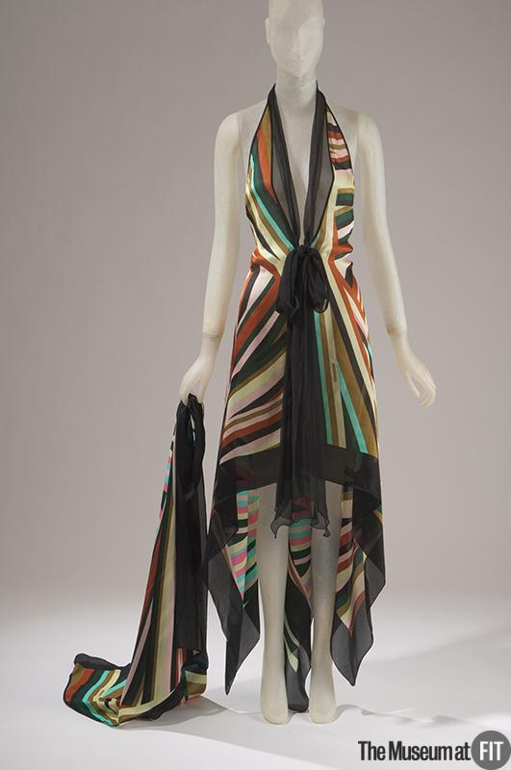
2000’s/ M by Missoni
Designer: Missoni
Date: 2003
Materials: Printed silk crepe de chine and silk chiffon
Culture : Italian
Credit : Gift of Missoni
Object number: 2003.52.2
In the 2000s Missoni continued to incorporate their bohemian style and intricate patterns and vivid bold colors into their garment. They also started to appoint corporate roles.
Angela Missoni became the creative director for the brand in the 90’s and wanted to update the Missoni line by editing collections to be bright and sporty.
Notes:
In the 2000s Missoni continued to incorporate their bohemian style and intricate patterns and vivid bold colors into their garment. They also started to appoint corporate roles for example this is when Angela Missoni became the creative director for the brand .
Pic 1:In the picture we can see a printed silk crepe de chine and silk chiffon dress that was gifted from Missoni to FIT in 2003.

Slide 7
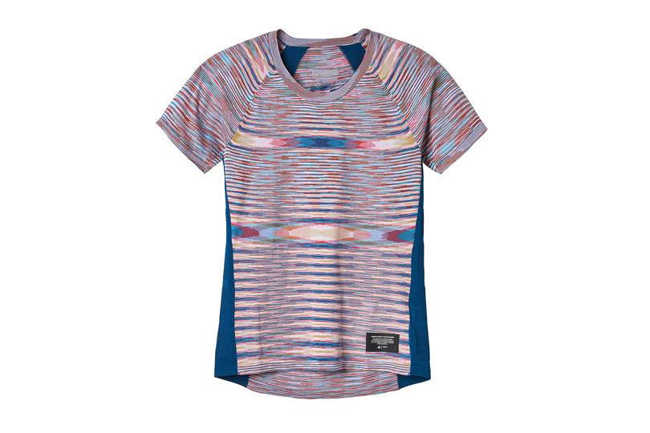
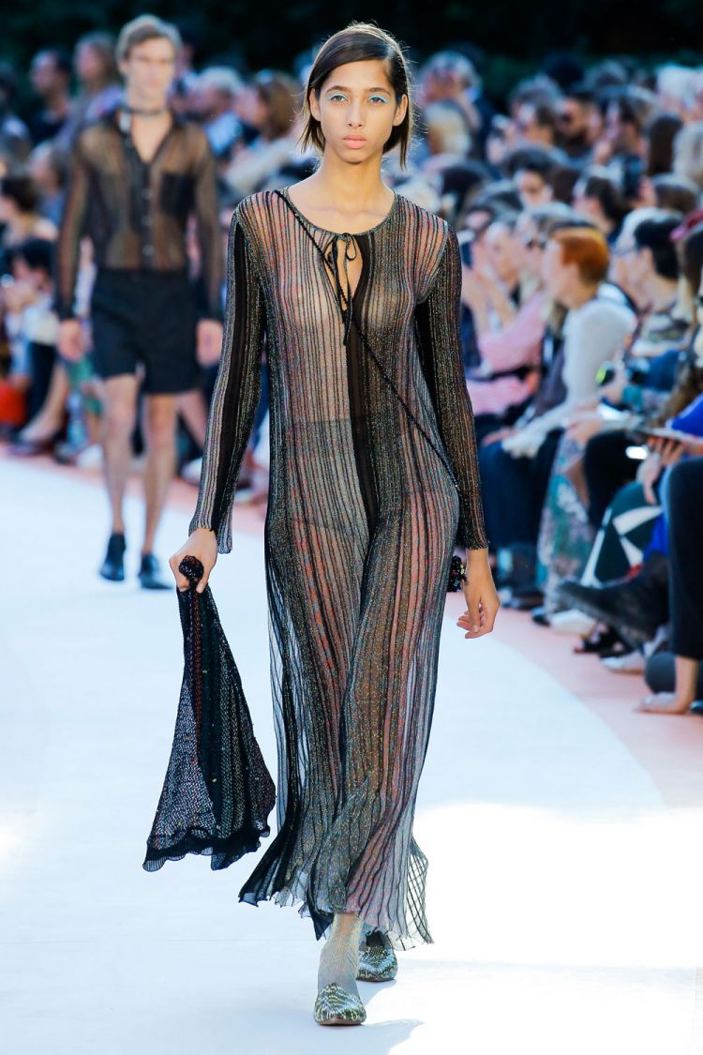
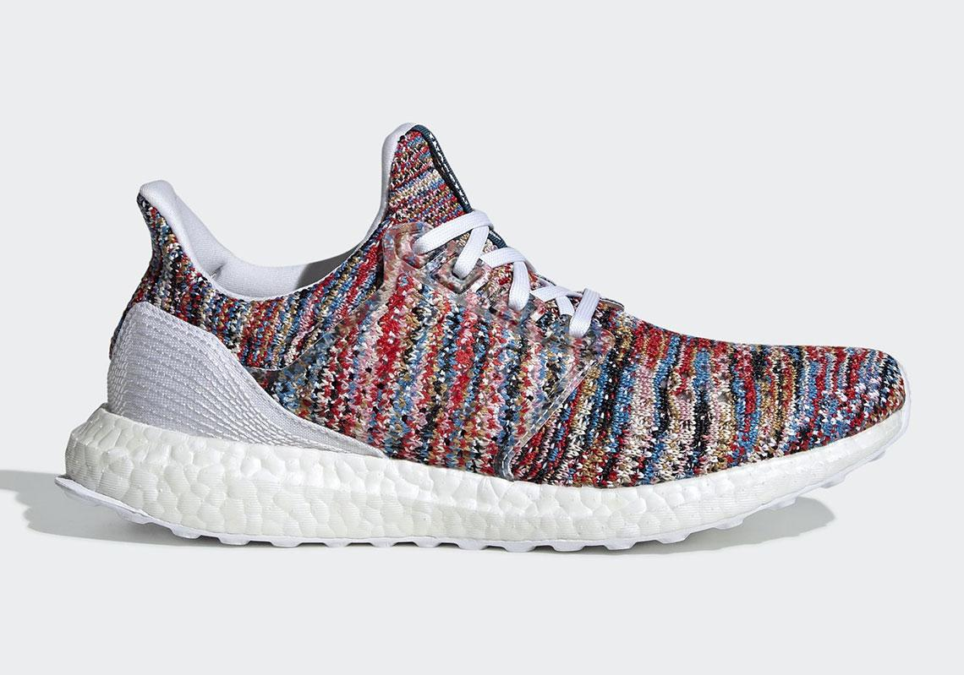
Missoni: Present day
Margherita Missoni Named Creative Director of M Missoni Line.
In April 2019 they collaborated with the sportswear brand Adidas. This was a huge opportunity to take for Missoni because it would have made Ottavio very proud since he was very interested in sportswear.
Missoni Spring 2018
Notes:
In 2013 Ottavio Missoni died in his sleep of a heart attack. More than a month later after that tragedy struck again when his eldest son, Vittorio, disappeared with his wife and four others flying in a plane on holiday to Venezuela (Watson, 2013). This put the Missoni family on the backseat for a bit. But they soon started to keep Ottavio vision going in April 2019 they collaborated with the sportswear brand Adidas (). This was a huge opportunity to take for Missoni because it would have made Ottavio very proud since he was very interested in sportswear.
Missoni continues on creating their intricate knit colored patterned garments and can be seen anywhere from highly seen fashion shows to stores like Target selling home goods.
Missoni also has a diffusion line called M Missoni which the creative director will now be Angela Missoni’s daughter Margherita Missoni since 2018 (Zargani, 2018). She is tasked with “further differentiating, repositioning and expanding the brand globally” (Zargani, 2018). Her first collection will be for spring 2020 (Zargani, 2018).
My parents did something very rare, which is that they actually invented a style” is how Angela explained the enduring appeal of Missoni. The label was a mood, she said, as much as a look, and “I guess it stands for freedom”- Angela Missoni (Morley, 2018).
I think it’s really interesting that Missoni has kept their unique and signature style throughout all these years. They will always be known for their bohemian/ hippy style and their patterns. Missoni still incorporates these features today. Many designers or brands usually lose who they are over the years and forget who their clients are, it’s good to see a brand that has never failed their mission.

Slide 8
References
Burns, J. (September 13, 2013) Missoni: A 60-Year Celebration Of Style.Italymagazine.com. Retrieved from
https://www.italymagazine.com/featured-story/missoni-60-year-celebration-style
Card, N. (May 7, 2016)Missoni homes in on the zigzags.Theguardian.com. Retrieved from
https://www.theguardian.com/lifeandstyle/2016/may/07/missoni-homewares-exhibition-fashion-textile-museum
Carrara, G. (2019) Missoni. Fashion-history.lovetoknow.com. Retrieved from https://fashion-history.lovetoknow.com/fashion-clothing-industry/fashion-designers/missoni
Fashion Institute of Technology museum. (2019) Missoni set. Fashionmuseum.fitnyc.edu. Retrieved from
https://www.metmuseum.org/art/collection/search/162858?&searchField=All&sortBy=Relevance&who=Missoni%24Missoni&ft=*&offset=0&rpp=20&pos=1
Fury, A. (2018) The 1960s Missoni Shows That Turned the World’s Attention to Milan. Anothermag.com. Retrieved May 8th 2019
https://www.anothermag.com/fashion-beauty/11178/the-1960s-missoni-shows-that-turned-the-worlds-attention-to-milan
Madsen, A. (April 24, 2019) Missoni's Sprightly Adidas Collection Takes The Italian Brand Full-Circle. Vogue.co.uk. Retrieved from
https://www.vogue.co.uk/article/adidas-missoni-collaboration-2019
Menkes, S. (September 24, 2017) #SuzyMFW: A Cornucopia Of Color in Milan. En.vouge.me. Retrieved from
https://en.vogue.me/suzy-menkes/suzymfw-missoni-etro-spring-2018-review/

Slide 9
References
Metropolitan Museum of Art. (2019) Missoni evening dress fall/winter 1978-79. Metmuseum.org. Retrieved from
https://www.metmuseum.org/art/collection/search/97614
Metropolitan Museum of Art. (2019) Missoni ensemble ca. 1971. Metmuseum.org. Retrieved from
https://www.metmuseum.org/art/collection/search/105263?&searchField=All&sortBy=Relevance&who=Missoni%24Missoni&ft=*&offset=40&rpp=20&pos=41
Metropolitan Museum of Art. (2019) Missoni Dress ca. 1980. Metmuseum.org. Retrieved from
https://www.metmuseum.org/art/collection/search/162858?&searchField=All&sortBy=Relevance&who=Missoni%24Missoni&ft=*&offset=0&rpp=20&pos=1
Morley, J. (September 22, 2018) Italy’s Missoni survives 65 years in fashion as a family affair. Theguardian.com. Retrieved from
https://www.theguardian.com/fashion/2018/sep/22/italy-missoni-65-years-fashion-food-friends
Rachlin, N. (May 5, 2016) How Sonia Delaunay and Lucio Fontana Inspired Missoni’s Cheerful Fashion and Home Line.Architecturaldigest.com. Retrieved from
https://www.google.com/amp/s/www.architecturaldigest.com/story/missoni-exhibition-fashion-and-textile-museum/amp
Sneakernews. (2019) Missoni Reupholsters The adidas Ultra Boost Clima In Three Ways. Sneakernews.com. Picture Retrieved from
https://www.google.com/amp/s/sneakernews.com/2019/04/15/missoni-adidas-ultra-boost-clima-release-info/amp/

Slide 10
References
Watson, L. (May 10, 2013) Ottavio Missoni: Fashion designer who transformed the world of luxury knitwear. Independent.co.uk. Retrieved May 8th 2019
https://www.independent.co.uk/news/obituaries/ottavio-missoni-fashion-designer-who-transformed-the-world-of-luxury-knitwear-8611726.html
Yotka, S. (April 25, 2016) 5 Things You Didn’t Know About Missoni. Retrieved from
https://www.vogue.com/article/missoni-history-5-unknown-facts
Zargani, L. (October 3, 2018) Margherita Maccapani Missoni Named Creative Director of M Missoni Line. Wwd.com. Retrieved from
https://wwd.com/fashion-news/designer-luxury/margherita-maccapani-missoni-named-creative-director-of-m-missoni-line-1202867143/

