Slide 1
Dunkin’ Brands Group
“America Runs on Dunkin’”
By Alexia Hernandez

Slide 2
Table Of Content
Brief History of Dunkin’
Target Market
Advertising/ Promotions
SWOT Analysis on Dunkin
Key Competitor (Starbucks)
Recommendations

Slide 3
Brief History of Dunkin’
Dunkin’ is an American multinational quick service restaurant chain based in Canton Massachusetts, founded in 1950 by William Rosenberg .
By 1998 the company had grown to 2,500 locations worldwide with$2 billion dollars in annual sales.
In 2005 Dunkin and Baskin-Robbins were sold to Carlyle Group and Thomas H. Lee Partner for $24 billion.
In 2018 the company dropped the donuts from their name in order to appeal to health conscious consumers.
By the end of 2020 new CEO Dave Hoffman plans to add 1,000 locations in the U.S.
First Dunkin’ Donuts in 1950

Slide 4
Target Market
Typically young, ages from 18-29.
Working class group.
Low to medium income.
Wants service to be fast.
Are most likely in a hurry.

Slide 5
Advertising/ Promotions
Known for their bold and fun colors Pink and Orange.
Great Tagline: “America Runs on Dunkin”.
Use modern designs on cups and retail stores through out the years.
Promote themselves by using billboards, commercials, and magazines.

Slide 6
SWOT Analysis on Dunkin’
Strengths:
Strong niche
Smart Marketers
Fantastic supply chain
Franchise Model: available market, experience, passion, and resources
Convenient in locations
Weaknesses:
Not Expanding fast enough
Direct and Indirect competition
No franchise relations
Numerous legal battles
:

Slide 7
SWOT Analysis on Dunkin’
Opportunities
Market expansion
Introducing more technologies
Menu Diversification
New products in their drink and sweets
Threats
Competition (Starbucks, Krispy Kreme and McDonalds')
Local Shops
Price Fluctuations

Slide 8
Key Competitor (Starbucks)
Known for their Strong brand image.
Has a high price point that consumers are still willing to pay for.
Great treatment of employees.
Don’t have a overly unique market. Room for opportunity.

Slide 9
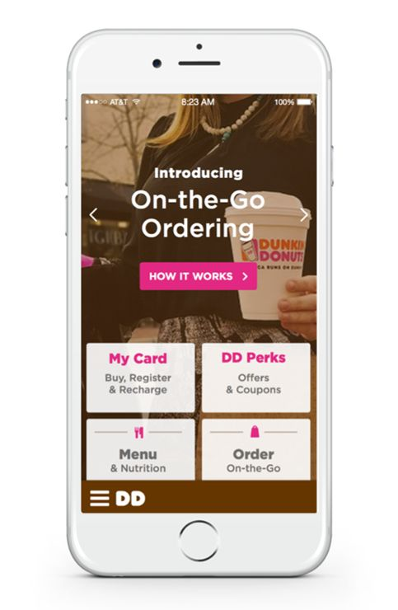
Recommendations
Expansion Internationally and across America.
Stronger brand image through marketing strategies. Ex: Social media outlets or Celebrities.
Innovations in Technology, such as face recognition.
Menu Diversification: Adding new products and Healthier menu.
Block chain technologies.
Better treatment of employees.

Slide 10
References
Atlas, R. D. (December 13, 2005) Parent of Dunkin’’ Donuts Sold for $2.4 Billion to Equity Firms. Nytimes.com. Retrieved from: https://www.nytimes.com/2005/12/13/business/parent-of-Dunkin’-donuts-sold-for-24-billion-to-equity-firms.html
Associated Press. (September 23, 2002) William Rosenberg, 86, Founder of Dunkin’’ Donuts. Nytimes.com. Retrieved from: https://www.nytimes.com/2002/09/23/business/william-rosenberg-86-founder-of-Dunkin’-donuts.html
Bhasin, H. (January 13, 2018) SWOT analysis of Dunkin’ Donuts. Marketing91.com. Retrieved from: https://www.marketing91.com/swot-analysis-of-Dunkin’-donuts/
Bush, T. (April 20, 2018) SWOT Analysis of Starbucks, the World’s Leading Coffehouse Chain. Pestleanalysis.com. Retrieved from: https://pestleanalysis.com/swot-analysis-of-starbucks/
Chesto, J. (July 11, 2018) New Dunkin’’ CEO charts a path for growth. Bostonglobe.com. Retrieved from: https://www.bostonglobe.com/business/2018/07/11/new-Dunkin’-ceo-charts-path-for-growth/eIW5p3baVd3XUtvoIPNDsI/story.html
Dunkin’’ News. (Sepetember 28, 2016) A Dozen Coffee Moments in Dunkin’’ Donuts History. News.Dunkin’donuts.com. Retrieved from: https://news.Dunkin’donuts.com/blog/a-dozen-coffee-moments-in-Dunkin’-donuts-history

Slide 11
References
Lombardo, J. (August 30, 2018) Starbucks Coffee Company SWOT Analysis & Recommendations. Panmore.com. Retrieved from: http://panmore.com/starbucks-coffee-swot-analysis
Picchi, A. (2017) Dunkin’’ Donuts new strategy to spice up sales: Fewer donuts. Cbsnews.com. Retrieved from: https://www.cbsnews.com/news/Dunkin’-donuts-reducing-spice-up-sales/
Pratap, A. (July 16, 2017) Dunkin’ Donuts SWOT Analysis. Cheshnotes.com. Retrieved from: https://www.cheshnotes.com/2017/07/Dunkin’-donuts-swot-analysis/
Scrudato, R. J. (April 21, 2015) Dunkin’ Brands: A Short SWOT Analysis. Valueline.com. Retrieved from: http://www.valueline.com/Stocks/Highlights/Dunkin’_Brands__A_Short_SWOT_Analysis.aspx#.XBBl0NtKh0w
Whol, J. (July 6, 2018). Dunkin’ Donuts Gets A Brand Update, But The Orange And Pink Logo Isn’t Going Anywhere. Adage.com. Retrieved from: https://adage.com/article/cmo-strategy/dunkin-donuts-a-brand-update/314128/

