Slide 1
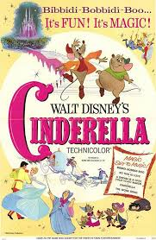
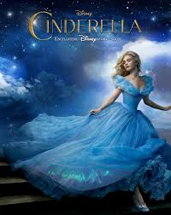
Cinderella the movie comparison
1950 & 2015
By Amber Alicea
Arielle Gustave

Slide 2
Cinderella Movie 1950s
Cinderella was an animated movie made for children
Released by Disney in the 1950s
In color
The original

Slide 3
Cinderella Movie: 2015
Also, released by Disney but in 2015
Made with real life people
Lily James played Cinderella
Sandy Powell was the costume designer

Slide 4
Costume designer
Sandra Jane Powell is a British Costume designer born in London on April 7th,1960.
She is the costume behind many well known award winning movies and her flamboyish style.
She wore suits to major award events to express her style and promote comfort.
Her style was also a reflection of her costume designs which is really fascinating.
Powell definitely had a good eye for fashion design which led her to be an multi award winning and nominated costume designer of the 20th century.

Slide 5
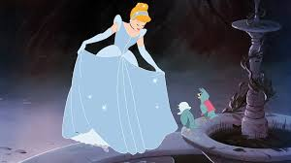
Garment #1
Animated yet detailed
Baby blue and white details with scalloped trimmings
Has puffed sleeves, headband to match.
Cinderella Ball Gown • 1950s

Slide 6
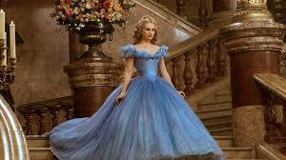
Garment #1
Top layer is made from silk crepeline
Under layers made up of a synthetic called yumissima.
The corset & crinoline cage was made of steel
It took 270 yards of fabric, more than 10,000 Swarovski crystals, 4 miles of thread & 3 miles of hems
Took 18 tailors 500 hours to complete.
Cinderella Ball Gown• 2015

Slide 7
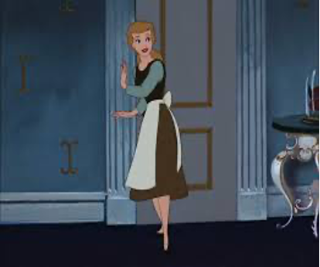
Garment #2
Brown skirt, cream tie around waist apron, dark brown sweater vest, teal long sleeve shirt
Most likely cotten
Wore almost everyday
This was plain fabric pieces
Cinderella Housework attire
1950

Slide 8
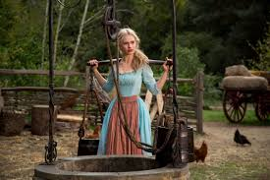
Garment #2
Blue dress and red waist apron
Ruffled sleeves with corset style top
Linen and cotton blend throughout the outfit
Dress silhouette is A-line
Cinderella HouseWork Attire
2015

