Slide 1
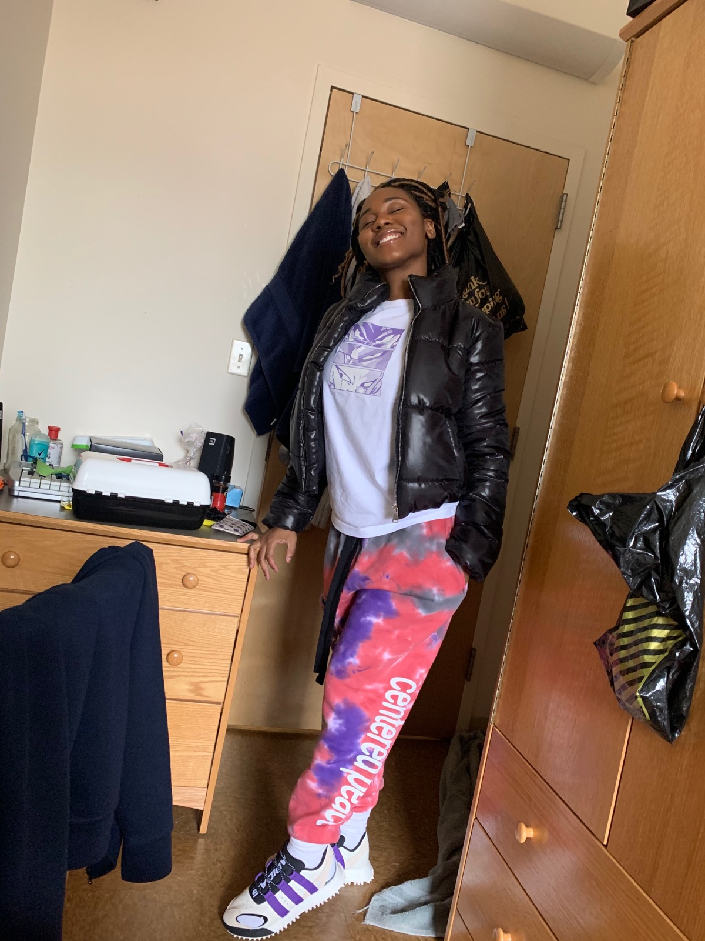
Textiles from your Wardobe
by Arielle Gustave
This dress is a gingham print from Zara about four years. The garment care tag says it’s made up of 100 percent polyester. However, its fiber content varies with the sample, but it’s makes up a thick material that is best to be worn in the fall or winter. The white and black color is the original gingham print. The dress has the print imitated throughout and gives a woven design as well. Gingham print is printed on an undyed background which the dress shows.
These sweatpants are designed by NBA player, Iman Shumpert which is made up of tie dyed. It’s 100 percent cotton and can be worn any time it is cold. Even the garment care tag says its 100 percent cotton.
However, the inside of the sweatpants feel as though it can be of a wool sample due to its thickness and warmth. It is also shown where the fabric resisted the dye because it was tied. It appears these were white sweats originally then the colors of grey, purple, and pink were the dye.

