Slide 1
Gabrielle “coco” chanel – Karl Lagerfeld
By Arielle A. Gustave
BUF3300 – Spring 2021
Prof. Jessica Roncero Appelstein
3 February 2021

Slide 2
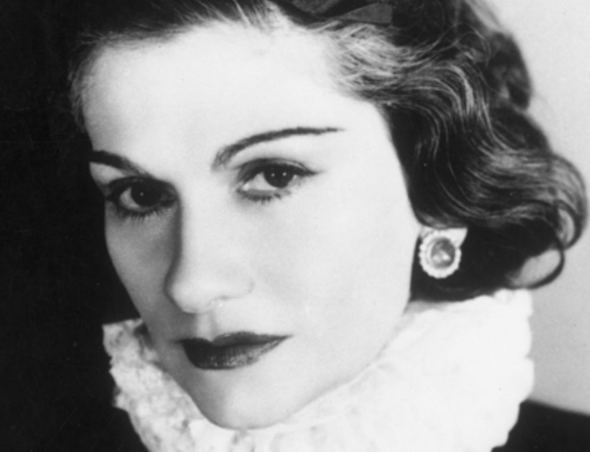
Gabrielle “Coco” chanel
Gabrielle “CoCo” Chanel was born August 19th,1883 and died at the age of 87 January 10th, 1971.
She was born in Saumur, France along with 4 other siblings.
In 1957, she won the Neman Marcus Award for Distinguished Service in the Field of Fashion.
Gabrielle “Coco” Chanel went from poverty and an orphanage to owning the most iconic brand to date.

Slide 3
Chanel’s career path
1910 – Chanel opens a hat boutique at 21 rue cambon named Chanel Modes (Chanel, 1910)
1912 – Chanel opens her first boutique in Deauville and from 1913, she beings to sell a line of sportswear made of jersey fabric (Chanel, 1910)
1915 – Chanel opens her 1st couture house in Biarritz & employs 300 workers (Chanel, 1910)
1918 – Chanel opens 31 rue cambon boutique (the entire building) and sets up the couture house there (Chanel, 1910)
1921 – Chanel launches 1st fragrance N5 (Chanel, 1920)
1924 – Chanel launches 1st makeup collection created in the same year (Chanel, 1920)
1927 – Chanel launches 1st beauty products of 15 skincare products (Chanel, 1920)
1932 – Chanel presents her only high jewelry collection Bijoux de Diamants (Chanel, 1930)

Slide 4
Best known contributions
2.55 Handbag – created in 1955; famous quilted handbag with a gold chain; named after its date of creation
Trimmed Tweed Suit – created in 1956; monochrome colorways
Two-Tone Pumps – created in 1957; black tips makes foot look smaller and the beige leather helped elongate the legs
Little black dress – released during the Great depression era where simple and affordable was key

Slide 5
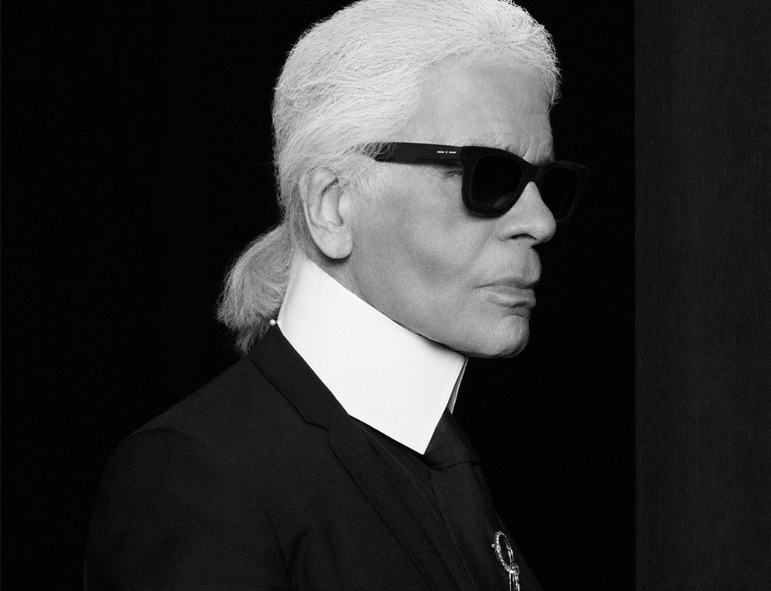
Karl Lagerfeld
Karl Lagerfeld was born September 10th, 1935 in Germany.
Karl was named Chanel’s Artistic Director in 1983 till he died at 88 in 2019.
Restores haute couture to its former glory
Created Chanel’s Ready-to-Wear as we know today
Creates 1st advertising campaign for Chanel as a photographer (1987-88)
“The Little Black Jacket” Exhibition

Slide 6
Overview of PERSOnal thoughts
Interesting Fact: Gabrielle ”Coco” Chanel closed the Couture House during World War II in 1939 and at the age 71, she decided to reopen the Couture house with a fashion show in 1954.
Chanel is a brand that came from a woman who wanted better for life. The dedication is admirable, and the innovation is inspiring to young women today. It was great to see that Karl Lagerfeld could take over for her and keep the Chanel brand true to its origin.
This is a brand that I would keep my eye on!

Slide 7
referEnces
Chanel. (2021). The history of the House of chanel 1883 - 2020. Retrieved February 04, 2021, from https://www.chanel.com/us/about-chanel/the-history/
Goldstone July 20, P., & Goldstone, P. (2017, August 04). History of the little black dress From Coco Chanel TO Audrey Hepburn. Retrieved February 04, 2021, from https://www.marieclaire.co.uk/fashion/little-black-dress-524293
McDowell, C. (2015, November 27). Gabrielle "Coco" Chanel (1883-1971). Retrieved February 04, 2021, from https://www.businessoffashion.com/articles/news-analysis/gabrielle-coco-chanel-1883-1971

