Slide 1
Christian Dior – Raf Simons
By Arielle a. Gustave
Buf3300 – Spring 2021
Prof. Jessica roncero applestein
10 February 2021

Slide 2
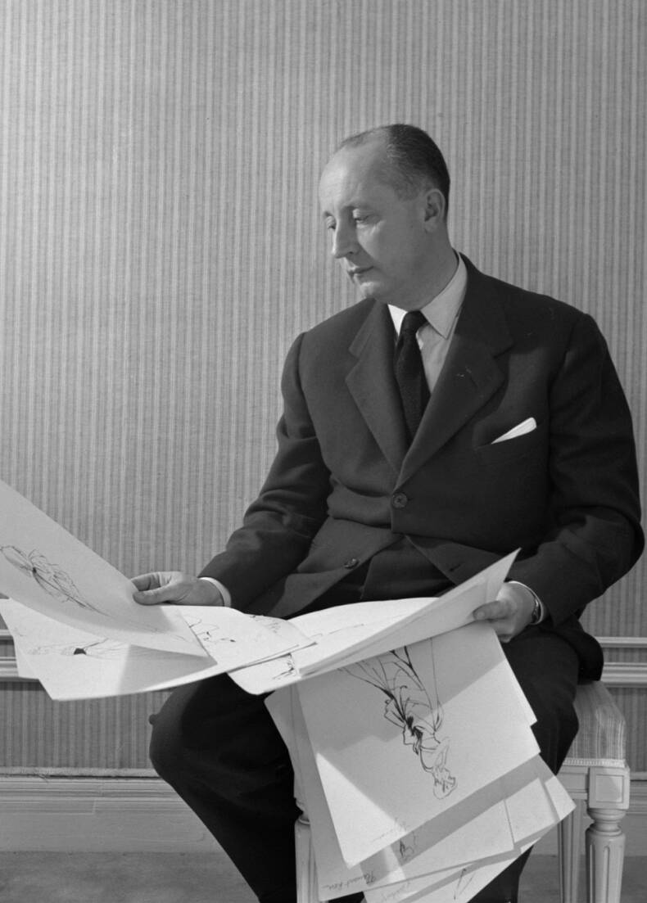
Christian Dior
Christian Dior was born January 21st, 1905 and died at the age of 52 October 24th, 1957.
He was born in Granville, France into a sheltered, wealthy family along with 4 other siblings.
In 1947, Christian Dior won the Neiman Marcus Award in Dallas.
In 1956, he won the Parsons School of Design Distinguished Achievement Award in New York.
Aside from being a fashion designer, Christian Dior was an author, an artist, architect, and served in the France Army.

Slide 3
Dior’s career path
Early on – Dior would sell his sketches on the street and then took over a small gallery his father brought for him
1940 – Dior was working with fashion designer Robert Piguet until he was called for the military service
1942 – Dior’s military service ended and worked for couturier Lucien Long
October 1946 – Dior opened his couture house at the age of 41 at 30 Avenue Montaigne Paris
12 February 1947 – Dior debuted his first collection in a fashion show which was named the New Look
November 1948 – Dior opened a luxury ready-to-wear house on the corner of 5th Ave and 57th St in New York
1949 – Dior arranged licensed production of his designs and was the 1st couturier to do so
1955 – Yves Saint Laurent was Dior’s design assistant at the age of 19
October 1957 – Christian Dior died of a fatal heart attack leaving the house in disarray

Slide 4
Best Known Contributions
the New Look Spring 1947: the Bar suit which included a skirt and jacket
Spring 1948: the new ZigZag cut of Dior
Fall 1949: bulky sleeves and belt above waist
Fall 1951: Dior’s new long line
Fall 1952: Dior’s molded body to the waist
Dior’s silhouettes was the most rememberable thing about him
Dior’s one obsession: to allow women to rediscover joy, elegance, and beauty

Slide 5
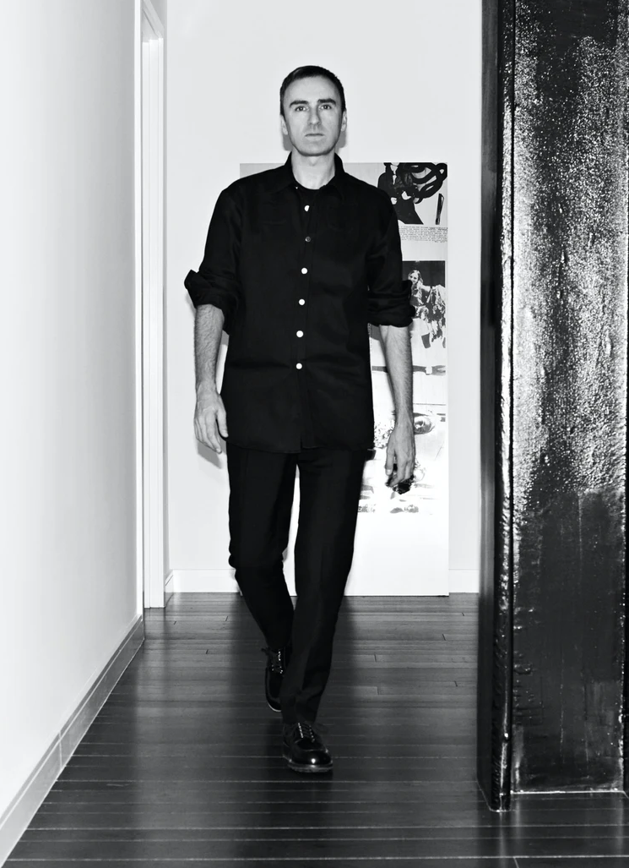
Raf simons
Raf Simons was born in Neerpelt, Belgium January 12th1968. His parents worked as a night watchman (father) and a house cleaner (mom).
He was named Dior’s creative direction in April 2012 and stepped down from the position in October 2015 to focus on his own label.
His first collection with Dior was Fall 2012 Haute Couture and reprised the Bar Jacket.
Raf casted Rihanna as the first black face of the Dior house in 2015 right before his departure.

Slide 6
Overview of personal thoughts
Fun Fact: Christian Dior’s sister, Catherine, was captured and imprisoned at the Ravensbrück concentration camp. In 1945, she survived and was freed; furthermore, as a tribute to her, Christian named his debut fragrance Miss Dior.
It was interesting how Christian Dior had already lived his life before opening his couture house; he got to see his couture house open for the last 10 years of his life. His brand Dior still has an impact on today’s fashion, art, and music such as the late Pop Smokes’ double platinum song Dior.
The Dior brand has started strong and is still going !

Slide 7
References
." encyclopedia of clothing and FASHION. . Encyclopedia.com. 13 Jan. 2021 . (2021, February 10). Retrieved February 10, 2021, from https://www.encyclopedia.com/people/literature-and-arts/fashion-biographies/christian-dior
Borrelli-Persson, L. (2017, May 26). Christian DIOR'S most FAMOUS silhouettes in vogue. Retrieved February 10, 2021, from https://www.vogue.com/article/christian-dior-archival-looks
Christian Dior, haute couture AND Ready-to-wear - fashion & leather goods. (n.d.). Retrieved February 10, 2021, from https://www.lvmh.com/houses/fashion-leather-goods/christian-dior/
Raf Simons is part of the BOF 500. (2020, April 16). Retrieved February 10, 2021, from https://www.businessoffashion.com/community/people/raf-simons
Sowray, B. (2019, August 15). Christian Dior. Retrieved February 10, 2021, from https://www.vogue.co.uk/article/christian-dior
Yotka, S. (n.d.). A brief history OF RAF Simons's storied career in fashion. Retrieved February 10, 2021, from https://www.vogue.com/article/raf-simons-biography-fashion-career-history-calvin-klein-creative-director

