Slide 1
Alexander McQueen
By Arielle a. Gustave
Prof. Jessica applestein
Buf 3310 – Spring 2021

Slide 2
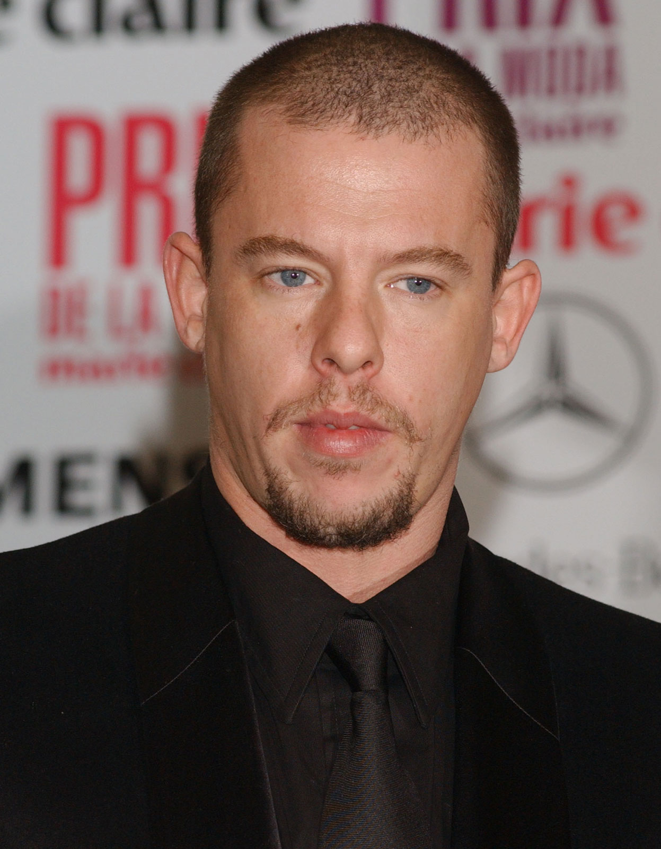
Alexander Mcqueen
Born on March 17th, 1969 in London
Died on February 11th, 2010 in London
Left school at 16 and trained at Savile Row at Gieves & Hawkes
Awards: British Fashion Awards’ British Designer of the Year,; CFDA Award for Best International Designer, 2003, Men’s Wear Designer of the Year, 2004
Notes:
Lee Alexander Mcqueen in East end of London to the son of a taxi driver and his mother was a teacher, youngest of six kids, Died by Committing suicide at the age of 40, reportedly embroidered a suit for the prince Charles saying “I am a CUNT” (in the linig); Won british designer of the year award four times,

Slide 3
McQueen's career path
1992
Earned master’s degree and launched his line
1995
Premiered 1st collection Highland Rape
1996
Became John Galliano’s successor at Givenchy
2000
Gucci Group acquired 51% of his label
2005
Teamed up with Puma
2008
Dedicated entire spring/summer collection to Isabella Blow
2009
Last Paris Fashion Week appearance
Notes:
Masters degreeat London’s Central Saint Martins in fashion design; stayed with Givenchy till march 2001 and was originally appointed by the LVMH president at the tiem, Bernard Arnault; in 1991 an influential stylist Isabella blow brought his entire show and later died from suicide in 2007 there fore in 2008,

Slide 4
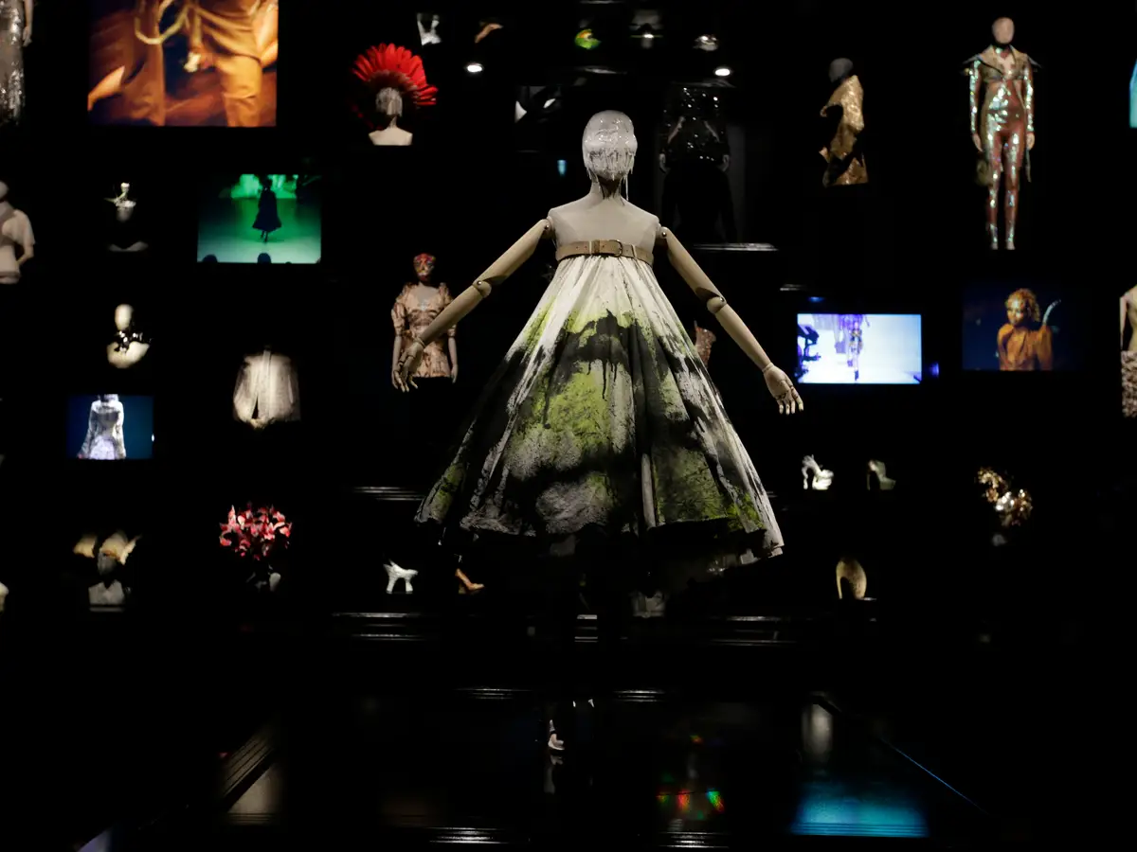
Best known contributions
Chaos
Innovation
Nudity
Signature cuts & Slashes
AgGression
Human Canvas Dress – Sept. 1998

Slide 5
Overview of personal thoughts
Fun Fact:
Honored with a CBE from Queen Elizabeth II
Considered being a fashion designer as a service
Made an affordable line
Outspoken, risktaker, unapologetically himself
Notes:
For his services to the fashion industry, CBE means commander of the order of the British Empire;

Slide 6
References
Davis, D. (2020, March 17). The life and rise of legendary designer Alexander McQueen. Retrieved April 14, 2021, from https://www.businessinsider.com/alexander-mcqueen-legendary-fashion-designer-life-career#the-following-year-mcqueen-launched-a-more-affordable-line-called-mcq-16
Milligan, L. (2019, August 14). Alexander McQueen. Retrieved April 14, 2021, from https://www.vogue.co.uk/article/alexander-mcqueen-biography
Vernose, V. (2021, March 12). How alexander mcqueen disrupted fashion. Retrieved April 14, 2021, from https://www.crfashionbook.com/fashion/a26836785/alexander-mcqueen-disrupted-fashion-legacy-birthday/

